Slide 1
pH Eye Fluid by Nitrazine Paper
Kaiser South Sacramento

Slide 2
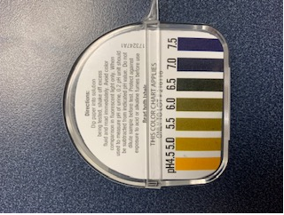
Nitrazine paper (phenaphthazine paper) is used to determine the pH of fluids in the 4.5 to 7.5 range

Slide 3
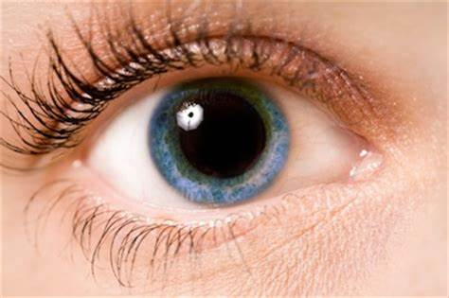
Nitrazine paper can be used to determine the presence of acidic or alkaline conditions after chemical splashes to the eye.
Ocular fluid should be near a pH of 7.0.

Slide 4
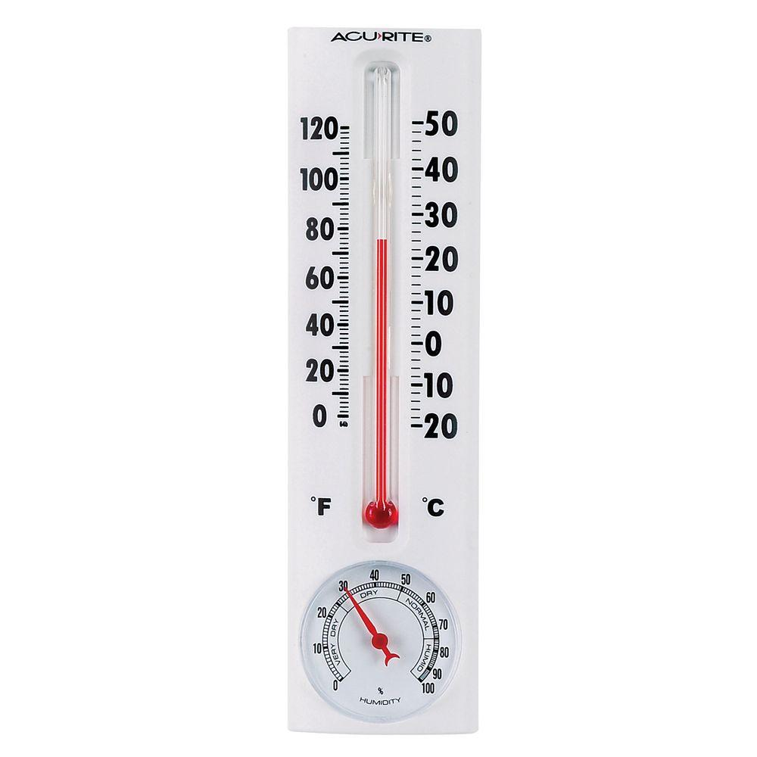
Nitrazine paper should be stored at room temperature, away from excessive heat and protected against exposure to acid or alkaline fumes.

Slide 5
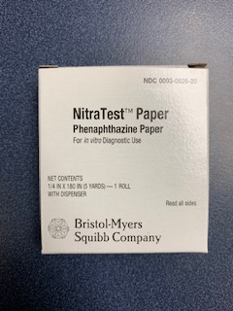
Nitrazine paper can be picked up from the laboratory when needed.
When picking up supplies, be sure to take only 1 roll at a time to prevent prolonged exposure to air, which may obscure results.

Slide 6
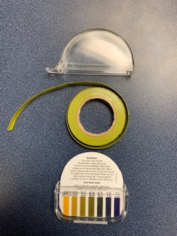
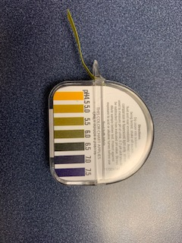
After obtaining the Nitrazine paper from the laboratory, open the dispenser and remove the roll from the foil, being careful not to contaminate it with any fluids.
Assemble the roll in the dispenser for easy access to Nitrazine paper when needed.

Slide 7
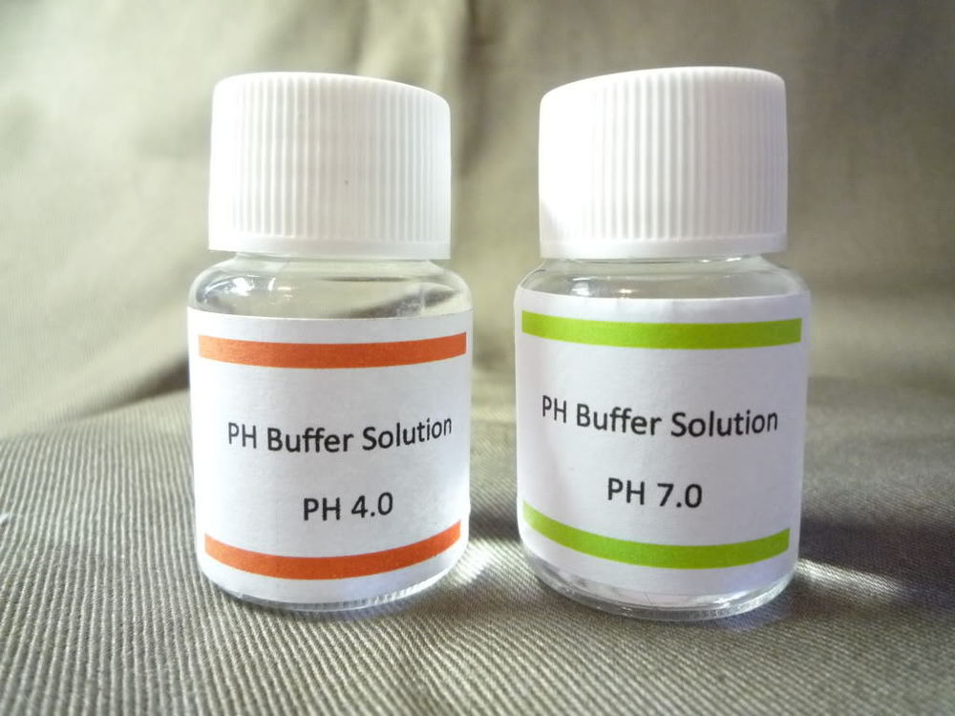
QC is performed by the POC staff in the laboratory every 30 days.

Slide 8
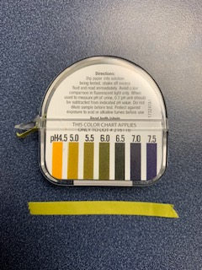
When running the pH test, rip off a strip of Nitrazine paper about 2 inches long.
Do not pre-rip strips of Nitrazine paper for future use. This increases the risk of contamination for those strips.

Slide 9
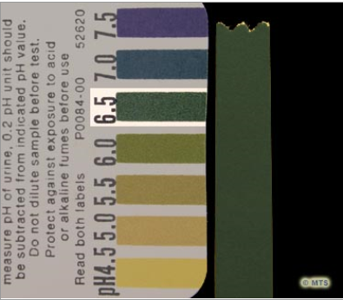
Apply patient sample to the Nitrazine paper and shake off excess fluid.
Compare the test results/color to the supplied color chart immediately.

