Slide 1
IS Change Management
Your Role as the Business Process Owner
July 2015

Slide 2
IS Change Management is:
A process to review, schedule, and approve IS changes prior to implementation in production
A “tollgate” or check point to confirm testing, communication, and planning have taken place
A process to decrease the risk of a change negatively impacting the production environment, caregivers or patients
A process to assist scheduling and to prevent conflicting changes happening simultaneously

Slide 3
Benefits and Need
Why is Change Management needed?
Ensure Business leaders get what is wanted
Decrease risk and application/ system downtime
Ensure IS changes are correctly tested and planned prior to implementation
Ensure the change is communicated and approved by Business Process Owners and IS
What are the benefits?
Enables the Business Process Owner to have input and understanding of IS process
Creates a stable IS and business environment
Promotes better planning and testing

Slide 4
How Does the Process Work?
Business requests a system enhancement or change
IS creates and develops change request
IS team submits a Change Request
Normal Change: submitted in time for weekly review of changes
Emergency Change: submitted outside normal lead time
IS team adds supporting documentation
Pre-implementation testing method and results
Implementation Plan (how will this get installed)
Post Implementation Validation Plan (how to test once installed)
Back-out Plan (how to reverse the change if not working)
IS team gathers approvals and communicates to Business
Business Process Owner approval
IS Management Approval
Change Advisory Board (CAB) Approval
IS members meet weekly to review and give final approval

Slide 5
What does this Mean for the Business?
Business Process Owner works with IS to decide best time to implement the change
Business Process Owner provides approval before a change is implemented. Normal Change approval includes:
Business Process Owner acknowledges a proper test plan was developed and yielded expected results
Business Process Owner acknowledges the date, time, and duration is appropriate to be the least impactful to operations
Business Process Owner acknowledges communication has taken place
Business is provided as much information as needed to be able to understand the change
Emergency Changes (issues that need to be fixed now) require post-implementation written approval. Verbal approval prior to implementation if possible is preferred.

Slide 6
Business Process Owner Responsibilities
Initially, an IS staff member contacts the Business Process Owner to discuss the change and all pertinent details
After the Change Request is created, the IS staff sends an email to the Business Process Owner requesting written approval of the change

Slide 7
Email Request Contents
The email is a formal request for the approval of a change. It contains:
Application impacted
Date, time, and duration of the change
Description of the change
Type of change (normal or emergency)
If an outage is required
IS staff member contact information for more information or questions

Slide 8
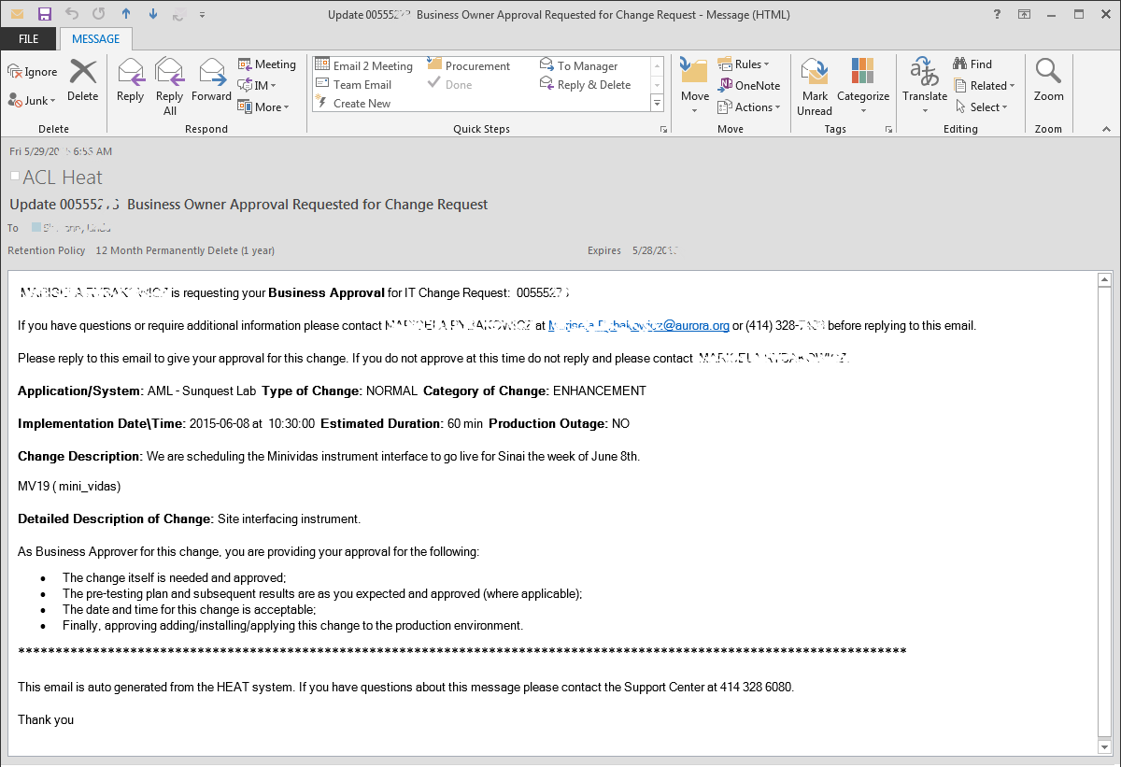
Example of an Email Approval Request

Slide 9
Business Process Owner Responsibilities after receiving email
Read email carefully
If there are questions, concerns or more information needed, directly contact the IS staff member indicated in the email
Once Business Process Owner is satisfied and approves of the change, click Reply
In the body of the message, indicate approval
Click Send
Email will be sent to the Heat system
Approval is logged on the Change Request

Slide 10
Email received but …
The Receiver is not the appropriate Business Process Owner for this system or change
Contact the IS staff member listed in the email to discuss
If a Business Owner needs to be changed, added or removed, the IS staff member can have this done BEFORE approving

Slide 11
Example: New Report Request
Business has a need and requests IS create new report
Request defines what the report should look like and includes other relevant criteria
Request also includes how to verify the report is functioning correctly. This is the test criteria and the expected results used in Change Management.
Business prioritizes the work for IS based on other projects
IS creates the report to the specifications provided in the request

Slide 12
Example continued
When ready for implementation, the IS staff creates a Change Request in HEAT including all appropriate documentation
Through HEAT, an email is sent to the Business Process Owner requesting approval to implement the change
Business Process Owner reviews email, verifies implementation date/time, acknowledges testing results and decides if this change should be implemented.
Business Process Owner replies to the email with approval or denial of the change request
IS CAB team reviews approved change requests to ensure that changes do not negatively impact each other

Slide 13
Remember- You are Approving
As a Business Process Owner, you are giving your approval of the change
Date, time, and duration are acceptable
A proper test plan was executed and testing results are as expected
Ultimately, YOU are authorizing IS to change YOUR system/application/process

Slide 14
Remember…
Business has an important role in IS Change Management
Business should know what is being changed, when it will be changed and that appropriate testing has occurred
Ask questions regarding the change, what is being planned and when change will occur
Please provide approvals as soon as possible as many associated deadlines require this approval for proper “go-ahead”

