Slide 1
Validation in Production Environments Using FAST Test Clients – Training module

Slide 2
A new tool for performing Test Validation
Placing orders in the FAST production environment for test build cycle validation has been difficult to navigate.
Predefined clients and patients are now available to be used by operations for FAST production validation.
Moving forward all validation orders entered in FAST production MUST use these clients and their associated pre-defined patients.

Slide 3
Order entry in FAST
This training guide is not intended to train FAST order entry. It is intended to train proper use of FAST Test Clients used for build cycle test validation in FAST only.
If you are unfamiliar with general order entry in FAST, please refer to Policy Tech FAST ORDER ENTRY, reference #5573.
This process uses Test Clients and Patients specifically designed for test validation only. They are NOT to be used for other purposes or when placing real orders.

Slide 4
Separate clients are to be used in IL and WI.
Specified Test Clients have been built in the FAST production environment. These Test Clients are to be used for test validation in ACL internal systems only, not for use with downstream systems. Use the appropriate Client ID defined for your testing needs:
If you are testing in Illinois use client code TEST04.
If you are testing in Wisconsin use client code TEST05.
Client ID Client Name
TEST04 TEST CLIENT IL OPS
TEST05 TEST CLIENT WI OPS

Slide 5
Specified patients have been pre-built for use with the clients.
These are the only approved patients to be used with the Test Clients
DO NOT create new patients.
DO NOT use patients other than those listed.
If you encounter a situation where these patients will not meet your validation needs, contact ACL Op App Support for assistance.

Slide 6
Illinois patients to be used with client TEST04.
NAME DOB ACL MRN
TESTPROD IL, ADULT MALE 2/29/1992 AAMN5349
TESTPROD IL, ADULT FEMALE 2/29/1928 AAMN5343
TESTPROD IL, CHILD 2/29/2012 AAMN5352
Wisconsin patients to be used with client TEST05.
NAME DOB ACL MRN
TESTPROD WI, ADULT MALE 2/29/1992 AAMN5360
TESTPROD WI, ADULT FEMALE 2/29/1928 AAMN5356
TESTPROD WI, CHILD 2/29/2012 AAMN5361

Slide 7
Order entry example
Now we will walk through an order entry example.
Log into FAST using the correct device location for your testing. This may vary depending on what you are validating and for whom.
If you need to verify labels make sure you are logged into the location for your label printer.
If you are testing routing make sure you are logged into a location of the ordering site.

Slide 8
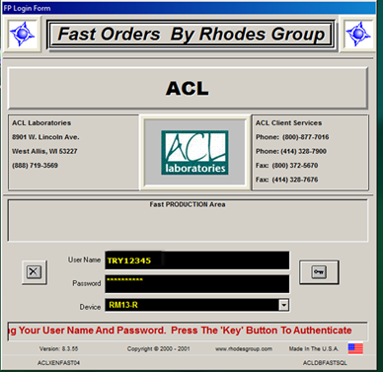
Illinois order entry example.
In this example will be use an Illinois client with an Illinois patient so we will log into an Illinois location.

Slide 9
Illinois order entry example.
Search for your patient by typing “testprod” into the search box.
Then select an appropriate patient from the drop down list. We will use one of the IL patients since this is an Illinois example.

Slide 10
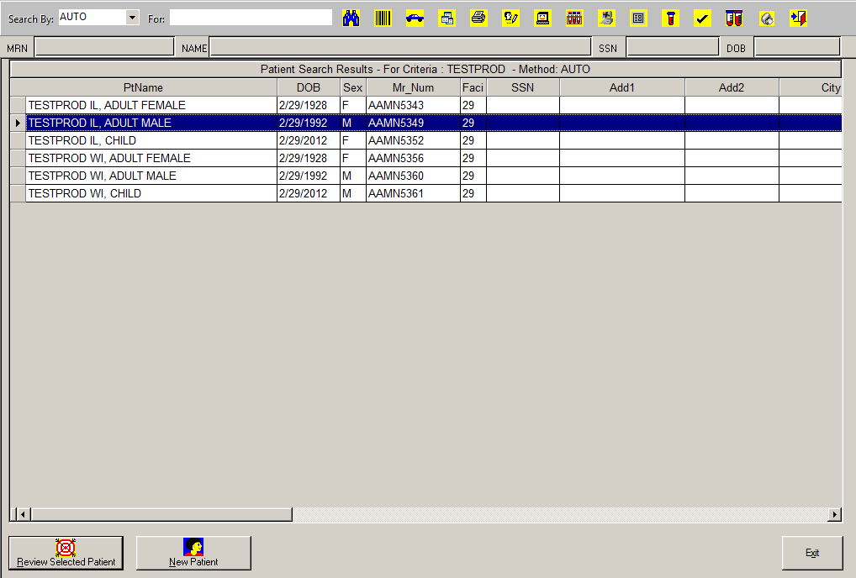
Illinois order entry example.
Click on Review Selected Patient as usual.

Slide 11
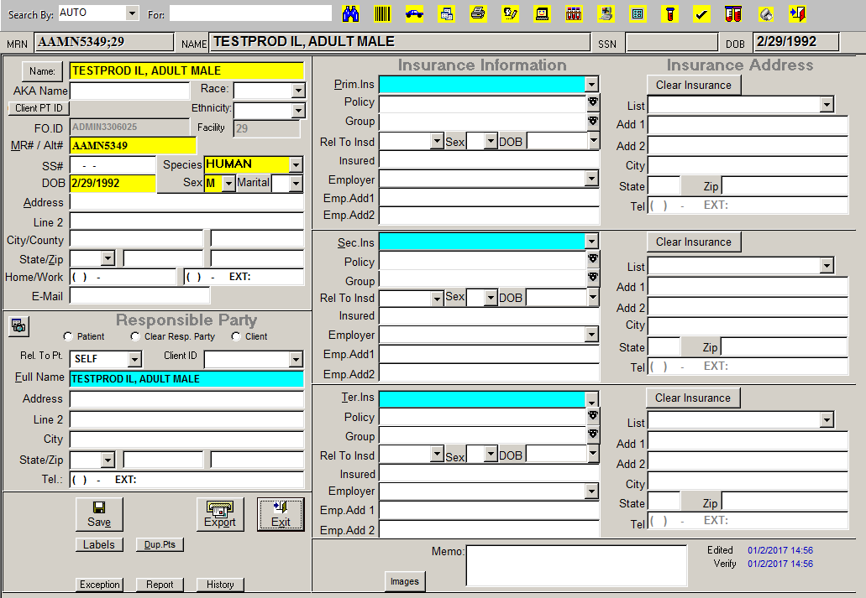
Illinois order entry example.
Click on “EXIT”. Do not alter or enter any insurance information.

Slide 12
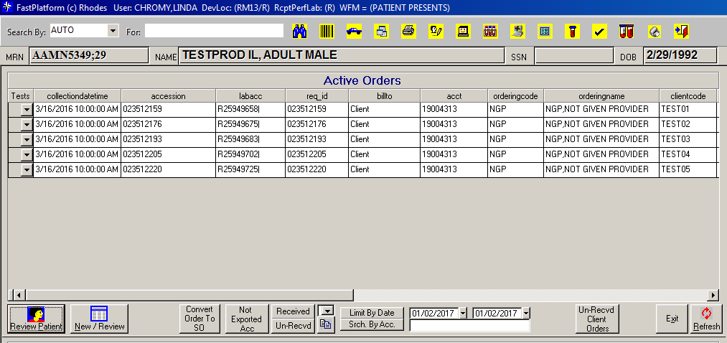
Illinois order entry example.
Click on “New/Review”.
This will take you to the order entry screen.

Slide 13
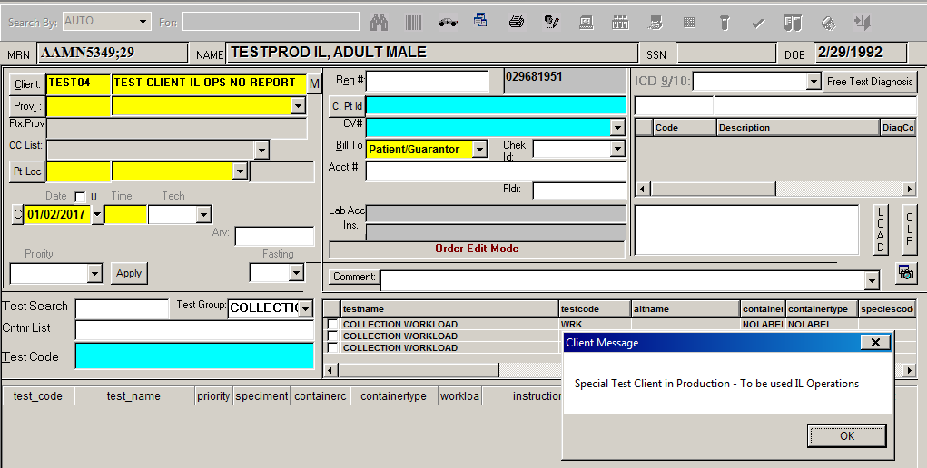
Illinois order entry example.
Enter the predefined client ID, TEST04 for Illinois, in the client field and hit “tab”. A pop up message will appear indicating this is the client IL Operations should use.
Click “OK” to close this box.

Slide 14
Illinois order entry example.
TEST04 and TEST05 are the clients defined for operations. Other Test clients have been built for use by ACL IS, Op App Support only.
Review the Client Message popup carefully. If the box states ACL IS or OP APP Support, abandon the order and reorder with a correct client.

Slide 15
Illinois order entry example.
Click on the provider drop down .
Select NGP, Not Given Provider. It will be the only provider on the drop down list.

Slide 16
Illinois order entry example.
Do not use any other provider. Settings for the client, patient, and provider will ensure results will not outbound from ACL
Double check your Patient, Client, and Provider entries before continuing with the order.
For our Illinois example, verify a TESTPROD IL patient, the TEST04 Client code, and the NGP provider.

Slide 17
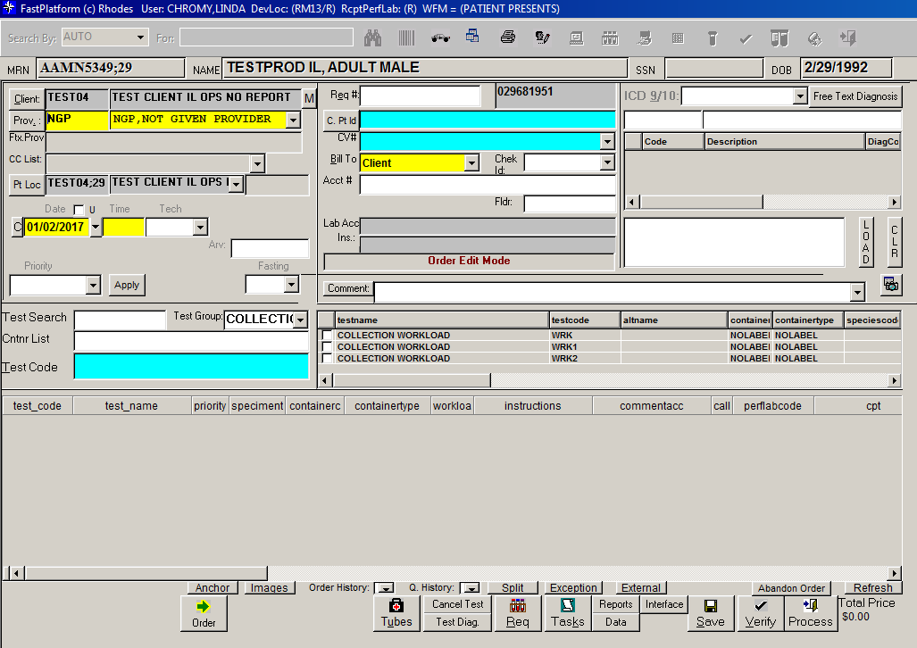
Illinois order entry example.
Proceed with order entry as usual. Enter a Dx code, time, test code, and click on order.

Slide 18
Illinois order entry example.
If you can validate what you need without processing the order, capture your documentation and then delete the test code and abandon the order.
Examples: validation of labels, container types, AOE questions, or pop-up messages.
If you need to process the order to complete validation be sure to cancel/credit the order when validation has been completed. Retrieve all printed FAST labels so they do not contribute to any patient safety issues. Do not leave accession numbers pending.

Slide 19
Use of the FAST Test Clients
Test Clients are to be used in limited situations. The current AML validation process, using Test Patients in Production by Site, is to be used in all cases where validation can be captured in AML.
For instance, if you need to verify a new test build, place one order in FAST to check labels, AOEs, batching, etc. Place the rest of your orders in AML to check worksheets, resulting, reference ranges, flagging, etc.
See policy tech Instructions for Using FAST Test Clients for Test Validation in Production, reference # 8816 for more examples.

Slide 20
Use of the Clients and Patients will be monitored
Use of Test Clients and associated patients for validation will be monitored periodically by Op App Support. Order carefully to avoid errors that may be interpreted as misuse.
Identified inappropriate use will result in a warning to the user.
Reeducation of the user will take place when indicated.

Slide 21
FAST order entry for test validation
To complete your training there are two documents you need to review and a competency to take.
Policy Tech procedure VALIDATION IN FAST PRODUCTION ENVIRONMENT reference # 8815.
Policy Tech attachment Instructions for Using FAST Test Clients for Test Validation in Production reference # 8816.
The FAST Test Clients competency test is attached to this MTS training module. It can also be found here: Home > Operations > On-line Training > Using Fast Test Clients for Production Validation - Training and Competency. Please complete the competency. If not completing in MTS, print a copy and submit to your supervisor.

