Slide 1
Diseases Detected by Flow Cytometry

Slide 2
What Do We Look At?
There are certain cells and cellular markers (CD markers) that are important to look at to determine what neoplasm may exist.
The presence of certain immature cells in a specimen can indicate disease.
The presence or absence of certain markers on cells can indicate disease.
The percentage of cells that express a certain marker can also be important.
In order to better visualize the different cell populations on the computer we add gates to give each population a color.

Slide 3
Interpreting the Graph
Q1: Cell populations in this quadrant stain positive for parameter 1 and negative for parameter 2
Q3: Cell populations in this quadrant stain negative for both parameter 1 and 2
Q2: Cell populations in this quadrant stain positive for both parameter 1 and 2
Q4: Cell populations in this quadrant stain negative for parameter 1 and positive for parameter 2
Parameter 1
Parameter 2

Slide 5
Acute Myeloid Leukemia (AML)
We focus on blast cells (immature cells)
CD markers are used to determine lineage and abnormality
There are different classifications of AML including:
Acute Promyelocytic Leukemia (APL)- abnormal promyelocytes
AML with monocytic differentiation- monoblasts/promonocytes

Slide 6
Important Markers in AML
CD45: When shown against side scatter (SSC) helps to locate the blast population
CD33,CD34: Help to identify the blast population
Markers to help define lineage include:
CD13, CD117, MPO: Myeloid
CD14, CD64: Monocytic
HLA-DR: Positive in most cases, notable exception is in APL which is characteristically HLA-DR negative

Slide 7
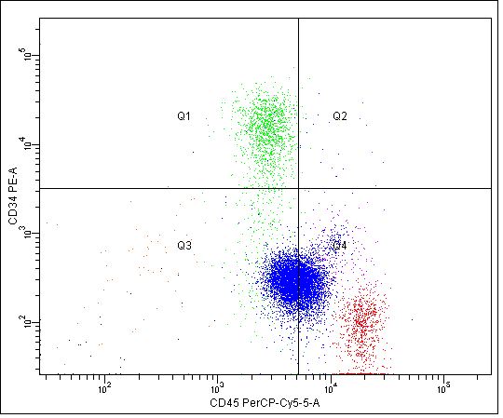
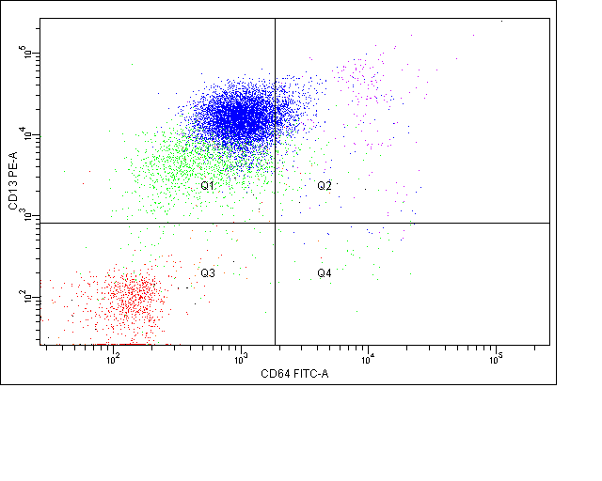
AML Graphs
Blasts = Green
Lymphocytes = Red
Granulocyte = Blue
Monocytes = Pink

Slide 8
Acute Lymphoblastic Leukemia (ALL)
The focus is on lymphoid blast cells (B-cell or T-cell)
Important markers include:
CD45: Helps to locate the blast population in graphs
CD33,CD34: Help identify the blast population
CD3: Positivity indicates that the blasts are T lymphoblasts
CD19: Positivity indicates that the blasts are B lymphoblasts

Slide 9
Lymphoma/Chronic Lymphocytic Leukemia (CLL)/Hairy Cell Leukemia
Types include: T-Cell Lymphoma, Follicular Lymphoma, Mantle Cell Lymphoma, Hairy Cell Leukemia, and CLL
The focus is on B and T cells
Important markers include:
CD3, CD4, CD8: T-cell markers
CD19: B-cell marker
Kappa and Lambda: Found on B-cells. We look at the ratio of cells that express each. Normal ratio is 1.5:1 Kappa/Lambda.
CD25, CD11c, CD103: Important markers in Hairy Cell Leukemia

Slide 10
B-Cell Expression of Kappa and Lambda
Normal Expression
Abnormal Expression

Slide 11
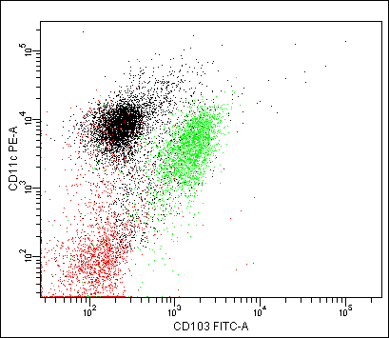
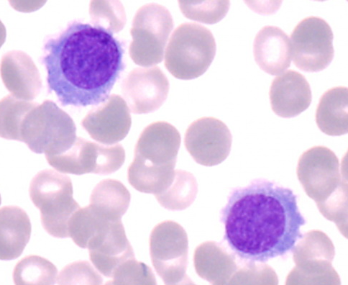
Hairy Cell Leukemia

Slide 12
Myeloma
The focus is on plasma cells
We perform cytoplasmic staining to look at Kappa/Lambda expression on the inside of the cells
Important markers include:
CD38: Helps to identify the plasma cell population
CD20,CD56: Helps to distinguish normal vs abnormal plasma cells
CD138: Very important for patients on Daratumumab therapy
Daratumumab targets the CD38 on cells, thus preventing our CD38 reagent from binding to cells and being detected by flow cytometry.
CD138 allows us to be able to detect these plasma cells.

Slide 13
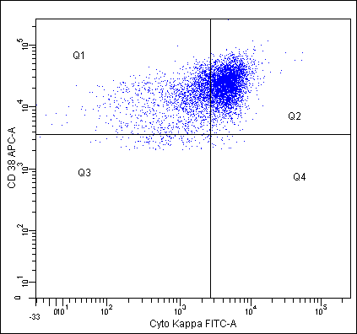
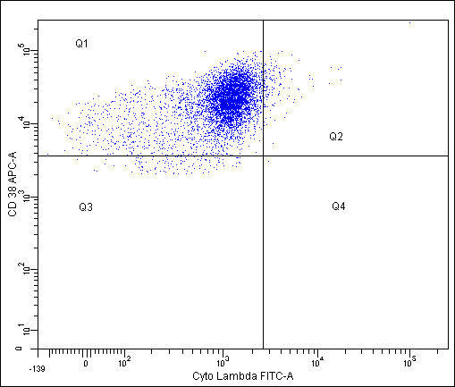
Myeloma Graphs
Plasma Cells
Cells are positive for Kappa
Cells are negative for Lambda
Cytoplasmic Staining

