Slide 1
BD FACSCanto
How the Flow Cytometer Works

Slide 2
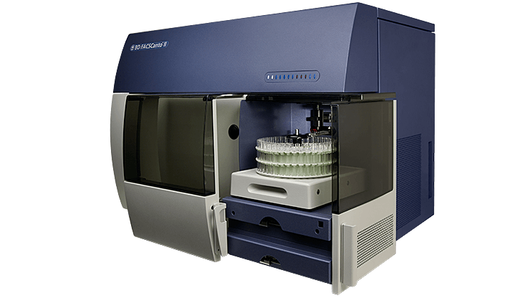
3 Key Components
Fluidics
Optics
Electronics

Slide 3
Fluidics
The fluidics system transports cells to the laser beam for interrogation.
Cells pass through the flow cell, where they are struck by the laser. Cells are carried in a fast moving stream of fluid at a rate of thousands per second, and are analyzed individually.
The instrument utilizes hydrodynamic focusing to achieve this.

Slide 4
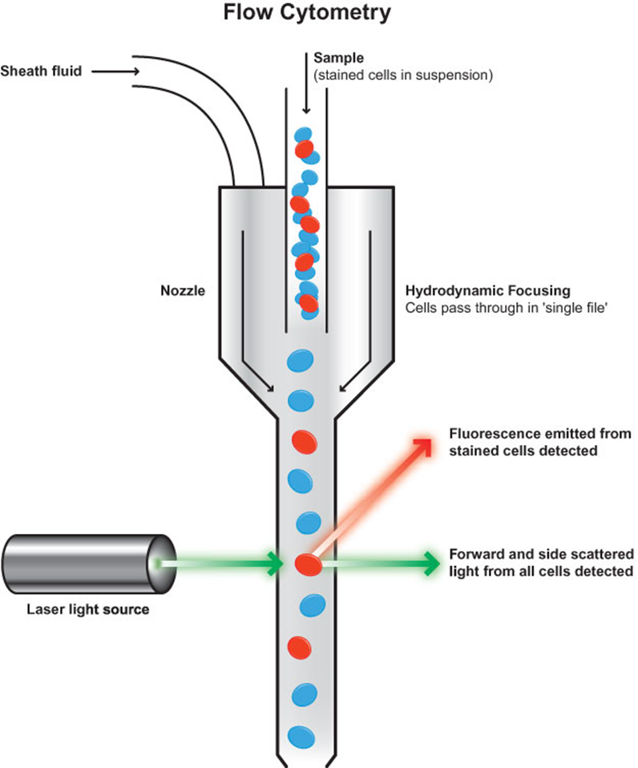

Slide 5
Optics
Antigens on the cell surface are stained with fluorescent antibodies, which fluoresce at different wavelengths when excited by a laser.
The size and granularity/complexity of the cell are measured, as well as the antibody/antigen reaction-if it’s positive or negative, and how strong the reaction is.
Lenses collect this emitted light, and filters route specific wavelengths into detectors.

Slide 6
Electronics
The instrument converts the reflected light into electronic signals, which are displayed on the computer screen as “dot plots”.
Each dot represents a single cell.
We can then do a preliminary analysis of this data, and a pathologist will do the final analysis.
We draw gates around the cell populations to give them different colors for easier analysis.

Slide 7
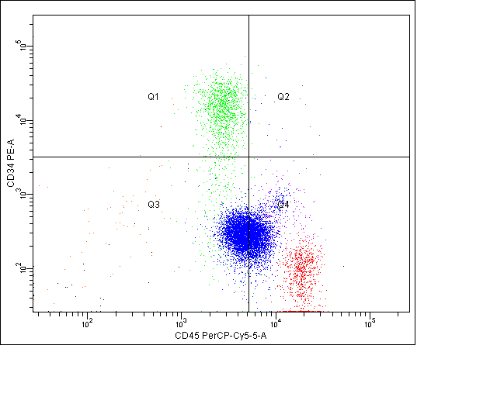
Examples of Dot Plot Graphs

Slide 8
The Flow Cell
The flow cell is considered the heart of the flow cytometer. This is where everything comes together: sample, laser light, fluidics, and emission light collection.

