Slide 1
Flow Cytometry
Specimen Processing (or what happens after you send your sample)

Slide 2
Bone Marrow Specimen Processing
The volume of the specimen is noted. Please do not cover the volume markings with any labels!
A portion of the sample is removed for a cell count and viability.
The sample is washed 2 times in RPMI.
Once the cell count is performed and the sample has been washed, the sample is diluted to a cell concentration of 5,000 to 10,000.
The sample is now ready for antibody staining.

Slide 3
Blood Processing
EDTA samples are poured off into a 15mL conical tube and are washed 3 times.
The WBC count from the CBC is used to adjust the volume of sample to get a WBC concentration between 5000 and 10000.
The sample is ready for antibody staining.

Slide 4
Tissue Processing
Tissues are disaggregated and filtered under the hood to get the cells in suspension. If needed, body fluids are also disaggregated, otherwise they are just centrifuged.
Chunks of tissue will clog the Flow Cytometer- even the smallest FNA is too big for the Flow Cell.
The cells are centrifuged and the supernatant is removed.
Red blood cells are lysed because we are testing the WBCs only.
Once the cell count is performed and the sample has been washed, the sample is diluted to a cell concentration of 5,000 to 10,000.
Some tissues have very low cell counts, but we will test anything that has viable cells present.
The sample is now ready for antibody staining.

Slide 5
Tissue Processing
Click to Play
Click to Play

Slide 6
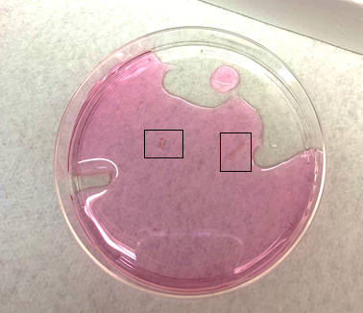
FNA Tissue Processing
Click to Play
FNA pieces

Slide 7
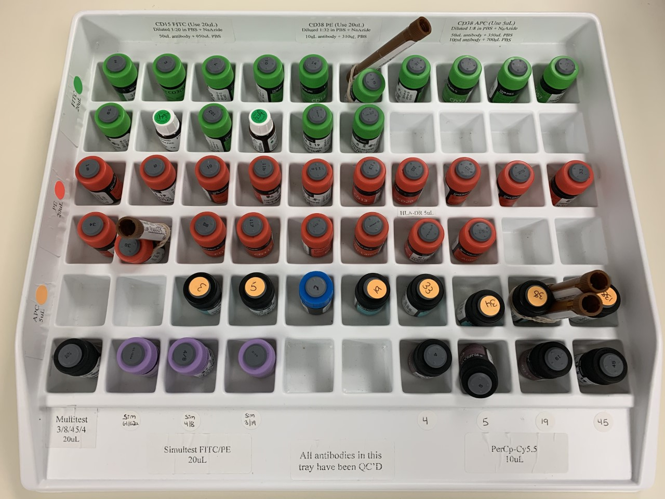
Panel Set Up
The appropriate panel or panels are chosen based on the patient’s diagnosis and history.
Set combinations of antibodies are then pipetted into test tubes and the patient sample is added.

Slide 8
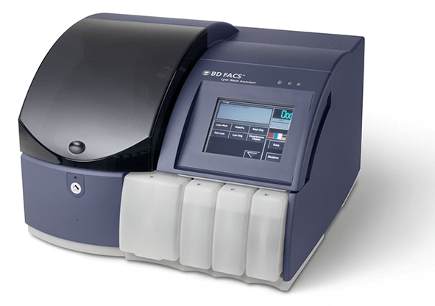
Lyse Wash Assistant (LWA)
Bone Marrow and Blood test tubes are placed on the LWA for incubation, RBC lysing, washing, and fixing.
Tissue and Body Fluid test tubes are incubated in the refrigerator for 30 minutes and then are washed and fixed with formalin on the LWA.
After the LWA, the samples are ready to be collected using the Flow Cytometer.

