Slide 1
TEAM MEMBER BEHAVIORS

Slide 2
To deliver on our promise to meet consumers’ evolving needs and reimagine care delivery, Advocate Aurora Health has arrived at a set of unified behaviors that will serve as the foundation of our integrated talent practices. By exemplifying these behaviors, we can support Advocate Aurora Health in transforming our culture, engaging our talent, empowering our team members, and executing towards results.

Slide 3
Moving forward, the Behaviors portion of the performance review (i.e., the “how”) will be based on the following six shared behaviors – Collaborates, Communicates Effectively, Exhibits Courage, Ensures Accountability, Foster Resilience, and Values Differences. These behaviors apply to all team members.
NOTE: For leaders, there are nine additional behaviors they will be evaluated on as part of the performance review.

Slide 4
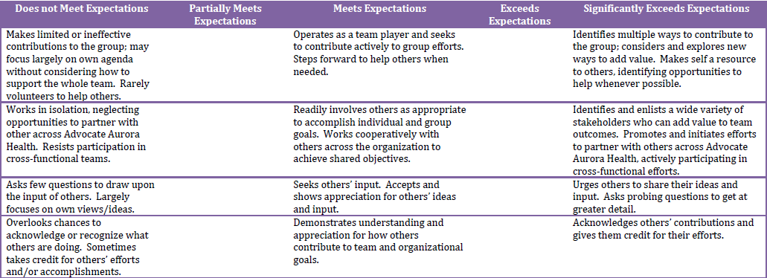
Collaborates

Slide 5
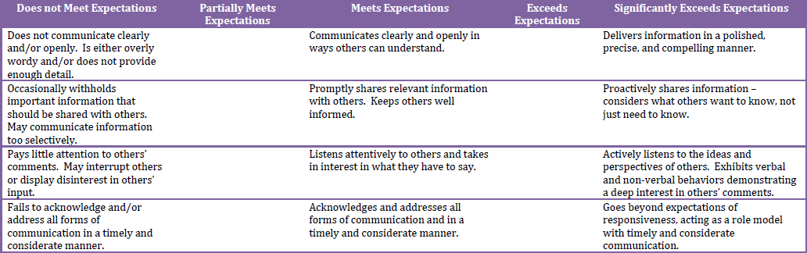
Communicates Effectively

Slide 6
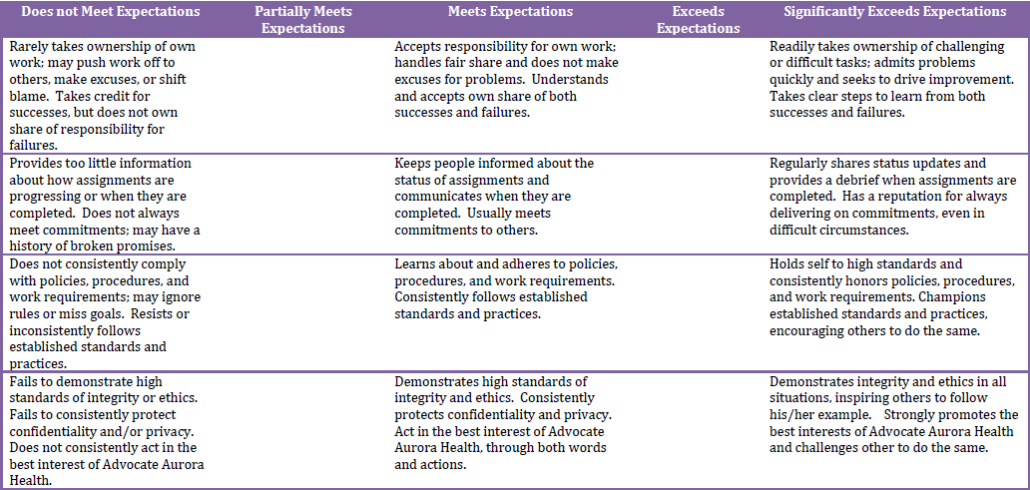
Ensures Accountability

Slide 7
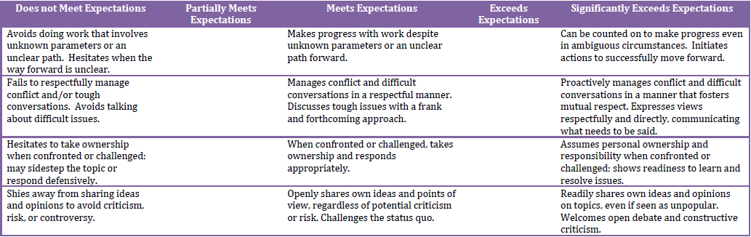
Exhibits Courage

Slide 8
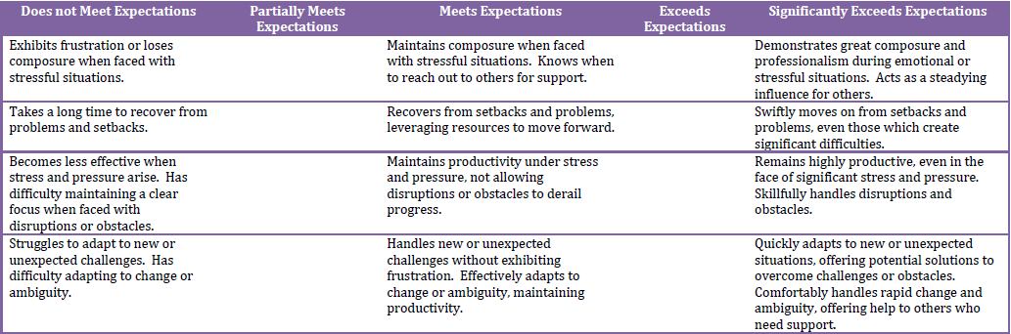
Fosters Resilience

Slide 9
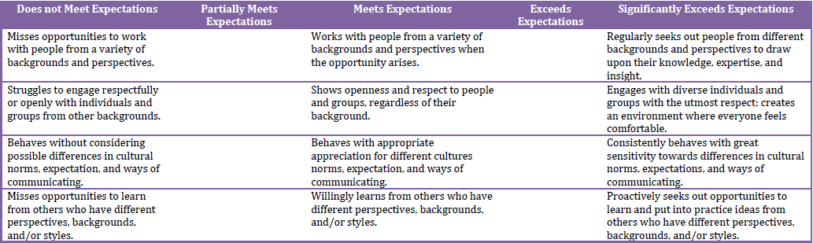
Values Differences

Slide 10
These behaviors will serve as the foundation of our integrated talent practices and are designed to guide our efforts as we live our purpose (We help people live well) and values (Excellence, Compassion, and Respect).
Leadership welcomes and encourages any conversations regarding Team Member Behaviors.

