Slide 1
Proficiency Testing

Slide 2
Objectives
After participating in today’s session, you will be able to:
Discuss the regulatory aspects and impact of proficiency testing (PT)
Identify approaches to effectively manage and fully utilize PT in your laboratory
List investigative techniques used to determine causes of poor PT performance and describe effective corrective actions

Slide 3
What is Proficiency Testing?
Purpose
The proficiency testing (PT) process is intended to demonstrate the laboratory’s ability to provide accurate and reliable results in its patient testing system
How
By testing of “unknown” samples from an approved PT provider.
Scope
The process incorporates elements in the pre-analytical, analytical, and post-analytical areas.

Slide 4
Why is Proficiency Testing Important?
Proficiency Testing (PT) is an important tool used to verify the accuracy and reliability of a laboratory’s testing.
  Routine review of PT reports can be used to identify areas of testing that are not performing as expected as well as subtle shifts and trends that, over time, could affect patient results.
  Identifying the root cause of a PT failure, and the laboratory’s subsequent corrective action, provides an opportunity for continuous improvement.
PT samples may be used for competency assessment AFTER formal evaluation by the PT provider.

Slide 5
Background
The clinical laboratory industry is highly regulated.
The Clinical Laboratory Improvement Amendments of 1988 (CLIA) is the law which regulates clinical laboratory testing.
The CLIA regulations are enforced by the Centers for Medicare and Medicaid Services (CMS). The College of American Pathologists (CAP) is one of the agencies that acts on behalf of CMS to ensure compliance with the CLIA requirements.
  Regulations and requirements for Proficiency Testing (PT) are stipulated by CLIA and enforced by CMS and CAP (or other deemed agency)
  The risk of non-compliance with the PT requirements is very high and may result in payment of civil money penalties, revocation of license or non-payment for Medicare or Medicaid services rendered.
2

Slide 6
CLIA - “The Law”
Clinical Laboratory Improvement Amendments of 1988
Public Health Law 100-578
  Laboratories performing testing under CLIA must comply with all CLIA requirements including those for PT
  CLIA requirements are found in Section 353 of the Public Health Service Act and 42 Code of Federal Regulations, Part 493
3

Slide 7
CLIA - “The Regulation”
Clinical Laboratory Improvement Amendments of 1988
493.801 Enrollment And Testing Of Samples
The laboratory must participate in a CMS-approved proficiency program for all CLIA specialties and sub-specialties included in the laboratory’s testing menu.
If a proficiency test program is not available, the analyte must be challenged by an Alternative Performance Assessment at least twice per year.
5

Slide 8
CLIA - “The Regulation”
Clinical Laboratory Improvement Amendments of 1988
493.801(b)(4) Testing of Proficiency Testing Samples
The laboratory must not send Proficiency Testing samples or portions of samples to another laboratory for any analysis for which it is certified to perform in its own laboratory. Any laboratory that the Centers for Medicare and Medicaid Services (CMS) determines intentionally referred its proficiency testing samples to another laboratory for analysis will have its certificate revoked for at least one year. Any laboratory that receives proficiency testing from another laboratory must notify CMS of the receipt of those samples.

Slide 9
Consequences for Non-Compliance
Laboratory may lose it’s CLIA license for one year (either in the specialty or sub-specialty or for the entire laboratory).
Laboratory Director may have sanctions imposed (e.g., not serve as director of any laboratory for two years).
Owner may not own or operate a laboratory for two years.
Fines may be imposed
Laboratory may lose ability to bill for Medicare or Medicaid services
Employees face termination
Bad publicity – Tarnished public image!
PATIENT CARE WILL SUFFER!

Slide 10
PROFICIENCY TESTING DO’s
Samples are tested on all shifts by technicians who routinely test patient samples
All surveys performed are treated as real patient samples. This includes using the same test methods for quality control, patient testing, workload accounting, verification and reporting of results.
  NOTE: This only applies to analytes that are tested in-house.
Personnel who routinely analyze patient samples will integrate all PT within the routine workload

Slide 11
Proficiency Testing DON’Ts
Test samples differently than patient specimens
Have the same people always do testing
Refer samples to another laboratory
Discuss results before reporting
Use PT sample for other purposes before submission date deadline

Slide 12
ENROLLMENT & PARTICIPATION
Required for all analytes listed in the PT Enrollment Guide
- Updated annually
In addition to enrolling and testing samples, you must:
-Ensure results are sent either electronically or via fax
-Ensure they are sent by the deadline
-Ensure all faxed pages are received
NOTE: Non-participation (failure to receive results) = UNSATISFACTORY

Slide 13
Evaluation of PT Results
To identify any deviation in proficiency testing from external requirements or facility's expectations that requires investigation and follow-up

Slide 14
PT Grading Policy
80% for regulated analytes and other analytes that have at least 5 challenges per PT event
100% for ABO/Rh & Compatibility testing
Passing grades on PT surveys with 5 challenges will require 4 correct, 4 challenges will require 3 correct, 3 or fewer challenges will require all to be correct.
Challenge Failures
Analyte Failures

Slide 15
Reported Causes of PT Failures
NO EXPLANATION
OTHER
PT MATERIALS
METHODOLOGICAL
CLERICAL
TECHNICAL

Slide 16
CLERICAL ERRORS
Post Analytic Phase
Same importance as testing errors
Examples:
  Transcription
  Method/Reagent/Instrument codes
  Missing Information (TNP, </>, etc)

Slide 17
TECHNICAL ISSUES
Directly attributable to human actions:
  Reconstitution
  Specimen Mix-up
  Improper Specimen Handling
  Incorrect Instrument Handling
  Failure to follow testing kit instructions
  Morphologic Misinterpretations

Slide 18
Methodologic Issues
  Mechanical difficulties
  Instrument Software Problems
  Frequency of CALIBRATION
  Inadequate Reagent Performance
  Inadequate Maintenance
  Other instrument malfunctions

Slide 19
Issues with PT Testing Materials
Hemolyzed, contaminated
Unstable PT materials
Perceived bias
Matrix effect incompatible with method
Late shipment

Slide 20
Investigation
Review the all-participant report received from your PT Provider
Review reporting records
Review sample preparation/handling, testing
Verify that the PT material was processed in the correct instrument mode
Review results from previous survey

Slide 21
Investigation 2
Review QC performance, instrument calibration, and reagent performance prior to, during, and after the original analysis of the PT challenge
Contact the instrument/reagent manufacturer for assistance
Retest the PT specimen(s), if possible or purchase additional specimens with different reagent lot

Slide 22
Proficiency Testing Exception Summary (PTES)
Unsatisfactory PT performance
  Failure to attain the minimum satisfactory score for an analyte, test, subspecialty, or specialty for a testing event.
Unsuccessful PT performance (2 of 3 testing events)
  Failure to attain the minimum satisfactory score for an analyte, test, subspecialty, or specialty for two consecutive or two of three consecutive testing events.
Critical PT performance (3 of 4 testing events)
  Failure to attain the minimum satisfactory score for an analyte, test, subspecialty, or specialty for three consecutive or three of four consecutive testing events. A laboratory must immediately cease testing for that analyte or the discipline.

Slide 23
UNSATISFACTORY PT PERFORMANCE
Laboratories that have unsatisfactory performance for 1 or more analytes on an event will receive PTES Exception Summary (PTES) report.
  Investigate the problem
  Determine cause
  Implement Corrective Action
  RESPONSE TO LAP is not required

Slide 24
UNSUCCESSFUL PT PERFORMANCE
Is unsatisfactory performance on 2 of 3 PT events
Laboratory will receive a PT Exception Summary (PTES) report
Laboratory must suspend testing or implement plan of corrective action
LAP must approve laboratory’s action

Slide 25
PT Monitoring by Accreditation Program

Slide 26
CORRECTIVE ACTIONS
Design a process to verify clerical entries prior to result submission
Retrain testing personnel as to the proper procedures for sample preparation, testing and reporting
Modify/Narrow QC acceptance range to detect problems sooner
Evaluate/increase frequency of calibration
Perform Instrument Function Verification (Precision, Linearity, Correlation)
Revise Procedure to reflect corrective actions

Slide 27
Closing the Loop
Include:
  Explanation of investigation
  Documentation of external validation
  Determination of whether there has been impact on patient care
  Implementation of new processes/procedures to prevent recurrence

Slide 28
Not Closing the Loop
May result in sanctions
  Additional documentation
  Suspension of testing
  Cessation of testing

Slide 29
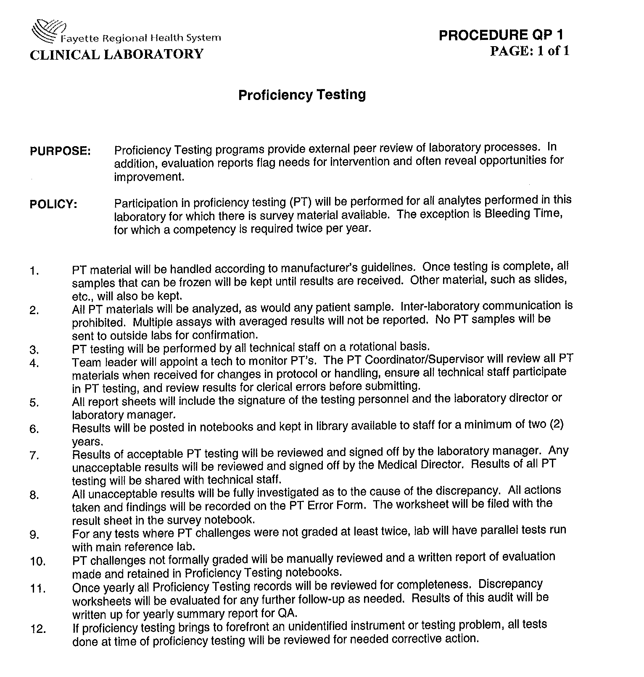
FRHS Lab Policy

Slide 30
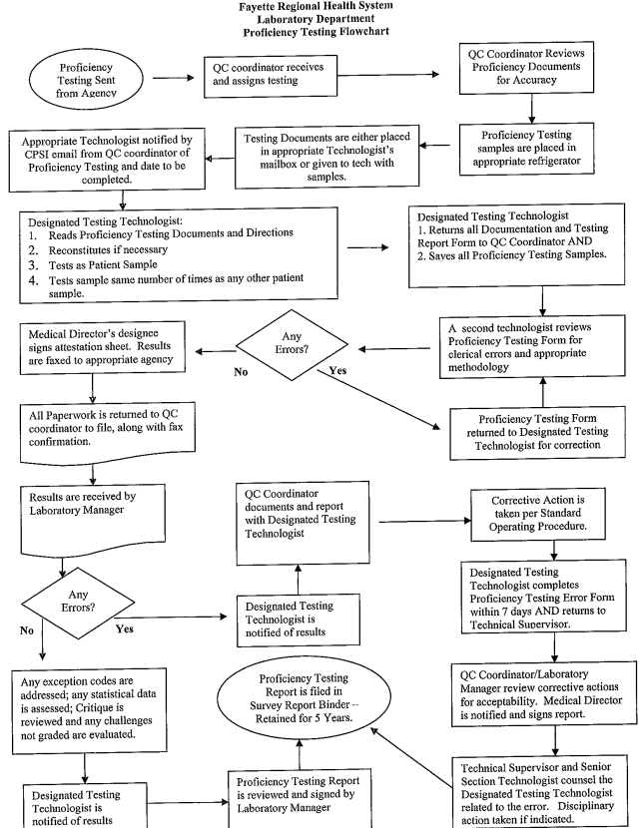
FRHS Lab Policy

Slide 31
Proficiency Testing
Take Quiz.

