Slide 1
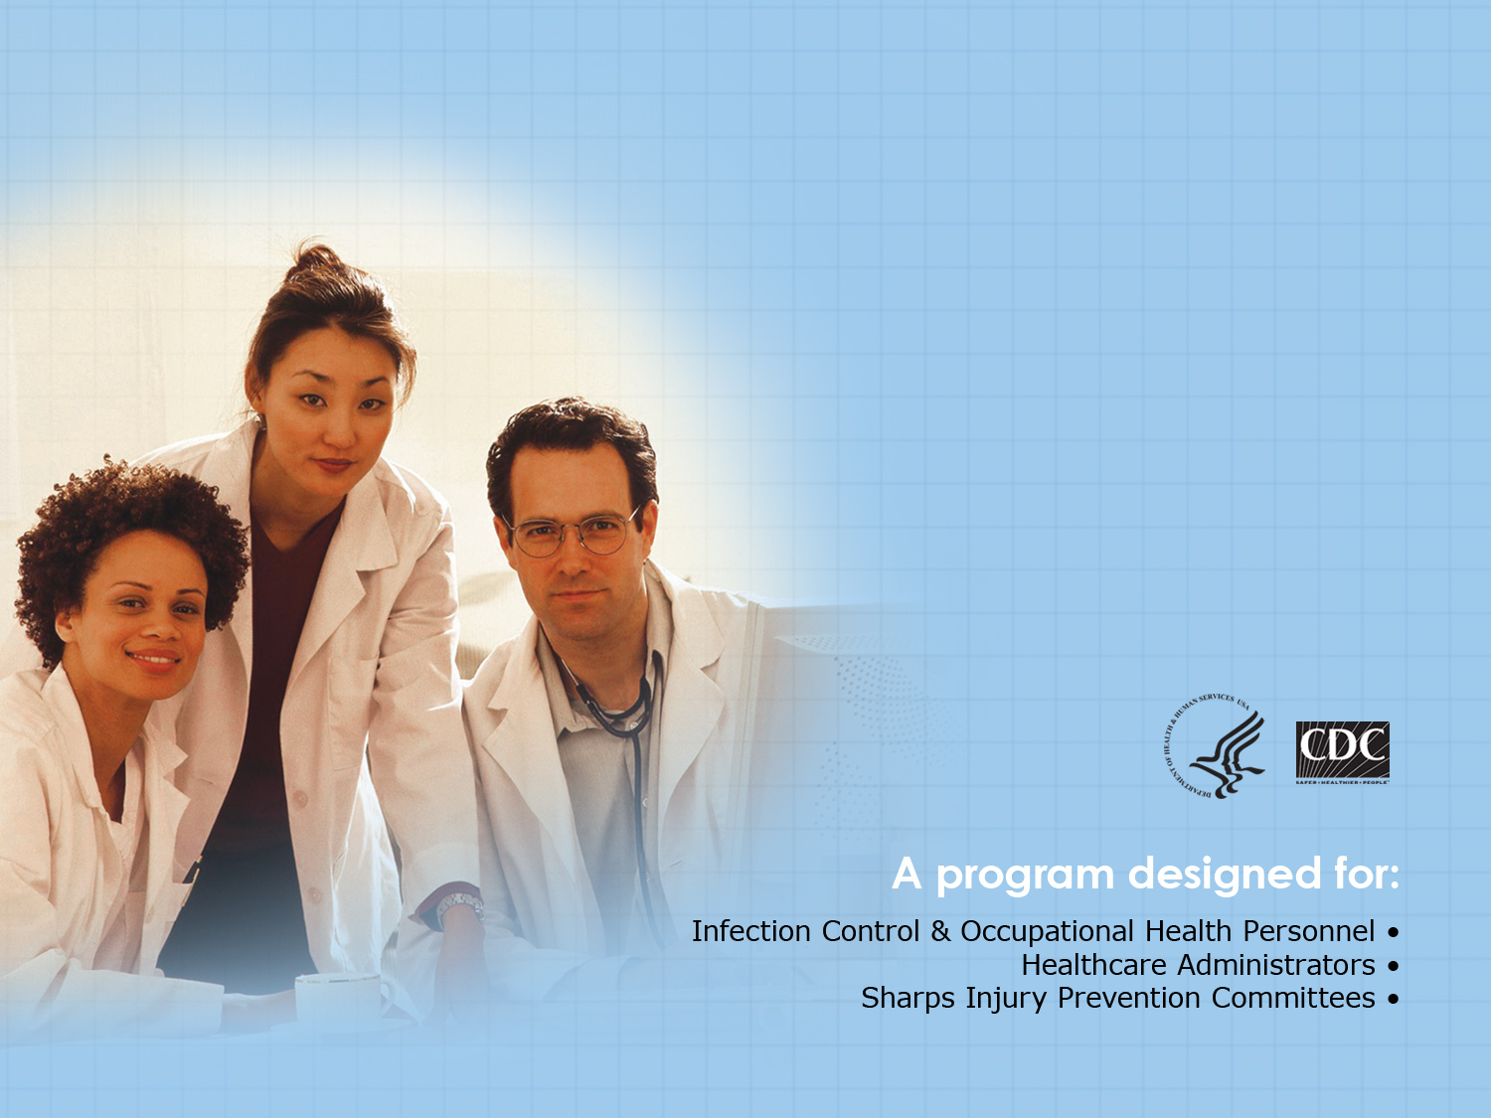
Preventing Needlesticks and Other Sharps Injuries…
Everything You Need to Know
Part III:
Safe Work Practices
Notes:
[Note to presenter: Feel free to discard slides or information to tailor this slide set to your particular organization’s needs.]

Slide 2
What Strategies Exist to Eliminate Sharps Injuries?
Eliminate or reduce the use of needles
and other sharps
Use devices with safety features
to isolate sharps
Use safer practices to minimize
risk for remaining hazards
Notes:
In Part II of this slide set series, we discussed a primary method of reducing sharps injuries. Obviously, the risk for sustaining a sharps injury is eliminated when needles or other sharp objects are substituted with alternative needleless systems. We also discussed many types of safer sharps devices and various methods for isolating sharp objects through engineering controls.
Even when these strategies are used, safe work practices must be employed.

Slide 3
Preventability of Needlesticks in NaSH Hospitals, June 1995—December 2003 (n=10,661)
Notes:
Here, data from CDC’s National Surveillance System for Healthcare Workers (or NaSH) show that most, but not all injuries, could have been averted. This holds true even if unnecessary needle use was eliminated, or if a safer needle device was used. Smaller, but significant percentages of sharps injuries occurred because safety features were not activated, or improperly activated; safe work practices were not followed, or sharps not disposed properly.
Many of the injuries classified as “nonpreventable” occurred when the patient moved during procedures requiring a needle. Preparing and alerting the patient before the procedure may prevent some of these injuries.

Slide 4
Injuries Related to Work Practices
Injuries occur because of the following:
  Passing or transferring equipment
  Recapping contaminated needles
  Colliding with coworkers
  Decontaminating/processing used equipment
Injuries occur from sharps left in unusual places:
  Laundry
  Mattresses
  Tables, trays, or other surfaces
Notes:
Many injuries related to work practices occur while sharps are being passed between different individuals, or transferred to a different location. Additionally, even though the practice of recapping contaminated needles has been discouraged for more than 20 years, approximately 5% of sharps injuries continue to occur due to recapping. Still other injuries related to work practices occur during collisions between workers and during decontamination or processing of used equipment.
Personnel also continue to be injured by the improper disposal of used sharps. These injuries occur when sharps are left in unusual locations such as laundry or linens or are stuck in mattresses, left in pockets, or left on tables, trays, or other surfaces.

Slide 5
The Sharps Safety Continuum
Prepare to use the device the moment the sharps are first exposed
Take precautions while using sharps
Take precautions during cleanup
Take precautions during disposal
Notes:
This slide summarizes the steps along the sharps safety continuum that will be reviewed in detail.
Work practices to prevent sharps injuries are typically present as a list of specific practices to avoid (for example, recapping used needles) or to use (such as, sharps disposal containers).
Data show that the risk of a sharps injury begins at the moment sharps are first exposed and ends once sharps are permanently removed from exposure in the work environment. Therefore, to promote safe work practices, healthcare personnel need to have an awareness of the risk of injury throughout the time sharps are exposed. They should also use a combination of strategies to protect themselves and their coworkers through the handling of the device. We will now review recommended practices that reflect this concept.

Slide 6
Sharps Safety Practices
Be prepared
Be aware
Dispose with care
Notes:
The recommended work practices that help ensure safety can be simplified into three quick points:
Be prepared.
Be aware.
Dispose with care.

Slide 7
Be Prepared
Before Beginning a Procedure
Organize equipment at the point of use
Make sure work space has adequate lighting
Keep sharps pointed away from the user
Notes:
Before beginning a procedure that involves the use of a needle or other sharps device you should:
● Ensure that equipment necessary for performing a procedure is available within arm’s reach, and organize the equipment so that the procedure can be done safely.
● Assess the work environment before starting and make sure that you have adequate lighting and work space for the procedure. In cases where low light is needed for the procedure, take steps such as verbal cuing and the use of neutral zones to minimize the risk of injury from passing sharps.
● Ensure that the sharp object being used is always pointed away from the user.

Slide 8
Before Beginning a Procedure (cont’d)
Be Prepared
Locate a sharps disposal container, or have one nearby
Assess the patient’s ability to cooperate
Get help if necessary
Ask the patient to avoid sudden movement
Notes:
● Identify the location of the sharps disposal container. If moveable, place it as near the point of use as appropriate for immediate sharps disposal. If sharps are reusable, determine in advance to where sharps will be placed for safe handling after use.
● Assess the potential for a patient to be uncooperative, combative, or confused.
● Obtain assistance from other staff or a family member to assist in calming or restraining a patient as necessary.
● Inform a patient of what the procedure involves. Explain the importance of avoiding any sudden movement that might dislodge sharps for successful completion of the procedure as well as prevention of injury to healthcare personnel.

Slide 9
Be Aware
During a Procedure
Maintain visual contact with sharps during use
Be aware of staff nearby
Control the location of sharps to avoid injury to yourself and others
Notes:
During a procedure that involves the use of needles and other sharps devices you should:
● Maintain visual contact with the procedure site and location of sharps.
● Be aware of other staff in the immediate environment.
● Take steps to control the location of sharps to avoid injury to yourself and other staff.

Slide 10
During a Procedure (cont’d)
Be Aware
Do not handpass exposed sharps from one person to another
Use predetermined neutral zone for placing/retrieving sharps
Alert others when sharps are being passed
Notes:
● Do not hand pass exposed sharps from one person to another.
● Use a predetermined neutral zone or tray for placing and retrieving used sharps.
● Verbally announce when sharps are being placed in a neutral zone.

Slide 11
During a Procedure (cont’d)
Be Aware
Activate safety feature of devices with engineered sharps injury prevention features as soon as procedure is completed
Observe audible or visual cues that confirm the feature is locked in place
Notes:
● If using an engineered sharps injury prevention device, activate the safety feature as the procedure is being completed. Observe for audible or visual cues that the feature is locked in place.

Slide 12
Clean Up and Dispose with Care
During Cleanup
Be accountable for sharps you use
Check procedure trays, waste materials, and bedding for exposed sharps before handling
Look for sharps/equipment left behind inadvertently
Notes:
During cleanup following a procedure, you should:
● Be accountable for sharps you use. You should dispose of any sharp object that you personally use.
● Visually inspect procedure trays or other surfaces (including patient beds) containing waste materials for exposed sharps used during a procedure before handling them.
● Look for sharps that may have been left inadvertently after the procedure.

Slide 13
Clean Up and Dispose With Care
During Cleanup (cont’d)
Transport reusable sharps in a closed container
Secure the container to prevent spillage
Notes:
During cleanup following a procedure:
● Transport reusable sharps in a closed container.
● Secure the container to prevent the spillage of contents.

Slide 14
Clean Up and Dispose With Care
While Disposing of Sharps
Inspect container
Keep hands behind sharps
Never put hands or fingers into sharps container
Notes:
While disposing of sharps:
● Visually inspect the sharps container for hazards caused by overfilling. You should also make sure the sharps container being used is large enough to accommodate the entire device.
● Keep your hands behind the tip of any sharps.
● Avoid bringing the hands close to the opening of a sharps container. Never place hands or fingers into a container to facilitate disposal of a device.

Slide 15
Clean Up and Dispose With Care
While disposing of Sharps (cont’d)
If you are disposing sharps with attached tubing
  Be aware that tubing attached to sharps can recoil and lead to injury
  Maintain control of both tubing and the device during disposal
Notes:
If you are disposing of sharps with attached tubing, such as a winged-steel or butterfly needle, be aware that the tubing can recoil and lead to injury. Be sure to maintain control of the tubing as well as the needle when disposing of the device.

Slide 16
Clean Up and Dispose With Care
After Disposing of Sharps
Visually inspect sharps container for overfilling
Replace containers before they become overfilled
Keep filled containers for disposal in a secure area
Notes:
After disposing of sharps, you should:
● Visually inspect the outside of waste container for evidence of protruding sharps. If found, notify safety personnel so they can appropriately dispose of the sharps container.
● Replace sharps containers before they become overfilled. If a sharps container is overfilled, place a new container and use forceps or tongs to remove protruding devices and place them in the new container.
● Keep filled sharps containers awaiting final disposal in a secure area.

Slide 17
Clean Up and Dispose With Care
If You Find Improperly Disposed Sharps in Work Environment
Handle carefully
  Keep hands behind sharps at all times
  Use mechanical device if you cannot safely pick up sharps by hand
Notes:
If you encounter improperly disposed sharps in the work environment, handle them carefully. Keep your hands behind sharps at all times. Use a mechanical device to pick up sharps if they cannot be handled safely.

Slide 18
Sharps Safety Practices
Be prepared
Be aware
Dispose with care
Notes:
Remember, when using or working around sharps devices:
Be prepared.
Be aware of the devices, where they are, and who is using them.
Dispose of devices in appropriate containers.

Slide 19
Conclusion
Preventing Sharps Injuries
Your Role
Notes:
Preventing sharps injuries requires involvement of staff at all levels. This next section will focus on the role that you can play in this prevention effort.

Slide 20
You are Part of the Prevention
Process when You
Adhere to safe practices and assist and support coworkers in safer practices
Report injuries or blood/body fluid exposures, sharps injury hazards, and near misses
Participate in training for devices and properly use sharps safety features
Participate in surveys (e.g., safety culture) and device evaluations
Notes:
You are part of the sharps injury prevention process when you:
Adhere to safe practices and assist and support coworkers in safer practices.
Report injuries exposures to blood or body fluids, sharps injury hazards, and near misses.
Participate in training for devices and properly use sharps safety features. If additional training for staff is needed, request that the vendor be asked to come back to provide training.
Participate in surveys and device evaluations If you have not been involved in the selection process or involved in piloting devices, ask about how that process works. Find out how you can provide written feedback on the use of new devices.

Slide 21
Always Handle Sharps With Care
Have a Safe Day!
Notes:
In this, and previous discussions, we have covered information about the distribution of injuries across departments and occupations, as well as devices and procedures associated with sharps injuries. We have also discussed engineering and work practice controls that can be used to reduce the frequency of sharps injuries. As noted, it takes a team effort; your role is very important, and your feedback about the use of various work practice and engineering controls is essential to designing a program that will work in this facility.
Thank you for your time and your continued diligence in helping to prevent sharps injuries.

