Slide 1

Emergency Eyewash Training
Use, Maintenance, Operation, and Inspection of Emergency Eyewash Stations
Durham VAMC
Safety Program

Slide 2
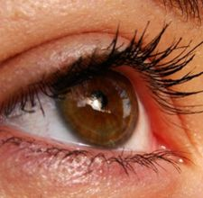

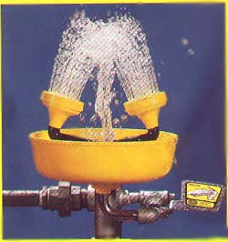
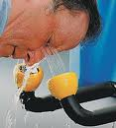
Accidents do happen
So lab staff must be Proactive
Not Reactive
By knowing how to properly maintain emergency equipment!
http://www.tsbrass.com/videos/video.cfm?id=10

Slide 3
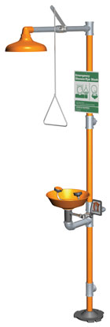
Introduction
All employees must be familiar with the location and use of eye wash even if their job does not involve working directly with toxic or corrosive chemicals.
Why? You may be called upon to aid a fellow employee who has had an exposure.
The distance from the location of the employee and safety device should not exceed 10 seconds walking distance. The path to the eyewash must be unobstructed.

Slide 4
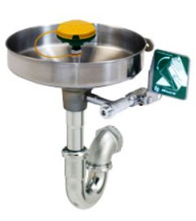
Introduction
The path to the eye wash cannot involve opening a door unless:
  There is always another employee present that can open the door.
  The exposed employee can exit the room without having to manually manipulate a door knob (i.e. push bar).
The location of all eyewashes must be clearly marked with a highly visible sign. The area around the eyewash must be well lit.
The temperature of the water delivered should be between 60º and 95º F.

Slide 5



Regulations
OSHA requires that suitable means for flushing and quick drenching of the eyes and body be available in any area where toxic and/or corrosive materials are in use.
The ANSI (American National Standard Institute) requires that control valves be located so that they can easily be turned on and remain on until manually shut off.
VHA Directive 2009-026 requires emergency eyewash and shower stations where there is a reasonable probability of injury to the eyes or skin resulting from an exposure to hazardous chemicals/materials.

Slide 6
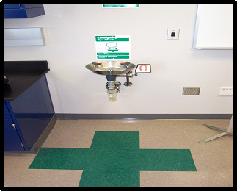
Emergency eyewash station
A device used to irrigate and flush both the face and the eyes.
Must be between 33 to 45 inches from the floor.
Minimum distance of 6 inches from the wall or other obstructions.

Slide 7
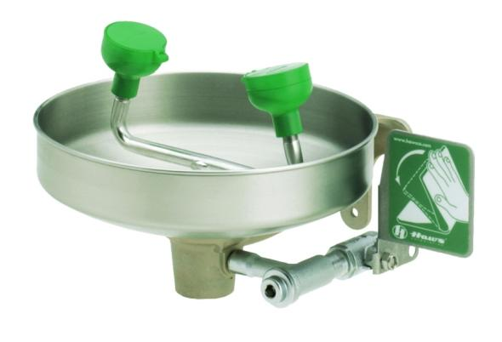
Eyewash Station Requirements
The control valve must also:
  Be designed to ensure flow of water without requiring the user’s hand.
  Go from “off” to “on” within 1 second.
  Remain in the “on” position until manually shut off.
  Resistant to corrosion that may inhibit the operation of the valve.
Control Valve Actuator
Control Valve

Slide 8
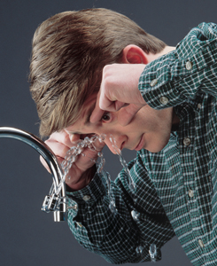
Emergency Eyewash Station
Velocity of the stream of water must be such that injury to the eye is avoided.
Controlled flow must be provided to both eyes simultaneously.
The nozzles must be covered to prevent contamination and covers must automatically open when the unit is activated.
User must have enough room to hold both eyes open while in the stream of water.

Slide 9
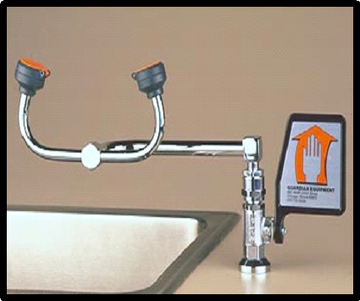
Plumbed eye wash
Counter mounted eyewash unit.
Must be between 33 to 45 inches from the floor.
Minimum distance of 6 inches from the wall or other obstructions.

Slide 10
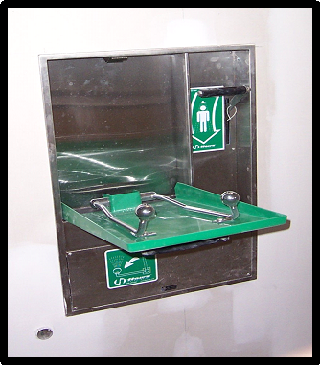
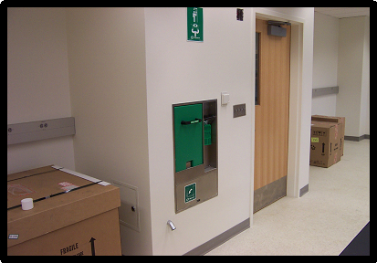
Plumbed Eye Wash
This unit is built into the wall. To activate, the handle is pulled down and valve is activated.

Slide 11
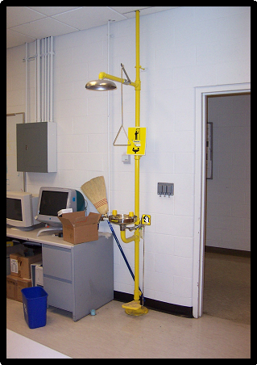
Combination unit
Interconnected assembly of emergency equipment (eye wash and safety shower) supplied by a single source of flushing fluid.

Slide 12
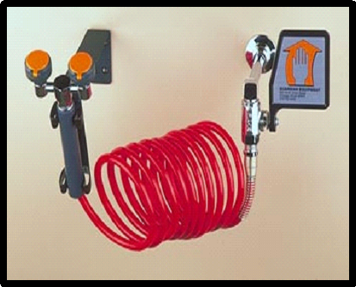
Drench Hose
This unit is a typical drench hose design but has been modified with dual nozzles and other features to meet eyewash standards.
Typical drench hoses are:
  Hand Held and single spray nozzle
  Designed to be a secondary safety device-treatment.
  Does not replace the need for an eye wash.
  Must deliver a minimum of 3 gallons per minute for a minimum of 15 minutes.

Slide 13
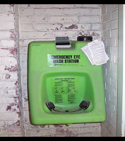
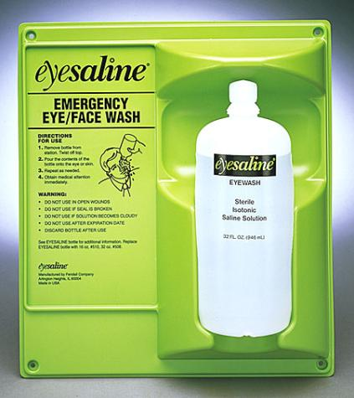
Alternative Emergency EyeWash
This self contained unit is to be used temporarily until a plumed unit can be installed.
This unit must hold enough water to dispense a minimum of 0.4 gallons per minute (gpm) for a minimum of 15 minutes.
Typically contain additives to protect against bacteria, fungus, and algae available.
Manufacturer’s fluid change-out schedules shall be rigidly followed.
Eyewash bottle stations are not authorized for use in areas where plumbed eyewash installations are feasible.
The main purpose of these units is to supply immediate flushing.
The injured person needs to proceed to a plumbed or self-contained eyewash to flush their eyes for the required 15-minute period.

Slide 14
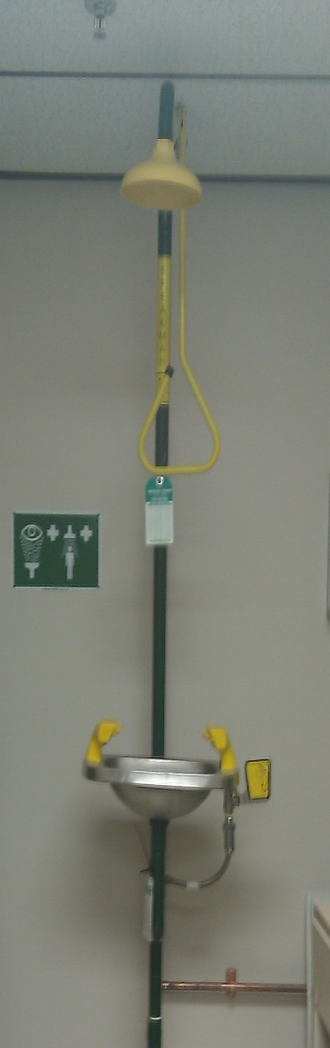
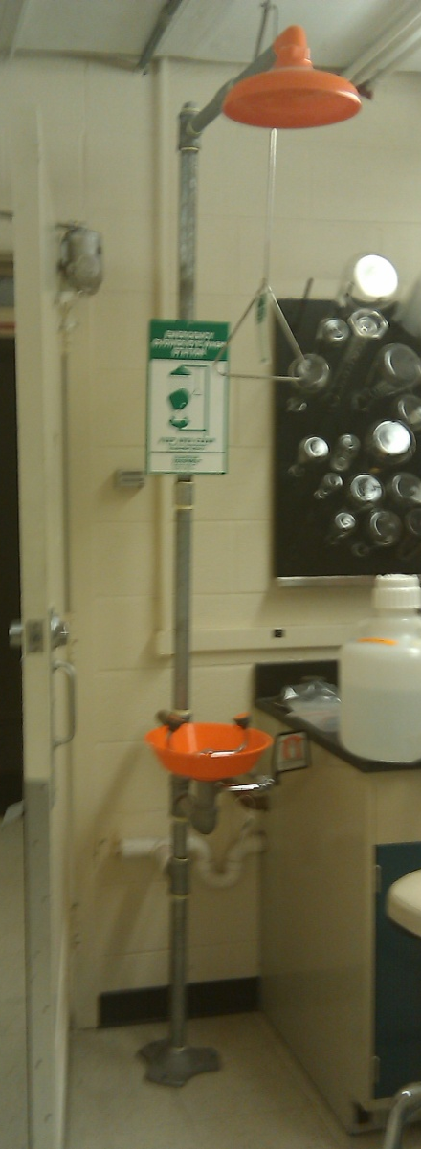
Equipment in Durham VA research labs

Slide 15
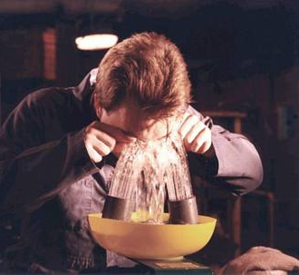
Eyewash Use Procedure
Hold eyelids open using the thumb and index finger to help ensure that effective rinsing has occurred behind the eyelid.
It is normal to close eyes tightly when splashed, but this will prevent water or eye solution from rinsing and washing the chemical out. Eyelids must be held open.
Practice of this procedure is encouraged to help familiarize potential users with the feel of rinsing.
It will also make it easier for the user to react both promptly and properly to an emergency situation.

Slide 16
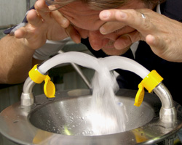
Eyewash Use Procedure
Always wash from the outside edges of the eyes to the inside; this will help to avoid washing the chemicals back into the eyes or into an unaffected eye.
Water or eye solution should NOT be directly aimed onto the eyeball, but aimed at the base of the nose.
Velocity of the stream of water must be such that injury to the eye is avoided.

Slide 17
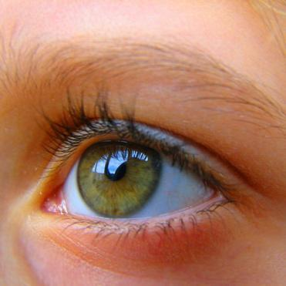
Eyewash Use Procedure
Flush eyes and eyelids with water or eye solution for a minimum of 15 minutes. “Roll” eyes around to ensure full rinsing.
Contact lenses must be removed as soon as possible to ensure that chemicals are not trapped behind the lenses and then the eyes can be completely rinsed of any harmful chemicals.
Medical attention should be sought immediately! Ideally another person should make contact with responders or dial “0”. The sooner medical attention can be given, the chances of not sustaining permanent damage or blindness is greatly improved.

Slide 18
Maintenance Of Eye Wash
Eyewash Stations are required to be activated and visually inspected weekly by lab staff to validate
        The eyewash station is free of obstruction
        The eyewash station is easily activated.
        The flow of water is clear after flushing.
        The nozzles are free from dirt and other contamination
        The nozzles are equipped with protective covers
        The covers are removed by eyewash activation
        The water is flowing an equal height from both eyepieces
        The eyewash is identified by a highly visible sign
        The inspection tag is signed and dated.

Slide 19
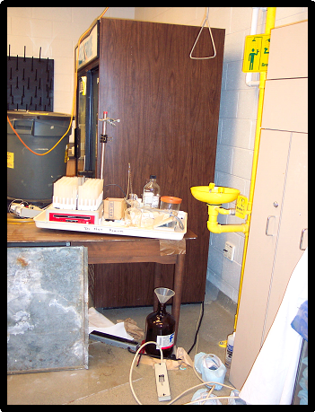
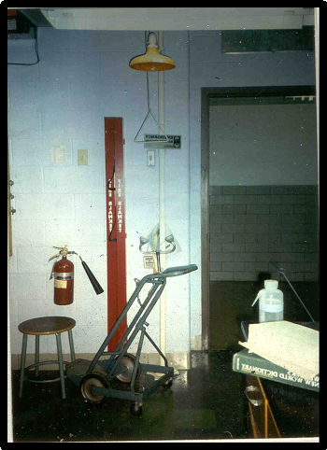
Examples of Violations

Slide 20
Prevention of Accidents
Know the chemicals that you are working with. Read the Safety Data Sheets (SDS) and ask questions.
Know the location of the eye wash and safety shower.
Know how to operate the safety equipment, you may need to use it yourself or assist others.
Always wear required personal protective equipment (PPE).
http://www.first-aid-product.com/training/safety-showers-eye-wash-lab-training.php

