Slide 1
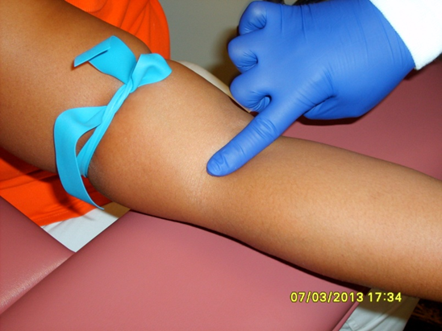
Tourniquet Review
Applied to increase pressure in the veins and aid in site selection
Applied 3 – 4 inches above the intended site
Should be left on for no longer than one minute

Slide 2
Prolonged Tourniquet Application
Causes:
  Stasis
  Localized Acidemia
  Hemoconcentration

Slide 3
Hemoconcentration
Intravascular pressure build up, allows analytes to escape through the capillary walls and into the tissues
This results with a concentration of analytes in the circulatory system
Biochemical changes take place in the trapped blood

Slide 4
Prolonged Tourniquet Application- Effects tests
Potassium
Magnesium
Ionic Calcium
Albumin/Protein
Decrease in pH
WBC and Hemoglobin
Cholesterol and Triglycerides
Coagulation Factors
Iron
Ammonia

Slide 5
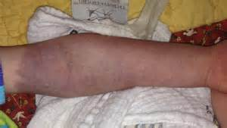
Prolonged Tourniquet Application- Effects patients
Pain/discomfort
Extremity edema
Extremity temperature change
Extremity color change
Numbness/tingling/ burning sensation
Skin tears
Delayed capillary refill

Slide 6

Phlebotomy
I, ___________________, commit to reducing the risk of leaving a tourniquet on a patient by: (circle all the processed that you will use)
Loosening tourniquets during any interruption in the blood draw process and before the needle is withdrawn.
Double-check that a tourniquet has been removed prior to leaving a patient’s room.
Rolling up gown sleeves (rather than pushing sleeves up) to enhance tourniquet visibility.
Placing the tourniquet over a sleeve to enhance visibility and patient comfort.
Reconciling the number of tourniquets taken into the unit with the number bringing out. Difference is the number of patients drawn.
I suggest ___________________________________________ ___________________________________________________
Return to Lab Education Coordinator for credit. This will be included with your competency documents in the personnel files.

