Slide 1
Regulated Medical Waste Management
Environmental Health Section
Blanchfield Army Community Hospital
Fort Campbell, KY 42223

Slide 2
Purpose
Employ Regulated Medical Waste (RMW) procedures in a hospital environment IAW Army (TG 177 & MEDCOM Regulation 40-35), Federal, State, and Local Regulations.

Slide 3
Objectives
State the definition of RMW according to MEDCOM Regulation 40-35.
Given a list of categories of RMW, identify the categories of RMW identified by MEDCOM Regulation 40-35.
Safely handle, segregate, and dispose RMW IAW regulatory requirements.
Respond appropriately to RMW spills IAW MEDDAC Regulation 40-5-11-7

Slide 4
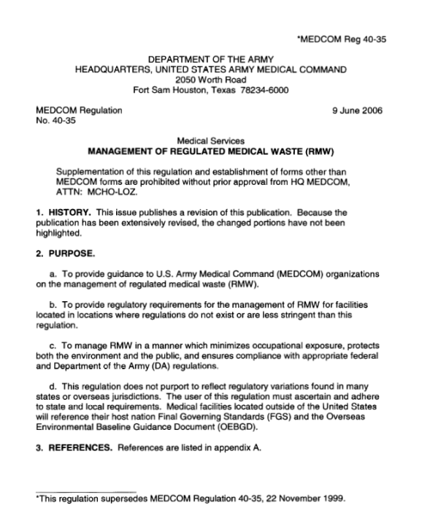
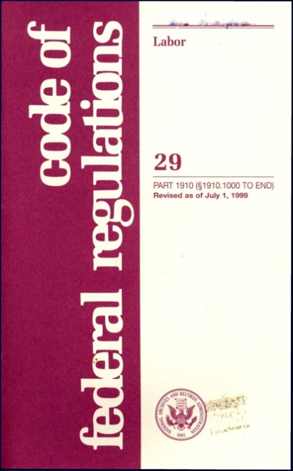
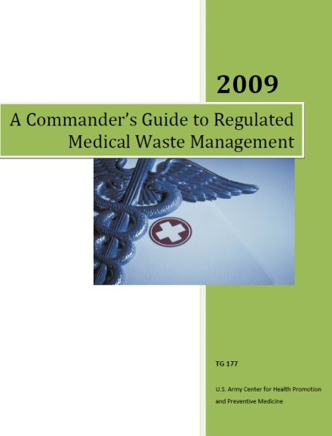
References
29 CFR 1910.1030
Bloodborne Pathogen Standard
MEDCOM Reg 40-35
Management of RMW
MEDDAC Reg 40-5-11-7
RMW Management
USACHPPM TG-177
RMW Management

Slide 5
Waste Streams in the Hospital
Regular Waste
Regulated Medical Waste
Cytotoxic Drug Trace Waste
Hazardous Waste
Universal Waste
Pharmaceutical Waste

Slide 6
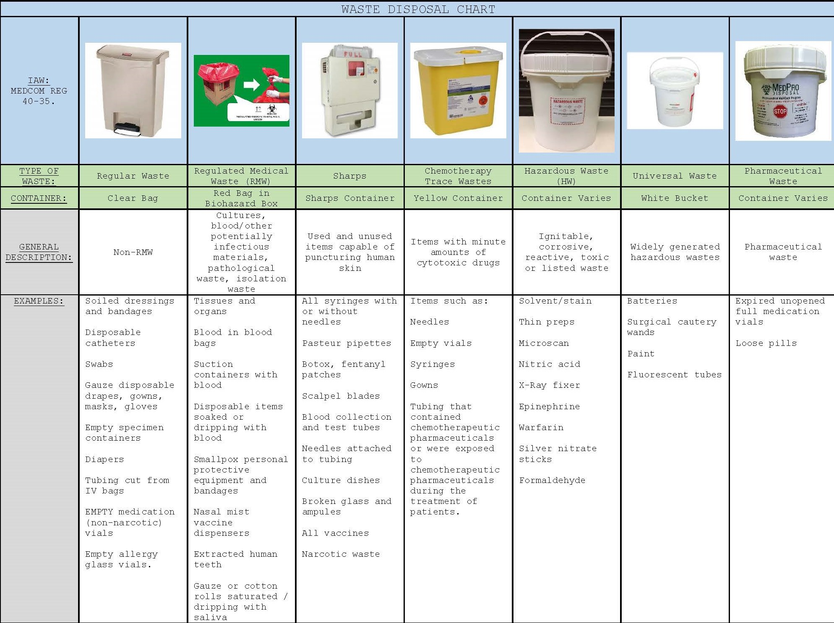

Slide 7
Definition of RMW
Waste generated in the diagnosis, treatment or immunization of human beings or animals which is capable of causing disease or which, if not handled properly, poses a risk to individuals or community.
These wastes are also called “Infectious Waste”, Bio-hazardous Waste”, “Clinical Waste”, “Biomedical Waste”, or simply, “Medical Waste” and consists of seven categories.
REF: MEDCOM Regulation 40-35

Slide 8
Definition of RMW
Though there is no universally accepted definition of RMW, the definitions by the regulatory agencies of EPA, CDC, WHO & OSHA are similar:
The regulatory agencies agree that: “regulated medical waste” includes those wastes with the potential for causing infection and for which special precautions are prudent. Some state and local regulations use similar, general definition – others list specific categories of waste that are considered infectious.
Notes:
MWTA includes:
- blood-soaked bandages
- culture dishes and other glassware
- discarded surgical gloves
- discarded surgical instruments
- discarded needles used to give shots or draw blood (e.g., medical sharps)
- cultures, stocks, swabs used to inoculate cultures
- removed body organs (e.g., tonsils, appendices, limbs)
- discarded lancets

Slide 9
Check for Understanding
Regulated Medical Waste (RMW) is also called all of the following except:
Infectious Waste
Hazardous Waste
Medical Waste
Sharp Waste
Biohazardous Waste

Slide 10
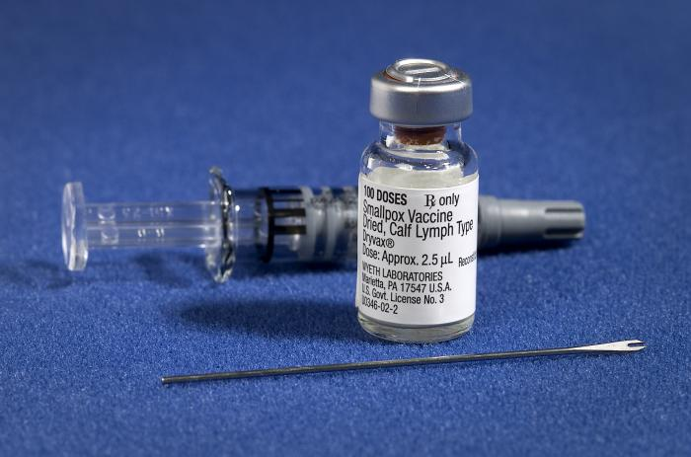
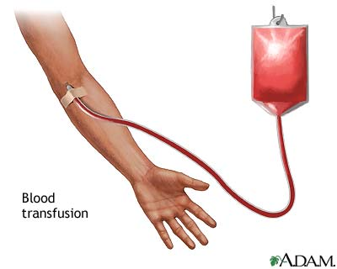
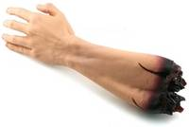
RMW - Identification
Group 1 – Cultures, Stocks and Vaccines
Group 2 – Pathological Waste, i.e. – tissues, organs, body parts, etc.
Group 3 – Blood and Blood Products
Notes:
Category 1 - Cultures and Stocks. Separate microbiologic waste (cultures and stocks of etiologic agents) from general waste for disinfection/sterilization. Liquid Class 1 RMW (e.g., liquid culture media) may be either steam sterilized and disposed of in the sanitary sewer system or kept in its original glass container and placed in the sharps container for treatment and disposal without using the sanitary sewer system.
Category 1 - Vaccines. Deposit full, partially full, or empty vials of vaccine in sharps containers. Carpules from dental procedures may also be placed in sharps containers.
Category 2 - Pathological Waste. Dispose of pathological waste inside an RMW container lined with a plastic bag or double bagged in RMW bags.
NOTE: Extracted teeth with amalgam will be cleaned, disinfected, and collected in a container marked “Tooth Amalgam Satellite Accumulation Storage”, separate from other amalgam scrap. These containers will be shipped to USAPHC for mercury analysis IAW US Army DENCOM Policy 6-8, Anesthetic Carpule and Other Regulated Medical Waste Disposal.
Category 3 - Blood and Blood Products. Dispose of breakable containers of bulk blood or blood products in rigid, puncture-resistant, leakproof containers. Use plastic RMW bags to dispose of bulk blood or blood products, such as blood bags and blood filter tubing, and items saturated, dripping, or caked with blood. Remove needles from the tubing (avoiding unsafe manipulation) and place in a sharps container for disposal.
NOTE: Products used for personal hygiene (for example, diapers, facial tissues, and feminine hygiene products/sanitary napkins/tampons) that are saturated or dripping with blood are not subject to the requirements of this regulation. Trash receptacles located in public places which contain these products are also not regulated. Personnel need to use judgment in deciding when and where these items, from patients, need to be managed as RMW.

Slide 11
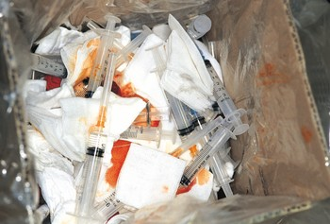
RMW - Identification
Groups 4 & 7 – Sharps & Syringes
Group 5 – Animal Waste
Group 6 – Isolation Wastes, including bedding, from patients or animals with Bio-Safety Level 4 agents which may include:
Notes:
Category 4 and 7 - Sharps. Discard all sharps directly into a rigid puncture resistant, plastic sharps container immediately after use. Discard disposable needles and syringes intact, and do not cut, break, bend by hand, or recap using a two-hand method. To prevent unauthorized removal of its contents, The U.S. Army Medical Command requires MTFs to manage sharps containers by either locking the container to a mounting device that is securely fastened to the building structure, or locating the container in an area that is under continuous visual supervision of ward or clinic personnel (ref 10). The requirement is found in paragraph 4-20, AR 190-51. Locate sharps containers as close as practical to the use area. The size (volume) of the sharps container will be determined by the activity serviced by that container and must meet the requirements of paragraph 9b(3)(e) of MEDCOM Reg 40-35. Remove and seal the sharps container when it either is 3/4 full or is filled to the line indicated by the manufacturer. Sharps containers mounted on the wall will be positioned at a height to
reflect safe use and safety standards for patients and visitors.
Category 5 - Animal Waste. Contaminated animal carcasses, body parts, and bedding of animals that are known to have been exposed to infectious agents during research (including those produced in veterinary facilities), production of biologicals, or testing of pharmaceuticals must be incinerated.
Category 6 - Isolation Waste. Isolation wastes including bedding, from patients or animals with Biosafety Level 4 agents. Examples include biological waste and discarded materials contaminated with blood, excretion exudates, or secretions from humans who are isolated to protect others from highly communicable diseases, or isolated animals known to be infected with highly communicable diseases caused by Biosafety Level 4 agents as shown in classification of Etiologic Agents on the Basis of Hazard (1974) and Biosafety in Microbiological and Biomedical Laboratories (1999). This category includes pox viruses and arboviruses (shown in appendix A).

Slide 12
RMW - Identification
The CDC classifies the following etiologic agents as Biosafety Level 4 agents
Abrin Botulinum neurotoxins* Botulinum neurotoxin producing species of Clostridium*
Conotoxins (Short, paralytic alpha conotoxins containing the following amino acid sequence X₁CCX₂PACGX₃X₄X₅X₆CX₇)¹
Coxiella burnetii Crimean-Congo haemorrhagic fever virus Diacetoxyscirpenol Eastern Equine Encephalitis virus³ Ebola virus* Francisella tularensis* Lassa fever virus Lujo virus Marburg virus* Monkeypox virus³ Reconstructed replication competent forms of the 1918 pandemic influenza virus containing any portion of the coding regions of all eight gene segments (Reconstructed 1918 Influenza virus)
Ricin Rickettsia prowazekii SARS-associated coronavirus (SARS-CoV) Saxitoxin South American Haemorrhagic Fever viruses: Chapare Guanarito Junin Machupo Sabia
Staphylococcal enterotoxins A,B,C,D,E subtypes T-2 toxin Tetrodotoxin Tick-borne encephalitis complex (flavi) viruses: Far Eastern subtype Siberian subtype
Kyasanur Forest disease virus Omsk hemorrhagic fever virus Variola major virus (Smallpox virus)* Variola minor virus (Alastrim)* Yersinia pestis*
REF: Federal Select Agent Program http://www.seletagents.gov/selectagentsandtoxinslist.html
Notes:
The following biological agents and toxins have been determined to have the potential to pose a severe threat to both human and animal health, to plant health, or to animal and plant products. An attenuated strain of a select agent or an inactive form of a select toxin may be excluded from the requirements of the Select Agent Regulations.
Go to the following site to obtain the complete list and overlap between organizations/regulations.
http://www.seletagents.gov/selectagentsandtoxinslist.html

Slide 13
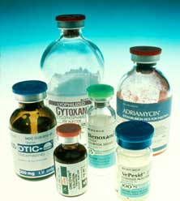
RMW - Identification
Group 8 – Other. Consult the Infection Control Officer (ICO) for specific instructions on handling RMW fluids.
Group 9 – Chemotherapy wastes, i.e., needles, empty vials and syringes, gowns, tubing containing chemotherapeutic pharmaceuticals
Notes:
Group 8- Other. This includes fluids that are designated by the local Infection Control Authority. This may include, but not limited to semen, vaginal secretions, cerebrospinal fluid, synovial fluid, pleural fluid, pericardial fluid, peritoneal fluid, and amniotic fluid. These designated fluids are considered RMW when free flowing, dripping, or saturated on substrates. This does not apply to feces, nasal secretions, sputum, sweat, tears, urine, or vomitus unless they contain visible blood, are from a patient suffering from a Biosafety Level 4 agent, highly resistant microbes, or are from a patient who has received cytotoxic medications within 48 hours.
Group 9 - Chemotherapy Trace Wastes. Items such as needles, empty vials and syringes, gowns and tubing that contained chemotherapeutic pharmaceuticals or were exposed to chemotherapeutic pharmaceuticals during the treatment of patients.
(9) Exclusions. The following are excluded from the definition of RMW. For categories (a)-(c), reference MEDDAC Regulation 40-5-11-6, Hazardous Material and Hazardous Waste Management Program:
(a) Waste which is managed pursuant to hazardous waste regulations.
(b) Waste which is managed pursuant to radioactive material regulations.
(c) Mixed wastes containing regulated quantities of (9)(a) and/or (9)(b) above.
(d) Etiologic agents or specimens being transported to a laboratory for purposes other than disposal (e.g., analysis).

Slide 14
Check for Understanding
In what category group does the following RMW fall into?
1. Sharps & Syringes?
Group 4 & 7.
2. Pathological Waste?
Group 2.
3. Blood & Blood Products?
Group 3.

Slide 15
Sharps Safety Standard
In 2001, in response to the Needlestick Safety and Prevention Act, OSHA revised the Bloodborne Pathogens Standard which:
Requires the use of engineering and work practice controls to eliminate or minimize employee exposure to bloodborne pathogens.
Employers must keep a sharps injury log for the recording of percutaneous injuries from contaminated sharps.
Clarifies the Exposure Control Plan.
Hepatitis B vaccine declination (Mandatory).
REF: OSHA Bloodborne Pathogen and Needlestick Prevention
http://www.osha.gov/SLTC/bloodbornepathogens/standards.html

Slide 16
RMW – Red Bag Waste
Authorized
Not Authorized
Items dripping, saturated, or caked with blood
Items with flowable blood (iv bags, etc)
Pathological waste
Cultures/stocks of infectious agents
Isolation waste from biosafety level 4 agents
Body fluids other than feces, nasal secretions, sputum, sweat, tears, urine, or vomitus unless they contain visible blood
Bottles and cans
Iv bags and tubing if no blood or needles
Regular plastics
Aluminum foil
Computer paper
Packaging material
Empty urine containers
Empty bed pans
Lightly-tinged gauze
Face masks
Notes:
Talk about your personal experience of what you have seen in red bags that does not belong there.
Other items that are NOT RMW:
- Gloves. Gloves are only RMW if they meet the sufficient quantity definition for OPIM or blood.
- I.V. tubing and empty I.V. bags. Only RMW if same as above for gloves.
(the needle from an I.V. bag should go in the sharps container)
- Urine specimen cups.
- Medical records

Slide 17
RMW – Sharps Container
Authorized
Not Authorized
Hypodermic needles
Syringes (with or without needle)
Scalpel blades
Blood collection tubes
Computer paper or packing material
Tongue depressors
Gauze pads
Disposable scissors
Plastic medicine droppers
Surgical gloves
Band-Aids
Medicine / pills

Slide 18
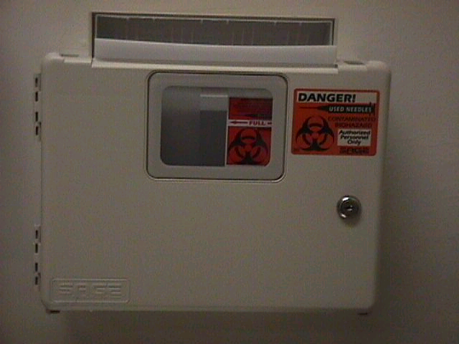
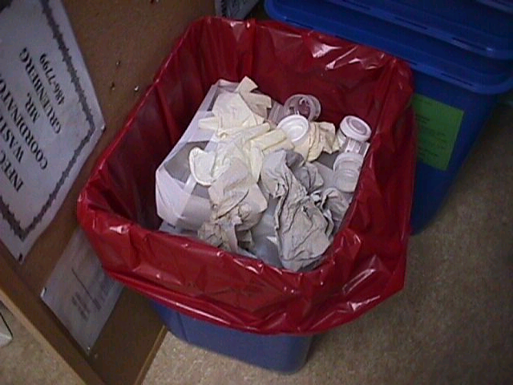
Regulated Medical Waste Segregation
Sharps Container
RMW – Red Bag Waste
Discontinue using sharps container and / or red bag when ¾ full.
Close red bag by securing the top with tape, twist ties, or rubber bands. DO NOT USE A KNOT TO CLOSE IT!!
Discontinue using sharps container by: (1) snapping the lid tight, (2) taping the lid to the containers and (3) labeling the container.

Slide 19
Check for Understanding
Can regular trash be placed into RMW labeled containers?
NO!!!

Slide 20
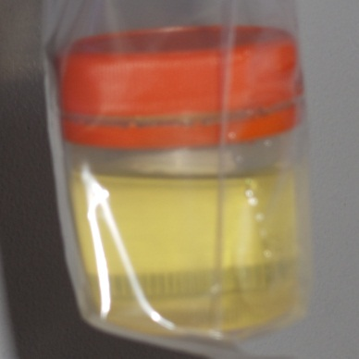
Check for Understanding
Does it belong?
Urine Yes or No
Pipet Yes or No

Slide 21
RMW - Labeling
Labels should display this universal biohazard symbol.

Slide 22
RMW - Packaging
RMW will be segregated from general waste at the point of origin.
Securely bagged to provide a barrier between waste and worker.
Bags will be tear resistant, 3 mils in thickness, and RED in color.
Puncture resistant sharps containers will be red in color and sealed when ¾ full.
Snap the lid shut.
Sharps containers must be sealed w/tape.
Marked with date closed and clinic name.

Slide 23
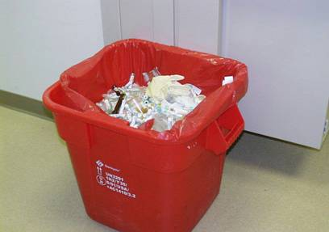
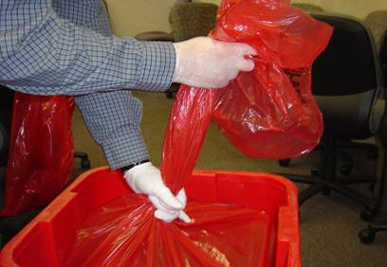
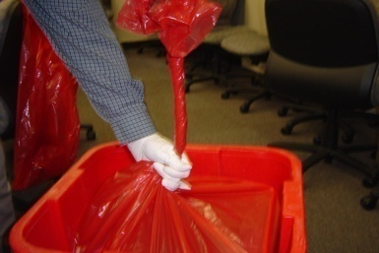
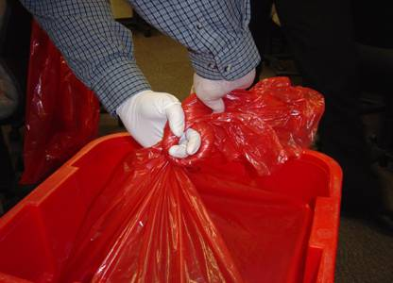
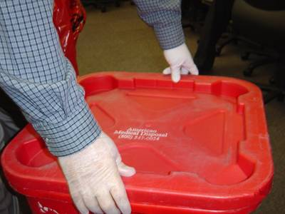
RMW - Packaging
Seal the bag using a tie knot – “bunny ear ties” do not meet the requirements
Lift bag by TOP only
Do not shake or compact
Do not drop or throw
Gloves will be worn when handling RMW
1
2
3
4
5
6

Slide 24
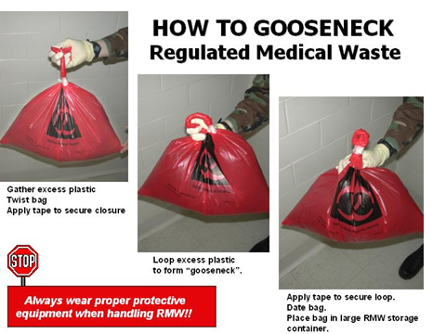
RMW - Packaging

Slide 25
RMW - Storage
Minimize storage time.
Store in cool location, such as Soiled Utility Room, with labeled door “Regulated Medical Waste”.
Area where RMW/Sharps are stored must be secure (locked or under direct supervision).
RMW and/or Sharps are picked up by Environmental Services Branch from the clinic to be stored in the central storage area prior to pickup by the RMW contractor.

Slide 26
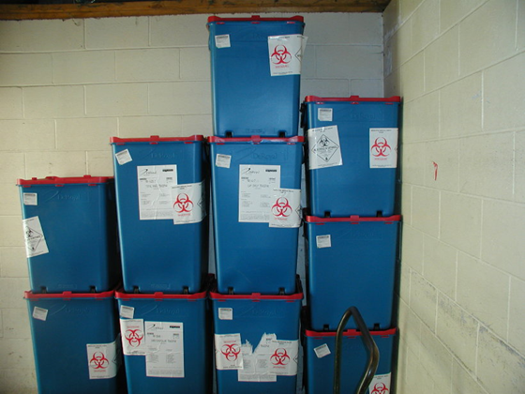
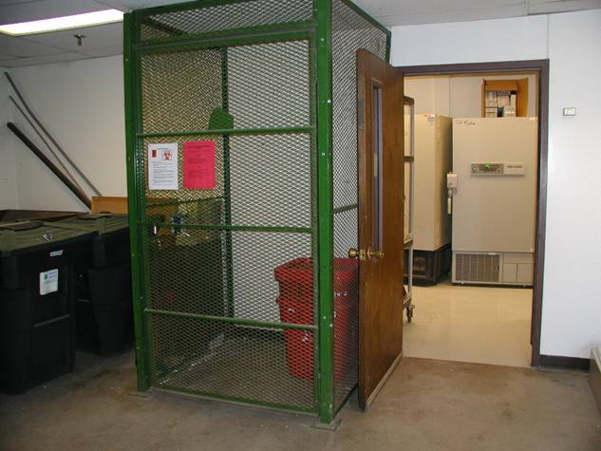
Appropriately Segregated RMW?

Slide 27
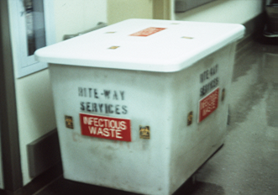
Transportation of RMW
Housekeeping will pick up RMW bags and sharps containers.
RMW carts must ONLY be used for RMW and cleaned daily (readily cleanable material, stainless steel or plastic).
A log should be kept to monitor/track any fluctuations in RMW volumes

Slide 28
Transportation of RMW
On-Post/Off-Post
Vehicles will be marked, be leak/spill proof and disinfected weekly
Spill containment/Clean-up kit
Segregation of wastes
Limited access
Manifest required for off-
post transport (no POVs),
must meet DoD & DOT
regulations

Slide 29
Treatment and disposal of RMW
Treatment:
Steam sterilization
Chemical sterilization
Microwave disinfection
Autoclaving/Encapsulation
Incineration
Disposal:
Landfill after treatment
Sanitary sewer
Treatment & Disposal:
Contract removal
Notes:
These are various treatments and disposal methods of RMW.
Sanitary Sewer: Certain medical wastes can be legally discharged to sewers. These wastes include blood and blood products, ground-up solid infectious wastes (e.g., body parts and organs), and other liquid and or semi-liquid infectious wastes. Hospitals will usually use a sink with a grinder that is similar to a in-home garbage disposal

Slide 30
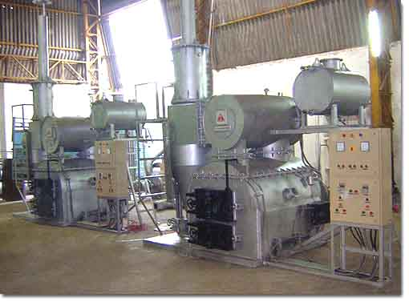
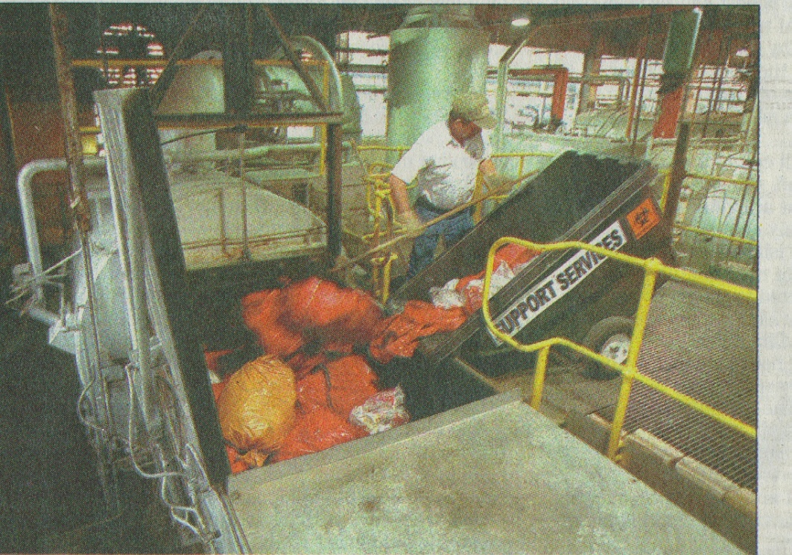
RMW Incineration
EPA FACT: Currently, more than 90 percent of potentially infectious medical waste is
Incinerated
http://www.epa.gov/osw/nonhaz/industrial/medical/mwfaqs.htm#5
EPA State Medical Waste Regulations: http://www.epa.gov/osw/nonhaz/industrial/medical/programs.htm

Slide 31
Spill Response & Notification
Spill Response
PPE (gloves worn at a minimum, consider eyewear, mask, and protective clothing if exposure poses a risk).
notify supervisor and secure the area.
IMMEDIATELY clean small spills.
Clean spills with detergent-disinfectant.
Use absorbent material, if needed, and treat it as RMW.
Consult MEDDAC Reg 40-5-11-7 for further guidance.

Slide 32
Spill Response & Notification
Notification Points of Contact (for BACH)
Duty Hours
Supervisor
Safety Officer, 798-8022
Environmental Health Section (EHS), 412-3990
Non-Duty Hours
Supervisor
AOD, 798-8388
Safety & EHS the next duty day

