Slide 1
Safety Training
HAZARD COMMUNICATION (HazCom) PROGRAM
FM Safety
Dial x6245

Slide 2
OBJECTIVES
This training has been developed to meet Occupational Safety and Health Commission (OSHA), Joint Commission (JC), Department of Veterans Affairs (VA), Veteran Health Administration (VHA) and St. Cloud VA Health Care System (SC VAHCS) Hazard Communication (HazCom) Employee Training Requirements. After this training is completed, the learner will:
Know the physical, health, simple asphyxiation, combustible dust & pyrophoric gas hazards as well as other hazards associated with chemicals used in the work area
Be aware of measures the SC VAHCS takes and employees must take to protect themselves from the above hazards. For instance, engineering controls (ventilation), administrative controls (procedures & training), and personal protective equipment required to be worn when using chemicals.
Know how to access a Safety Data Sheet (SDS), the information contained in a SDS & how to use the information within a SDS.
Know primary and secondary container labeling requirements and how to print a label

Slide 3
Chemical Hazards in Work Areas – How To Find
Go to the SC VAHCS SharePoint home page to finds GEMS under Employee Resources, (GEMS is the acronym for Green Environmental Management System)
Within the GEMS SharePoint page under documents find and click on “Safety Data Sheet and Hazard Communication Information” to find and open a spreadsheet titled “Chemicals and Hazards in Work Areas”
Notes:
There is a spreadsheet located in the GEMS SharePoint site that contains the chemical hazards of chemical products used at the facility. This spreadsheet can be sorted by location, i.e., Business Office (HAS). The spreadsheet is downloaded from the chemical inventory online program twice per year in January and July.
Employees need to be shown this information and know how to access it.

Slide 4
Sort the Spreadsheet by Location to Find your work area
What important to know? For example, the Power Duster in the Director’s Office is a flammable asphyxiant and should be kept away from heat.

Slide 5
Protective Measures For SC VAHCS Employees
Adequate Ventilation
Monitored by FM
Personal Protective Equipment
Gloves, gowns, respirator, goggles, face shields
Administrative Controls
Safety and Environmental Review prior to chemical purchase
Chemical Inventory Maintenance
Training
Notes:
Workplace hazard assessments are to be conducted annually by job title
Service Line Directors are responsible for conducting and documenting hazard assessments
Supervisors are responsible for conducting and documenting employee training per the hazard assessment
Reference: Red Book, Section 1, Chapter 7
Several facility policies require Safety/GEMS approval of chemical prior to purchase
The safety data sheet must be routed to Safety/GEMS for approval
Safety/GEMS is located in FM Building 3, dial x6245
A chemical inventory of all hazardous chemicals onsite is maintained and can be accessed 24/7/365 via the online chemical inventory service

Slide 6
What is the SC VAHCS HazCom Training Requirement?
All employees will be provided with information and training on hazardous chemicals/materials in their work area at the time of their initial assignment and before a new hazard is introduced into their work area

Slide 7
what can you learn from a Safety Data Sheet (SDS)?
The SDS contains important product safety information
Click the video reel to learn the top 10 things an SDS will tell you!
Can you name two things in the Top Ten that’s important to you?

Slide 8
Where are your Safety Data Sheets?
SDSs are kept in SDS books in works areas along with a list of the SDSs in the book that contains the date the list was last verified
SDSs are also kept in online inventory service accessible by all employees with computer access
Both the paper copies and the online inventory must be reviewed and reconciled quarterly with the chemical products in use in work area
Do you know where the SDS book for your work area is located? Be prepared for surveyors to ask that question.

Slide 9
SDS online Access? Click the Book on the SC VAHCS Home page

Slide 10
Click Search on this page
Notes:
IClick ‘SDS Search’ button in the middle of the page.

Slide 11
Click My Locations - Click + to expand To your Location
Notes:
Select location (click + to expand). To VISNs, then to St. Cloud, then to your SL/program area
Enter search criteria to find a product or click show all to show all available products.
If the SDS is not in the System, contact Safety to have the SDS added to the system
Sometime multiple SDS’s will appear in the search, for example, a search for Sani-Wipes will result in several different wipes to choose from.
Product searches are not case-sensitive; however, using dashes, commas, parentheses, or spaces may change your search results. Trying different search combinations is recommended.
If you have the product in hand, it is helpful to search for the product name as it is written on the label. Alternatively, it may be helpful to start with a single field of data, such as a manufacturer name, product name, or manufacturer part number, and browse the search results for the correct product. Search results are organized alphabetically to assist you in finding the correct SDS.
Contact Safety to update the SDS inventory

Slide 12
Enter search Criteria Then Click Search

Slide 13
Click Action Drop Down Box to View SDS & Attachments

Slide 14
You can View, Print or Share

Slide 15
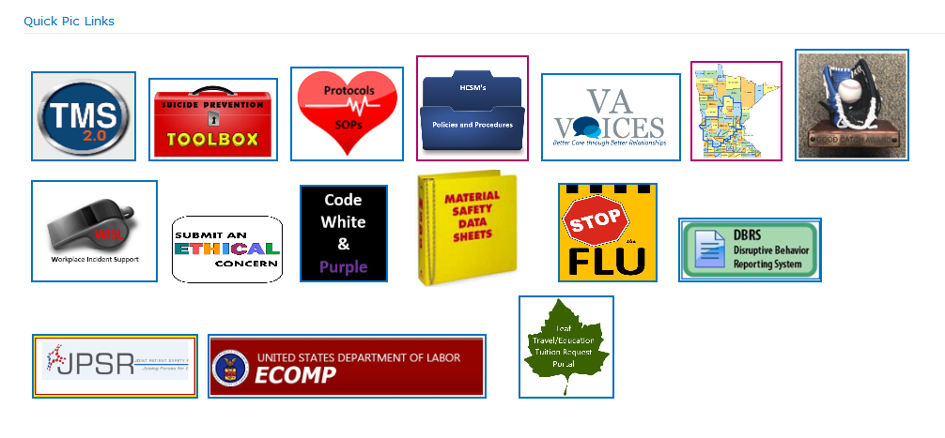
SDS Online access Review
Click the SDS book SharePoint Quick Pic Link
Click “SDS Search” button in the middle of the page
First click on “My Locations”, then click on “VISN 23”, then click on “St. Cloud”, then click on your SL/program area
Enter “Search for” criteria and click on show to see the product or show all to see all products in the inventory
Click the action drop down box next to the product name and select view SDS & attachments
Click “View” or “ Email”
Print and Post for Quick Reference!

Slide 16
Product LABELs Are another way to identify product Hazards
Product Identifier
Signal Word
Pictogram
Hazard Statement(s)
Precautionary Statement(s)
Name, Address, and Telephone Number of Supplier or Manufacturer

Slide 17
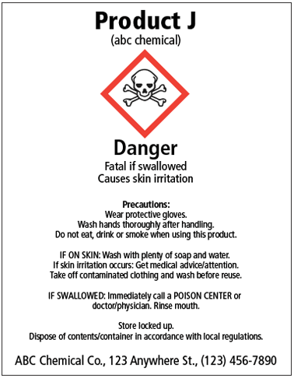
Labels Must contain:

Slide 18
Pictograms on labels help You identify the Hazards

Slide 19
Label ExampleS

Slide 20
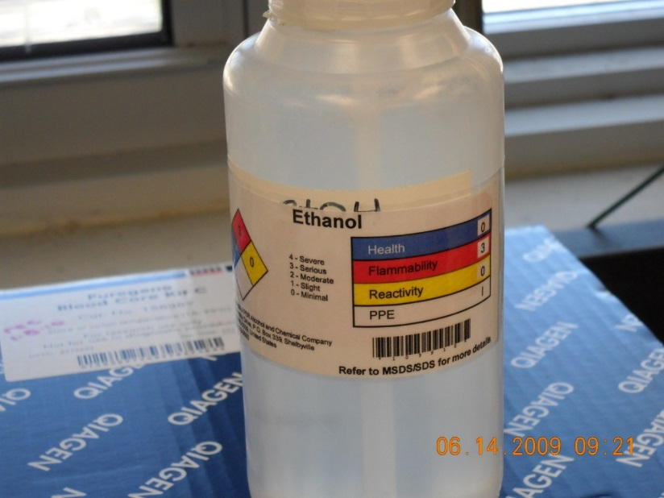
Secondary Container labeling
If a product is put in a secondary container and not used immediately a label must be placed on that container
Immediate use means that the hazardous chemical will be under the control of and used only by the person who transfers it from a labeled container and only within the work shift in which it is transferred

Slide 21
This is not an OK Label

Slide 22
The online SDS System has a Label Printing Feature
You can print a label or ask Safety (x6245) for help printing a label
Notes:
The drop down box used to view, fax or Email an SDS also features a label maker. You can print a label or ask Safety for assistance to print a label.

Slide 23
SC VAHCS Hazard Communication Policy
Safety, Occupational Health and Fire Protection Program (Red Book), Section V, Chapter 2, Hazard Communication Program

Slide 24
Record annual Training
A record of training that includes the date of training, the employee’s printed name and signature can be recorded in TMS
Send training records to Education (Karen Hohmann)
The training course name is STC Hazard Communication Program
The training course ID is 4500111

Slide 25
QUESTIONS?
Call Safety at x6245

