Slide 1

Federal
Employee Drug Testing

Slide 2
  As a collector you must maintain the specimen’s security and integrity during and after collection.
  You must maintain proper conduct.
  Be polite
  Protect privacy of the donor
  To the point
  Collect specimens as you would want your specimen collected.
  Answer any reasonable and appropriate questions donor may have
  Have a refresher retraining every 5 years

Slide 3

Drugs Tested in the
Federal Employee Drug Screen Program…
Marijuana (THC)
Cocaine
PCP
Opiates
Amphetamines

Slide 4
Reasons for Random Drug Screens at the VA
Applicant (pre-employment) testing
Random testing monthly of sensitive employees in testing designated positions.
Reasonable suspicion testing
Injury, illness, unsafe or unhealthful practice testing
Voluntary testing
Testing as a part or as a follow-up to counseling or rehabilitation.

Slide 5

Collectors
Qualification Training:
  All steps to complete Custody and Control Form (CCF)
  Collection procedure
  Direct observation procedure
  Monitored collections
  “Problem” collections (Shy Bladder)
  Fatal Flaws, Recoverable Flaws and Omission of information
  5 mock urine drug collections
  TMS 20497 training

Slide 6
Collector Requirements
Gender Requirements
  Normal and Monitored collections: It is permissible to collect for the opposite gender identity.
  Observed collections- monitor (person entering the restroom with the donor) must be same gender identity
Who may not serve as a collector
  The donor
  Employee of the testing Laboratory (Minneapolis) who can link the donor with the specimen drug results
  Co-worker from the same testing Laboratory
  Friend or relative of donor
  Immediate supervisor unless there is no feasible alternate trained collector
Notes:
Directly Observed Requirements: No Exceptions. Never. Nada. Zilch
Monitored: May cross gender if monitor is a medical professional in the jurisdiction they are collecting (Doctor, Nurse, Physician Assistant)

Slide 7
Gender identity
Gender identity means a person’s internal sense of being male or female, which may differ from that person’s sex assigned at birth.
For direct observed collection, the observer/monitor must match the donor’s gender identity (not gender).
IMPORTANT: The collector asks the donor to write the donor’s gender identity on the Federal CCF in the REMARKS area and initial it. The donor will then be provided an observer whose gender identity matches the donor’s gender identity. The collector documents the observer’s name and gender identity on the Federal CCF in the REMARKS area and have them initial it.

Slide 8
Collection Sites
Where can a urine collection take place?
  Private
  Secure
  Ability to turn off water supply or secure water supply
  Removable soap/ towelettes
  Removable trash/disposal receptacles
  Work area – Materials needed
  Secure area for storage of donor items
  Note: If unable to turn off water supply or secure water supply must do a monitored collection.

Slide 9
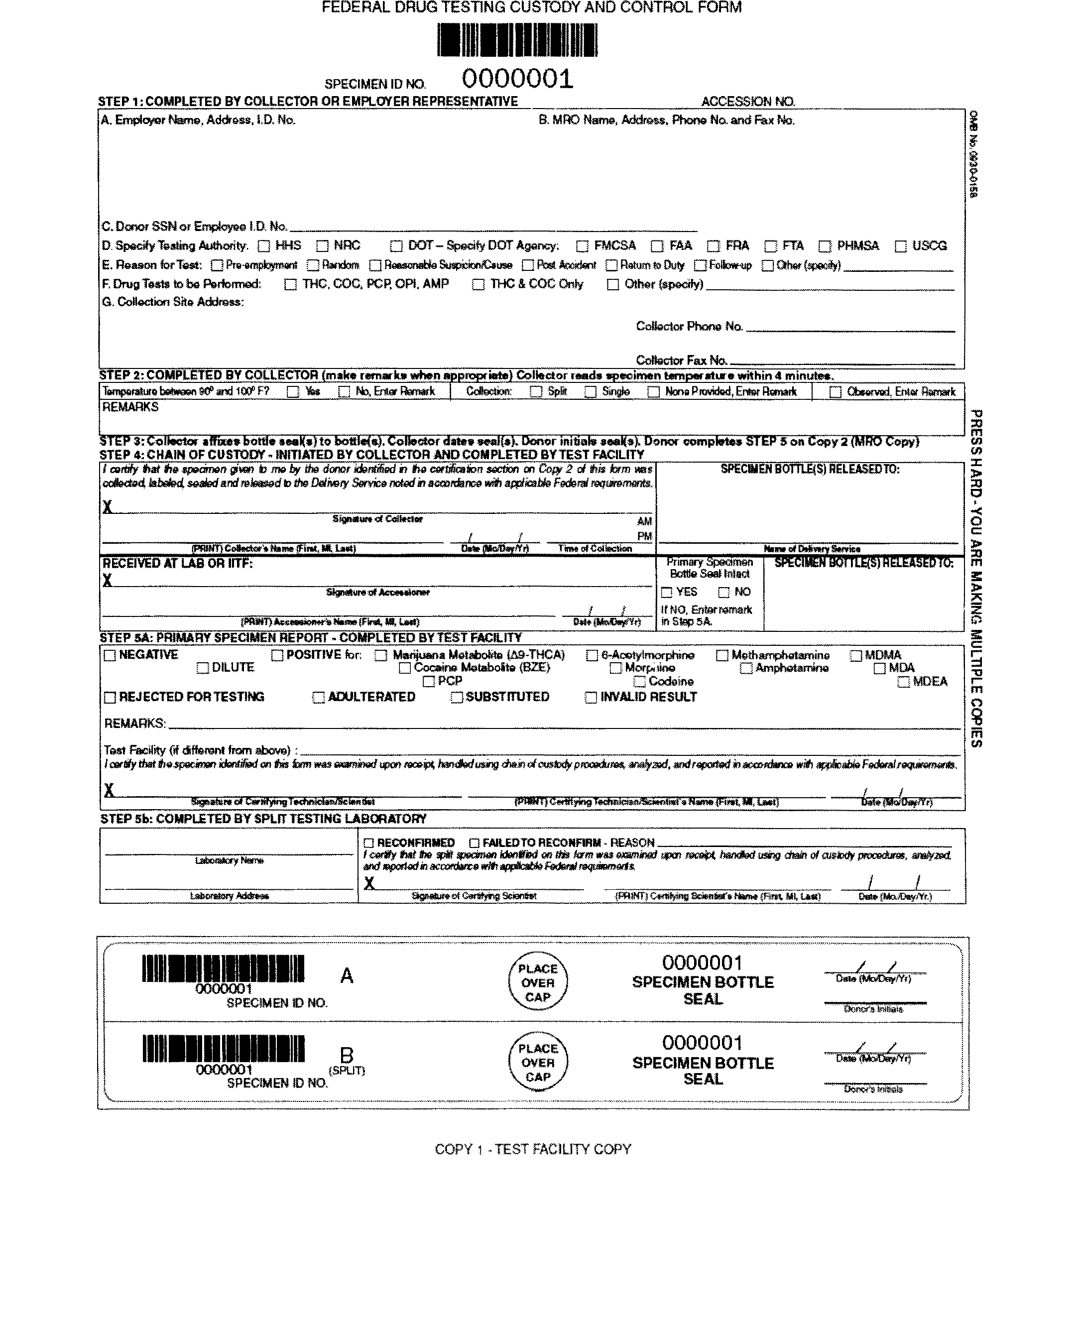
Steps for filling out the
Custody and Control Form
(CCF)

Slide 10
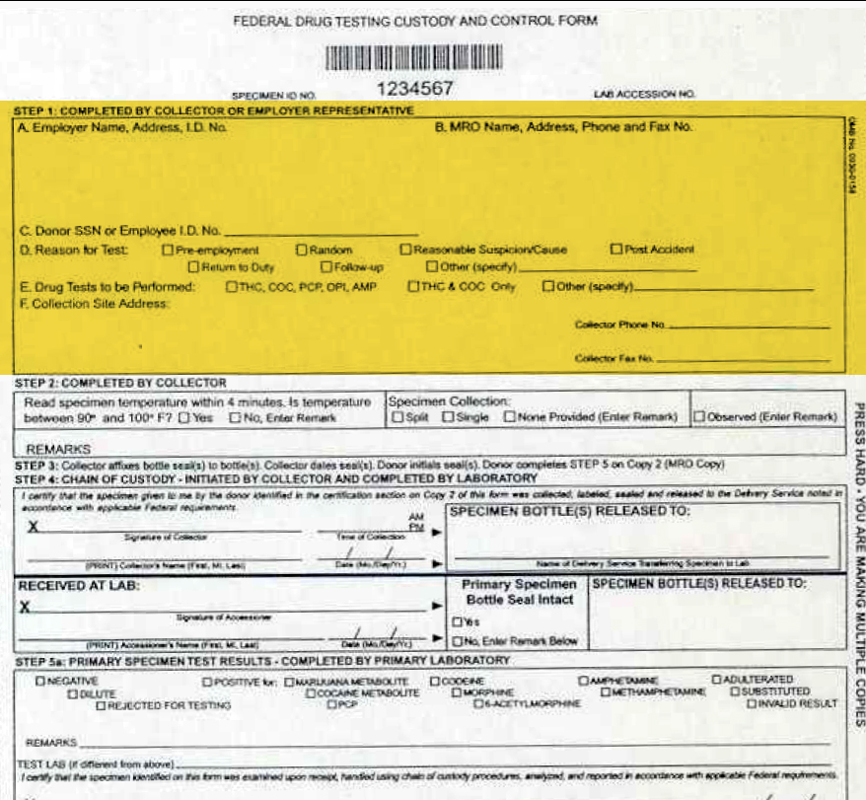
Federal CCF: Step 1
A. Employer Name and Address
B. MRO Name, address, phone and secure fax number
C. donor’s social security number
D. Specify Testing Authority
(HHS)
E. Reason for Test
F. Drug Test to be performed (always check the box with the 5 drugs)
G. Collection Site Address

Slide 11
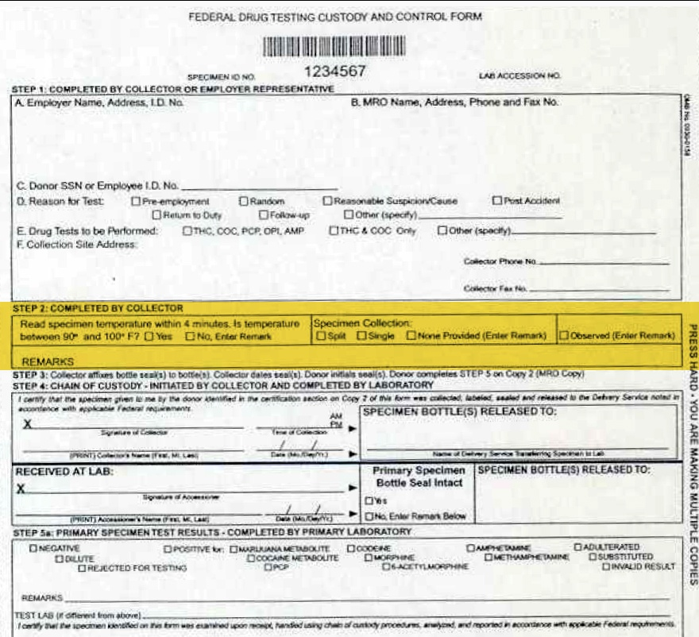
Federal CCF: Step 2
Temperature
Specimen Collection
split or single-(only to be used in special circumstances)
Observed Collection (check box only if preformed) (follow the direct observation procedure)
Remarks (spot to enter any information for the testing lab)

Slide 12
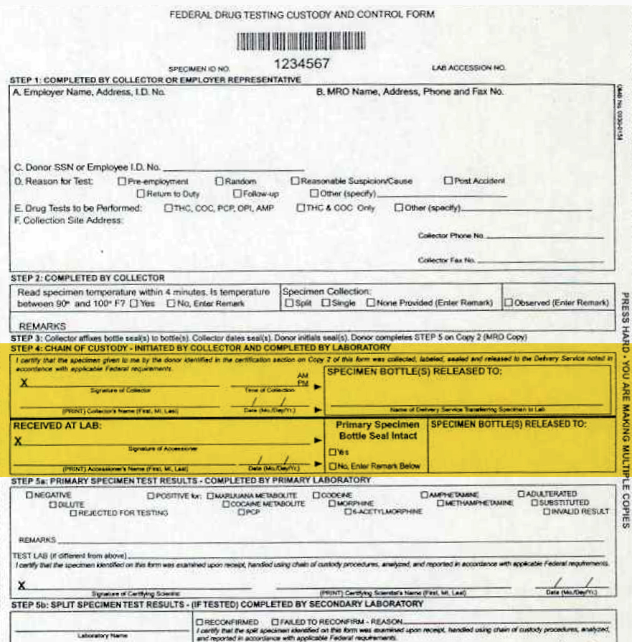
Federal CCF: Step 4
Signature of Collector (lab personnel)
Printed name of Collector
Time
Date
Specimen Bottle Release (UPS)

Slide 13
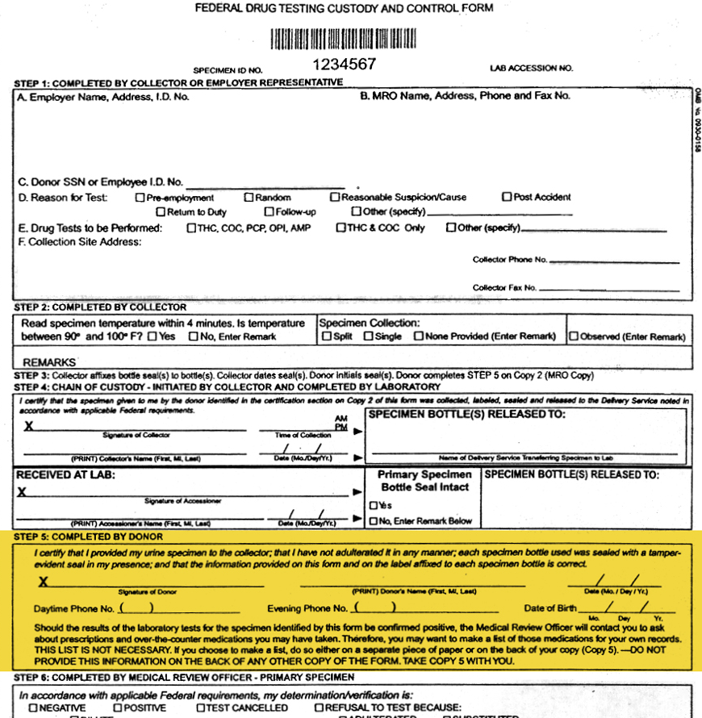
Federal CCF: Step 5
Located on Copy 2 of CCF
Donor signs their name(PRE-)EMPLOYEE
Donor prints their name
Date of collection
Day and evening phone numbers
Date of birth
If donor refuses to sign or fill out step 5, document in the REMARKS section “donor refused to fill out section 5” and print the donors name in section 5, then specimen is ok to send out.

Slide 14
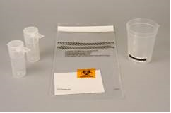
Specimen Collection Supplies
Toilet bluing
Urine Drug Screen Kit
A single-use collection container/cup capable of holding up to 55mL with temperature strip.
Two vials which can be sealed for transport (one vial must
have minimum of 30 ml’s of urine and the other vial must have a minimum of 15 ml’s of urine)
Absorbent material
Plastic bag shipping bag
****Donor must choose collection kit****

Slide 15
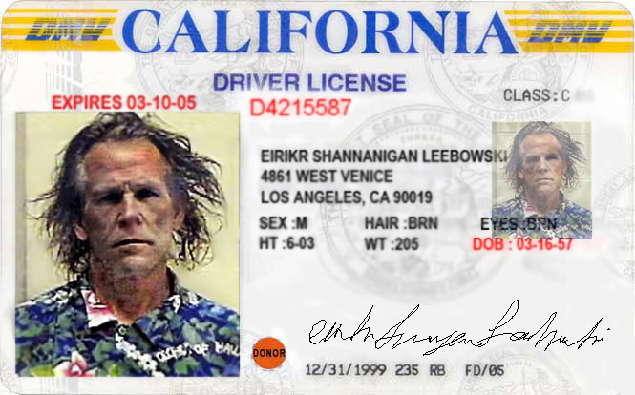
Collection Procedure
Must begin the collection procedure without delay when donor arrives at the collection sight.
Donor must have filled out a release of information form before collection can begin.
Introduction
  Be Polite
  To the point
  Do not make judgements
Identification
  VA ID card, Drivers License, Supervisor, Human Resources Personnel
  Document in the drug testing record book
  Date and time of collection
  Donors name and how you I'd them
  Donors SS#
  Number of the CCF
Initiate the CCF
  Must be kept in numerical order
Drug Testing Kits- Must chosen by employee
Notes:
Act out good intro, bad intro and lax intro
To the point – Exemplify – do not muddy the water
Identification: HHS Collector Handbook 6

Slide 16

Collection Procedure (cont.)
Secure the donor’s: ALL personal items must be locked in cabinet
  Outerwear (coats, Lab coats, sweaters)
  Contents of pockets (must be emptied)
  Handbags
  Hats(not worn for religious purpose)
  All other loose items
Place valuables in cabinet and lock-If donor requests a receipt of items left behind, one must be provided. Give the cabinet key to donor until testing is complete. This is the only key we have for the cabinet. Items can be returned after specimen box is sealed.
Refusal to comply by donor is refusal to test, write in the REMARKS section on the CCF “donor refused” and notify HR. Send copies of CCF to HR and MRO.

Slide 17
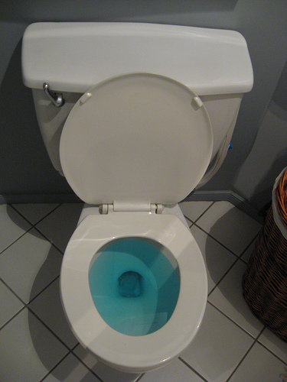
Collection Procedure (cont.)
Secure the collection site
  Add bluing to toilet water. Add to the tank
  also, if present.
  Turn off water supply- switch located on wall outside restroom A57C at the St Cloud VA location.
  Verify the water is completely disabled by checking the faucet.
  Check and remove other samples from pass-through window.
  Remove or secure all soaps, towelettes or other potential adulterants.
  Remove trash receptacle, biohazard container or other items sitting around restroom.
  Visually check for unauthorized materials in restroom. *Repeat after collection*

Slide 18

Note:
If the donor arrives at the collection sight with a container of yellow fluid or something they are trying to conceal, possibly to adulterate the urine sample. This in considered a REFUSAL. Stop and don’t perform collection. Write in the REMARKS section “Refusal. Donor arrived at collection site with a concealed liquid to possibly adulterate test”

Slide 19
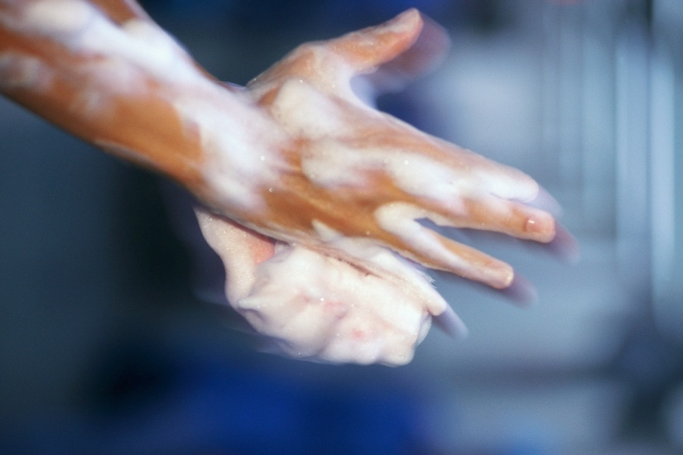
Collection Procedure (cont.)
Instruction to the Donor:
  Wash hands
  (Collector Must Observe)
  Do not flush toilet
  (water will be turned off)
  Do not wash hands after collection
  (water will be turned off)
  Exit as soon as possible
  (need to take temp of urine in less than 4 minutes of collection)
  Must collect a minimum of 45 mL of urine
  (if less than 45ml’s and within temp do a Shy Bladder Collection. If less than 45ml’s and out of temp range or tampering suspected do Direct Observation Collection)
  Must exit restroom in a reasonable amount of time.
  (use good judgment of donor's time spent in restroom)

Slide 20
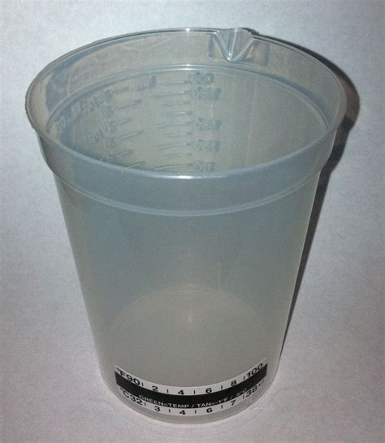
Donor Presents Specimen to Collector
Specimen Processing
  Until tamper proof seals are applied to sample, always keep it in view of collector and donor.
  Minimum amount of urine (45 mL).
  Inspect for signs of tampering.
  Check Temperature (90-100°F).
  Split urine vial 1 (30 mL min.) and vial 2 (15 mL min).

Slide 21
Specimen Processing (cont.)
    Seal the specimen with white seals from CCF form over corresponding vial Place the “A” label over the vial with a minimum of 30ml’s and label “B” over the vial with minimum 15 ml’s.
  Collector must date white seals and Donor must initial white seals on both bottles. (Do not bend barcode on labels when applying to the vials so that the barcode scanner can read the entire length of the barcode.)
  Failure to have donor sign will result in specimen rejection
    If donor refuses to sign bottles or CCF form, document in remarks section, “donor refused to sign (bottles/ CCF)” (still ok to send to lab if documented in “remarks” section ) The collector must write their initials on the vials.
  Donor verifies numbers match on bottles and top of CCF form
  Turn on water. Replace soap, trash, biohazard bucket and inform donor that they can wash their hands
  Specimens should be placed in the front pocket of bag
  Donor to Complete copy 2 of the CCF step #5
    If donor refuses to complete step 5 of the CCF form, document in remarks section, “donor refused to complete step 5” (still ok to send to lab if documented in remarks section ) Just write the donor’s name in section 5.
    Ask donor name of supervisor so compliance email can be sent
  Place copy 1 of CCF (Laboratory copy) in rear pocket of bag. Seal bag by placing the sticky blue adhesive over the cross hatched area of bag.
  Give the donor copy 5 of the CCF for their records
  Return belongings and inform donor that they can return to duty

Slide 22

Copies of Federal CCF’s
Copy 1 - send to testing Laboratory with samples
Copy 2 - send to Medical Review officer
Copy 3 - keep in collecting lab file in secure area
Copy 4 - send to human resources
Copy 5 - send with donor *if donor wants to document medications they are taking, may do so on the back of their copy only.

Slide 23

Send VISTA compliance e-mail to indicate: “Donor Name” has reported and completed the (pre-)employee urine drug screen collection include date and time of collection.
SEND VISTA EMAIL TO:
-(Pre-)Employee’s Supervisor
-G.EMP (select employee drug screen)
Members include:
a. Human Resources Officer
b. Personnel Specialist for Employee Drug Screen
c. Medical Review Officer
d. Occupational Health Program Support Assistant
e. f. Lab Manager

Slide 24
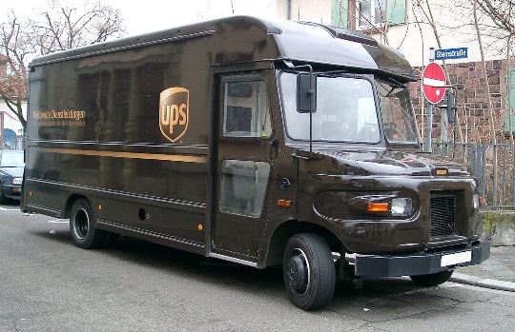
SHIPPING
MAIL SEALED SHIPPING PAK USING UPS
Fill out the shipping label using the UPS web site, must be preregistered by the mailroom. Place the shipping label into a peel-and-stick pouch, attach to the UPS shipping pak. (shipping pak and plastic shipping label pouch are kept in the send out area). Place the sealed urine drug screen bag in the UPS shipping pak and seal. Take sealed shipping pack to mailroom.
- after 3pm mailroom is closed. Place UPS pak in lockbox and place in the glass urine department refrigerator for next day shipping. Place the lockbox key back in the locked drug screen cabinet. Place note on white board to have AM staff mail the specimen (record tracking number for the air bills on copy 3using pre-labeled stickers)

Slide 25

Monitored Collection
Used when water supply can not be turned off or secured
The collector can be the opposite gender identity as the donor.
Requirements for the Monitor: (the person entering the restroom with the donor).
  If collector is not comfortable serving as the monitor, use another person to monitor- medical professional (ex. nurse, doctor, PA, technologist)(see slide #28 for monitor requirements)
  Fill out “Monitored collection Form” (located in procedure) and retain with our copy 3 of the CCF form.
  Write in “remarks” section of CCF monitors name, and the donor’s name. Have each of them initial. Also document that a monitored collection was performed.
  (Monitor may not touch collection container unless the monitor is also serving as the collector)
  DO NOT WATCH –must be a barrier between monitor and donor (stall door, curtain or portable barrier.) Listen for sounds, observe for other evidence of tampering.
  Other than this difference, follow the same collection procedure.

Slide 26

Direct Observation
As a collector you must do a direct observation when:
  A Federal Agency requests it
    Positive drug test, negative dilute, adulterated, or substituted specimen
  Temperature out of range
  Donor conduct
    Conduct indicates an attempt to adulterate or substitute the specimen
  Signs of tampering
    Unusual color, excessive foaming when shaken, unusual odor, trying to conceal a fluid to substitute

Slide 27
Direct Observation (Cont.)
**You must confer with Human Resources prior to proceeding with an observed collection
  Explain process to donor
    Fill out “Direct Observation Form” (located in procedure) and retain with our copy 3 of the CCF form
  Donor and monitor MUST be same Gender Identity
  If as a collector, you are not same gender identity, you must use a “monitor” who is the same gender identity as the donor- medical professional (ex. nurse, doctor, PA, technologist) (see next slide for monitor requirements)
  Document monitor/observer’s name and gender identity and the donor’s gender identity, and have them initial in REMARKS section on the CCF
  Document why the direct observation was performed in the REMARKS section on the CCF (temp. out of range; sample integrity in question; requested by Federal Agency, donor conduct)
  Check the “direct observation” box on the CCF
Notes:
Inform

Slide 28
Monitor Requirements
If using an individual to serve as a monitor for a Monitored or Direct Observed collection, they must satisfy the following requirements:
All steps necessary to perform their role in the Direct Observed/Monitored collection.
The monitor’s responsibility for maintaining the integrity of the collection process.
Ensuring the privacy of individuals being tested.
Ensuring that the monitoring/observation is done in a professional manner that minimizes the discomfort to the employee.
Ensuring the security of the specimen by maintaining visual contact with the collection container until it is delivered to the collector. Monitor must not handle sample.
Avoiding conduct or statements that could be viewed as offensive or inappropriate.

Slide 29
Direct Observation (Cont.)
If the direct observation warrants 2 specimens to be sent…
Use REMARKS section of CCF to create forensic tie
Example:
Document on original CCF in the REMAKS section:
“first attempt=Temp out of range, 2nd specimen will be collected under DO, Spec ID: 987645”
On the 2nd CCF in the REMARKS section:
“1st Spec ID: 987644” (also check the “observed” box)

Slide 30
Direct Observation (Cont.)
Direct Observation Collection Process
  Same steps as normal test
  EXCEPT:
  Collector (Same Gender identity) enters collection room with donor (or use a monitor of same gender identity as donor)
    Collector/monitor watches urine exit the body and flow into the collection container.
    Do not use mirrors or video camera
    Enter the needed information in the ”REMARKS” section
    Check the Direct observation box

Slide 31

Shy Bladder
(Donor can not provide adequate urine sample for testing (45mL)
    Under no circumstances can sample from multiple attempts be combined
Donor has 3 hours from 1st attempt to produce a sample.
Fill our “shy bladder” form located in the procedure and retain copy with our CCF form copy #3.
May be given up to 40 oz. of fluid during the 3 hours. They can not be forced to drink fluids. The donor may drink 8 oz. every 30 minutes.
Must remain in direct contact at all times with the donor.
  Failure to remain in contact will result in test refusal
  If donor refuses to give specimen will result in refusal
  If donor refuses to comply with any part of shy bladder
  procedure will result in test refusal

Slide 32

Shy Bladder (cont.)
After 3 hours if donor is unable to provide a sample contact Human Resources
Document in Remarks section of CCF
Shy bladder. donor unable to leave sample after 3 hours
Number of attempts
Amount of fluid given to donor
Then send out the copies of
the CCF to the appropriate areas

Slide 33
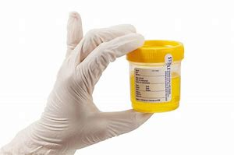
Split Specimen
(sample in bottle B)
  72-hour rule. Testing lab will keep sample for 72 hours incase of confirmation request.
  Donor request goes through the MRO.
      MRO makes request to the
      testing lab.
  The specimen (bottle B) is shipped to another lab for additional testing.

Slide 34
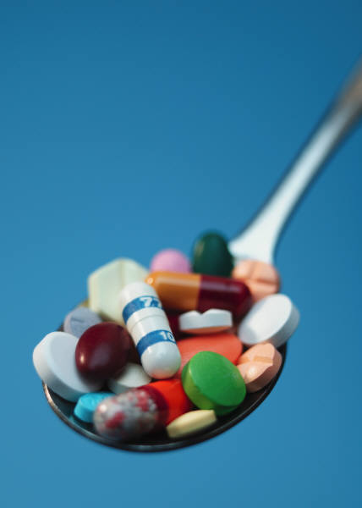
REQUEST FOR ADDITIONAL DRUG TESTING OF DRUGS NOT IN THE ROUTINE PANEL.
All requests for additional drugs should include a justification to test a specific specimen for a specific drug.
1. Facilities wishing to test for other drugs not tested in the routine panel, must fill out the “Request for additional drug testing form under reasonable suspicion/cause” form #F100-23.
a. This form should be filled out by the HR Manager or the MRO
2. The Completed form must accompany the CCF /specimen to the lab.
3. The testing lab requests approval from HHS for testing and can only test other drugs after HHS approval is granted. (This usually has a short turn-around time).

Slide 35

Refusals
  Donor:
    Fails to appear
    Remain at the collection site
    Provide a sample (unwilling)
    Allow “observer” or “monitor” to perform duties
    Undergo medical evaluation for shy bladder
    Cooperate with process
    Shows up to lab with a container of yellow fluid or something else they are trying to conceal possibly to adulterate the urine sample

Slide 36

What to do with Refusals?
Action Items
  Notify the Human Resources by telephone as soon as possible
  Document “REFUSAL to Test” on CCF in the REMARKS area
  Send copies of Federal CCF to the Human Resources and MRO. Keep the rest of the forms in our file.

Slide 37

  Fatal Flaws, Recoverable Flaws and Omission of information
Fatal Flaws causes testing lab to cancel test. Collector will have to undergo error collection training.
Recoverable flaws testing lab will allow us to correct. Testing lab will fax a “Certificate of Correction” to complete and fax back to them
Omission of information are an indication that not enough attention is being paid to the process. According to HHS these errors are considered insignificant only if they are committed less than once a month. The lab does inform the MRO of this error either at the bottom of the faxed result or mailed where the MRO receives mailed results from the lab.

Slide 38

Examples of fatal flaws
Bottle Seals Not Affixed to Specimen Bottle
Specimen ID# does Not Match/ID# Not on Bottle
Collector’s Name and Signature Omitted From Step 4
Specimen Volume is Insufficient and/or leaked in transit
Bottle Seal is Broken or Tampered
Chain of Custody Form Not Included With Specimen

Slide 39

Examples of Recoverable Flaws
Specimen Temperature Not Indicated
Collector’s Signature is Omitted From CCF

Slide 40

Examples of Omission of information
Employer Name/Address Omitted
MRO Name/Address Omitted
Donor ID Omitted
Testing Authority Omitted
Reason for Test Omitted
Two Reasons for Test Given
Drug Tests to be Performed Omitted
Collection Site Address Omitted
Collector’s Phone/Fax Number Omitted
Split/Single Specimen Collection Not Indicated
Split/Single Specimen Indicated; Split/Single Received
Collector’s Printed Name Omitted
Collection Date/Time Omitted From Step 4
Collection Date/Time is Incorrect
Specimen Bottles Released to in Step 4 Not Indicated
Collector Documented in Received at Lab Area
Donor’s Initials on Bottle Seal Omitted
Date on bottle Seal Omitted

Slide 41

Collector errors made on the Federal CCF
If you make an error you should:
  Make a line through the erroneous information, leaving the original info legible
  Write the correct info near the original annotation
  Initial and date the change

Slide 42
Conclusion
Things to remember
    Collect specimens as you would want your specimen collected.
    Inspect the collection sites regularly
    Double check all CCF’s before sealing them in box
    Remember to be a “collector” when you are a collector.

Slide 43
5 mock urine drug collections
1 uneventful collections
1 insufficient quantity
1 temperature out of range
1 donor refuses to sign CCF and initial specimen bottle tamper evident seals.
1 donor refuses to sign CCF

Slide 44

Question & Answer and
TMS Training

Slide 45
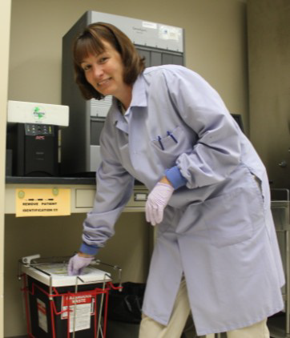

GET THIS PROCEDURE DOWN, AND YOU WILL SMILE TOO!

Slide 46
Instructions to use the urine drug screen collection cups

Slide 47
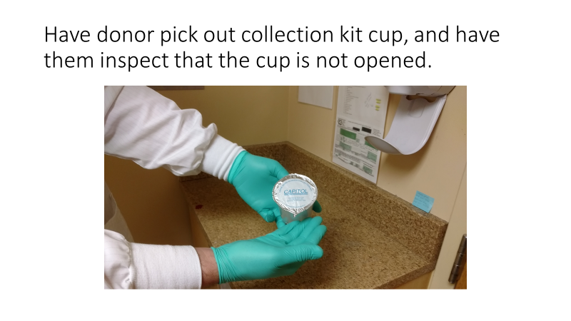

Slide 48
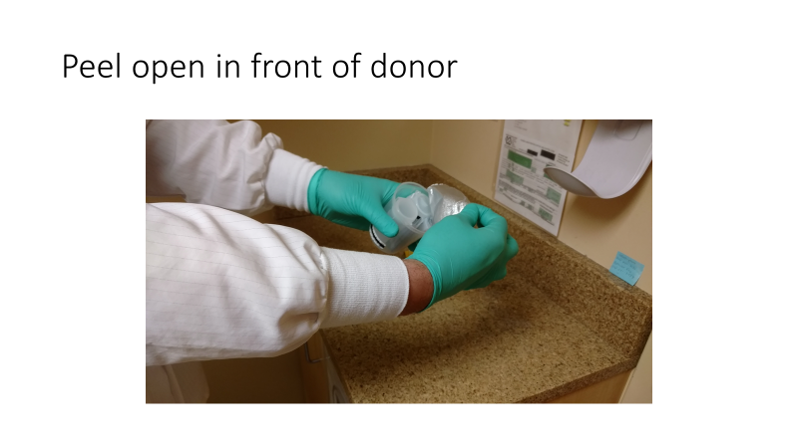

Slide 49
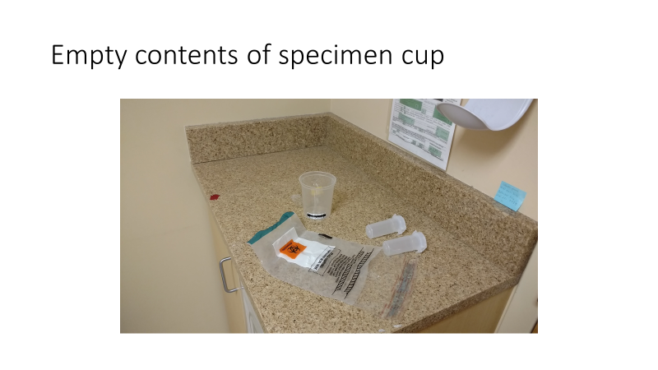

Slide 50
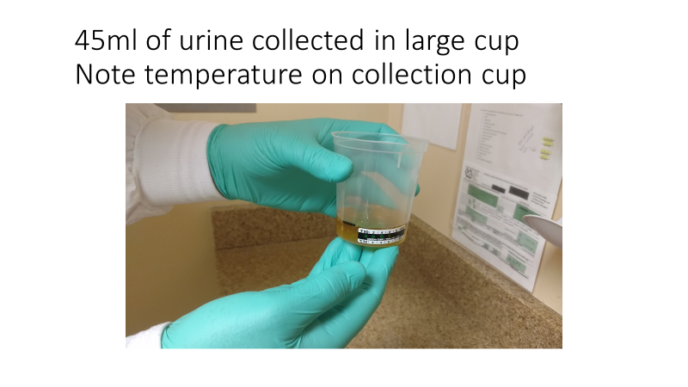

Slide 51
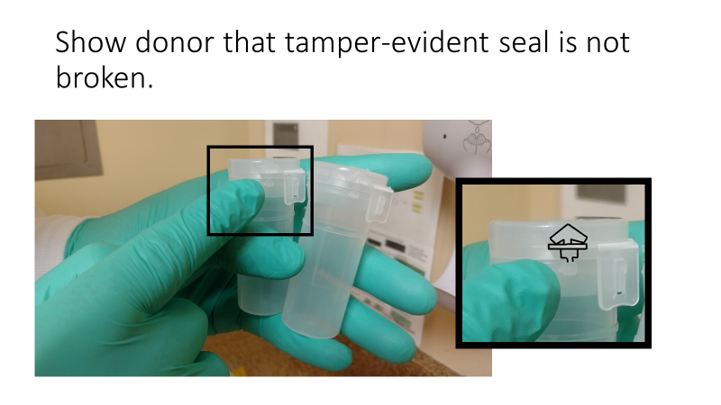

Slide 52
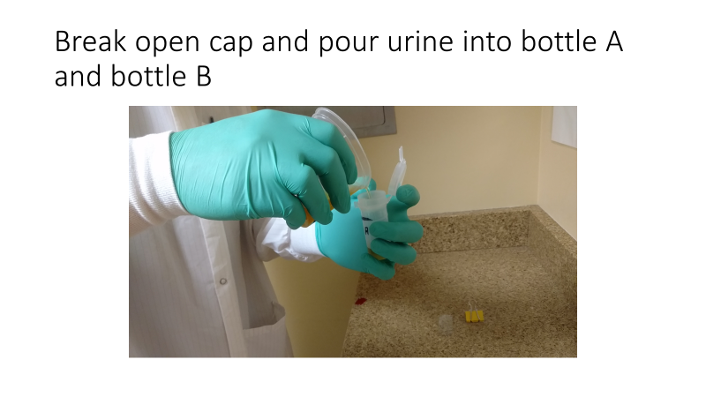

Slide 53
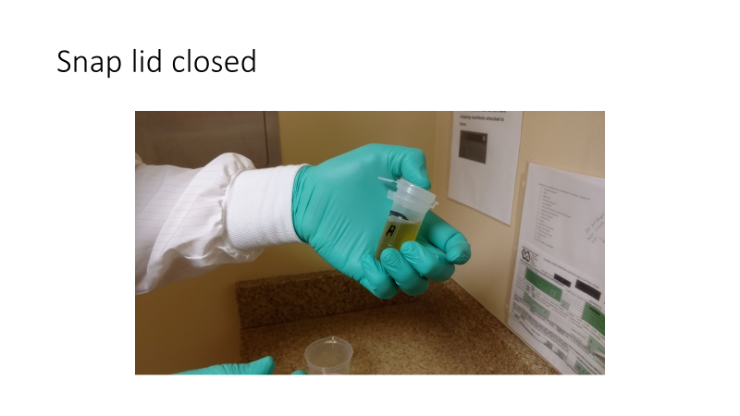

Slide 54
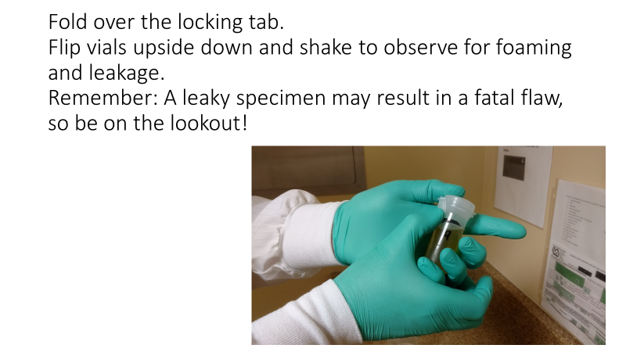

Slide 55
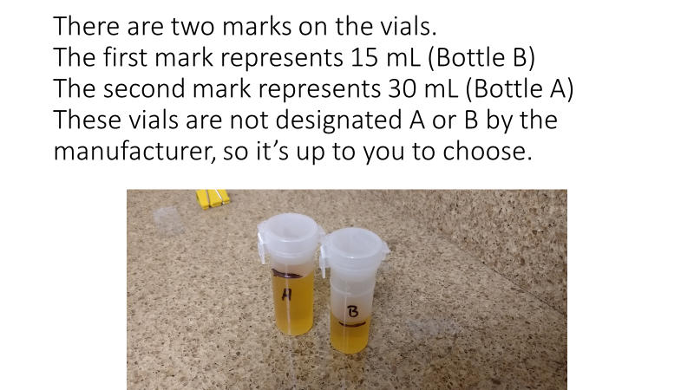

Slide 56
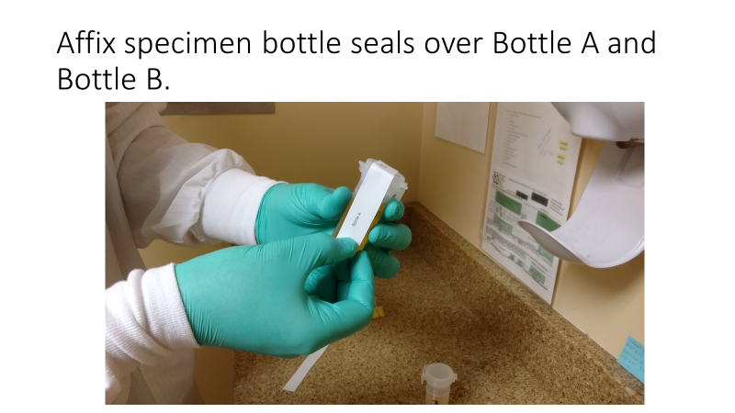

Slide 57
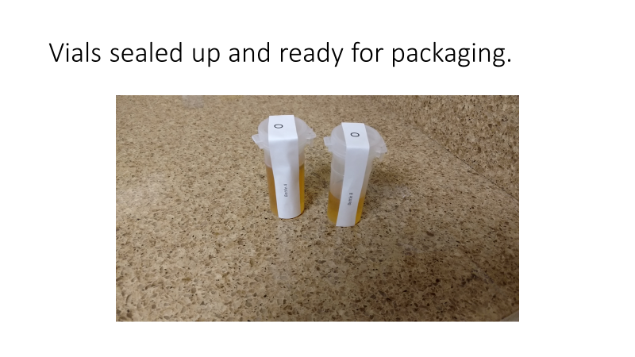

Slide 58
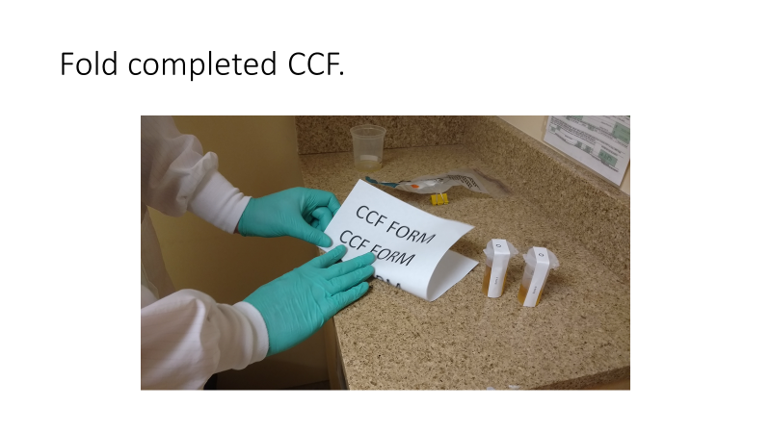

Slide 59
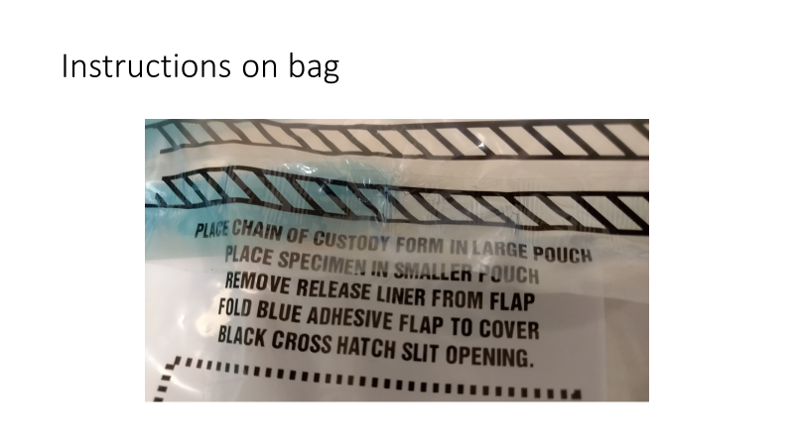

Slide 60
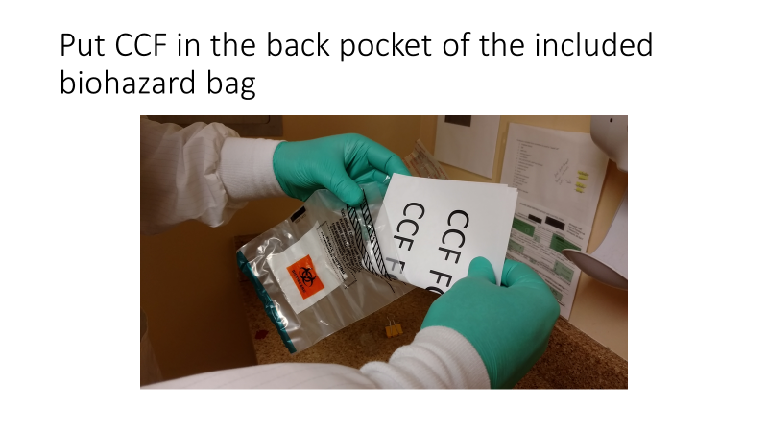

Slide 61
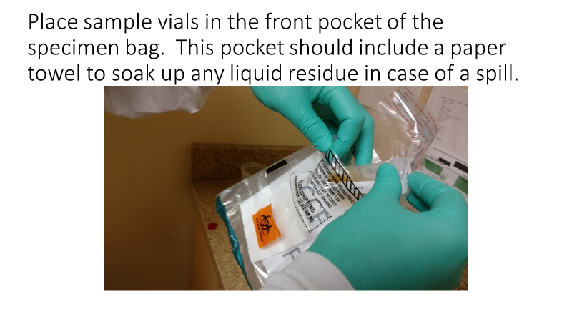

Slide 62
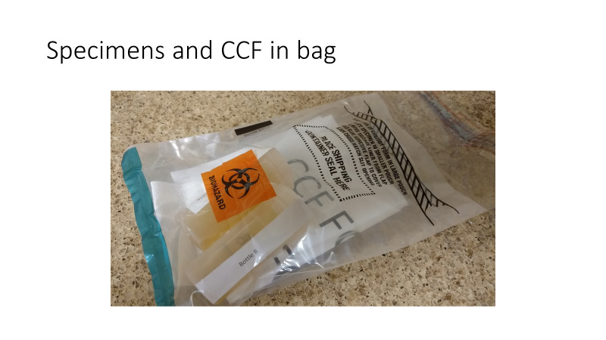

Slide 63
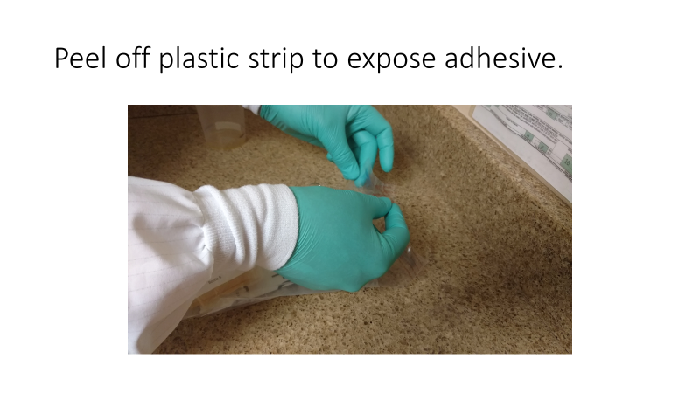

Slide 64
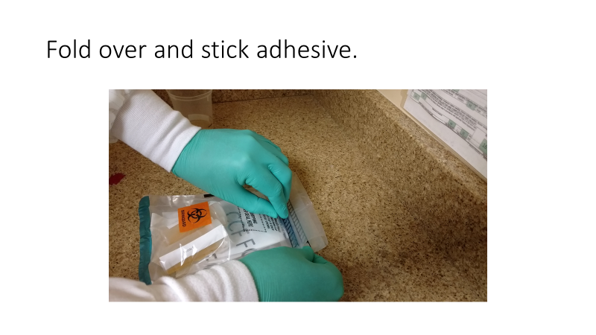
Cover the black cross
Hatch slit opening

Slide 65
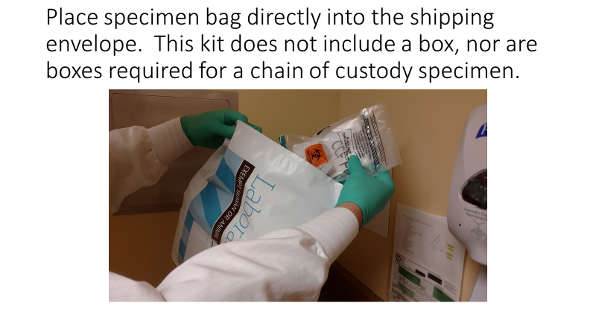

Slide 66
