Slide 1
Fire Saftey
Proquis GEN-043
FM 03.01

Slide 2
What to do
Call 6333 for Fire-Say CODE RED and your location.
Use pull-boxes (when available).
Evacuate patients immediately upon notification using the nearest exit.
In the event that staff and/or veterans require additional assistance to safely evacuate, the VA Police shall be contacted immediately utilizing the emergency contact number at extension 6224.
Lab staff will stay with disabled patients/visitors until an all-clear is called.

Slide 3
LOCATIONS
1 Pull box by emergency exit stairs

Slide 4
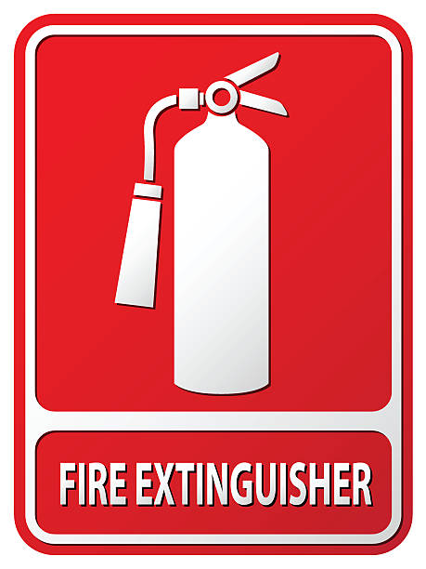
Fire Extinguishers
Lab has 3 Fire Extinguishers
1 dry chemical ABC extinguisher in lab patient waiting area
1 water mist AC extinguisher in hallway entering room A63
1 water mist AC extinguisher on wall across from urinalysis in A63
To use fire extinguishers, remember “PASS”

Slide 5
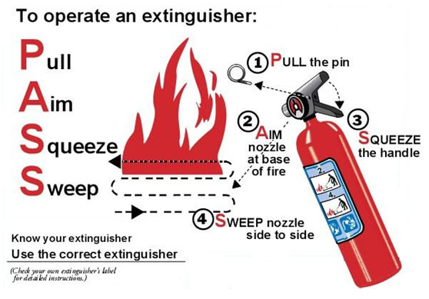
PASS
PULL- pull the ring pin, snapping the plastic seal
AIM- aim the nozzle toward the base of the fire. If hose assembly is clipped to the extinguisher body, release it and point.
SQUEEZE- squeeze the handles together and discharge.
SWEEP- sweep from side to side

Slide 6
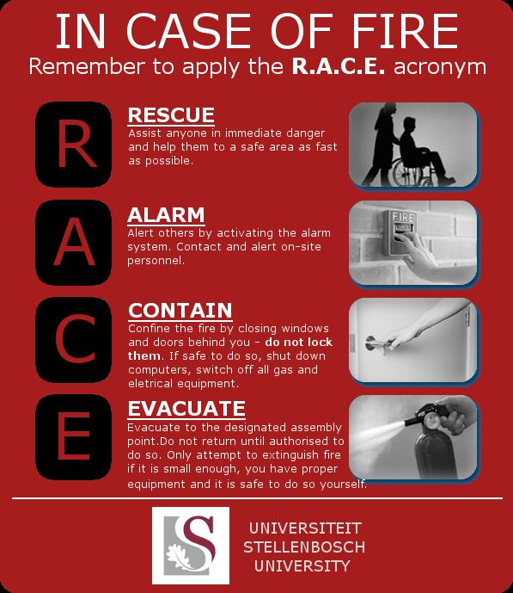
RACE

Slide 7
EVACUATION PLAN
PRIMARY EXIT: Proceed out the north hallway (the hallway outside of the locker room and microbiology), up the stairs to the outside.
• SECONDARY (ALTERNATE) EXIT: Proceed south through the laboratory patient waiting area, down the hallway and through the fire door into the corridor between Building 1 and Building 1 Annex and proceed to the outside.
• TERTIARY(ALTERNATE) EXIT: Proceed to the hallway in Room A61 (Office area), go down the hallway through the fire door into the Respiratory Therapy area, from Respiratory Therapy continue to the corridor between Building 1 and Building 1 Annex and proceed to the outs

Slide 8
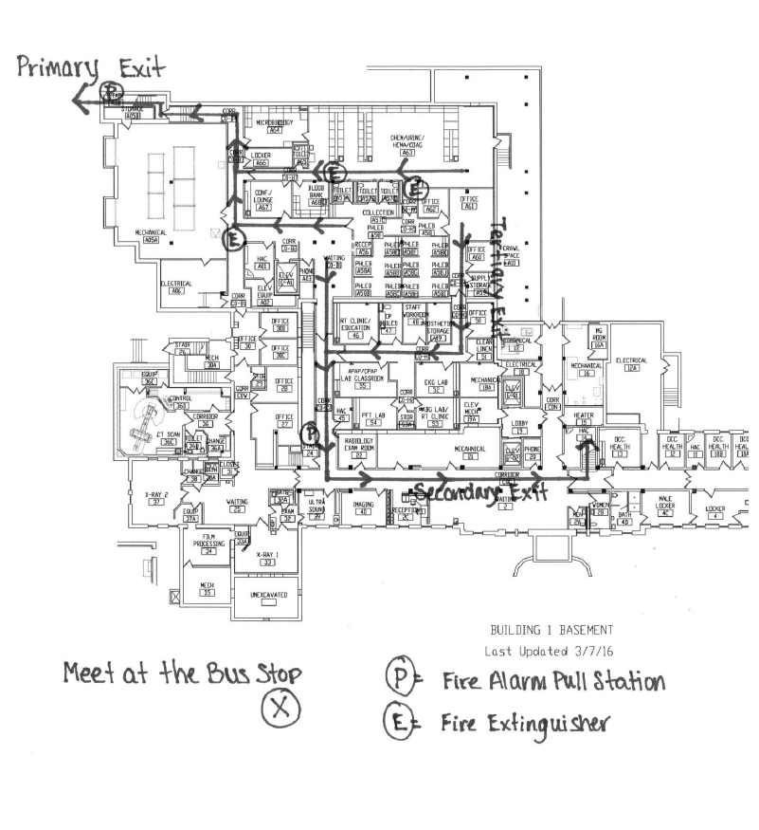
Evacuation Plan

