Slide 1
Utilities Management
Laboratory 2019

Slide 2
NOTIFICATION
Notifications are made to Facilities Management:
Enter a MAXIMO work order or
Normal Business hours: Work Order Clerk at Ext. 6245
Off tours and weekend/holiday: Boiler House at Ext. 6347

Slide 3
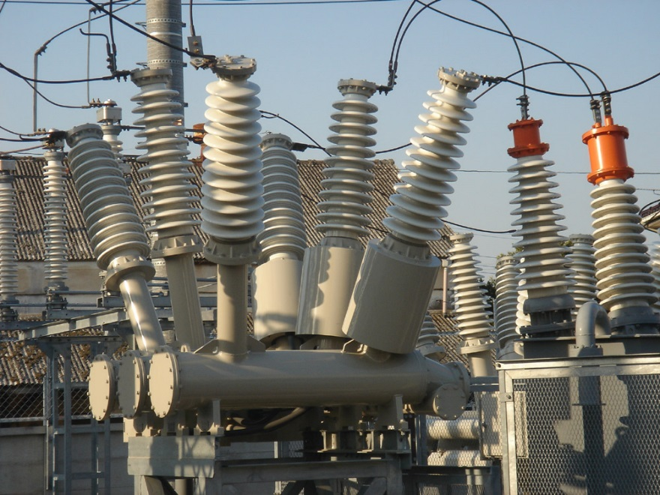
Utilities Include The following systems
Electrical Distribution Failure
Emergency Electrical Power Systems
Elevators
HVAC
Steam Production and Distribution
Plumbing Systems
Medical Gasses and Vacuum
Telecommunication
Fire Alarm systems
Nurse Call Systems

Slide 4
Electrical Distribution System
Two Separate sources from Xcel Energy Services
These two underground systems enter the campus on the East end of the campus.
Failure of the primary source will trigger an automatic switchgear to the alternate source within 10 seconds of failure.
The system is inspected, tested and adjusted on a 3-year cycle.
The Electrical shop will coordinate these activities with lab to minimize down time.

Slide 5
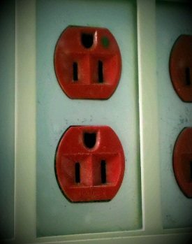
Electrical system
Notify Facilities Management.
Essential equipment is plugged into emergency power outlets (red outlets).
Essential equipment will remain operational on backup generator.
If backup generator power fails, samples needing STAT analysis will be sent to St. Cloud Hospital.
Use flashlights.

Slide 6
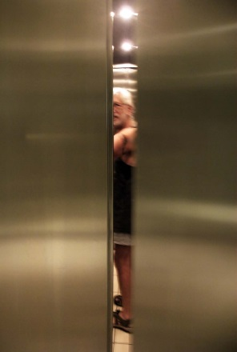
ELEVATORS
Notify Facilities Management
Use stairs.
Move only essential equipment vertically.
Any employee riding an elevator and experiences any type of emergency should use the car phone to call for help. The car phone rings directly to the switchboard operator as soon as the receiver is lifted.
Evacuation/rescue procedures will be performed by the VA Police and FM.
Routine maintenance is performed by FM and inspected twice a year by an outside contractor.
This Photo by Unknown Author is licensed under CC BY-NC-SA

Slide 7
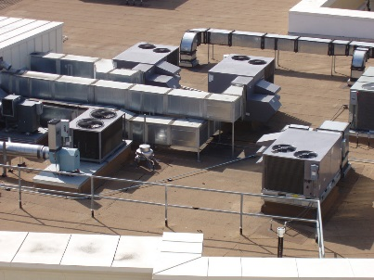
HVAC system Heating/Ventilating/air conditioning
To report a system failure, notify FM.
Check the temperature in the laboratory.
If possible, adjust the thermostat in the laboratory.
Open the doors leading into the core lab to increase air flow and equilibrate temperature.
Actions dictated by weather and the season of the year.

Slide 8
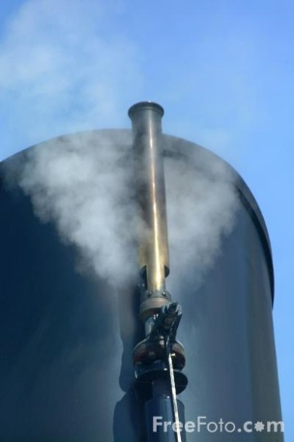
Steam Production & Distribution
The Health Care System has four boilers to generate steam. This steam is used for such things as hot water, heat and laundry.
The steam generated at the Boiler Plant is piped throughout the Health Care System in underground tunnels and crawl spaces.
In the event of a natural gas outage, the boilers will be powered on fuel oil- the facility has a 10-day supply of fuel oil.
In the event of an electrical outage the boilers will be powered by an emergency generator.
All preventive maintenance is documented.
The boilers are inspected annually by a licensed boiler inspector.

Slide 9
Plumbing systems
The Health Care system is served by an 8-inch water main from the city, with multiple shut off valves, used to isolate problems.
The sewage system is connected to each building and then to the city system which goes to the waste treatment facility.
In the event of a problem with St. Cloud city water, the VA has a 400,000-gallon tank as a back-up system.
The Health Care System has a limited cache of bottled drinking water.
If back-up water is depleted, testing will be sent off site.
Limit use of water and toilets.
Antiseptic hand wipes and no-rinse alcohol-based cleansing gels will be used for hand washing.
Hot water- systems in place to prevent scalding. Maximum temperature will be =/<110º F

Slide 10
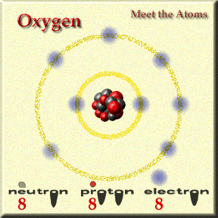
Medical Gasses and Vacuum
This system provides oxygen, medical air, nitrogen, nitrous oxide, carbon dioxide, and vacuum to the Health Care System.
This system includes master signal panels, area alarms, automatic pressure switches, shut off valves, flexible connectors and outlets.
Two bulk oxygen tanks supply medical oxygen to the facility. One is located north of building 4 and the other is located north of building 49.
The medical air supply system consists of 4 tandem air compressors which serve buildings 49, 50, 51 and 1/1A.
The nitrogen, nitrous oxide and carbon dioxide are supplied to bldg. 1A from tanks located in 16A-001
The vacuum supply system consists of 5 tandem vacuum pumps serving bldgs. 51, 50 49, 1 and 3.

Slide 11
computers
Announcements regarding station wide problems with the computer will be made by the operator over the PA system.
Staff should report problems to the Information Management at extension 4357 (HELP) or enter a ticket using the “Your IT” icon on the desktop.
The Laboratory contingency plan for computer problems will be implemented in the event of a computer outage (OPM 113-05). Located in Proquis.
Laboratory will communicate with the care units any delay in availability of results.
Couriers will be utilized to deliver hard copy results to the units if the outage is longer than 24 hours.

Slide 12
telecommunication
The Health Care System will have a plan in place to use in the event of a communications system failure. communication systems are defined as telephone, paging, public address, and two-way radios.
The laboratory has the following:
1emergency phone (located in the phone center, orange sticker on the receiver
4 cisco phones (in house use)
4 long distance pagers for after hour use.
Notify Lab Information Manager if problems occur.
Batteries available through SPD.
Problems with telecommunications are reported to the National Service Desk at ext 4357

Slide 13
Fire alarm system
The Health Care Systems’ Fire Alarm system shall be operated and maintained in accordance with procedures that assure reliability and reduce the risks in normal and emergency situations.
Code Yellow announced via the PA system indicates the fire alarm is not functional. Keep watch for smoke and fire in your area.
To report a fire call Ext. 6333 (located on all the phones in Laboratory).
Code Yellow- All Clear will be announced via the PA system indicates the fire alarm system is functioning.

Slide 14
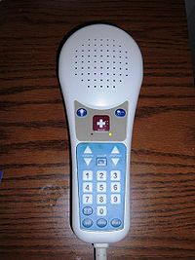
Nurse Call System
The Health Care Systems’ Nurse Call System will be operated and maintained in accordance with procedures that assure reliability and reduce risk in normal and emergency situations.
Call systems are installed per facility risk assessment.
The following criteria is used to assess appropriateness prior to installation in a bathroom:
Traffic flow in the area of the bathroom
Location of the bathroom
Ability to monitor bathroom while in use

Slide 15
Refrigerators/Freezers
Refrigerators/ freezers are monitored continuously through MetaSys. If MetaSys is down temperatures will be recorded manually.
If a temperature falls out of acceptable range an audible alarm will sound.
The refrigeration shop should be notified.
If the problem can not be resolved the products should be moved to a functioning refrigerator/freezer until the problem can be resolved.
This Photo by Unknown Author is licensed under CC BY

Slide 16
Congrats
You made it through this power point!!!!!

