Slide 1

Hazardous waste
MCP FM-06 HAZARDOUS MATERIAL AND WASTE MANAGEMENT PROGRAM

Slide 2

What is waste
A material not needed, wanted or used.
Unusable.
Intended to be discarded.

Slide 3
WHAT IS WASTE?
General Waste: Non-hazardous solid waste disposed of in standard waste containers
Biohazardous Waste: Infectious material waste that may contain pathogenic agents that could cause disease in exposed persons. This includes blood/blood products, all body substances in the amount that could leak and spill into the environment, dialysis waste, microbiology waste, used needles/sharps, pathology waste, and surgery waste.
Universal Waste: Batteries, mercury containing devices, and lamps with a hazardous component.
Hazardous Materials: Any waste which is considered a listed hazardous waste or characteristic waste according to EPA regulations and MPCA rules

Slide 4
Is waste Hazardous or Not?
The Environmental Protection Agency established the Resource Conservation and Recovery Act (RCRA) in 1980 for the purpose of regulating the proper handling, storage, and disposal of HW.

Slide 5
Types of hazardous waste
Listed Hazardous Waste: Included on the F,K,P, and U lists as designated by the EPA. (RCRA)
Dual Waste: Waste that is both hazardous and infectious.
Characteristic Waste: Display the characteristics of Ignitability, corrosivity, reactivity, or toxicity

Slide 6
F listed waste
F-Listed Wastes
Degreasing Solvents
Paint/lacquer thinners
Brake/carburetor cleaners
Dry clean solvents
Many common laboratory solvents
Including: Methanol, Acetone, Xylene

Slide 7
K listed
K-Listed Wastes
Wood preserving
Pesticide manufacturing
Iron and steel industries
Healthcare providers are not listed as K-list waste generators

Slide 8
U Listed
U-Listed wastes
Toxic and others
Examples: Formaldehyde, Mercury, Methanol

Slide 9
P listed
P-Listed Wastes
Acutely Hazardous
Fatal to human in low doses (ie arsenic, strychnine, cyanides)
Examples: Sodium azide
Listed waste is collected if it is the sole active ingredient of the product. Most P listed chemicals used in lab are preservatives. They are NOT the sole ingredient, so we do not collect.

Slide 10
Updated hazcom standard
Defines hazard classifications for the health hazards or physical hazards of a chemical.
Many classifications are divided into categories based on the degree of the hazard.
In GHS, a category 1 is the highest level of hazard; Category 2 is somewhat less hazardous, etc.
Some physical hazard categories have a different rating system. (Type A, Type B, or Division 1.1, etc)
Some Health Hazard Categories are further divided into sub-categories

Slide 11
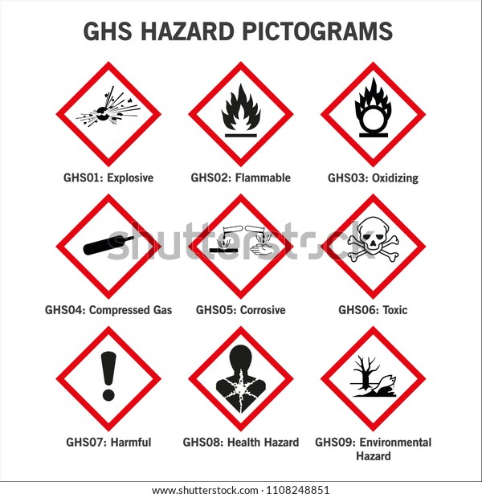
Ghs hazard pictograms

Slide 12
Wastes we have in lab
8 Gallon Container for Alkaline Corrosive Architect Products
8 Gallon Container for Acid Corrosive Architect Products
7L Container for Flammable Hazardous Heme Waste
2 Gallon Container for MN01 Hazardous Waste Containing Ethylene Glycol
2 Gallon Container for Dual Flammable/MN01 products

Slide 13
Wastes we have in lab
7L Container for Flammable Gram Stain Products
2 Gallon Container for Alkaline Corrosive Cepheid Cartridges
Cytolyt is flammable and is collected as hazardous waste when needed. (ie expired bottle)

Slide 14
Where can I find a sds?
Updated SDSs are stored in binders under the ACL Top
There is also a link to the SDS in the St. Cloud Sharepoint site SDS/Chemical Inventory Service .

