Slide 1
Find SDS
August 2022

Slide 2
Locate the Gold Star on your desktop

Slide 3
Find STC Shortcuts

Slide 4
Find STC VAHCS SharePoint Site

Slide 5
Find the Yellow Book

Slide 6
Select SDS Search

Slide 7
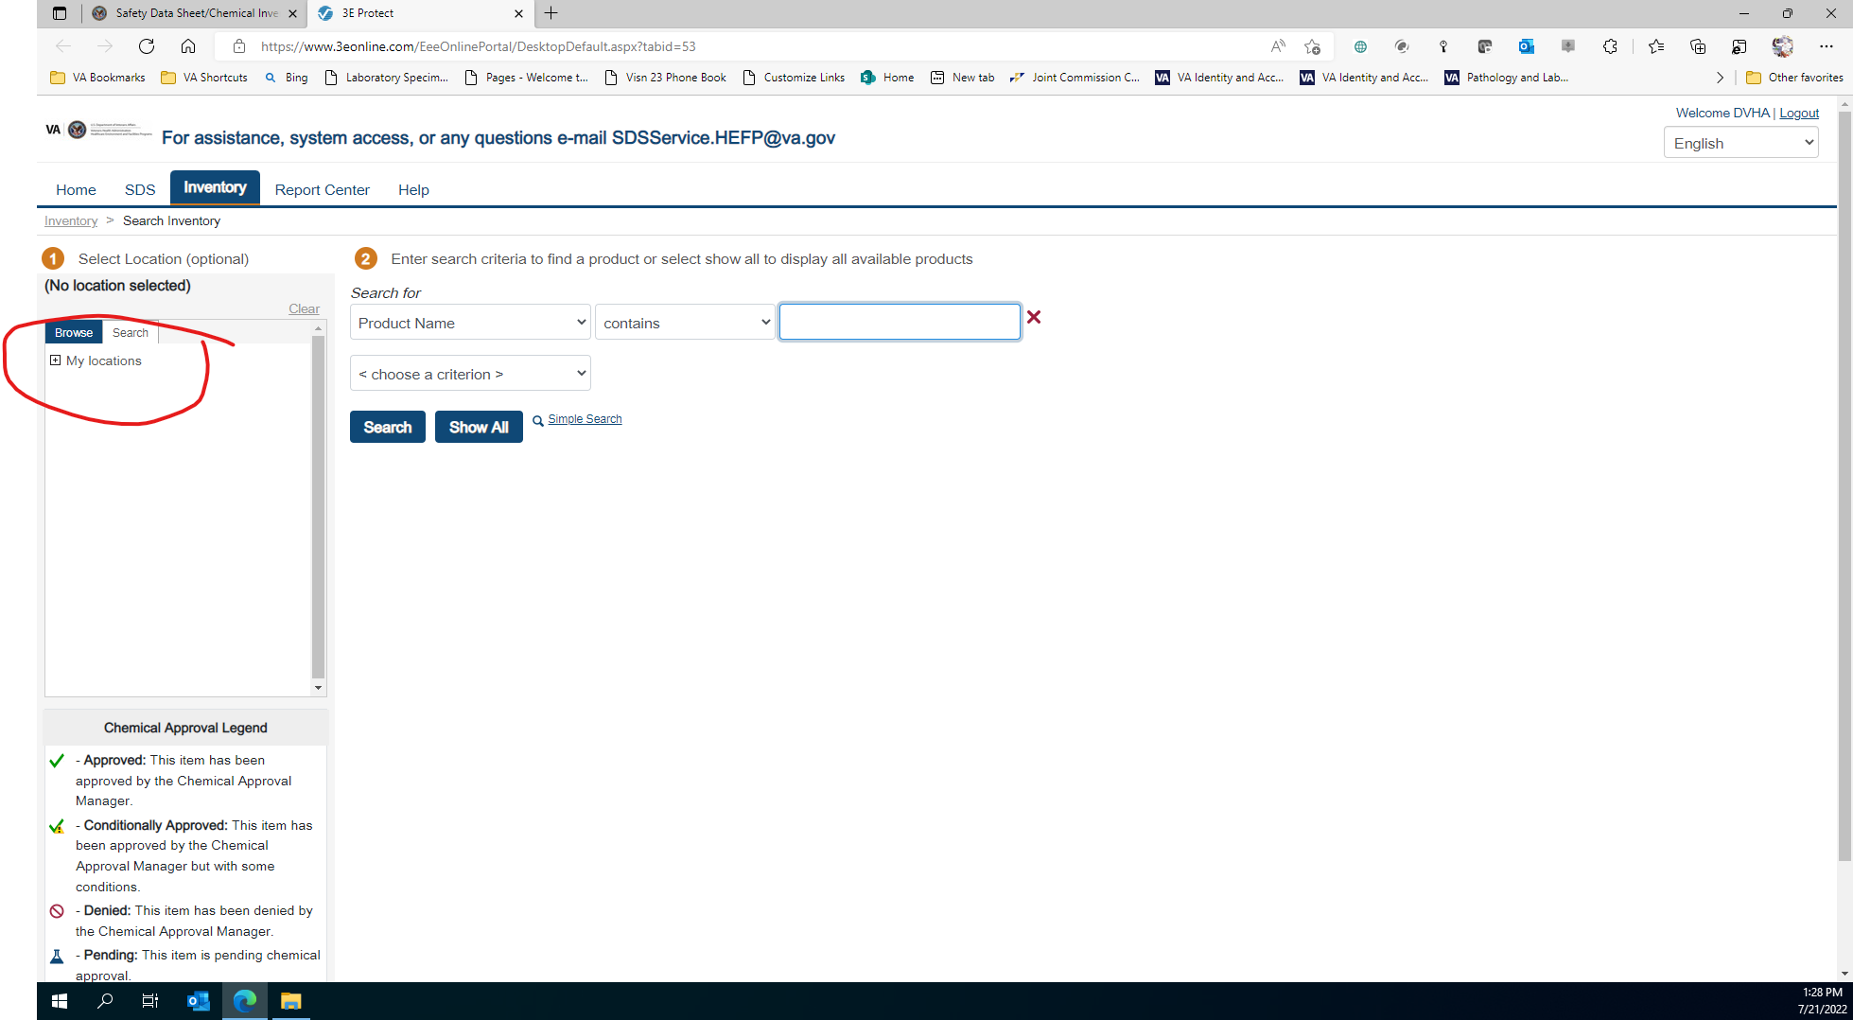
Expand My locations

Slide 8
Expand VISN 23

Slide 9
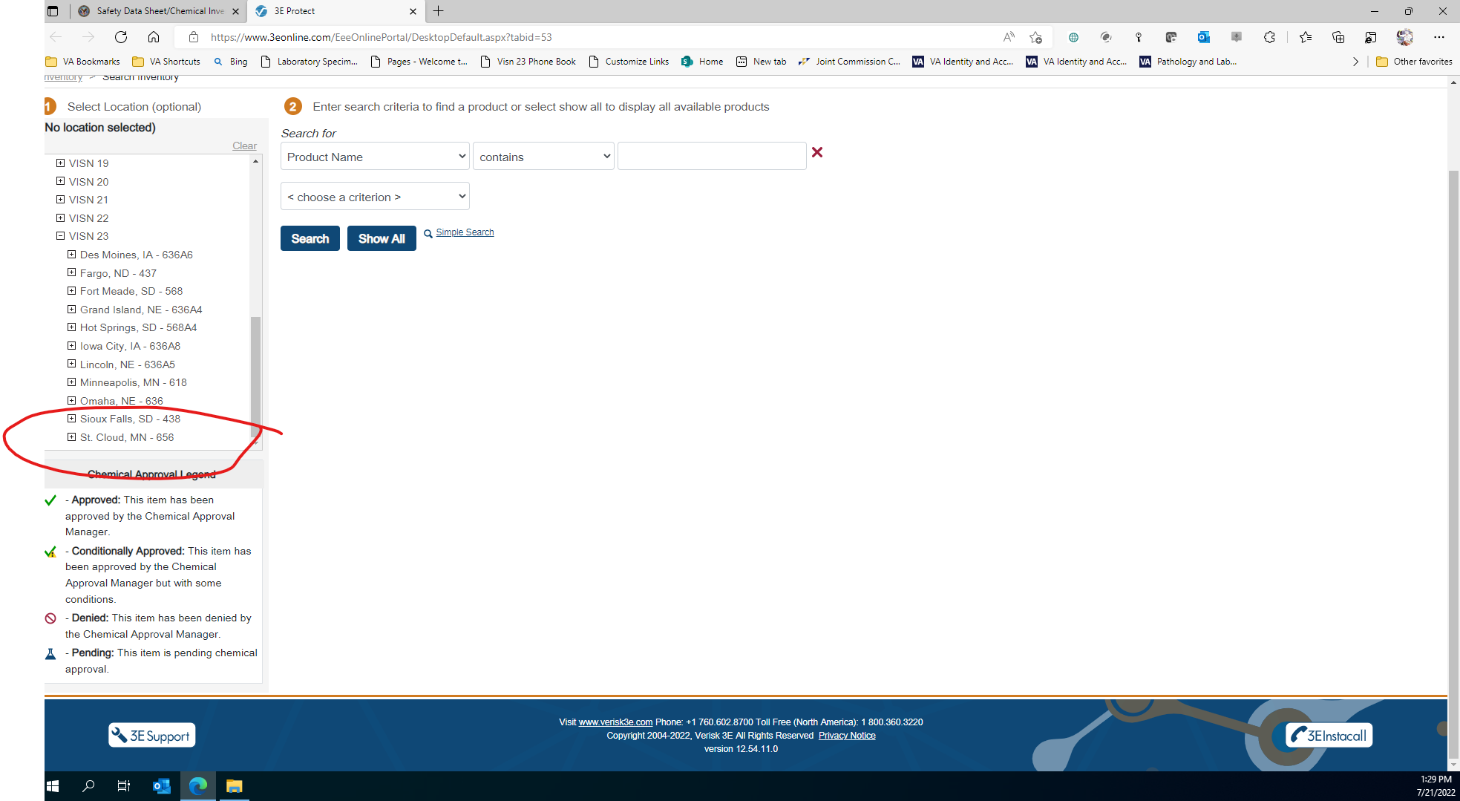
Expand St. Cloud,MN-656

Slide 10
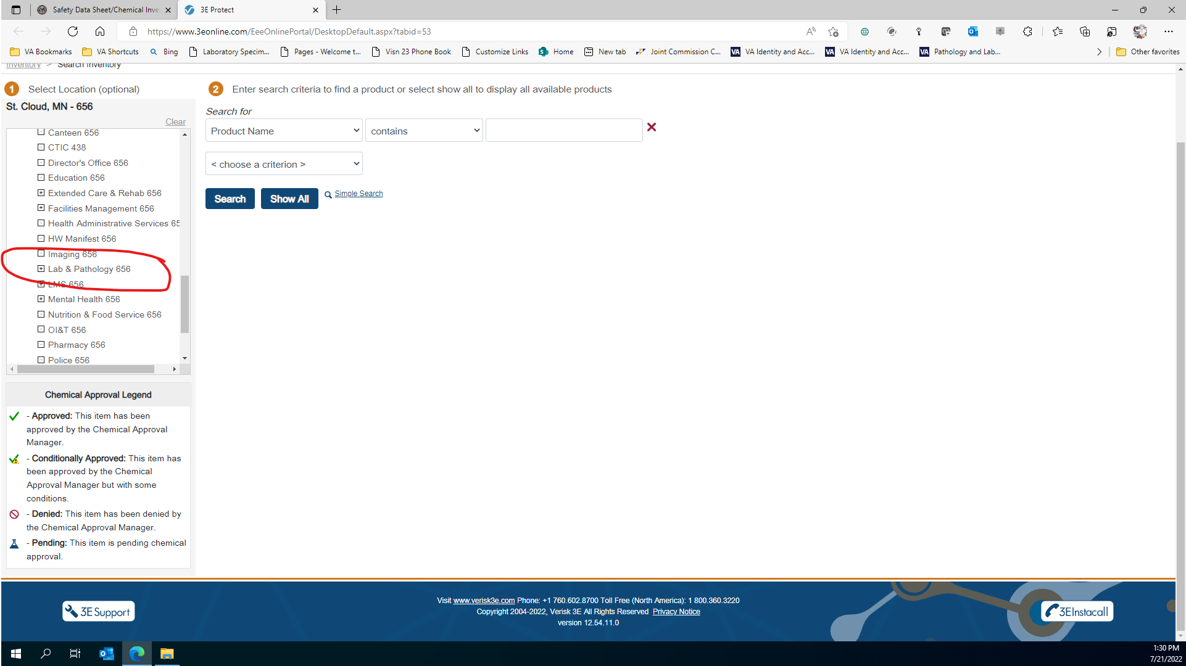
Expand Lab & Pathology 656

Slide 11
Select the department

Slide 12
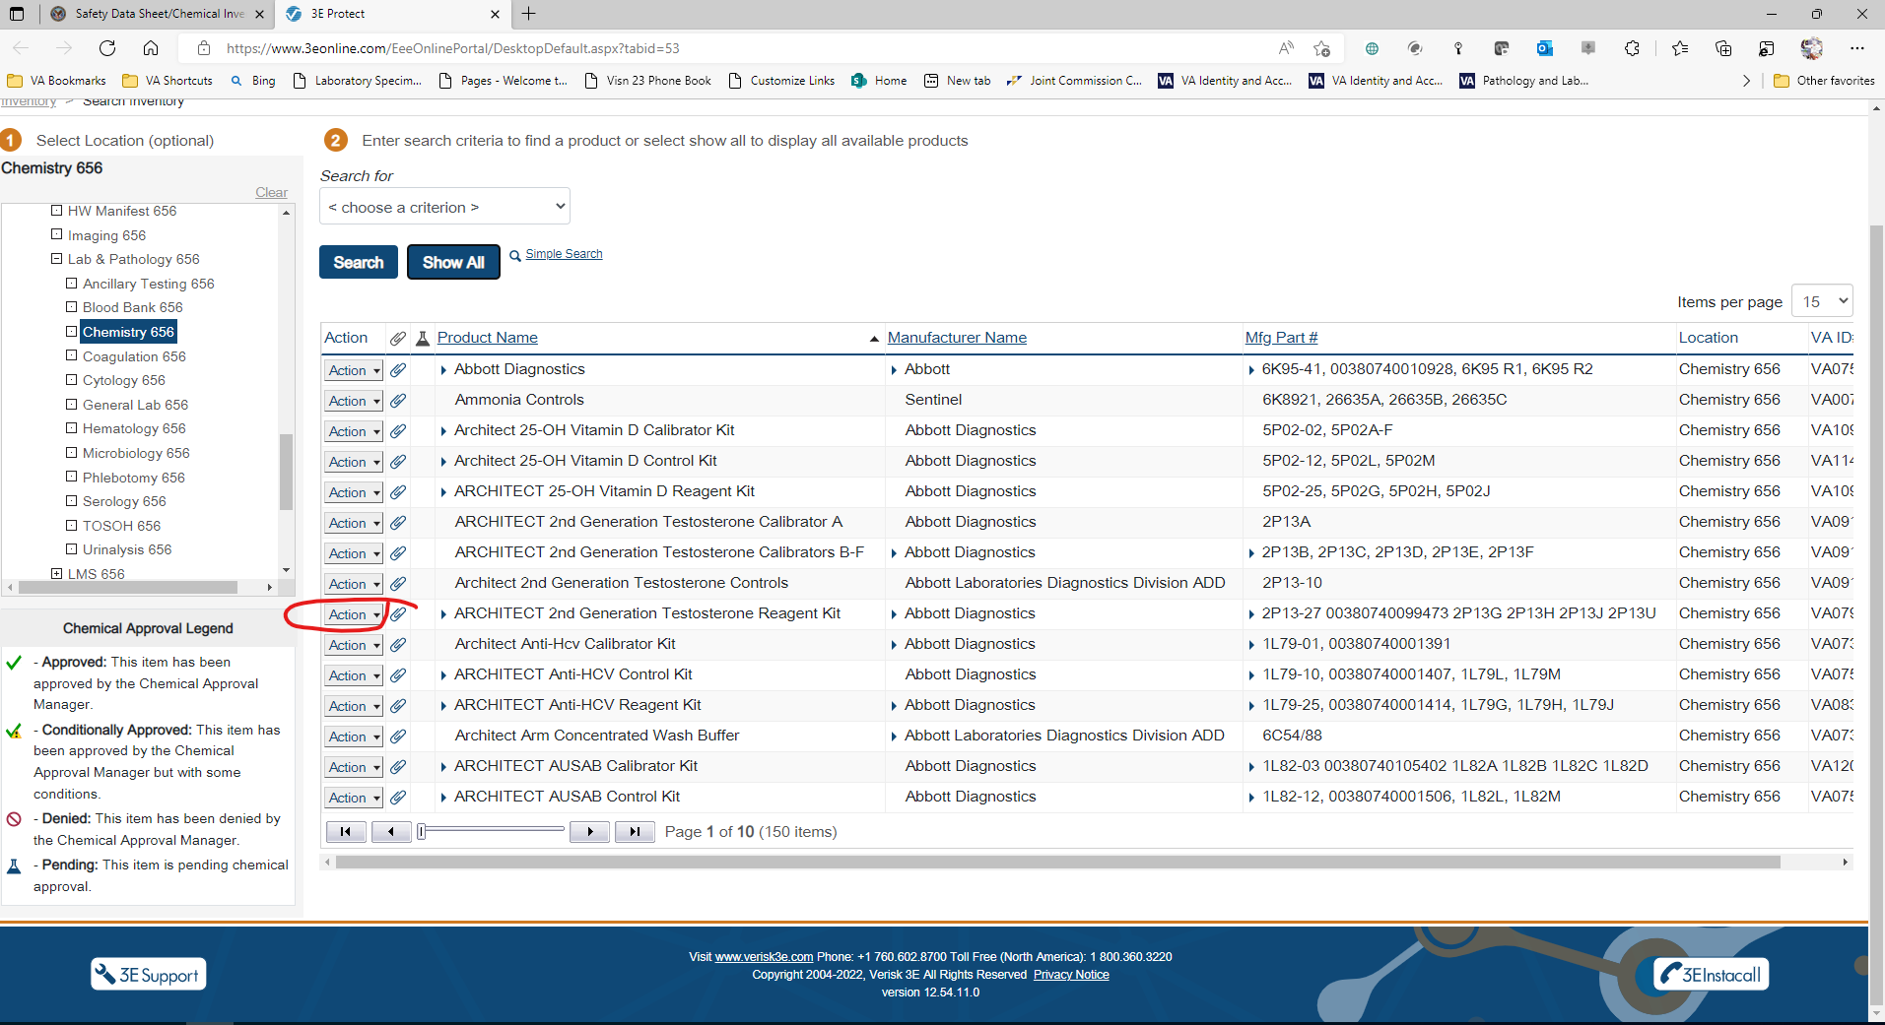
Find your chemical, click on drop down menu

Slide 13
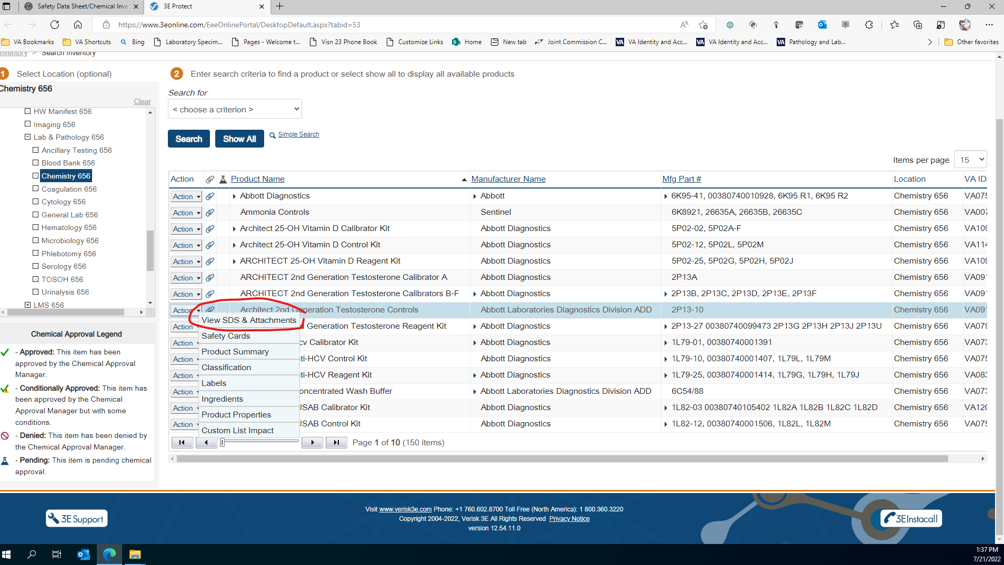
Select View SDS & Attachments

Slide 14
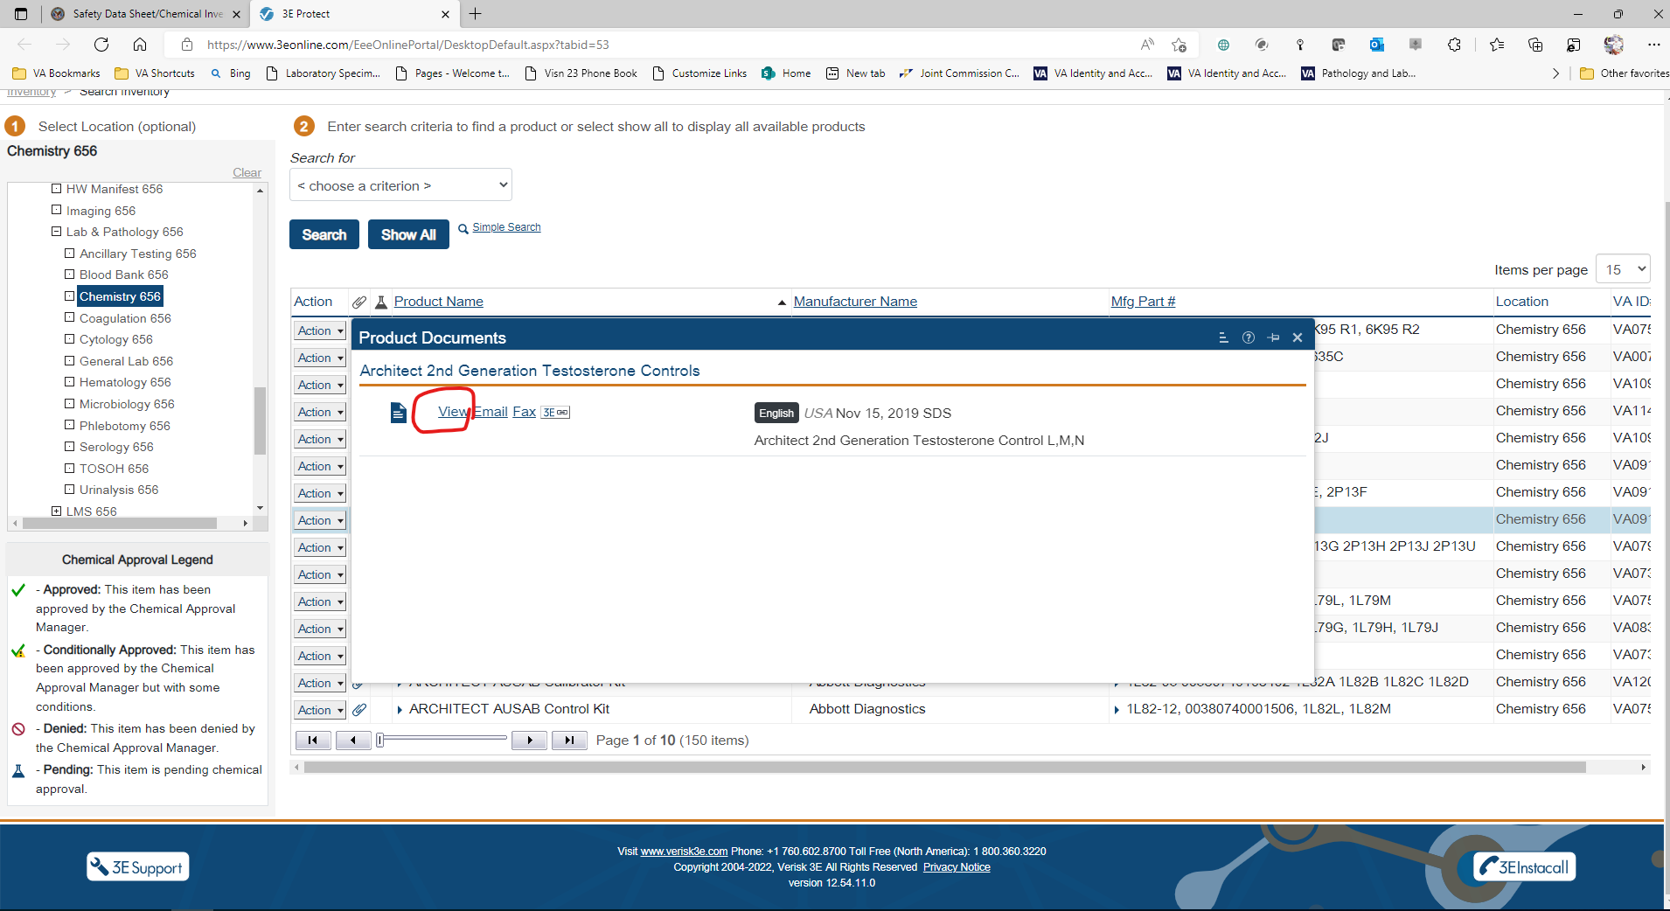
Select View

Slide 15
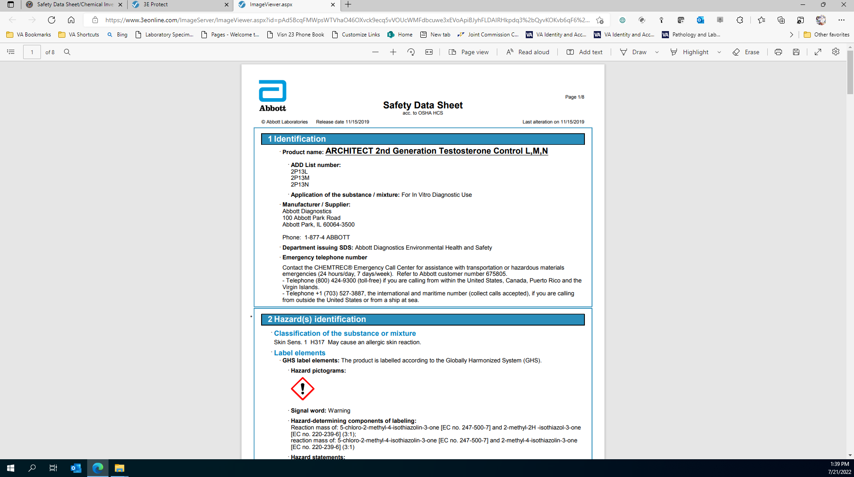
Here’s the SDS

