Slide 1
GEMS
Green Environmental Management Systems
FM 06.22

Slide 2
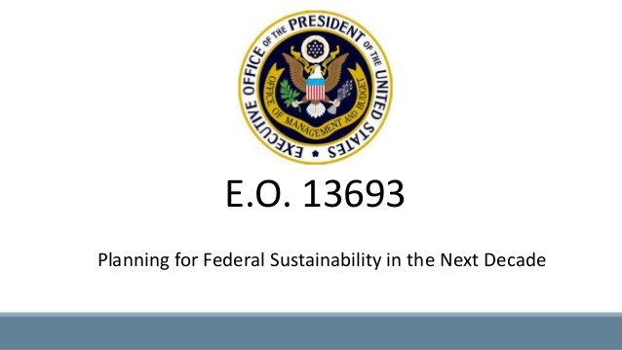
GEMS POLICY
Executive Order 13693
Requires federal agencies to have a governing environmental policy in place for the operation of its facilities.
The objectives of an environmental management system are to ensure that facilities are in full compliance with environmental regulations and are operated and managed in such a way as to result in the continual improvement of the environmental program.

Slide 3
GEMS MISSION
Be a good steward of the environment
Comply with federal, state, and local environmental laws and regulations.
Prevent pollution, minimize waste, conserve cultural and natural resources, and continually improve environmental programs
Use sustainable practices to eliminate, minimize, or mitigate adverse environmental impacts

Slide 4
GEMS PROGRAM
Medical Center Director
  Responsible for implementation of GEMS.
  Appoints key personnel, including GEMS program manager and GEMS committee members to develop and implement GEMS

Slide 5
GEMS PROGRAM
Gems Program Manager
  Key member of the GEMS Committee with technical expertise in environmental management systems, environmental technology, and regulatory compliance
  Coordinates the development and implementation of GEMS across organizational elements
  Is appointed to the Safety and Health Executive Council (SHEC) and provides GEMS Committee reports to SHEC monthly.
  Facilitates the exchange of environmental information to staff, including development and implementation of training and educational programs
  Serves as a technical resource to service lines, consulting on correction of environmental compliance issues as needed.

Slide 6
GEMS Committee
Establishes goals and provides governance and policy direction for the Health Care System.
Ensures compliance with relevant environmental standards; increases the efficiency of energy, water, and other resource usage.
Helps reduce regulated air emissions
Utilizes pollution prevention principles
Incorporates environmentally preferable practices for the design, construction, and operation of buildings
Ensures St. Cloud VA facilities are good neighbors in the local communities.

Slide 7
SERVICE LINE DIRECTOR/MANAGER/DESIGNEE
Works closely with GEMS Program Manager to ensure aspects and impacts have been appropriately identified to facilitate the selection of environmental targets and objectives.

Slide 8
EMPLOYEES
Will be good stewards of the environment by attending GEMS training when required.
Conserve energy and water
Recycle as directed
Provide a clean and safe environment that follows local, state, and federal regulations

Slide 9
PATIENTS
Will be good stewards of the environment by abiding by the environmental guidelines as communicated through patient education

Slide 10
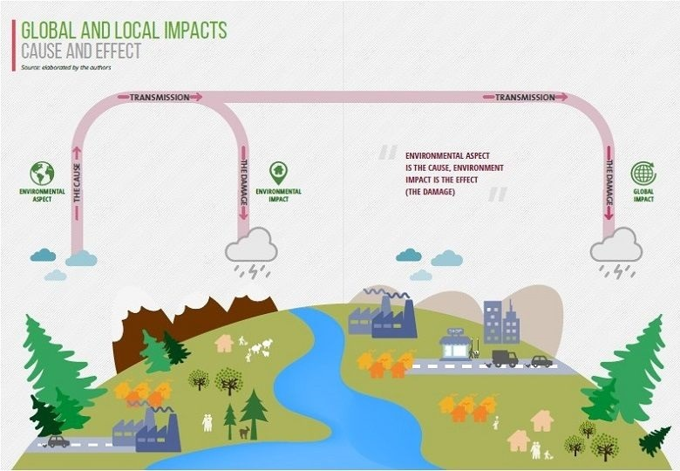
Aspects and Impacts

Slide 11

Aspects
Aspects are activities within the service line that can interact with the environment.
Aspects can include both positive (paper recycling) and negative (leaking oil drum) events.

Slide 12

Impacts
An actual or potential change to the environment, wholly or partially resulting from the organization’s activities or services.

Slide 13
Paper Conservation
Lab will conserve paper whenever possible
We will do this through
  Increased auto-verification
  Printing hard copies when necessary
  Reusing paper when applicable
  Printing double-sided.
  Increased awareness of paper usage.

Slide 14
Hazardous Waste Reduction
We will achieve waste minimization through:
Lean ordering.
Keeping minimal volumes of hazardous reagents on hand.
Replacing hazardous products with environmentally friendly products whenever possible.
Procuring environmentally friendly products.

Slide 15
Green Purchasing Policy
CD00-62
Procuring Safer Choice products when available
Complete a product review form for GEMS approval
Once approved the product can be ordered
Staff training on SDS

Slide 16
Questions
If you have questions regarding the GEMS program
  Kate Dierkhising-Quality Manager ext 6022
  GEMS Coordinator (Jody Staples)-ext 6508

