Slide 1
National Patient Safety Goals
NPSG.01.01.01
NPSG.07.01.01

Slide 2
PURPOSE
To comply with NPSG.01.01.01
Use at least two patient identifiers when providing laboratory services.
To comply with NPSG.07.01.01
Comply with either the current Centers for Disease Control and Prevention (CDC) hand hygiene guidelines and/or the current World Health Organization (WHO) hand hygiene guidelines.

Slide 3
Evidence of Compliance
NPSG.01.01.01
St. Cloud VA staff will use the full legal name and full Social Security Number (SSN) when identifying patients (active identification).
Staff will give patients a calculator to enter their full SSN. (VA Directives 1106 and 1186)
If the patient does not know their full SSN, Date of Birth is acceptable.
Label containers used for blood or other specimens in the presence of the patient.
Staff will allow patient the opportunity to review labels prior to leaving the collection area.

Slide 4
Evidence of Compliance
NPSG.07.01.01
Staff will perform hand hygiene prior to donning gloves for phlebotomy procedure.
Staff will perform hand hygiene after doffing gloves for phlebotomy procedure.
Appropriate forms of hand hygiene include:
Use of alcohol-based hand sanitizer (gel, foam).
Washing hands with soap and water.

Slide 5
When to do Hand Hygiene
When arriving at work
Before and after patient contact
Before and after using gloves
Before eating and handling food
After coughing, sneezing, wiping nose, or touching face.
Wash hands with soap and water when hands are visibly soiled, feel sticky, and after using the toilet.
Before going home

Slide 6
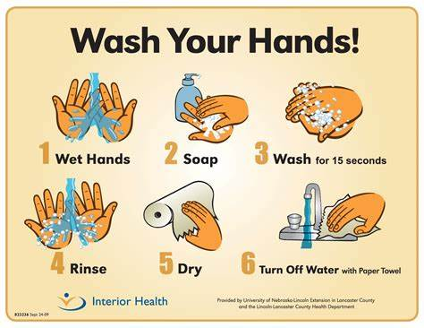

Slide 7
Alcohol Based Hand Cleaners
Foam-Walnut size blob
Gel-Nickel size blob
Rub hands together covering all surfaces until dry.

Slide 8
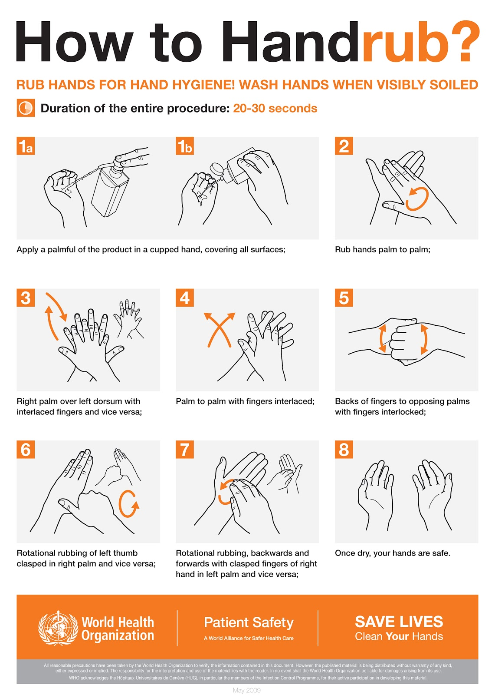

Slide 9
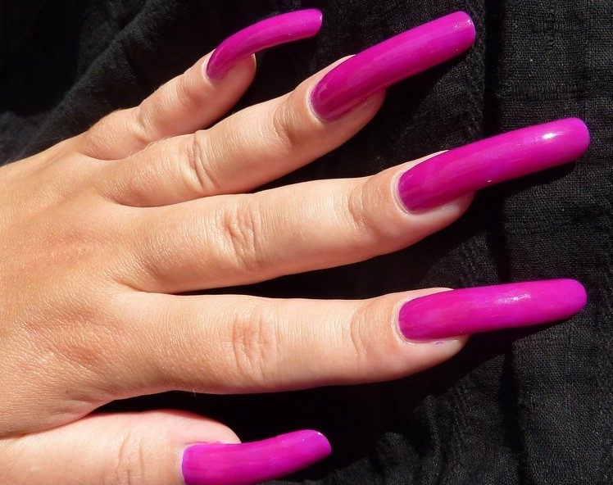
Fingernails
Do not wear artificial fingernails, extenders, or nail gel when having direct contact with patients
Keep natural nail tips less than ¼ inch long.

Slide 10
Questions?

