Slide 1
EMERGENCY OPERATIONS PLAN
St. Cloud VAHCS SharePoint
Blue Book Icon
January 2023

Slide 2
BASIC PLAN (MCP FM-07)
Allows the HCS to mitigate, prepare for, respond to, recover from, and restore essential services in any emergency.
In an emergency, life safety and patient care take precedence over all other responsibilities.
Any employee may take those actions necessary to mitigate, prepare for, respond to, recover from, and restore essential services in a threatened or real emergency.

Slide 3
BASIC PLAN
Except for CODE BLUE, all other notifications use plain language names.
CODE BLUE 6400
CRISIS RESPONSE 6213
FIRE 6333
VA POLICE 6224

Slide 4
ALERTS, NOTIFICATIONS, AND WARNINGS (SOP FM-07.02)
NOTIFICATION: Boiler Plant (steam whistle), Fire Alarm, and/or PA system
INTERNAL DISASTER
Signals Three 10 second steam whistle blasts with 5 seconds between each blast, and/or fire alarm, and/or PA system announcement

Slide 5
ALERTS, NOTIFICATIONS, AND WARNINGS
EXTERNAL DISASTER
HCS director will determine if an external disaster exists.
HCS director will activate the ICS.
During normal working hours designated staff will report to ICS

Slide 6
INCIDENT COMMAND SYSTEM
NOTIFICATION: Overhead page
HCS director oversees all emergency operations and directs initial response actions.
HCS Director may activate the Incident Command System, which is a standardized staff structure, organized by function, that is formed to help the Incident Commander manage any emergency.

Slide 7
ACTIVE THREAT (SOP FM-07.17)
NOTIFICATION: Staff will immediately contact VA Police at Ext 6224, 6355, or 6911 to give location, number of subjects, description, and weapons if known.
RESPONSE:
Staff have 3 options:
Evacuate (run)
Evade (shelter-in-place/hide)
Engage (fight)

Slide 8
BOMB THREAT/SUSPICIOUS PACKAGE (SOP FM-07.10)
NOTIFICATION: Verbal/Electronic Notification to VA Police or panic button, gain attention of another employee without alerting the messenger/threat.
LETTER/PACKAGE RESPONSE:
Handle it as briefly as possible
Call 6355 and report location
Inform Supervisor
Evacuate and/or secure area

Slide 9
BOMB THREAT
Phone Call Response: DO NOT PANIC
Use Bomb Threat Checklist
Keep caller on the line; ask them to repeat message
Record message if possible/write information about call
Have co-worker call 6355 to report the threat and notify supervisor
After call, give details to VA Police
Await directions from VA Police

Slide 10
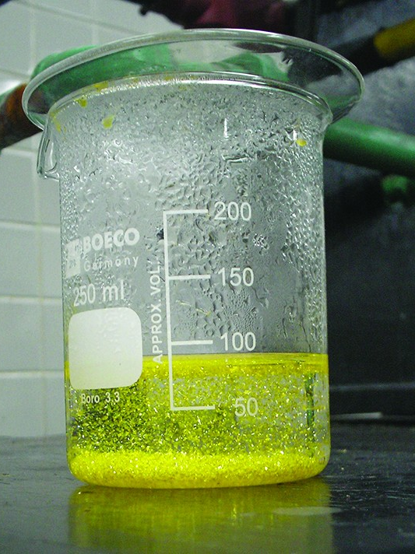
CHEMICAL SPILL (SOP FM-07.11)
NOTIFICATION: Call during normal business hours
Facilities Management Safety Ext 6364
GEMS Coordinator Ext 6508
OFF-TOUR:
Boiler Plant Ext 6347
VA Police Ext 6224
This Photo by Unknown Author is licensed under CC BY

Slide 11
CHEMICAL SPILL
RESPONSE: Clear the affected area and isolate the spill area to prevent others from coming in contact with the spill
Call the Garage (Ext 6452) to have drain covers brought to the location if the spill has or will affect a drain
Obtain Safety Data Sheet (SDS) for the spilled material and assess the hazard
Follow PPE and spill cleanup instructions found on the SDS
Notify Supervisor
Ensure a spill report is properly completed and submitted to FM personnel

Slide 12
Clinical Information Contingency Plan (SOP HAS 11.1)
NOTIFICATION: In the event of information technology and/or computer outages/downtime, the VistA Read Only (VistA-RO) Contingency Plan will be announced on the public address system.
Response: Staff will access the VistA-RO system.
The VistA-RO system is available from any computer desktop within the Health Care System 24/7.
VistA-RO is a real time, read only copy of patient clinical information
All charting activities that occur during the downtime will be electronically entered into CPRS once the system has been restored.

Slide 13
MAJOR FIRE PROCEDURES (FM-07.12)
NOTIFICATION: Audible alarms, flashing lights, and overhead page of FIRE, Fire Alarm, (location)
Response: Upon detection of smoke and/or fire:
Call Ext 6333 and/or pull nearest pull station
This Photo by Unknown Author is licensed under CC BY-NC

Slide 14
RACE
Rescue anyone in imminent danger
Alarm others in the area; do not hesitate to activate alarm pull boxes!
Contain the fire by closing doors.
Extinguish (only if safe to do so) and/or
Evacuate
Magnetic door locks will automatically open in affected areas
Telephone operators will page the “All Clear”
This Photo by Unknown Author is licensed under CC BY

Slide 15
P&LM EVACUATION PLAN
Primary Exit- Proceed out the north hallway, past the locker room, up the stairs to the outside. Meet at the bus stop.
Secondary Exit- Proceed through the lab waiting area, down the hallway to bldg. 1, up the stairs and out the front revolving door. Meet at the bus stop.
Tertiary Exit- Proceed down the hallway in RmA61(office area) through the fire door into Respiratory therapy. Proceed down the hallway to bldg. 1, up the stairs and out the front revolving door. Meet at the bus stop.

Slide 16
P&LM EVACUATION PLAN
Patients, visitors, employees with disabilities should be assisted by Lab staff to the safety exit.
Non-ambulatory patients will stay in the lab area with lab staff, VA police will be notified at Ext. 6224
Handicapped lab staff will be issued a buddy each day of work to assist.
Be aware of exits unavailable due to construction.

Slide 17
EVACUATION (SOP FM-07.9)
NOTIFICATION: Verbal notification and/or overhead page to affected area(s).
RESPONSE: Review department specific plans. Place evacuation placards as directed by supervisor.
Evacuation Options directed by your supervisor:
Shelter-in-Place: No evacuation. Stay put.
Horizontal Evacuation: Move to a safer place on the same floor.
Vertical Evacuation: Move to a safer place on a different floor.
Total Evacuation: Completely leave the building.

Slide 18
CODE BLUE/RAPID RESPONSE (SOP CD11-27.1)
DESCRIPTION: Medical Emergency or Rapid Response
NOTIFICATION: Digital Pagers and Overhead Page of CODE BLUE or Rapid Response
RESPONSE:
Call 6400 and report location
Tell the Operator the nature of the emergency and if it is a CODE BLUE or a Rapid Response
Tell the Operator the specific location of the person (i.e., Bldg 1A Rm A63).
Send someone to hallway to meet and direct the response team.

Slide 19
Crisis Response (SOP FM 07.26)
DESCRIPTION: Violent incidents or suicidal behavior.
NOTIFICATION: Call 6213 or provide verbal/electronic notification to nearby staff so they may call on your behalf.
RESPONSE:
Comply with reasonable demands without compromising the safety of yourself or others.
DO NOT disarm suspect
Evacuate affected area(s), if safe.
Employee(s) who experience violence report to Occupational Health and/or Emergency Department.
This Photo by Unknown Author is licensed under CC BY-SA

Slide 20
FACILITY LOCKDOWN/RESTRICTED ACCESS (SOP FM-07.22)
NOTIFICATION: Incident Commander may call ICS to generate an overhead page for the reason for the lockdown
RESPONSE:
Police will establish specific doors for both staff and Veterans to utilize during the lockdown at the Medical Center.
Follow your service line procedures for lockdown.

Slide 21
MASS CASUALTY (SOP FM 07.15)
DESCRIPTION: External Disasters may result in an influx of both Veteran and Community patients on a temporary basis.
NOTIFICATION: Overhead Page of Emergency Event
RESPONSE: As directed by Incident Commander

Slide 22
MISSING MINOR/MINOR ABDUCTION (SOP FM 07.23)
NOTIFICATION: Staff will immediately report any suspected incidence of a missing minor child to the VA Police at 6355.
RESPONSE: VA Police will coordinate response actions. Staff will conduct an immediate preliminary search of their area and report finding to VA Police.

Slide 23
MISSING PATIENT (SOP FM 07.18 AND SOP CD 11-23.04)
NOTIFICATION: Staff will immediately determine if the patient is missing or absent.
RESPONSE:
Accountable Staff Person (ASP) searches the immediate area.
If patient found, stop search, and report the close call event.
If not found, ASP contacts immediate supervisor to conduct further assessment.
Individual staff members support search activities as directed by supervisor.

Slide 24
SEVERE WEATHER (SOP FM 07.14)
NOTIFICATION:
Overhead Page of Severe Weather (description, instructions)
RESPONSE:
Staff in patient care areas will move patients away from windows.
Patients that cannot be moved should be covered with extra blankets, sheets, and pillows to protect from possible flying debris.
All other personnel shall return to their departments and move to safe areas (i.e., interior rooms, corridors without windows)

Slide 25
SHELTER IN PLACE (SOP FM 07.07)
Shelter in place is not a stand-alone action and is used as a response to an emergency
NOTIFICATION: Overhead Page of start time, reason, and expected duration
RESPONSE:
In an emergency, persons in immediate danger should seek safe refuge areas immediately.
Person not in immediate danger should shelter in place and wait for orders.

Slide 26
TRANSFER FOR VA FACILITIES (SOP FM 07.16 AND MCP CD 11-76)
NOTIFICATION: per Incident Commander
RESPONSE: Follow instructions and CD 11-76 inter/intra facility transfers
Implement service line/program specific plans.

Slide 27
UTILITY FAILURE (SOP FM 07.19)
NOTIFICATION:
During normal business hours: FM Work Order Clerk Ext 6245
Off tour hours: Boiler Plant Ext 6347
RESPONSE:Take necessary actions to protect
1. Patients
2. Staff and Visitors
3. Property and Equipment

Slide 28
LABORATORY EMERGENCY PREPAREDNESS PLAN (OPM 113-04 MEDIALAB SAF 3)
Medical Technologist, Technicians, Secretarial Staff
Call back cascade is initiated.
Receive briefing from lab manager or designee.
Read job action sheet pertinent to your job.
Perform functions as specified or directed by the Lab Manager or designee.
Secretarial staff will provide administrative support.

