Slide 1
Personal Protective Equipment
SOP
FM-02.05

Slide 2
Laboratory Policy on PPE
SAF 7 Chemical Hygiene Plan
SAF 9 Infection Control Plan
SAF 1 Pathology and Medicine Safety Program

Slide 3
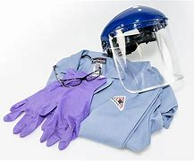
The Lab is responsible for:
Providing a Workplace Hazard Assessment
Procuring and buying appropriate PPE
Train Employees on the Use and Care of PPE
Maintain PPE
Ensure PPE use compliance.

Slide 4
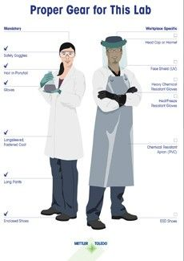
The Employee is responsible for:
Utilize appropriate PPE as directed by Lab.
Maintain PPE in clean, sanitary, and reliable condition.
Responsible for the replacement of prescription safety glasses that are lost or damaged, except when such loss or damage occurs in the performance of regularly assigned duties.
Report deficient, damaged, or lost PPE to their supervisor.

Slide 5
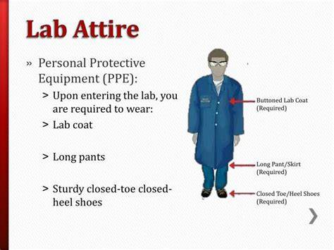
PPE
Used when engineering controls alone are not enough to protect employee.
Lab coats, gloves, and safety eyewear are the basic PPE needed in a lab. Additional PPE may be needed for other hazards.

Slide 6
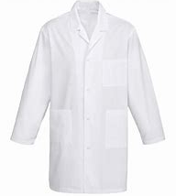
Lab Coat
A lab coat or other protective clothing should be worn whenever chemicals or biological materials are handled. The lab coat will protect the wearer’s personal clothing and exposed skin (such as on arms) from contaminants. Lab coats should be buttoned closed for best protection.

Slide 7
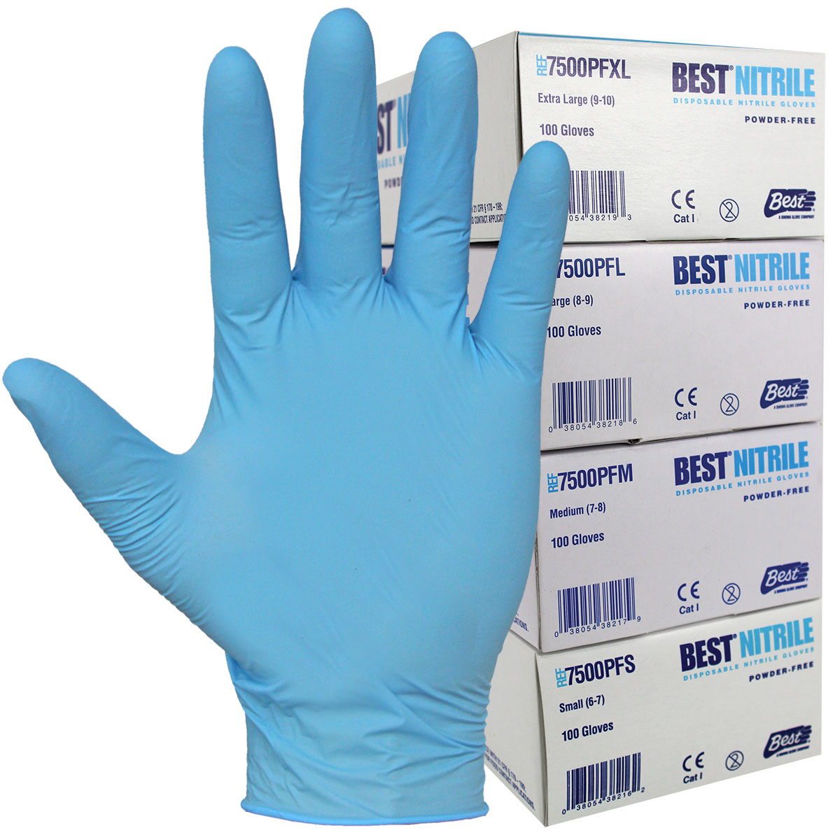
Gloves
Gloves should also be worn whenever handling hazardous materials, even in small quantities. It is important to choose the appropriate type glove for the hazard present, such as chemical resistant gloves, heat resistant gloves, etc. Be aware that no chemical resistant glove protects against all chemical hazards.
Should be well-fitting (not too big, not too small—just right)
Should be free of holes and tears.

Slide 8
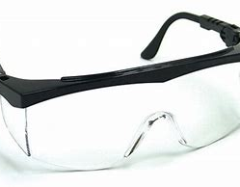
Safety Glasses
Eye and face protection is extremely important when working in a lab and must be worn if hazards exist that could cause injury.
Used whenever splashing is reasonably anticipated, or when the SDS instructs the user to use eye protection.

Slide 9
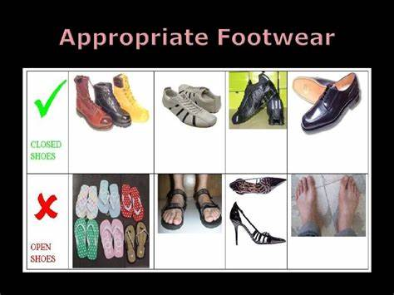
Footwear
Closed-toe shoes are also a must for lab workers; they protect against chemical splash, moving machinery, sharp objects, hot materials, and falling objects. Crocs or other shoes with holes in the tops are not appropriate foot protection.

Slide 10

Please watch this video about donning and doffing lab coats

Slide 11
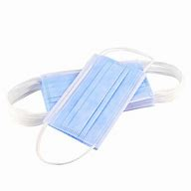
Face Masks
Face Masks help prevent the spread of droplets.
They are mandatory in the building and must be worn at all times.
Please refer to the St. Cloud VA Sharepoint COVID PPE page for more guidance.

Slide 12
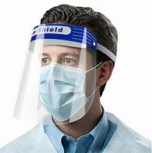
Face Shields
Face shields protect the entire face from projectiles and offers some protection from splashes.
Should be worn with all patient encounters.
Does not replace the need for a mask.
Can be used in lieu of safety googles in the lab.
Recommended use in urine department.

Slide 13
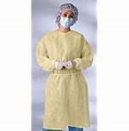
Droplet Protection
Gowns are used to protect the wearer from the spread of infection or illness if the wearer comes in contact with potentially infectious liquid and solid material. They may also be used to help prevent the gown wearer from transferring microorganisms that could harm vulnerable patients, such as those with weakened immune systems.

Slide 14
Respiratory Protection Program
SOP FM-02.06
STC Respiratory Protection Program - FM02-6E Respiratory Protection Program Annual Education Handout.pdf - All Documents (sharepoint.com)
Please read the handout and watch the videos

Slide 15
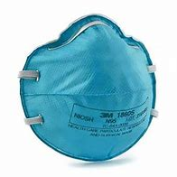
Respiratory
Inhalation is one of the principal routes by which harmful materials can enter the body. If an individual is exposed to a hazardous airborne concentration of such a material, then undesirable health effects can result.
VA supplied N95 respirators (must be Fit Tested) and PAPRs.
Fit Testing to occur initially on hire, when new styles are available, and yearly after.
Not to be used in low oxygen environments (<19.5 O₂)

Slide 16

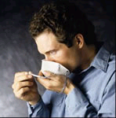
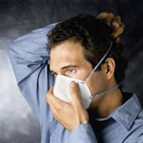
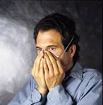
How do I use the N 95 Mask?
Cup the respirator in your hand with headbands facing up. Place under the chin first, then bring it up over the nose. Position the lower headband at the base of your neck and position the other headband on the backside of your head near the top. Proceed to mold the nose piece to your face.

Slide 17
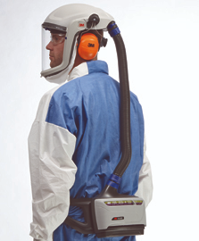
PAPR
Powered Air Purifying Respirator
Filter ambient air and provide workers with safe, breathable air. PAPR systems have a battery-powered blower that passes ambient air through a filter into the facepiece.

Slide 18
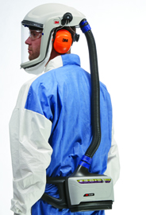
PAPR
Use when :
You can’t use N95
Shortage of N95 respirators
When recommended by VACO guidance
Currently recommended to wear a face mask underneath the PAPR hood.

Slide 19
PAPR
PAPR: Perform a visual inspection of the head gear, breathing tube and blower.
Attach breathing tube to headgear. Ensure cartridges haven’t been opened or expired. (Cartridge caps are already attached and ready to go).
Perform a flow check . Middle of ball in flow indicator must rise up to at least the 6 CFM location on flow meter. If not, check the breathing tube, battery and filter and repeat test.
Connect breathing tube to blower and secure with screw clamp. Attach PAPR and belt around your waist. Hook up battery.
Pull hood over your head and adjust so headband wraps around your head.
Tuck inner shroud under your protective clothing and allow outer shroud to hang outside your clothing.

Slide 20

COVID OUTBREAK PPE
Containment Zone
Keep Gown, N95, and face shield on between patients. Change gloves and perform Hand Hygiene between patients. Keep phlebotomy trays in the clean zone of the unit.
Convalescent Unit
Use Surgical mask, face shield, gloves, and gown. Change gown and gloves between patients.
Clean Unit
Use lab coat, surgical mask, face shield, and gloves. Change gloves between patients.

Slide 21
What PPE do I use?
Area | PPE required
Phlebotomy Outpatient | Mask, gloves, face shield, Lab coat
115 phlebotomy | Mask, gloves, face shield, Lab coat
115 COVID | N95, face shield, gown, gloves
Urgent Care | Mask, gloves, face shield, lab coat (may wear N95)
Urgent Care COVID | N95, face shield, gown, gloves
CLC | Low risk- mask, gloves, face shield, lab coat
 | High risk- N95, face shield, gown gloves
 | See outbreak slide

Slide 22
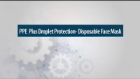
Please watch the following video

