Slide 1
Infection Control
Isolation and Precaution Signage on the CLC

Slide 2
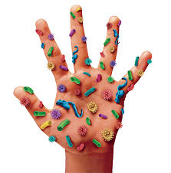

Slide 3
Hand hygiene
Frequent effective hand hygiene is the first line of defense in infection control.

Slide 4
Hand hygiene should always be done:
Before touching a patient
Before clean/aseptic procedures
After body fluid exposure/risk
After touching a patient
After touching patient surroundings.

Slide 5
washing hands with antimicrobial soap and water:
Wet hands first with water
Apply the antimicrobial soap to the hands
Rub the hands together vigorously for at least 15 seconds, covering all surfaces of the hands and fingers
Rinse hands with water and dry thoroughly with a disposable towel
Use a clean disposable towel to turn off the water.

Slide 6
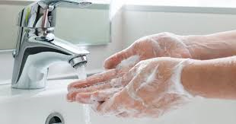
Washing with soap and water
Washing with soap and water should be done when hands are visibly soiled or when indicated by isolation signage.

Slide 7
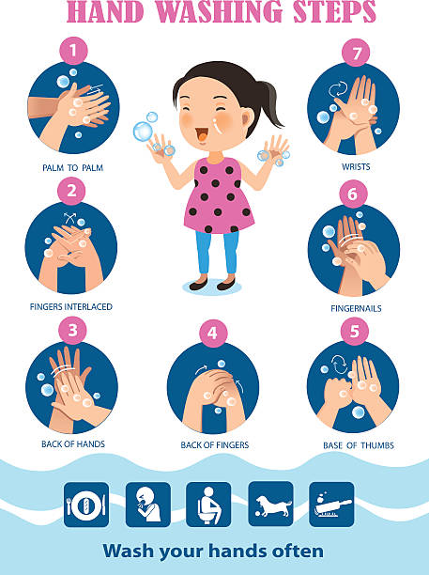

Slide 8

Alcohol-based hand sanitizer
Is recommended for use for all routine hand sanitizing

Slide 9
COVID PPE
SOP CD11-25.05 Management of COVID-19

Slide 10
Covid ppe
Masking required in High-risk areas
Urgent Care
Infusion
Oncology
Masking will be implemented when a unit is in outbreak status
CLC
Masks must be worn within 6 feet of a veteran.
Mask required if requested by veteran, caregiver, or family member

Slide 11
COVID PPE
Special Droplet, Contact Precautions, and respiratory protection (N95 or PAPR) will be utilized in all areas when caring for Veterans with confirmed or suspected COVID.
PPE required when collecting COVID sample:
N95/PAPR
Gown
Face shield/Eye protection
Gloves

Slide 12
Procedures to follow before entering an Isolation room:
Follow all directions on signage before entering isolation room.
Check the laboratory test orders and select the equipment needed.
Any supplies you take into the room must be left there or discarded.
Do not take trays into the isolation room.
Always leave lab trays in a secure area (e.g. behind counter at the nursing
station or in a locked cart).
Always change PPE between patients who are in the same room.
Hand hygiene should be completed upon entrance to the patient’s room and before exiting the room, after any contact with body fluid or OPIM and before and after gloving.
Additional PPE may be required. See Isolation Signage below.

Slide 13
Procedures to follow in the Isolation room:
Perform hand hygiene.
PPE should be put on before entering the isolation room. This should be located outside the patient’s room.
Perform phlebotomy, avoiding any unnecessary contact with the patient and the bed.
Dispose of blood collection equipment per facility policy.
Place the tubes in a biohazard bag. The bag serves as a secondary container, which will contain the specimen if the tubes break or leak in transit.
Remove personal protective equipment and dispose in proper containers inside the room.
Perform appropriate hand hygiene.

Slide 14
Enhanced Barrier Precautions:
Implemented when there is anticipated contact with a colonized/infected resident or their environment.
Does not require PPE upon entrance into the resident’s room when only talking to the resident.
PPE MUST be worn if it is anticipated that there will be contact with the resident or anything in the resident’s room.
Used for colonized MRSA patients.

Slide 15
Enhanced barrier precaution

Slide 16
Contact Precautions:
Implemented when transmission occurs from physical contact made with the infected resident or the resident’s environment.
Also pertains to situations where the presence of excessive wound drainage, fecal incontinence or other discharges from the body suggest an increased potential for extensive environmental contamination.
Includes all acute infections/admissions with MRSA, VRE, ESBL or other resistant organism, and all uncontained infections.
Personal protective equipment (gowns and gloves) must be used by everyone (staff, volunteers and visitors) upon entrance into the infected resident’s room.

Slide 17
Contact precautions

Slide 18
Droplet Precautions:
Implemented when transmission of diseases are caused by large respiratory droplets that are generated by coughing, sneezing, or talking.
Special air handling and ventilation are not required to prevent droplet transmission.
PPE: Follow instruction on signage. Wear a surgical mask if within 3 feet of the patient.
Handle items contaminated with respiratory secretions with gloves.
Includes influenza, meningitis, and meningococcal pneumonia

Slide 19
Droplet precautions

Slide 20
Droplet and Contact Precautions:
Implemented when the patient requires both precautions (i.e., pneumonia and MRSA), one is spread by droplet, and one is spread by contact.
PPE: Follow instruction on signage.

Slide 21
Droplet &Contact Precaution

Slide 22
Enteric and Droplet Precautions:
Used when a patient requires both precautions (i.e. C-Diff and pneumonia), one is spread by droplet and one is spread by contact but requires a soap and water hand-washing, and bleach cleaning to environment due to spores.
Follow instructions on signage

Slide 23
Enteric & Droplet Precaution

Slide 24
Enteric Precautions:
Used specifically for diseases such as Clostridium Difficile (C-Diff), Norovirus, Rotavirus and acute diarrhea with unknown etiology.
Private room required. Room must be cleaned with bleach.
Use disposable and dedicated equipment.
Follow instruction on the signage

Slide 25
Enteric Precautions

Slide 26
Airborne Precautions:
Implemented when transmission of infectious organisms remains suspended in air and travel great distances.
These diseases include measles, smallpox, and pulmonary tuberculosis.
Wear fit tested N-95 or PAPR.
A negative pressure room on 50-2 should be used until the disease has been ruled out.

Slide 27
Airborne Precautions

