Slide 1
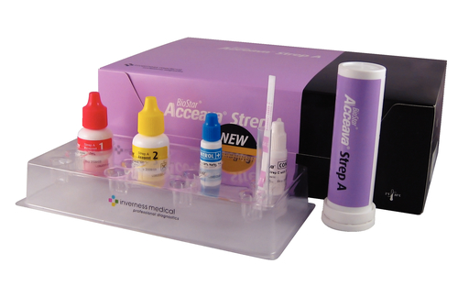
STREP A
BY ACCEAVA

Slide 2
Principle:
The BioStar Acceava Strep A Test is a qualitative, lateral flow immunoassay for the detection of Strep A carbohydrate antigen in the throat swab. In the test, antibody specific to Strep A carbohydrate antigen is coated on the test line region of the strip. During testing, the extracted throat swab specimen reacts with antibody specific to Strep A carbohydrate that is coated onto particles. The mixture migrates along the membrane. If the Group A Streptococcus antigen is present in the sample, it will form a complex with the anti-Group A Streptococcus antigen conjugated color particles. The complex will then be bound by the anti-Group A Streptococcus capture antibody and a visible red Test line will appear to indicate a positive result. To serve as a procedural control, a red line will always appear in the control region if the test has been performed properly. If the red line does not appear in the control region, the test is invalid.

Slide 3
SPECIMEN REQUIREMENTS:
Pharyngeal swab collected with a sterile polyester swab provided in the test kit.
Specimen collected from sources other than the throat or nasopharynx are unacceptable. Take care to avoid teeth, gum, tongue, or cheek surfaces.
Swabs with wooden shafts, calcium alginate, or cotton tips are unacceptable.
Transport in Modified Stuart’s liquid transport media is acceptable. Semi-solid transport media or media containing charcoal cannot be used.
Test the throat swab specimens as soon as possible after collection. Swabs can be stored in a clean, dry plastic tube at room temperature (15-30˚C) for up to 8 hours or refrigerated (2-8˚C) for up to 72 hours. Allow refrigerator swabs to reach room temperature (15-30˚C) prior to testing.
If a culture is also required, streak the culture plate with the swab before testing, or collect two separate swabs.

Slide 4
Interferences:
Poor throat swab collection technique may produce false negative results.
Excess blood or mucous on the swab specimen may interfere with the test performance and may yield a false positive results.
Avoid touching the tongue, cheeks, and teeth and any bleeding areas of the mouth with the swab when the collection specimens.
If the level of antigen present in a sample is below the sensitivity of the test, the result will be false negative. Studies have shown that the Acceava Strep A test kit detected 96% of the low and medium positive samples.
The Acceava Strep A Test does not differentiate between viable and nonviable Group A Streptococci.

Slide 5
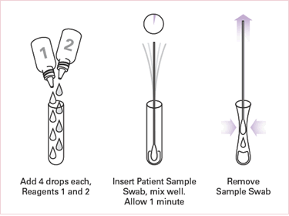
PROCEDURE:
Just before testing, add 4 drops of Reagent 1 (pink to light red) and 4 drops of Reagent 2 to the Test Tube. The solution should turn light yellow.

Slide 6
Immediately insert patient’s throat swab into the Test Tube of pale yellow solution. Rotate the swab 10 times in the tube. Leave the swab in the tube.
Let stand 1 minute.
Express as much liquid as possible from the swab by squeezing the sides of the tube as the tube is withdrawn.
Discard the swab.
Remove Test Stick from the container. Recap the container immediately.
Place the Absorbent End of the Test Stick (arrows pointing down) into the extracted sample.
Read the results in 5 minutes. A positive result may be read as soon as the red Test Line AND the red Control Line appear. Weak positive and negative results require

Slide 7
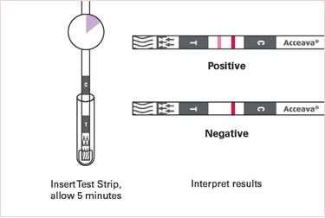
Procedure con’t:
NOTE: Do not read the results after 10 minutes.

Slide 8
RESULTS REPORTING:
Positive Result: A red Test Line AND a red Control Line MUST be present for the test result to be positive for the detection of Group A Streptococcus antigen. Note: A red line which appears uneven in color density is considered a valid result. In cases of moderate or high positive specimens, some red color behind the Test Line may be seen; as long as the Test Line and Control Line are visible, the results are valid.
Negative Result: The presence of red Control Line but no red Test Line is a negative result.
Invalid Result: If no Control Line appears or background color makes reading the red Control Line impossible, the result is invalid. If this occurs, repeat the test using a new Test Stick.

Slide 9
STORAGE:
Store test kit and reagents tightly capped at room temperature (15-30˚C) or refrigerated (2-30˚C) or refrigerated (2-30˚C).
Do not use Test Kit and reagents after the expiration date.
Do not interchange or mix components from different kit lot numbers.
The Test strips must remain in the closed canister until use. Record the initial opening date on canister.
Once the canister is opened, the remaining test strips are stable for 12 months. Do not use beyond the expiration date.

Slide 10
SUMMARY:
Streptococcus pyogenes is non-motile gram-positive cocci, which contains the Lancefield group A antigen that can cause serious infections such as pharyngitis, respiratory infection, impetigo, endocarditis, meningitis, puerperal sepsis, and arthritis. Left untreated, these infections can lead to serious complications, including rheumatic fever and peritonsillar abscess. Tradition identification procedure for Group A Streptococci infection involve the isolation and identification of viable organisms using techniques that require 24 to 48 hours or longer.

