Slide 1
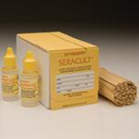
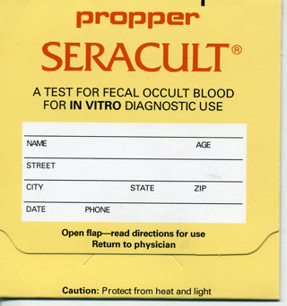
Fecal Occult Blood
Seracult

Slide 2
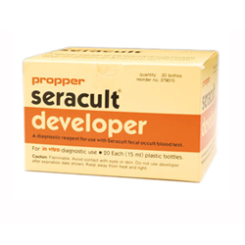
Fecal Occult Blood (Seracult)
The seracult test is a rapid acceptable method of detecting fecal occult blood. It is used as an aid to diagnose various gastrointestinal conditions which are sometimes found in stool specimens.
Due to its design and ease of handling, it is routinely used in physical examinations, hospital screening for colorectal cancer.

Slide 3
Fecal Occult Blood
When a small smear from stool sample is applied to the paper, the hemoglobin from the blood contacts with the impregnated guaiac on the slide. Two drops of developer is applied and will turn blue if positive. Negative is no change in color.
These results should not be considered conclusive. Other procedures such as endoscopy, barium enema, or x-ray studies should be considered by a physician.

Slide 4
Policy
Seracult test will only be used as a screen for the presence or absence of gastrointestinal bleeding.
Test will be performed by Physicians, nursing staff, and laboratory personnel who are trained.
All kits will be obtained from the laboratory.

Slide 5
Storage and Stability
Seracult slides and developer should be stored 15-30˚C.
Slides are stable until the expiration date printed on each box.
If properly stored, developer will remain stable for until the expiration date printed on the bottle.
Do NOT refrigerate or freeze test kit.

Slide 6
Specimen Collection and Storage
If possible, the patient should be placed on a meat-free low-peroxidase diet to reduce the possibility of false positive indications 2 days before and through out the testing period.
Specimen required is a small stool sample which should be applied as a VERY THIN SMEAR onto both windows of the Seracult slide.
Slide may be developed immediately after specimen application or may be stored and developed up to 8 days after specimen application.
Recommended collections for these are preferably on 3 different days. Thin smears on 3 cards with date and time are acceptable.

Slide 7
Quality Control
The test kit does not have a negative and positive external quality control but a Performance Control area that verifies the reactivity of the paper and developer used in each Seracult slide test.
Any blue color in this area acts as verification of correct product performance.
The Performance Control area of the cards need to be completed with each test.
A lack of blue color in the Performance Control Area after proper development indicates that the slide test is not performing to product specifications.
Specimen test needs to be repeated if the performance control fails.

Slide 8
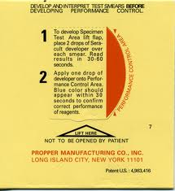
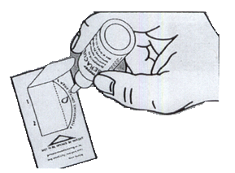
Quality Control
Lift tab to reveal internal quality control area
Internal quality control area

Slide 9
Procedure
Open front flap of slide.
Collect a small sample of stool on one end of the applicator stick. Apply a VERY THIN SMEAR to one window. Wipe applicator clean.
From another part of the stool, collect another small sample using the same applicator as before and apply to the other window.
Close front flap.
Open perforated cover on back of slide.

Slide 10
Procedure
Apply 2 drops of developer solution to each smear in the Specimen Test Area.
Read results within 30-60 seconds. ANY TRACE OF BLUE IS POSITIVE FOR OCCULT BLOOD. Color begins to fade after 2-4 minutes.
Develop the performance control ONLY AFTER SPECIMENT TESTS HAVE BEEN COMPLETED AND INTERPRETED. Apply one drop of developer solution to the Performance Control line. Blue color should appear within 30 seconds indicating that the slide test is performing to product specifications.

Slide 11
Interpretation of Results
Any trace of blue color in the Specimen Test Area is Positive for the presence of occult blood.
Presence of blue color even in one smear is Positive for the presence of occult blood.
The absence of a blue color in the Specimen Test Area is Negative for the presence of occult blood.
Report patient results only after you have confirmed the internal control (Performance Control Area) as positive (blue).

Slide 12
Documentation of Patient and Performance Control Result
POCT personnel developing Seracult slides must document patient results on the test log.
They MUST document the results of the Performance Control Area. Do NOT report patient results unless internal quality control is acceptable.
The test log must also include the date of testing, testing personnel initials, provider, sign or symptom, patient initials, patient’s medical record number and EHR entry.
All patient and performance control results must be entered into EHR or RPMS.

Slide 13

Remember…
Presence of blue color even in only one smear is positive for presence of occult blood.
Results for patients and internal QC results must be recorded at the Point of Care Stations in the test log.
Specimen test results from a slide which fails the Performance Control Test should be considered invalid and the test repeated.
The Seracult tests cannot be used to test for occult blood in gastric contents.
Do not interchange test kits.

