Slide 1
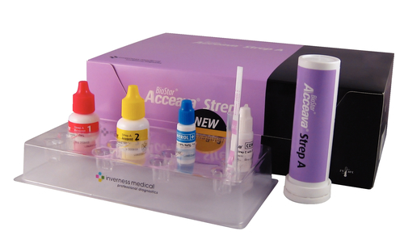
STREP A
BY ACCEAVA

Slide 2
Principle
The BioStar Acceava Strep A Test is a rapid, lateral flow immunoassay for the qualitative detection of Strep A antigen from throat swabs. To aid in the diagnosis of Group A Streptococcal infection.
Streptococcus pyogenes is non-motile gram-positive cocci, which contains the Lancefield group A antigen, that can cause acute upper respiratory tract infection. Early diagnosis and treatment has been shown to reduce the severity of symptoms and further complications.
Antibody specific to Strep A carbohydrate antigen is coated on the test line region of the strip. During testing, the extracted throat swab specimen reacts with an antibody to Strep A that is coated on particles. The mixture migrates up the membrane to react with the antibody to Strep A on the membrane and produces a red line in the test region.

Slide 3
STORAGE
Store test kit and reagents tightly capped at room temperature (15-30˚C) or refrigerated (2-30˚C).
Do not use Test Kit and reagents after the expiration date.
Do not interchange or mix components from different kit lot numbers.
The Test strips must remain in the closed canister until use. Record the initial opening date on canister.
Once the canister is opened, the remaining test strips are stable for 12 months. Do not use beyond the expiration date.

Slide 4
SPECIMEN REQUIREMENTS
Use the sterile rayon swabs supplied with the kit. Double swabs with transport tubes containing liquid media and modified Stuart’s Transport media are also acceptable.
Collect specimens with a sterile swab from the tonsils and/or the back of the throat. Avoid the teeth, gums, tongue, or cheek surfaces and any bleeding areas of the mouth.
Do not use swabs with wooden shafts, calcium alginate, or cotton tips. Do not use a collection system that contains charcoal or semi-solid transport media.
Test the throat swab specimens as soon as possible after collection. Swabs may be stored at room temperature (15-30˚C) for up to 8 hours or refrigerated (2-8˚C) for up to 72 hours. Allow refrigerated swabs to reach room temperature (15-30˚C) prior to testing.
If a culture is also required, streak the culture plate with the swab before testing, or collect two separate swabs.

Slide 5
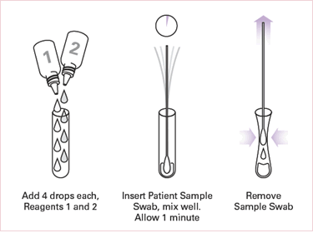
PROCEDURE
Add 4 full drops of Reagent 1 (pink to light red) and add 4 full drops of Reagent 2 (colorless) to the Extraction Test Tube. The solution should turn light yellow. Tap the bottom of the tube gently to mix the liquid.

Slide 6
Procedure continued
Immediately add the patient’s throat swab into the Test Tube of pale yellow solution.
Rotate the swab 10 times in the tube.
Leave the swab in the tube for one minute.
Press the swab against the side of the tube and squeeze the bottom of the tube while removing the swab so that most of the liquid stays in the tube.
Discard the swab.
Remove the test strip from the container and use it as soon as possible. Recap the container immediately. Once opened, the remaining test strips are stable for 12 months.
With arrows pointing down, place the test strip into the tube of solution and start the timer.
Leave the strip in the tube and read the results at 5 minutes. The result is invalid after 10 minutes.

Slide 7
Procedure continued
NOTE: Do not read the results after 10 minutes.
Any trace of red is positive.

Slide 8
Internal Quality control
Internal procedural controls are included in the test.
A red line appearing in the control region (C) is an internal positive procedural control. It confirms sufficient specimen volume and correct procedural technique.
A clear background is an internal negative background control. If the test is working properly, the background in the result area should be white to light pink and not interfere with the ability to read the test result.
Internal quality control must be recorded on the patient log sheet with each test.

Slide 9
External Quality control
Positive and negative controls must be run with each new lot number and with each new untrained operator. External positive and negative controls are supplied in the kit.
Each new untrained operator will be required to run positive and negative controls before performing patient testing.

Slide 10
External quality control
Procedure for External Quality Control:
Add 4 full drops of Reagent 1 and 4 full drops of Reagent 2 into and extraction test tube. Tap the bottom of the tube gently to mix the liquid.
Add 1 full drop of positive OR negative control solution into the tube, holding the bottle upright.
Place a clean swab into the tube. Rotate the swab 10 times in the tube.
Leave the swab in the tube for 1 minute. Then press the swab so that most of the liquid stays in the tube. Discard the swab.
Continue with Step 7 from above.

Slide 11
Interpretation of results
Positive Result: Two distinct red lines appear. One line should be in the control region (C) and another line should be in the test region (T). A positive result indicates that Strep A was detected by the sample. Any shade of pink or red is positive.
Negative Result: One red line appears in the control region (C). No apparent red or pink line appears in the test region (T). A negative result indicates that Strep A is not present in the sample, or is present below the detectable level of the test.
Invalid Result: Control line fails to appear. If no Control Line appears or background color makes reading the red Control Line impossible, the result is invalid. If this occurs, repeat the test procedure.

Slide 12
DOCUMENTATION OF PATIENT AND PERFORMANCE CONTROL RESULTS
Personnel performing the Rapid Strep test must document results on the test log.
The results of the Internal Quality Control must be documented. Do not report patient results unless quality control is acceptable.
The results must also include the date of testing, patient initials, medical record number, sign/symptom, medical provider, patient result, internal quality control result, testing personnel initials, and EHR entry.
All patient and performance control results must be entered into EHR.

Slide 13
Interferences
The test should be used for the detection of Strep A antigen in throat swab specimens only.
A negative result may be obtained if the concentration of the Strep A antigen in the throat swab is not adequate or is below the detectable level of the test.
Excess blood or mucous on the swab specimen may interfere with the test performance and may yield a false positive results.
The test will only indicate the presence of Strep A antigen in the specimen from both viable and nonviable Group A Streptococcus bacteria.
As with all diagnostic tests, all results must be interpreted together with other clinical information available to the physician.

