Slide 1
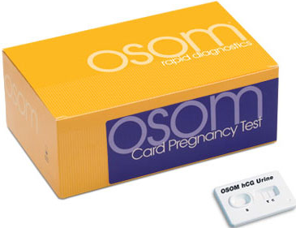
Urine Pregnancy Test hCG
HHCC Laboratory

Slide 2
Principle
Human chorionic gonadotrophin (hCG) is a glycoprotein hormone secreted by the developing placenta. After fertilization, the concentration of hCG rapidly rises in both the urine and serum of pregnant women.
The OSOM Card Pregnancy Test is a rapid test which one can detect the presence of hCG in urine.
For the qualitative detection of human chorionic gonadotrophin (hCG) in urine as an aid in the early determination of pregnancy.

Slide 3
Policy
Urine pregnancy test will be done utilizing the OSOM Card Pregnancy test kit.
Only nursing and medical staff who have had documented and demonstrated competency assessment for the point of care testing locations will perform urine pregnancy testing.
Urine pregnancy testing is for screening purposes only.

Slide 4
Materials Required
OSOM Card Pregnancy Test Device
Disposable pipette (contained in kit)
Clock or Timer
Collection Cup
Positive and Negative Controls

Slide 5
Storage & Stability
Store OSOM Pregnancy Test Kits at room temperature (15°-30°C), out of direct sunlight.
Test devices are stable until the expiration date printed on the kit or foil pouch
DO NOT freeze.

Slide 6
Specimen Collection
Urine specimen collected in a clean, dry, sterile container without preservatives.
The first morning specimen of urine is recommended since it usually contains the highest concentration of hCG. However, specimens collected at random may also be used.
Urine specimen may be stored at room temperature (15°-30°C) for up to 8 hours, or refrigerated at 2°-8°C for up to 72 hours.
If specimen has been stored refrigerated, allow it to warm to room temperature before use.

Slide 7
Internal Quality Control
The appearance of the control band in the results window is an internal positive procedural control which validates the following:
  Test System: The appearance of the control band assures that the detection component of both the test line and control line is intact, that adequate sample volume was added and that adequate capillary migration of the sample has occurred. Also, verifies proper assembly of the Test Device.
  Operator: The appearance of the control band indicates that an adequate volume of fluid was added to the sample well for capillary migration to occur. If the control band does not appear at the read time, the test is invalid.
  The clearing of the background in the results area may be documented as a negative procedural control. It also serves as an additional capillary flow control. At the read time, the background should appear white to light gray and not interfere with the reading of the test. The test is invalid if the background fails to clear and obscures the observation of a distinct control band.
  Results of the internal quality control will be recorded with each patient test.

Slide 8
External Quality Control
Two levels of quality control need to be tested, negative and positive.
  KOVA-Trol I – Negative Control
  KOVA-Trol III – Positive Control.
The negative and positive controls are to be tested bi-weekly and with each new box of test kit opened.
The following control results must be obtained before reporting patient results:
  Level 1 Negative Control: No band in the test window (T) and one gray band in the control window (C).
  Level 2 Positive Control: One gray band in the test window (T) and one gray band line in the control window (C).
  Internal Positive Control: A gray band in the control window (C) confirms that a sufficient sample volume was delivered and that the correct procedure was used.
  Internal Negative Control: A white to light gray background area indicates that the test is working properly.
Results of the quality control must be recorded in the Point of Care QC logbook.

Slide 9
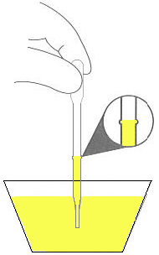
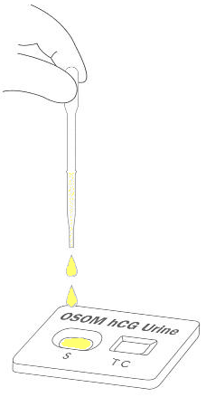
Procedure
Remove the Test Device and the pipette from the pouch. Place the device on a flat surface.
Squeeze the bulb of the pipette and insert the barrel into the patient sample. Release the bulb and draw up enough sample to fill the barrel to the line indicated on the pipette. Do not overfill.
Expel the entire contents of the barrel (135 µL) into the sample well of the Test Device. No drop counting required.
Discard the pipette in a biohazardous waste container.
Read results at 3 minutes.
Results are invalid after the stated read time.

Slide 10
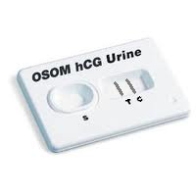
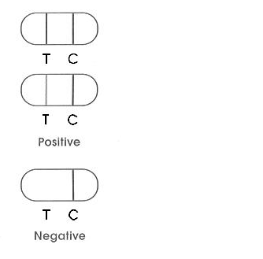
Interpretation of Results
Positive Result: Two separate black or gray bands, one at (T) – Test area, and the other at the (C) – Control area, are visible in the results window, indicating that the specimen contains detectable levels of hCG. While the intensity of the test band may vary with different specimens, the appearance of 2 distinct bands should be interpreted as a positive result.
  Note: If the test band appears very faint, it is recommended that a new sample be collected 48 hours later and tested using another OSOM Card Pregnancy Test Device.
Control Area
Test Area

Slide 11
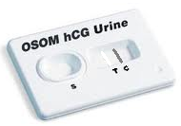
Interpretation of Results
Negative Result: If no band appears at the (T) – Test area and a black or gray band is visible at the (C) - Control area, the test is considered negative, indicating that the specimen contains no detectable level of hCG.
Control Area
Test Area

Slide 12

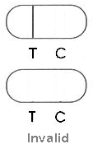
Interpretation of Results
Invalid Result: If no band appears at the (C) - Control region, the test is invalid. The test is also invalid if incomplete or beaded bands appear at the (T) Test or (C) Control region. The test should be repeated using another device.
  Note: The test is valid if the control line appears by the stated read time regardless of whether the sample has migrated all the way to the end of the sample window.
Control Area
Test Area

Slide 13
Documentation of Patient and QC Results
POCT personnel performing the Pregnancy Test (hCG) must document patient results on the test log.
In addition they must document the results of the Control Area (Internal QC). Do not report patient results unless quality control is acceptable.
The test log must also include the date of testing, patient initials and medical record number, testing personnel initials, provider, and sign or symptom.
All patient and performance control results must be entered into EHR.

Slide 14
Limitations
This assay is capable of detecting only whole molecule (intact) hCG, which is the predominant form of hCG in early pregnancy. It cannot detect the presence of hCG fragments or free subunits.
In later term pregnancies (beyond the first trimester), occasionally urine samples can contain very high levels of hCG fragments. Therefore, the OSOM Card Pregnancy Test is most effective when used for the detection of pregnancy in its earlier stages.
For diagnostic purposes, hCG test results should always be used in conjunction with other methods and in the context of the patient’s clinical information (e.g., medical history, symptoms, results of other tests, clinical impression, etc.). Ectopic pregnancy cannot be distinguished from normal pregnancy by hCG measurements alone.

Slide 15
Limitations
If the hCG level is inconsistent with, or unsupported by, clinical evidence, results should also be confirmed by an alternative hCG method. Test results should be confirmed using a quantitative hCG assay prior to the performance of any critical medical procedure.
Because of the high degree of sensitivity of the assay, specimens tested as positive during the initial days after conception may later be negative due to natural termination of the pregnancy. Overall, natural termination occurs in 22% of clinical unrecognized pregnancies and 31% of other pregnancies. In the presence of weakly positive results, it is good laboratory practice to sample and test again after 48 hours.

Slide 16
Limitations
Detection of very low levels of hCG does not necessarily indicate pregnancy as low levels of hCG can occur in healthy, nonpregnant subjects. Additionally, post-menopausal specimens may elicit weak positive results due to low hCG levels unrelated to pregnancy. In a normal pregnancy, hCG values double approximately every 48 hours. Patients with very low levels of hCG should be sampled and tested again after 48 hours, or tested with an alternative method.

