Slide 1
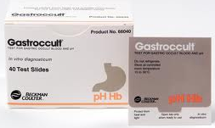
Gastroccult
Test For Gastric Occult Blood and pH

Slide 2
Purpose
Gastroccult is a rapid screening test to detect the presence of occult blood and determine the pH of gastric aspirate or vomitus.
The identification of occult blood can be useful in the early detection of gastric trauma or deteriorating gastric condition, while pH may be of use in evaluating antacid therapy.
The Gastroccult test is not recommended for use with fecal samples.

Slide 3
Summary
The Gastroccult slide includes both a specially buffered guaiac test for occult blood and a pH test based on the principle that certain dyes change color with changes in hydrogen ion concentration.
This test is designed to be used with gastric samples since the occult blood test is not affected by low pH.
When a gastric specimen containing blood is applied to Gastroccult test paper, the hemoglobin from lysed blood cells in the sample comes in contact with the guaiac. Application of the Gastroccult developer causes a peroxidase-like reaction which turns the test paper blue if blood is present.

Slide 4
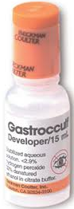
Materials Required
Gastroccult Slides
For In Vitro Diagnostic Use
Protect slides from open air.
Keep slides sealed inside special wrapper until ready to use.
Developer
Should be protected from heat and the bottle kept tightly capped when not in use.
Gastroccult developer is an irritant. Avoid contact with the skin. Do not use in eyes.
Do NOT Use the developer and slides after the expiration dates.

Slide 5
Storage & Stability
Do not refrigerate or freeze.
Store slides at controlled room temperature (15-30˚C).
Do not store slides and developer near volatile chemicals (e.g. iodine, ammonia)
The slides and developer will remain stable until the expiration dates which appear on each slide and developer bottle.
Protect from heat and light.

Slide 6
Specimen Collection
A gastric aspirate obtained by nasogastric intubation or vomitus are appropriate samples for use with the Gastroccult test. Sample may be applied by using applicators, or by any other method whereby a drop of sample is applied to the reaction areas.
It is recommended that the samples be tested immediately after collection. If this not possible, the following procedure will yield satisfactory results:
Apply the sample in the pH Test area and Gastroccult Test Area (for occult blood). Read the pH within 30 seconds after sample application. The Gastroccult Test Area may be developed immediately or up to 4 days after sample application; Store at room temperature.
Samples for occult blood testing may be stored, prior to application, in a cleaned sealed container (plastic or glass) for 24 hours at room temperature or 5 days refrigerated.

Slide 7
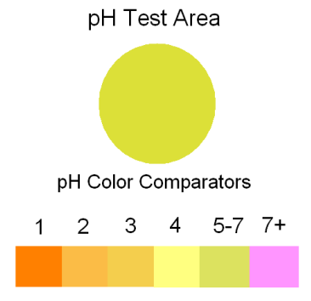
Procedure
Important: This test requires only Gastroccult Developer. Do not use Hemoccult Developer or any other Developing Solution.
Open Slide.
Apply one drop of gastric sample to pH test circle and one drop to occult blood test area.
Determine pH of sample by visual comparison of test area to pH color comparator. This MUST be done within 30 seconds after sample application.

Slide 8
Procedure
Apply 2 drops of Gastroccult Developer directly over the sample in the occult blood test area.
Important: Some gastric samples may be highly colored and appear as blue or green on the test area. Test results should only be regarded as positive if additional blue is formed after Gastroccult Developer is added.
Read occult blood results within 60 seconds. The development of any trace of blue color in the occult blood test area is regarded as a positive result. Record results on patient log.

Slide 9
Procedure
Add drop here
Apply one drop of Gastroccult Developer between the positive and negative Performance Monitor areas. A blue color will appear in the positive Performance Monitor area within 10 seconds. The color will remain stable for at least 60 seconds.
Interpret the Performance Monitor results and record on the patient test log.

Slide 10
Procedure
No blue should appear in the negative Performance Monitor area when developer is added.
Note: If the sample is applied in such a way that it contacts the Performance Monitor areas, the negative Performance Monitor area may appear positive. This should be avoided.
Any blue originating from the Performance Monitor areas should be ignored when reading the specimen test results.

Slide 11
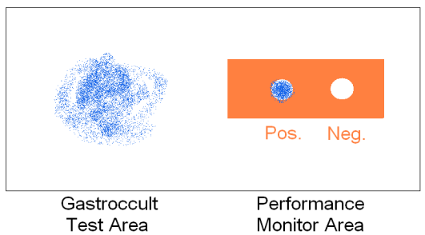
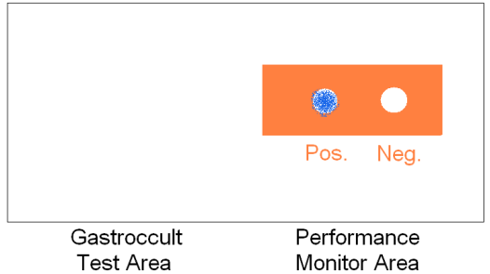
Interpreting Results
The development of any trace of blue color in the Gastroccult Test Area is a positive result.
No shade of blue is a negative result

Slide 12
Interpreting Results
Determine pH of sample by visual comparison of pH Test Area to ph Color Comparators. Read results within 30 seconds.
Note: Because this test is visually read and requires color differentiation, it should not be interpreted by individuals who are colorblind or the visually impaired.

Slide 13
Internal Quality Control
The function and stability of the guaiac paper and developer can be tested using the on-slide Performance Monitor feature located to the right of the occult blood test area.
The positive Performance Monitor area contains a hemoglobin-derived catalyst which, upon application of developer, will turn blue within 10 seconds. The color will remain stable for at least 60 seconds.
The negative Performance Monitor area contains no such catalyst and should not turn blue upon application of developer.
The Performance Monitor Area must be performed with each patient test.

Slide 14
External Quality Control
Quality control of the pH test portion of the Gastroccult slide must be performed bi-weekly using buffered referenced standards. Also, with each new lot number.
Two levels of buffer standards:
A neutral pH 7
An acid pH 2

Slide 15
Documentation of Patient & Quality Control Results
Personnel performing the Gastroccult test must document results on the patient test log.
The results of the Performance Control must be documented (“OK” or “Unsat”). Do not report patient results unless internal quality control is acceptable.
In addition to patient results, the following must also be documented: date of testing, patient initials, medical record number, sign/symptom, provider, internal quality control, testing personnel initials, and EHR entry.
All patient and performance control must be entered into EHR.

Slide 16
Limitations
As with any occult blood test, the results of the Gastroccult test cannot be considered conclusive evidence of the presence or absence of upper gastrointestinal bleeding or pathology.
NOTE: Many foods (e.g., incompletely cooked meat, raw fruits, vegetables, etc) have peroxidase activity which can produce a positive test result. Thus, a positive test result does not always indicate the presence of human blood.
The Gastroccult test is designed for use as a preliminary screening aid and is not intended to replace other diagnostic procedures.
A positive test result may suggest the need for more careful monitoring of the patient.

Slide 17
Interfering Substances
It is unlikely that there will be any inhibition of the occult blood test by antacids if gastric samples are tested no sooner than 60 minutes after last antacid administration and stomach irrigation.
Antacid products containing magnesium hydroxide (e.g., Mylanta II and Maalox Plus) exhibit the most inhibitory effect on the test.
Ascorbic acid (vitamin C) has been shown to cause false-negative test results for occult blood. This may also occur with the Gastroccult test.

