Slide 1
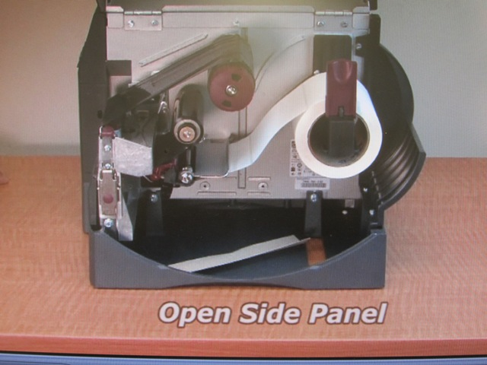
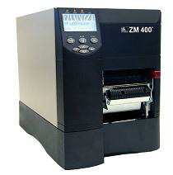
ZM 400 DIGI-TRAX LABEL MAKER Label and Ribbon Loading Guide
Overview:
Ribbon Take-up Spindle
Label Supply Guide
Label
Print Head Assembly
Label Supply Hanger
Print Head Release latch
Ribbon Supply Spindle
Dancer Assembly
Label Guide

Slide 2
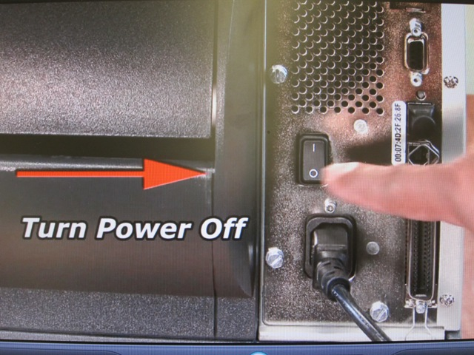
Installing the ZM 400 Label and Ribbon
To Avoid Shock and Prevent Equipment Malfunction always Turn the Power off .

Slide 3
Note: ZM Strongly recommends the use of Zebra-brand supplies for continuous high-quality printing. A wide range of paper stock has been engineered to enhance the printing capabilities of the printer and to prevent premature print head wear.

Slide 4
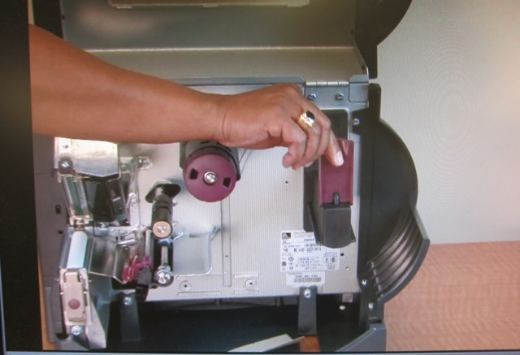
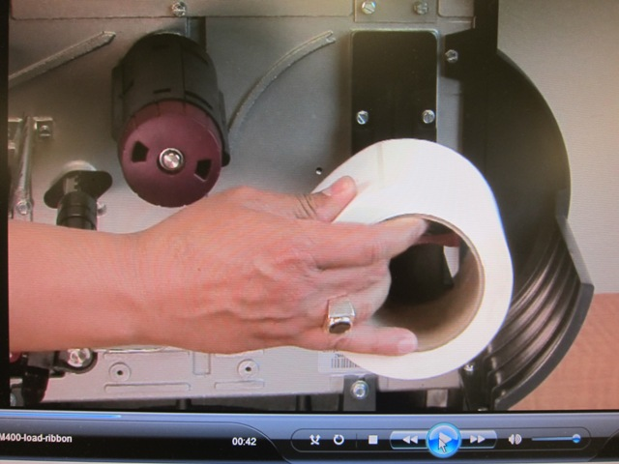
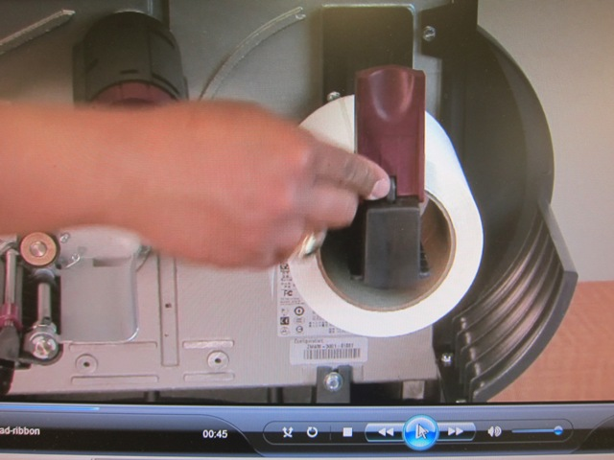
N
1. Open the side panel.
Flip down the Label supply guide.
1
1
2
2. Place the roll of label on the label supply hanger. Push the roll as far back as it will go
3.Flip up the label supply guide until it touches the edge of the roll.
Label supply guide
3

Slide 5
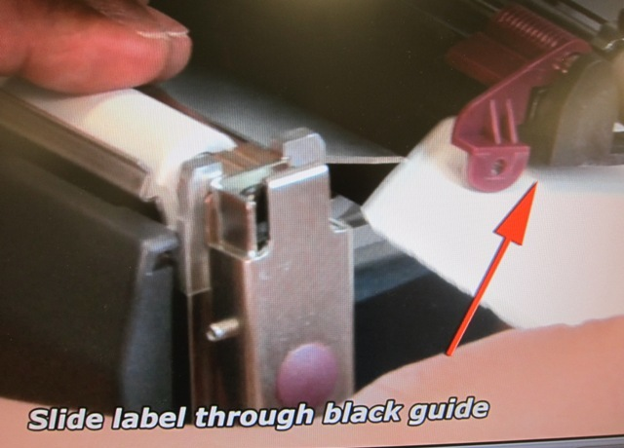
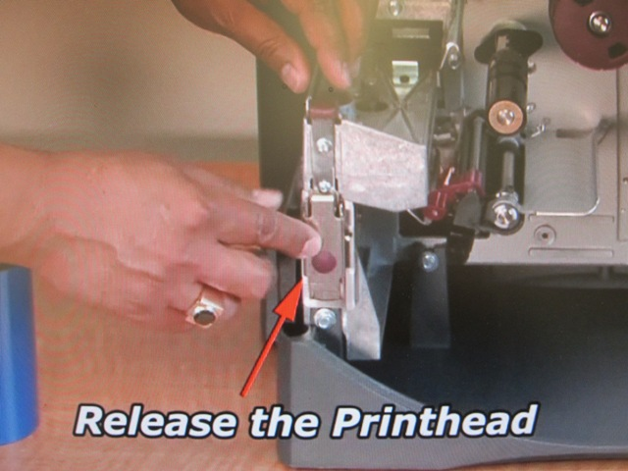
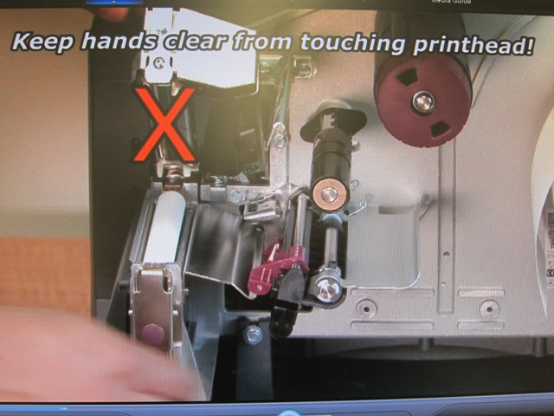
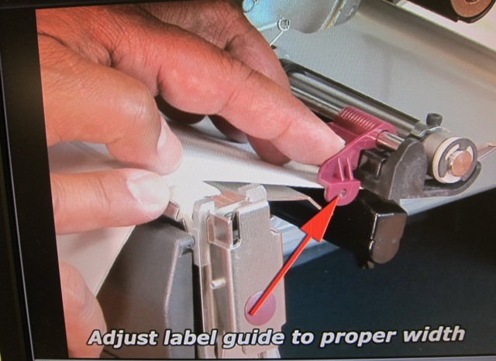
4
5
NOTE:
5
6

Slide 6
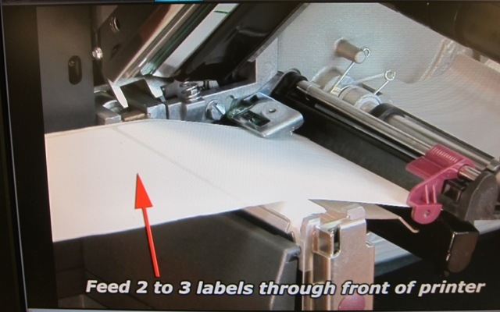
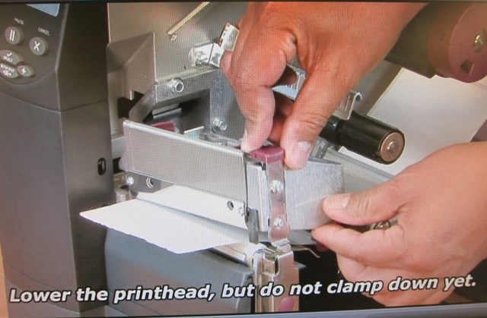
7
Note: By default the printer automatically calibrates on power up or when the print-head is closed. During auto calibration the printer determines the label length and sensor settings.( If you only installing the label ,closed the print head and power up)
The ZM 400 is ready for printing.
8

Slide 7
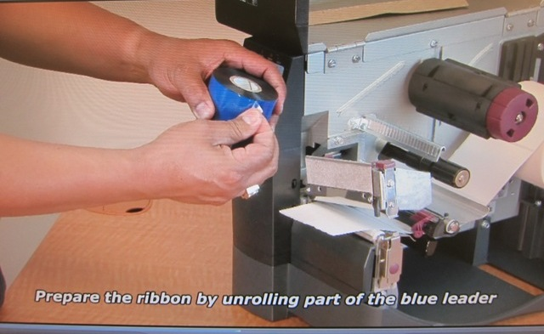
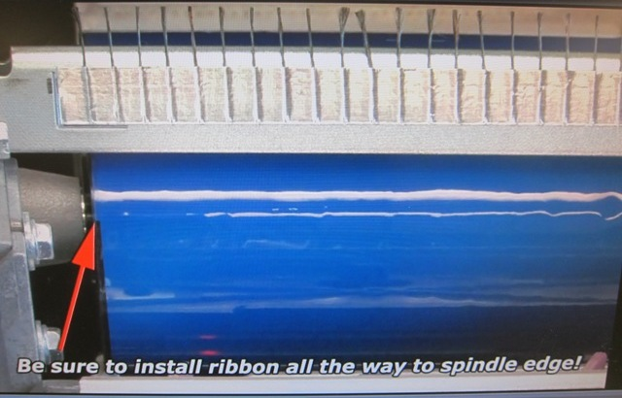
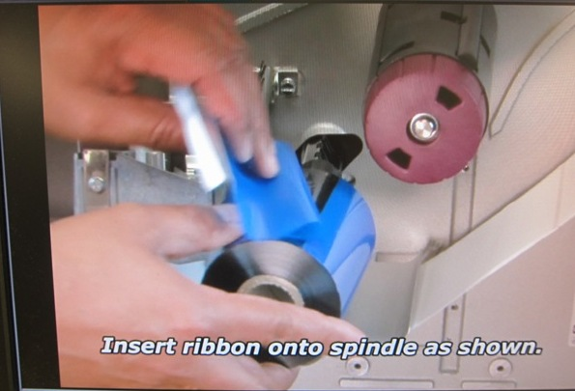
Loading the Printer Ribbon
1
3
Note: The standard black ribbon spindle uses ribbon coated on the outside
2

Slide 8
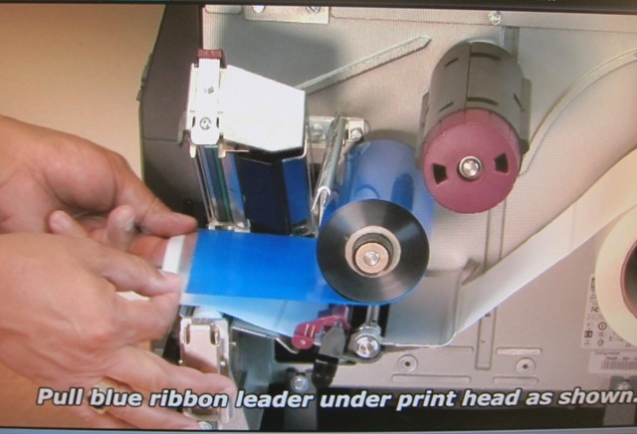
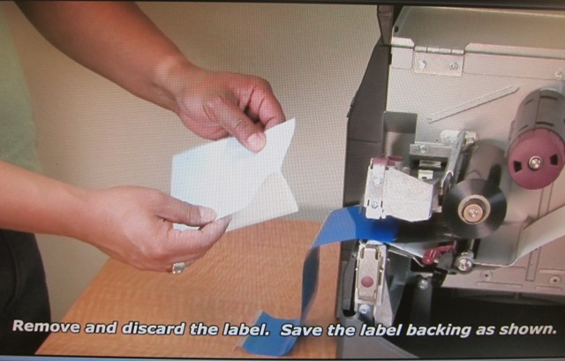
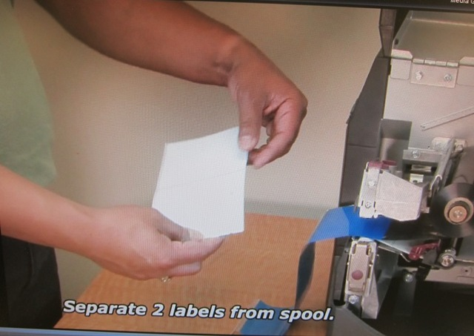
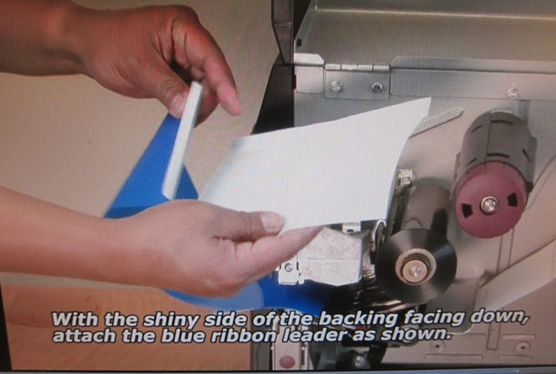
6
4
5
7

Slide 9
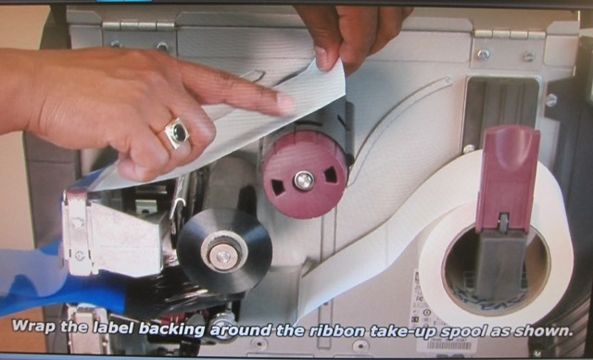
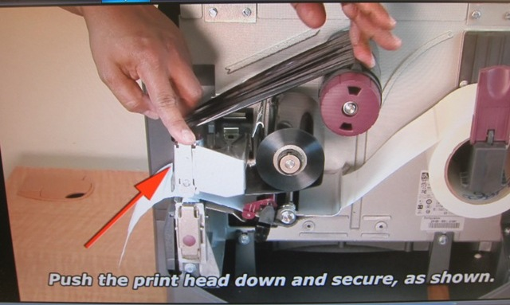
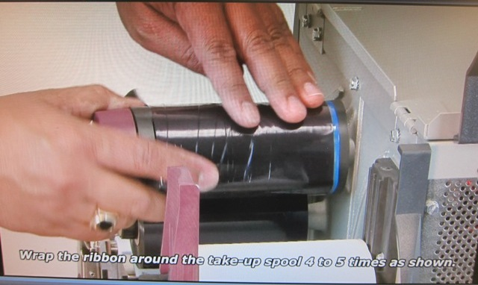
8
10
9

Slide 10
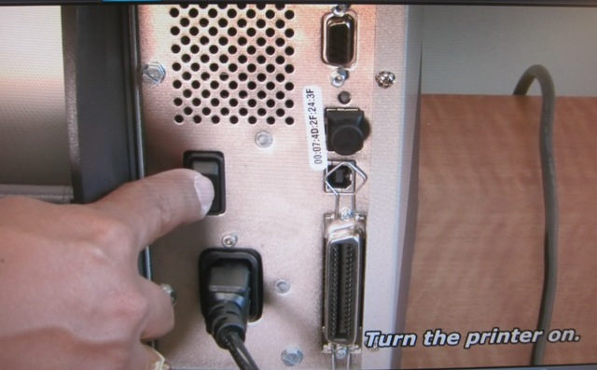
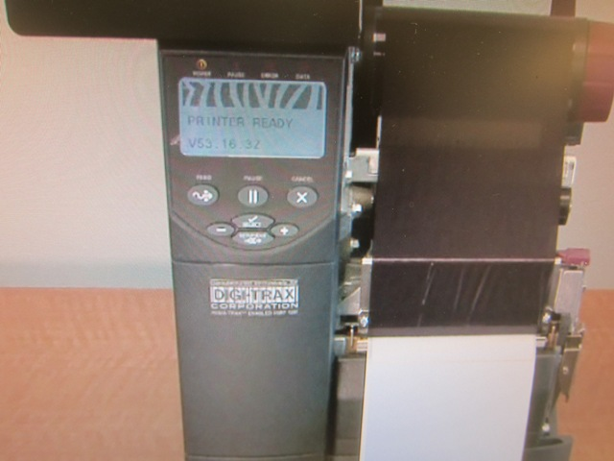
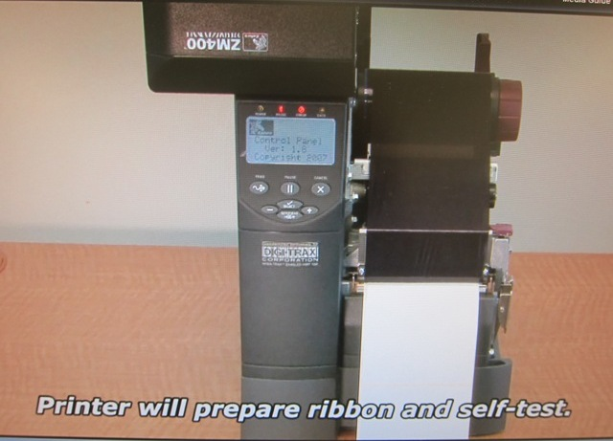
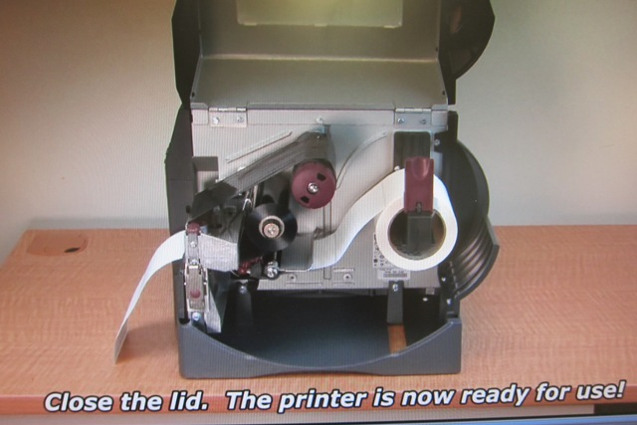
PRINTER READY
13
11
12
14

