Slide 1
Chart Recorder Operation
The Chart Recorder requires some setup prior to operation. The following items must be addressed prior to operation
and occasionally during normal operation of the Chart Recorder:
• Temperature Calibration
• Installing and Changing the Chart Paper
• Installing and Changing the Battery Backup
• Running a Test Pattern

Slide 2
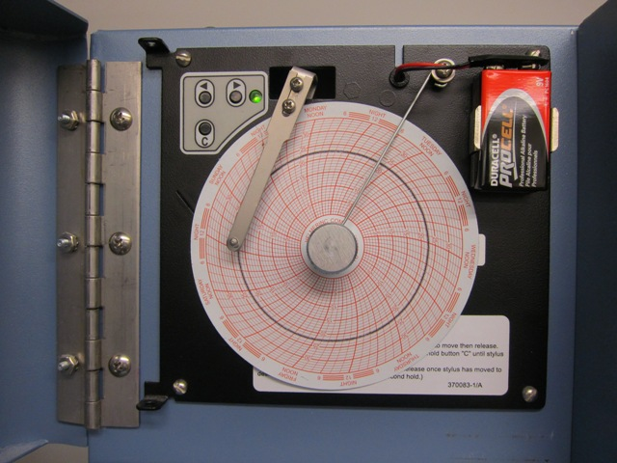
Temperature Calibration
If the temperature marked by the chart recorder does not match that of the device chamber after the chamber has stabilized at set point, adjustments are made using the Left or Right Arrow on the Chart Recorder (Fig 1.1)
Battery Connection
Right Arrow
Left Arrow
Chart Change key
Stylus
Time Line Groove
Chart Knob
Chart Paper

Slide 3
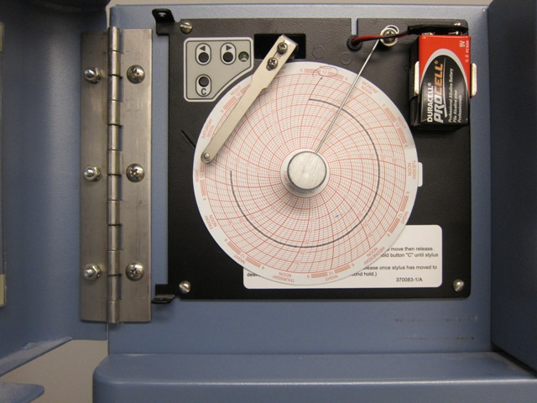
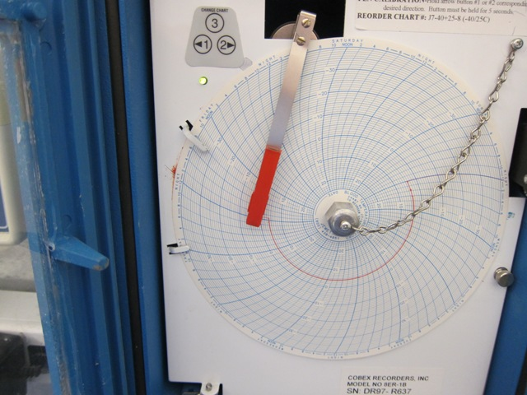
Press and hold down the Left or Right Arrow for five (5) seconds to initiate stylus movement.
2. Continue to press the Left or Right Arrow until the stylus moves to the correct temperature.
NOTE: If neither arrow key is pressed for five (5) seconds, the new temperature setting takes effect and the recorder returns to normal operation.
Left and Right Arrow
Left and Right Arrow

Slide 4
Changing the Chart Paper
1. Press and hold Chart Change (C).
2. When the stylus begins to move toward the left, release the Chart Change key.
Chart Change

Slide 5
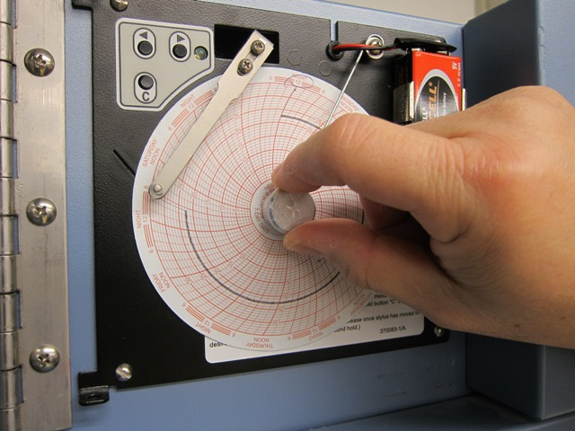
3. When the stylus has moved to the edge of the chart, remove the Chart Knob by turning it in a counterclockwise direction.
4. Remove the chart paper.

Slide 6
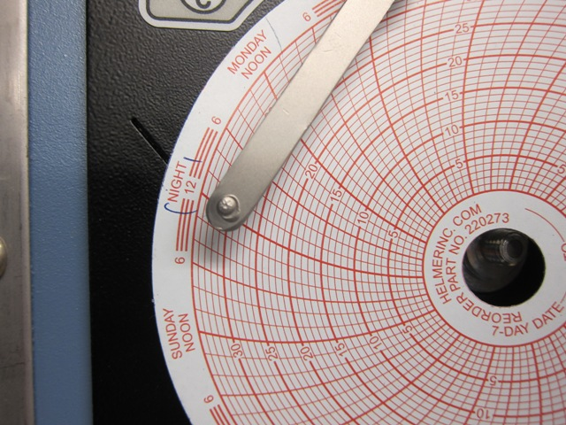
5. Position the new chart paper so that the correct time line coincides with the time line groove (Figure 1-1).
6. Re-attach the Chart Knob by turning it in a clockwise direction until it fits securely against the chart.
CAUTION: When the stylus is in the change position, pressing the Left or Right arrow
buttons changes the chart recorder temperature range. Refer to Section 1.5, Chart
Range, for more information.
Time Line Groove

Slide 7
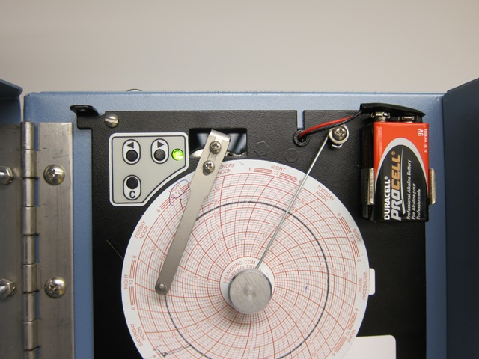
Battery Backup
The battery allows the Chart Recorder to continue functioning normally for approximately two hours in the event of a power failure.
If the battery is good, the light on the face of the Chart Recorder remains a constant green color.
LED Light is ON

Slide 8
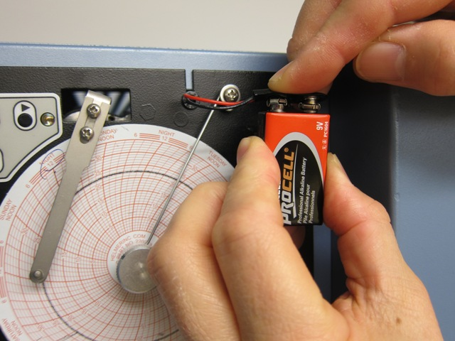
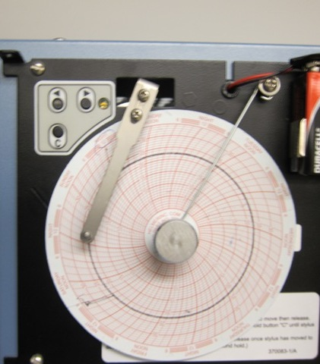
Battery Backup
If the battery becomes weak and needs to be replaced, the light flashes.
If the indicator is flashing: Install a 9-volt battery as shown in Figure 1-2 and connect the lead.
Flashing LED
Flashing LED light
FIG 1.2

Slide 9
Running a Test Pattern
Test patterns are run to verify operation of motors and electronics. To run a test pattern:
1. Press and hold Chart Change and the Right Arrow simultaneously until the LED goes out.
2. The recorder proceeds through a test consisting of stepped patterns through the temperature range, which
end when the pattern has completed one rotation.
NOTE: The test may be terminated at any time by pressing any button on the Chart Recorder for one second
3. After testing, the chart recorder automatically returns to normal operation and the LED turns back on.

Slide 10
Chart Ranges
The Helmer Chart recorder supports several temperature ranges:
Determining and Changing the Current Chart Range. (see example below Fig 1.5).
Note: Refer to Equipment Manuals/Recorder for correct temperature range
Temperature range
RANGE | TEMPERATURE RANGE | CURRENT CHART RANGE INDICATION
RANGE 1 | 0°C TO 35°C (PLATELET INCUBATOR PRODUCTS) | LED SINGLE FLASH
RANGE 2 | -5°C TO 20°C ( REFRIGERATOR PRODUCTS ) | LED DOUBLE FLASH
RANGE 3 | -90°C TO O°C ( FREEZER PRODUCTS ) | LED TRIPLE FLASH
(FIG 1.5)

Slide 11
CHART RANGES
To determine current chart range, press and hold Chart Change until the stylus begins moving toward the edge of the chart.
The LED flashes the currently selected chart range 1, 2 or 3.
The chart range may be changed by pressing the Left or Right Arrows, increasing or decreasing the range value,
respectively. The LED flashes out the currently selected range.
To save a new range setting, press and hold the Change Chart again until the stylus begins moving towards the
temperature range.

Slide 12
2 Troubleshooting
PROBLEM 1: The Chart Recorder paper is not moving
CAUSE: The Chart Knob is not tightened on the paper.
ACTION: Tighten the chart knob.
PROBLEM 2: The LED continuously blinks
CAUSE: The battery backup is either low or not hooked up.
ACTION: Check the battery connection.
ACTION: If the battery is correctly connected, test the battery strength and replace, if required.

Slide 13
PROBLEM 3: Chart stylus not marking on paper
CAUSE: The stylus is bent away from the paper.
ACTION: Gently bend the stylus until it touches the paper
ACTION: If it is still not marking, remove the stylus arm by loosening the two stylus arm mounting screws,
bend the bracket, replace the stylus and retighten screws.
NOTE: When refastening the stylus arm, ensure it is positioned in line with the time line groove

Slide 14
PROBLEM 4: After changing the paper using Chart Change (C), the stylus does not return to the
proper temperature
CAUSE: When the stylus was in the change paper position, the left or right arrow button was accidentally pressed changing the chart temperature range.
ACTION: Refer to Fig 1.5, Chart Range, to reset the temperature range.

