Slide 1
Terumo Heat Sealer Use and Maintenance

Slide 2
Safety Precaution
Contact between the tissue and Radio Frequency can result in severe burns.
Keep fingers a safe distance (approximately 2 inches) from sealing jaws when using the tube sealer.

Slide 3
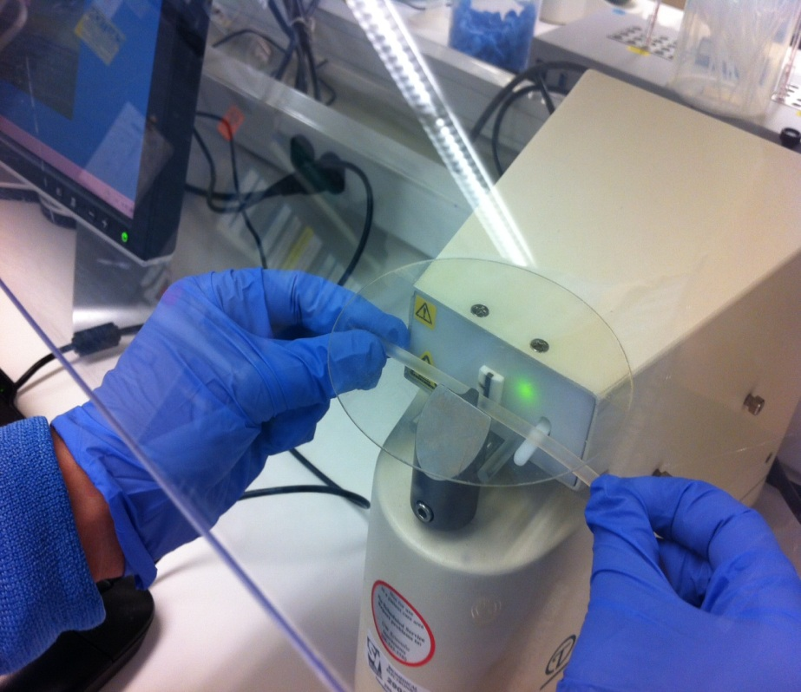
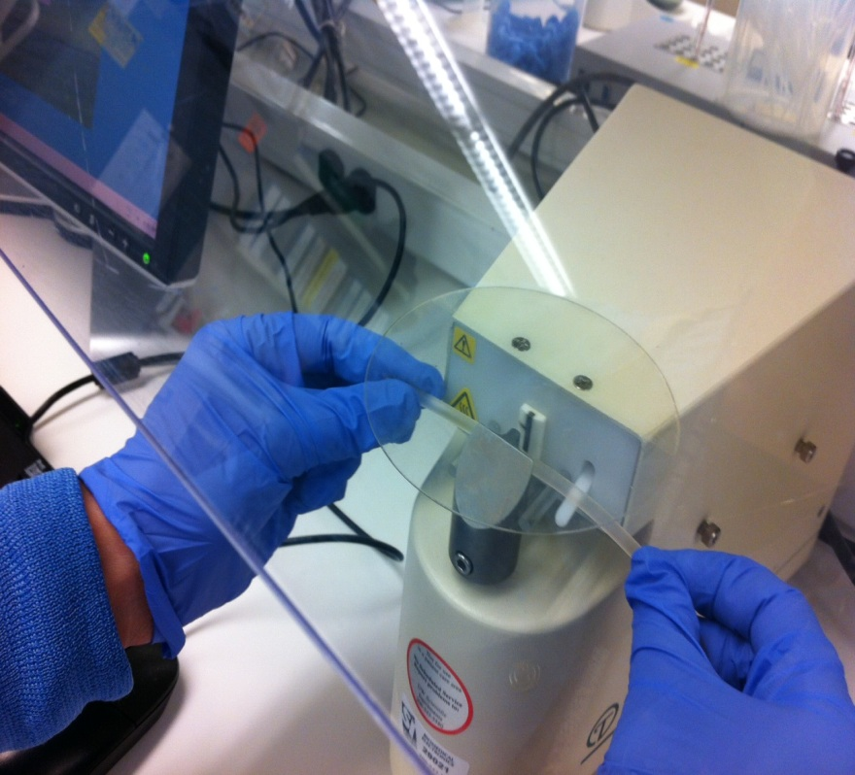
Place tubing between sealing jaws.
Allow the tubing to rest against sealing trigger, but above the tube guides.
The green light is an indication of “seal ready”.

Slide 4
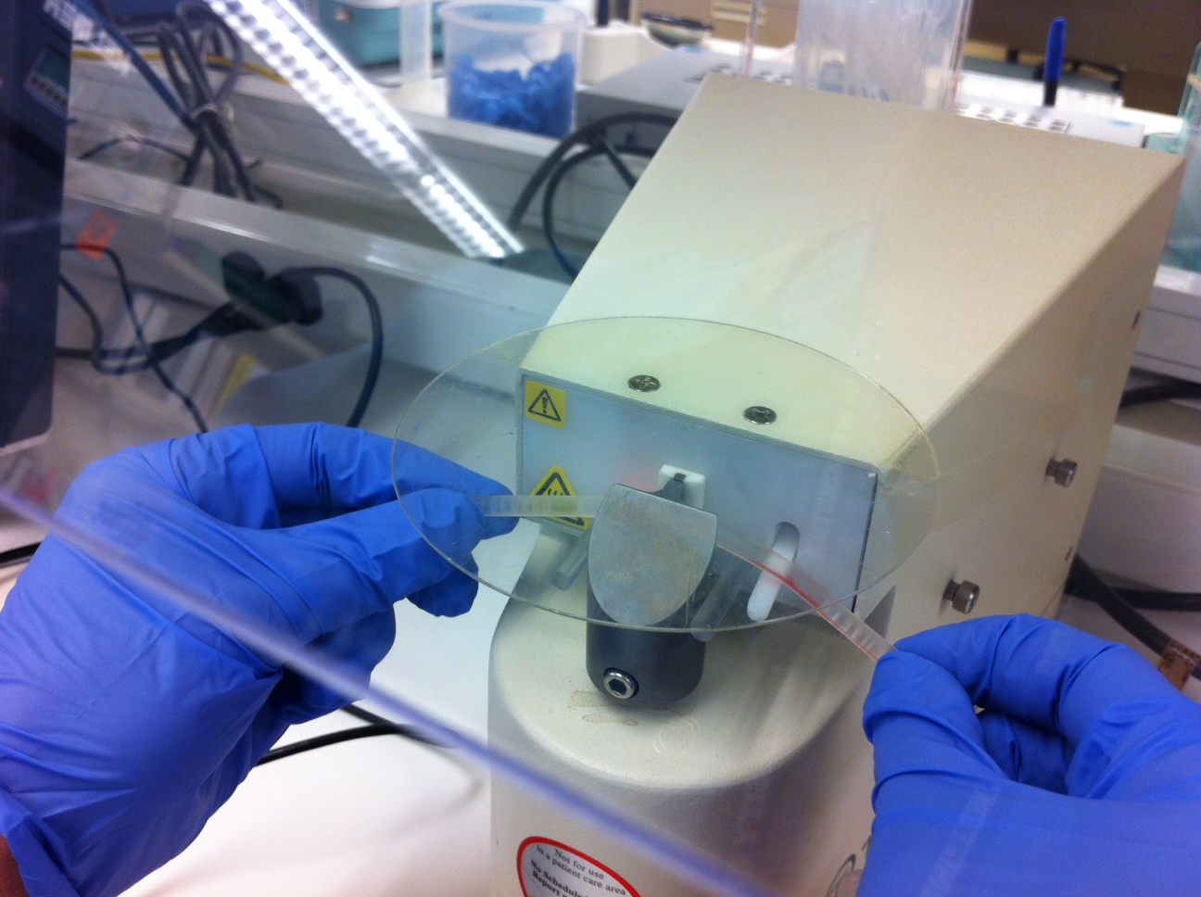
The sealing jaws will release when the process is finished, indicated with a red light.
Caution: Pulling down on the tubing may create enough force to cut through and expose products to non-sterile conditions.

Slide 5
Clean sealer as needed.
  Make sure the green “seal ready” light is no longer illuminated.
Turn off power.
Wet a cotton swab with an alcohol prep wipe.
Clean jaws and adjacent areas of the sealer.

