Slide 1
Thermometers
Reading, Repair, and Safety

Slide 2
Two Part Learning Experience
First:
  Reading and Recording Thermometer temperatures
Second:
  Calibration
  Contents, handling, and clean-up
  Safety First!
  Repair

Slide 3
Reading Thermometers
Significant Figures, Units of Measure, and Numbers

Slide 4
High School Math
Long, long ago…
In a math class far, far away…
There were
  Significant Figures
  Units of Measure
  Measurement Figures

Slide 5
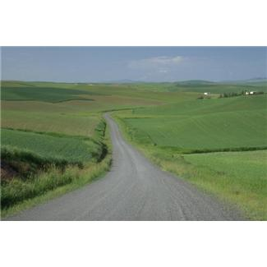
Let’s take a walk down memory lane

Slide 6
Measurements
All measurements have some degree of error
Data should be recorded in a systematic way
In order to convey unambiguously the degree of uncertainty

Slide 7
Significant Figures
Significant Figures are the CERTAIN and the UNCERTAIN digits recorded in a measurement.
  Certain: directly from the markings on the measurement device
  Uncertain digit, the last figure of the measurement: estimated between the last two markings
  Only 1 uncertain digit should be recorded for each measurement.

Slide 8
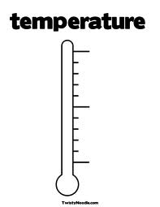
Gradations
38
What is the value of each gradation between 37 and 38?
0.2 degrees - the arrow is pointing at 37.8ºC
Every thermometer should be examined for gradations.
Differences exist on every thermometer as we will see in the following slides.
But what is the temperature reading for this thermometer?
Next Slide…
37

Slide 9
Temperature Example
37.1
38
37 : certain digits from the markings
.1 : uncertain digit estimated between the Markings
37.16 would be incorrect because it has 2 uncertain digits
37.0 or 37.2 would be incorrect because they would be a round down or round up to the nearest marking with no uncertain digit.
37

Slide 10
Your Turn! Heatblock
38
What temperature do you read and record?
37

Slide 11
Answer
38
What temperature do you read and record?
37.9
37

Slide 12
Take a Look at any Temperature Record
What do you see on the recorded temps ?
  Lots of variation?
  2 figures with no decimal point?
  Some possible round ups or round downs?

Slide 13
To be Consistent is our Goal
CTs doing Bench QC each shift
Every Heatblock temperature recording has 3 digits:
  Use 2 certain digits
  Use 1 uncertain digit

Slide 14
To be Consistent is our Goal
All Staff recording Storage Unit temperatures
Follow the significant figure rule when recording
  Use 1 or 2 certain digits
  Use 1 uncertain digit
Thermometers differ in markings
Blood Storage Refrigerators on next slide

Slide 15
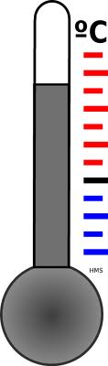
Your Turn! Blood Storage Refrigerator
6
What temperature do you read and record?
4
2

Slide 16
Answer
6
What temperature do you read and record?
4
5.7 Or 5.6
Last digit is the uncertain figure
2

Slide 17
Chart Recorder Readings
Tiny Gradation Lines and Wide Pen Lines
  May not be able to visualize an insignificant figure
Equipment Module
  Reading – Ask Questions of the Lead/trainer
  Chart recorder changing
    Make sure the chart is correctly set 1 hour later
  Discuss/demonstrate recording pen calibrations

Slide 18
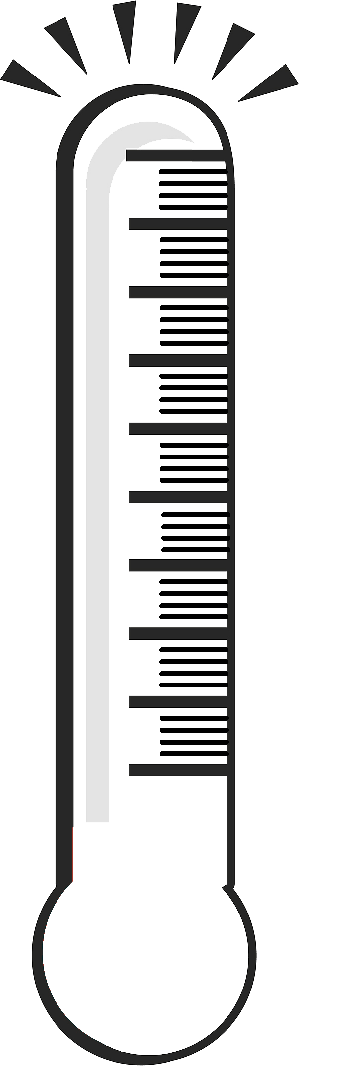
Platelet Chamber
Chart, Digital, Spirit Fill Thermometer
30
20
10
0

Slide 19
Platelet Chamber
Chart, Digital, Spirit Fill Thermometer
30
20
10
23.0
Last digit is the uncertain figure
0

Slide 20
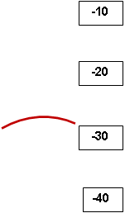
Freezers
Odd because they are
  upside-down
  1 degree markings
Lower is better
Temperature is ??

Slide 21
Freezers
Temperature is ??
-27.5
Last digit is the uncertain figure

Slide 22
Part 2: Thermometer
Calibration
Contents
Handling
Clean-up
Repair

Slide 23
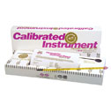

NIST, Fluke and their Cousins
NIST
  National Institute of Standards and Technology
Fluke
  Brand Name
  Manufacture, distribute and service electronic test tools and biochemical equipment
Recalibrated annually by an external service
Their Cousins
  All other thermometers
  Re-calibrated annually against a NIST standard

Slide 24
Why don’t we have NIST or Flukes everywhere?
NIST and Flukes are Expense to buy and calibrate
Fluke probes are delicate
Thermometers are assigned to equipment and provide a constant temperature reference source
NIST and Flukes are used to:
  Calibrate “cousins”
  Resolve discrepancies between temperatures in a storage unit.
  Perform Monthly Plasma Thawer QC
  Take temperature of questionable component shipments from PSBC

Slide 25
What is in Thermometers?
No Mercury!!
  Lab Med and UW Hospitals have a mercury free policy
Spirit-Filled Thermometers
  Ever wonder what the red stuff is?
  MSDS available

Slide 26
Red Spirit Fill Thermometer Liquid
100% Toluene
Poison!! Harmful or Fatal if Swallowed
Flammable!! Rating: 3
Inhalation may cause irritation
May be absorbed through the skin
Severe eye irritation
And then there is the broken glass hazard

Slide 27
Red Spirit Fill Thermometer Released
Ventilate area
Isolate area
Wear protective clothing
  Broken Glass and Liquid Exposure
Absorb liquid with an inert material
  Spill Kit!
Dispose in chemical waste container
  Available in Gen Lab

Slide 28
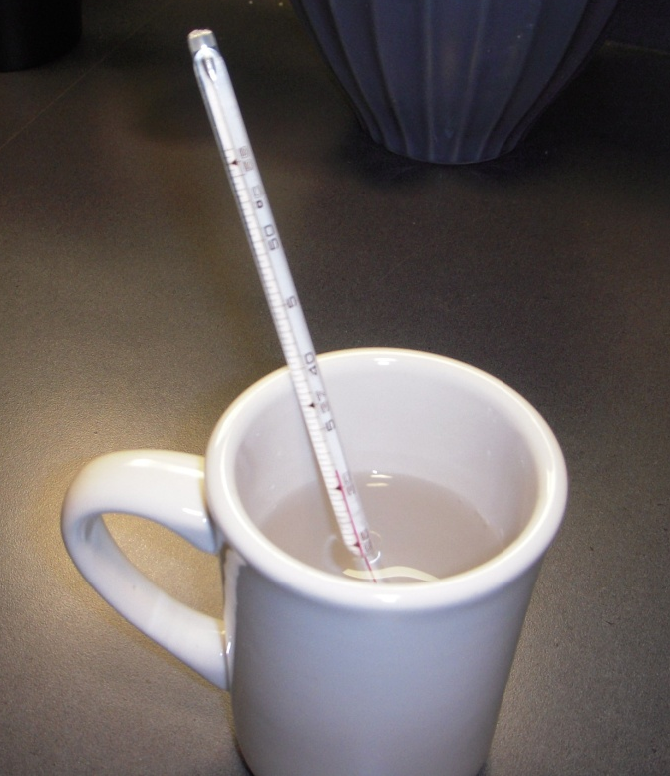
Red Spirit Column Repair
Red Spirit column “splits”
Raise temperature to force liquid up to the top
Allow fluid to drop
Should correct the problem
Replace thermometers that do not “reconnect”
Microwavable Container
for hot water
Cole-Parmer’s website says to lightly tap the thermometer against your palm to break loose
the fluid, causing it to flow back down. Hasn’t worked for me but maybe for you!

Slide 29
Summary
Temperature recording should be a consistent combination of significant and 1 insignificant figure
Thermometer calibration due dates must be honored
Thermometers must be handled with care due to content and glass hazards

Slide 30
Sign off in MTS
PowerPoint Viewed
Test to complete
  MSDS questions
  Reading Thermometers on the next few slides

Slide 31
Record your Reading in MTS
Question 1
The thermometer reading is:
37.3
37.5
37.0
36.2
40
38
36

Slide 32
Record your Reading in MTS
Question 2
The thermometer reading is:
-21
-20.7
-20.1
-21.3
-18
-20
-22

Slide 33
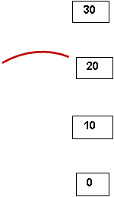
Record your Reading in MTS
Question 3
The thermometer reading is:
22.0
23.0
21.5
26.0

