Slide 1

Colorado Laboratory
Cerner Computer Manual
DEPARTMENT ORDER ENTRY

Slide 2
DEPARTMENT ORDER ENTRY
Used to enter patient orders into Cerner
  Paper orders
    Outside providers
    SNF (Skilled Nursing Facilities)
    ALF (Assisted Living Facilities)
    Can also be used to:
  Add to previous orders
  Cancel orders
  Register a patient prior to order entry

Slide 3
DEPARTMENT ORDER ENTRY
Set up your Cerner ICON
Patient Search = Click View > Patient > by Medical Record Number
Orderable Filter = View > Orderable Filter> Laboratory

Slide 4



DOE – NEW ENCOUNTER
Create a NEW patient encounter
You must start with the “Red Book”
DO NOT use an existing encounter
You must exit DOE application
Re-click the DOE ICON between patients
Create a new encounter for ALF/SNF also

Slide 5
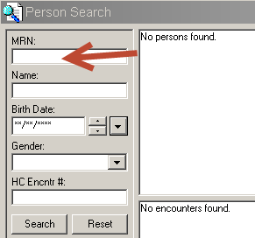
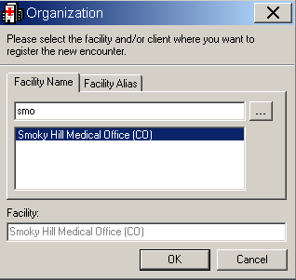
DOE – Registering a New Patient Encounter
Enter the patient’s 9 digit medical record number (MRN)
Press Enter.
Click Add Encounter
Add your clinic site
Click OK

Slide 6
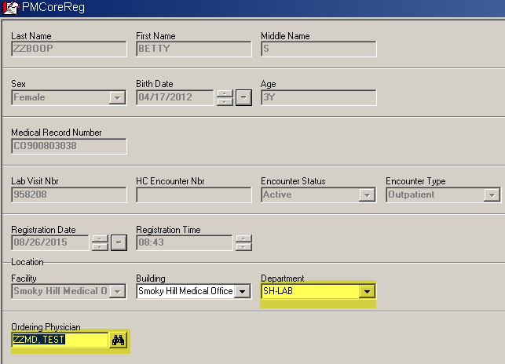
DOE - Registering a New Patient Encounter
Enter DEPARTMENT AND ORDERING PROVIDER
Dept. is always LAB
Click OK

Slide 7
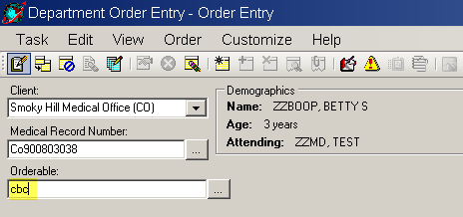
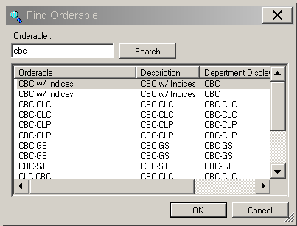
DOE – Placing an Order
Enter a test code in the Orderable Selection Box
exact test order code
or
the first few characters
Choose the correct test in Find Orderables

Slide 8
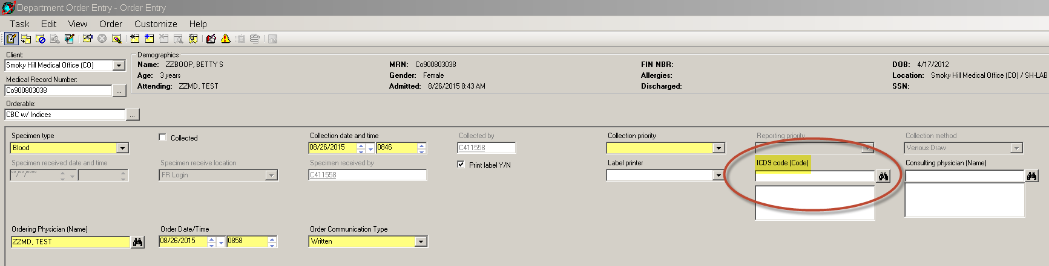
DOE – Entering the Order Details
You must complete Highlighted Yellow fields
And the ICD9 code (CODE)!!!!!
When Collected by not specified use NURSE or MISC COLL code

Slide 9
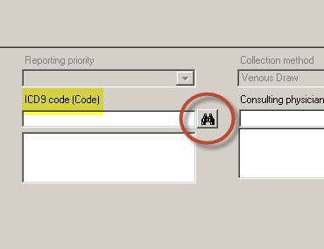
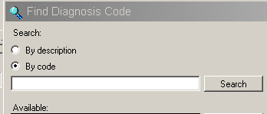
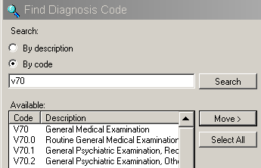
DOE – Entering ICD9/10 Code
Click on the binoculars
Select by Code or Description
Enter and Search
Shorter descriptions are better
Always include the “v” when given

Slide 10
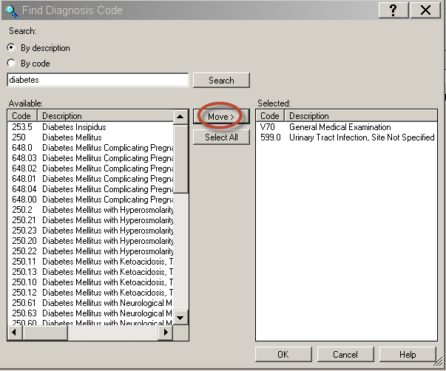
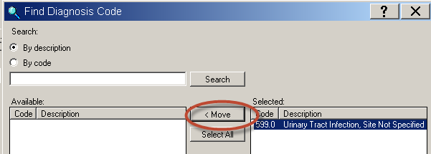
DOE – Entering ICD9/10 Code
Click MOVE and OK to add to order
You can remove unwanted codes here
Highlight and Move back

Slide 11

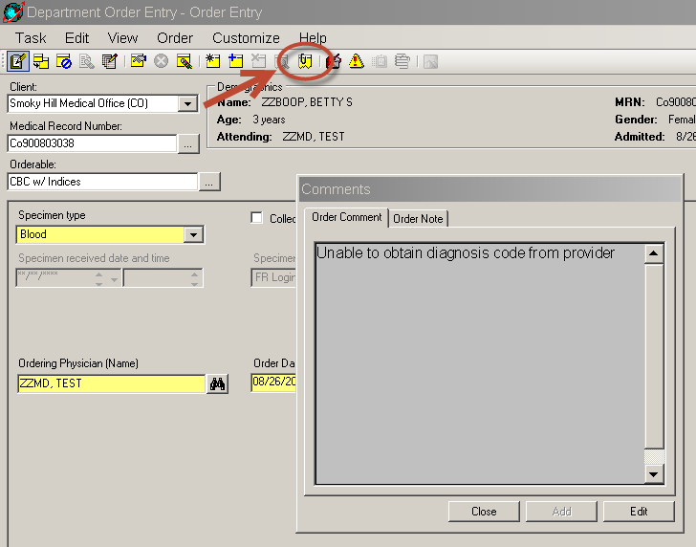
DOE – Entering ICD9/10 Code
If NO Diagnosis Code is provided
You must make at least one attempt
to contact the provider and get the code(s)
If still unable to get a code:
Enter the order with comment
“Unable to retrieve diagnosis code from provider”

Slide 12
DOE – Entering Physician
When the ordering provider is not in the system
External providers, must have address, phone and fax number listed in provider address.
NOTE: If the external provider does not have the necessary information on the laboratory requisition and you are unable to acquire the information from the outside provider, fax the laboratory request to Client Services at 303-404-4030 and note (on the form) that you were not able to obtain all the necessary information.

Slide 13
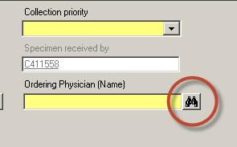
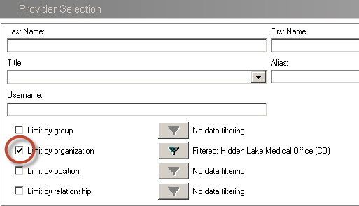
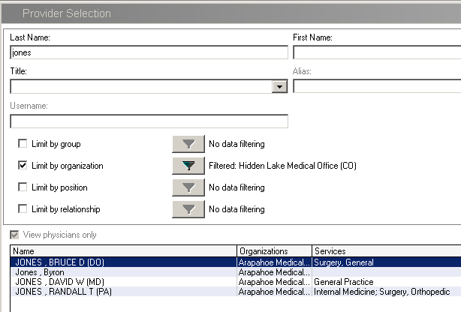
m

Slide 14
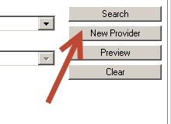
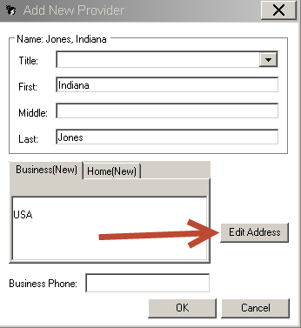
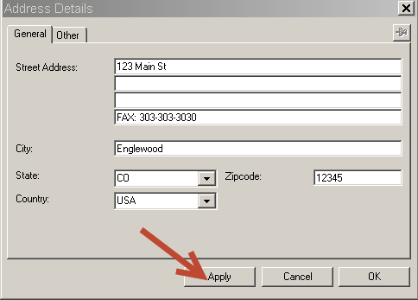
n

Slide 15

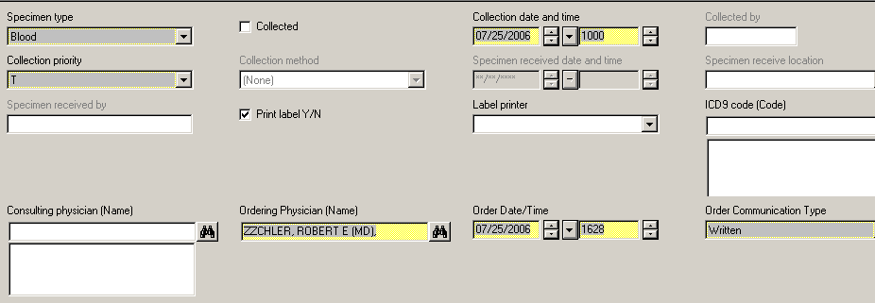
DOE - Glucose Tolerance Test
Order Glucose Tolerance Test priority as “T” for timed.
Enter the tolerance start time as the collection time.
Separate accession number will be assigned for each collection.

Slide 16



DOE – Completing the Order
Click Add Orderable to Scratch Pad icon in the menu bar.
Add all of your orderables to the scratch pad
Click on the Submit Orders icon in the menu bar.
You must exit DOE application
Re-click the ICON between patients

Slide 17

NOW on to…
Ordering for
Skilled Nursing Facilities SNF
Or
Assisted Living Facilities ALF

Slide 18
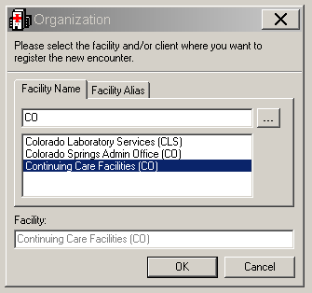
DEPARTMENT ORDER ENTRY
SNF/ALF
Skilled Nursing Facilities or Assisted Living Facilities
Start with Red Book
Organization is entered as “CO”,
choose Continuing care Facilities

Slide 19

DEPARTMENT ORDER ENTRY
SNF/ALF
Department code (drop down menu) is facility you are ordering
If the facility is not available in drop down menu,
order using your MOL or RRL location.
If entered for the MOL or RRL location
Add the fax number in the comment box for the tests ordered.

Slide 20
DEPARTMENT ORDER ENTRY
SNF/ALF
Collection time will always need to be modified when entering order for SNF/ALF facilities. Refer to the requisition for the collection time.

Slide 21


NEXT
Ordering MISCELLANEOUS Tests

Slide 22

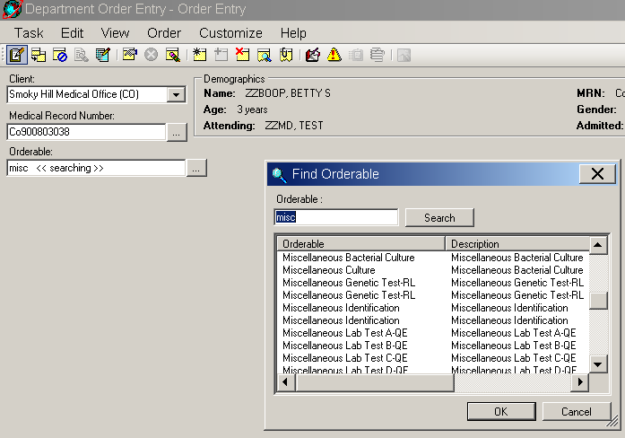
DEPARTMENT ORDER ENTRY
MISCELLANEOUS TESTS
Always start with the Red Book.
Enter the patient MRN #.
Create a new encounter
for your location.
Enter MISC as order code

Slide 23
DEPARTMENT ORDER ENTRY
MISCELLANEOUS TESTS
MISC orderable
  QUEST - MISC QE = first ordered for Quest.
  MISC A-QE = second ordered for Quest
  MISC B-QE, MISC C-QE, MISC D-QE, MISC E-QE, etc
  When entering multiple MISC. orders for Quest, you must create a new DOE encounter for each order, so they are have different accession numbers.
MISC RL is used for ALL other non-Quest orderables.
MISC GML is used for all orders for Genoptix
•MISC Genetic Test-RL is only to be used by Client Services for authorized Genetic orders.

Slide 24
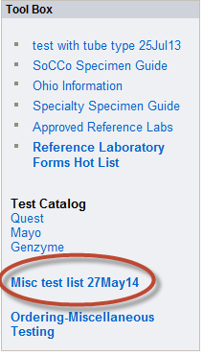

DOE - MISCELLANEOUS TESTS
Order Comment
You must add the Order Comment:
  specimen collection requirements
  testing lab address/contact number
  CPT/ICD 9 codes
  special handling for the misc test ordered.
Find the “Misc test list.”
Open up the Misc Test spreadsheet.

Slide 25
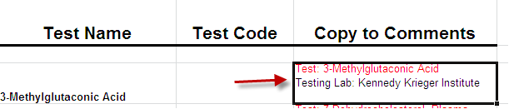
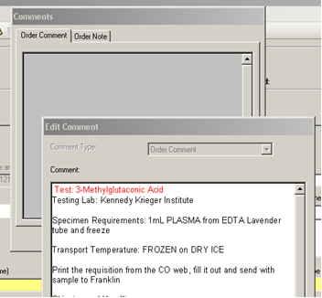
DOE - MISCELLANEOUS TESTS
Order Comment
Find your tests. (In alphabetical order)
Highlight comment box.
If a lab test is not found on the Misc test list, contact Client Services for guidance.
Copy and Paste into the comments of test. (Control-C to copy, Control-V to paste)

Slide 26
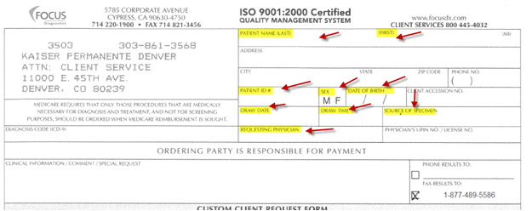
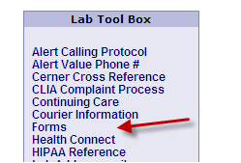
Fill out Reference Lab FormFind the form specific to the reference lab for that test. (Reference lab info will be found in the comments of spreadsheet.)
Forms for reference labs can be found on the website
Fill out highlighted areas. Remember to fill out ICD code (Diagnosis code) This can be found in Health Connect-Patient Snapshot data. (If you do not know which code to use you can write them all.)

