Slide 1
Colorado Laboratory Cerner Computer Manual
DEPARTMENT ORDER ENTRY

Slide 2
DEPARTMENT ORDER ENTRY
Used to enter patient orders into Cerner
Paper orders from
Outside providers
SNF (Skilled Nursing Facilities)
ALF (Assisted Living Facilities)
Can also be used to:
Add to previous orders
Cancel orders
Register a patient prior to order entry

Slide 3
DEPARTMENT ORDER ENTRY
Set up your Cerner ICON
Patient Search = Click View > Patient > by Medical Record Number
Orderable Filter = View > Orderable Filter> Laboratory

Slide 4
DOE – NEW ENCOUNTER
Create a NEW patient encounter each time
You must start with the “Red Book”
DO NOT use an existing encounter
You must exit DOE application between patients
Re-click the DOE ICON between patients

Slide 5
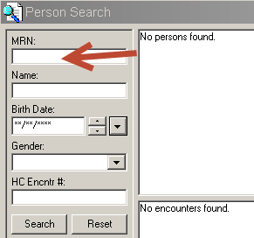
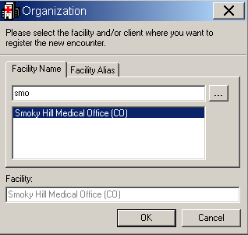
DOE – Registering a New Patient Encounter
Enter the patient’s 9 digit medical record number (MRN)
Press Enter.
Click Add Encounter
Add your clinic site
Click OK

Slide 6
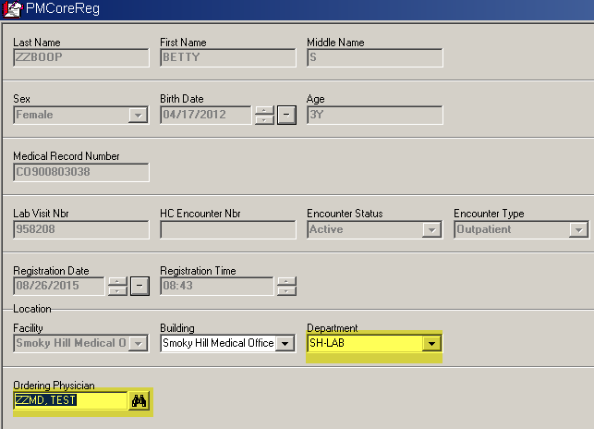
DOE - Registering a New Patient Encounter
Enter DEPARTMENT AND ORDERING PROVIDER
Dept. is always LAB
Click OK

Slide 7
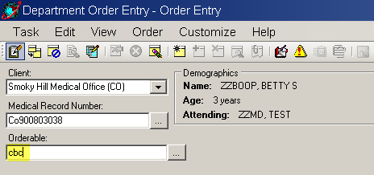
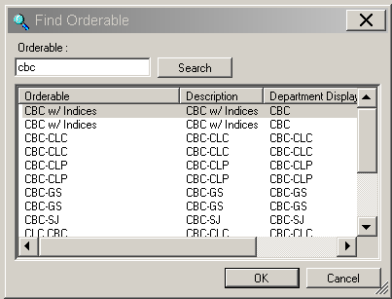
DOE – Placing an Order
Enter a test code in the Orderable Selection Box
exact test order code
or
the first few characters
Highlight the correct test in Find Orderables

Slide 8
DOE – Entering the Order Details
You must complete Highlighted Yellow fields
And the ICD9 code (CODE)!!!!!
When Collected by not specified use NURSE or MISC COLL code

Slide 9
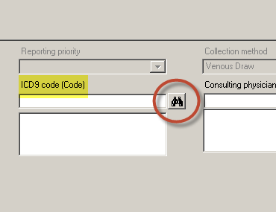
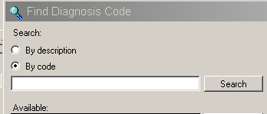
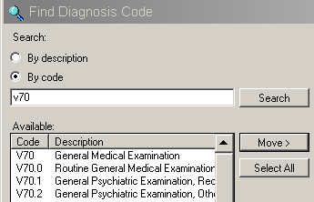
DOE – Entering ICD9/10 Code
Click on the binoculars
Select by Code or Description
Enter and Search
Shorter descriptions are better
Always include the “v” when given

Slide 10
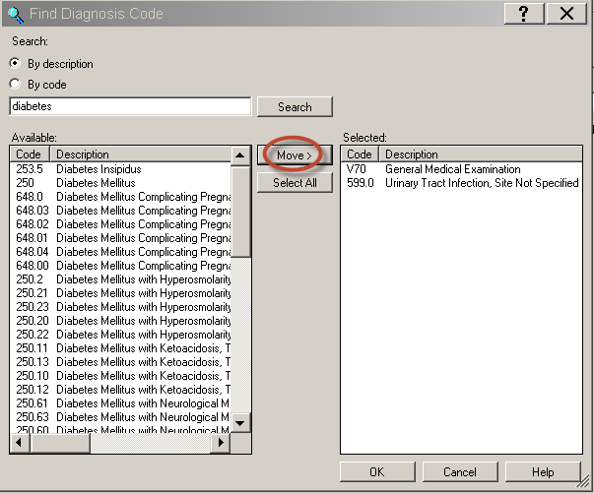
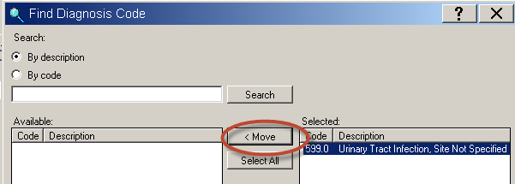
DOE – Entering ICD9/10 Code
Click MOVE and OK to add to order
You can remove unwanted codes here
Highlight and Move back

Slide 11
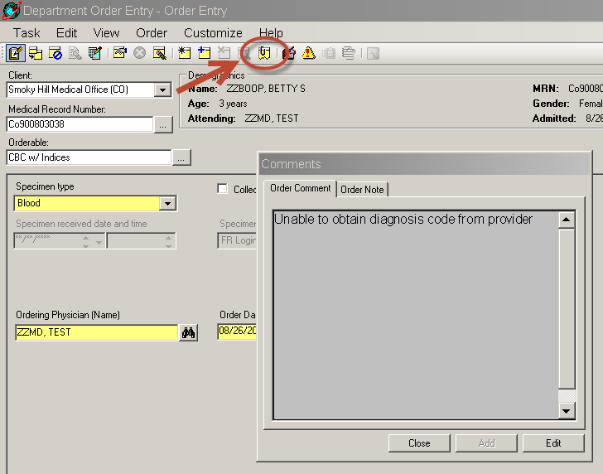
DOE – Entering ICD9/10 Code
If NO Diagnosis Code is provided
You must make at least one attempt
to contact the provider and get the code(s)
If still unable to get a code:
Enter the order with comment
“Unable to retrieve diagnosis code from provider”

Slide 12
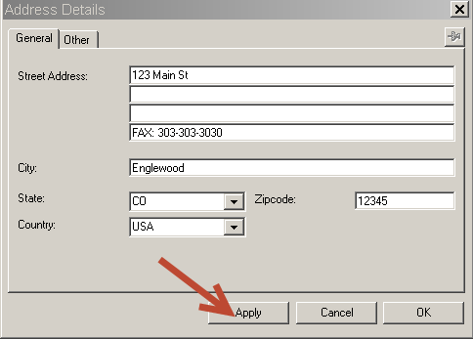
DOE – Entering Physician
Ordering provider is not in the system?
Required information!!! (all three)
Office address
phone number
fax number - listed in provider address
New providers NOT available immediately
LIS must authenticate
If you need to order new provider twice,
Ex. Two patients in a row, same unregistered provider
STOP! Call LIS to enter provider, or he becomes a duplicate

Slide 13
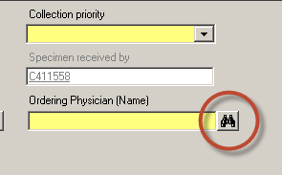
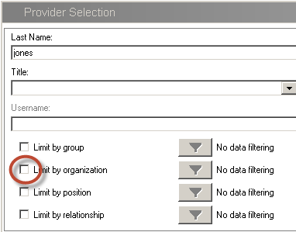
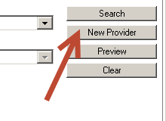
DOE – Adding External Providers
Click on binoculars
Enter Provider last name
Deselect the Limit by organization
Search

Slide 14
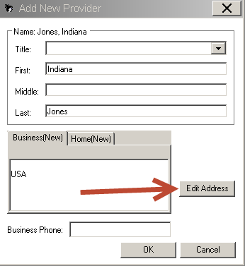
DOE – Adding External Providers
-Add first name -Enter the street address info, City, State and Zip
-Click Edit Address -last line of Street Address, enter the word FAX: and provider’s fax number
-Apply

Slide 15
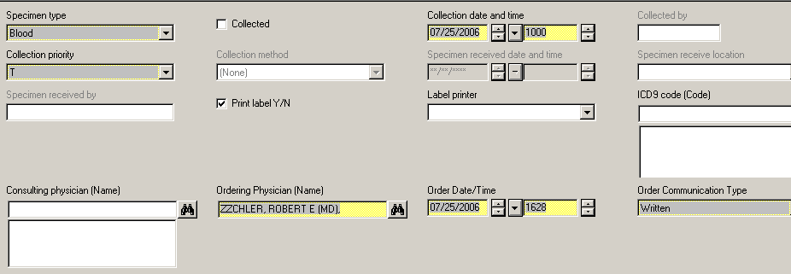
DOE - Glucose Tolerance Test
Order Glucose Tolerance Test priority as “T” for timed.
Enter the tolerance start time as the collection time.
Separate accession number will be assigned for each collection.

Slide 16
DOE – Completing the Order
Click Add Orderable to Scratch Pad icon in the menu bar.
Add all of your orderables to the scratch pad
Click on the Submit Orders icon in the menu bar.
You must exit DOE application
between patients and
Re-click the ICON Clicking the RED book is NOT enough, leave the page!

