Slide 1
WAM Medical Office Laboratory Training
Presented by
Trainers
2017

Slide 2
Introduction
Presentation on WAM software
You will learn how to operate WAM software.
Presented by Lab Trainers for MOL’s as well as RRL Super User.
Notes:
How presentation will benefit audience: Adult learners are more interested in a subject if they know how or why it is important to them.
Presenter’s level of expertise in the subject: Briefly state your credentials in this area, or explain why participants should listen to you.

Slide 3
Training Outline
What is WAM?
What are the components in the software?
How to Navigate through WAM.
Notes:
Lesson descriptions should be brief.

Slide 4
WAM log on
User name = NUID
(Letter is upper case)
Password=wam
( Lower Case)
Use TAB key to move from User ID field
To Password field.
Do not user ENTER.
Notes:
Example objectives
At the end of this lesson, you will be able to:
Save files to the team Web server.
Move files to different locations on the team Web server.
Share files on the team Web server.

Slide 5
WAM Log on
The user will be prompted to change password.
This will be unique to user.
To change Password in future-
Go to: WAM main menu- System Icon

Slide 6
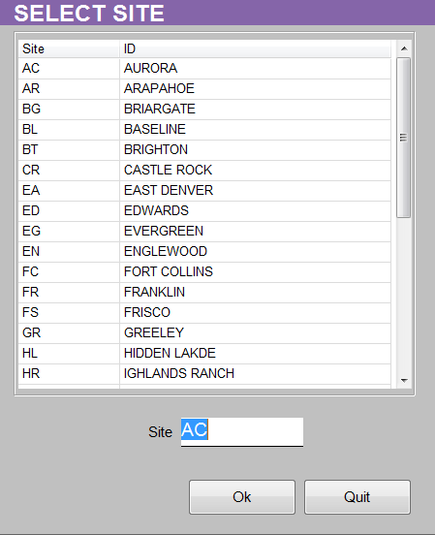
Site Selection
Once Logged in choose the
Site which the user is located.
Click OK
Only result in WAM under the site where the tests are run at.
You change your Site Location
in WAM using the Log Off icon.
Site All will allow user to see all pendings
for the region. User is only able to view in
this screen.

Slide 7
Main Menu
Banner Bar
Main Screen Icons MOL’s to use
Sample Explorer
System
Orders Pending
Orders Re-Run
To Validate

Slide 8
Sample Explorer- Validate Results
The Sample Explorer – Validate Results screen is where the user can enter accession number or patient information for validating or querying results. In the Selection Criteria Section enter or scan your accession number into the From Sample ID field. Validate Results is the default radio button that is selected. If you are performing a query change the radio button to select Query Orders. Click the Search Icon in the black Banner Bar to retrieve the Accession Number. WAM disregards the leading 1 on our Accession Numbers. Be sure to add the Container ID at the end of the Accession number.

Slide 9
Banner Bar
Help
Search
Clear
Save
Accept
Quit
Log out
Icons may change based on the function you are in.

Slide 10
Sample Explorer
In the Banner Bar- New Icons Displayed:
VAL ALL
VAL CBC
VAL SEL
ALL CBC’s are to be used using VAL ALL.
No partial results should be released using VAL CBC or VAL SEL.
Result Validation Screen will automatically appear

Slide 11
Result Validation Screen
Selection Criteria
Displays search parameters used on the validation selection screen. Sample ID orders with test results that require validation and match the search criteria will be displayed in the Results validation screen.
Patient Demographics
Patient Demographics and Sample Location is received from Cerner.
OP Alerts: Operator Alerts are warning messages that are based on defined rules. They will notify the user as to what the next steps will be. Easier to view using Op Alerts Tab.

Slide 12
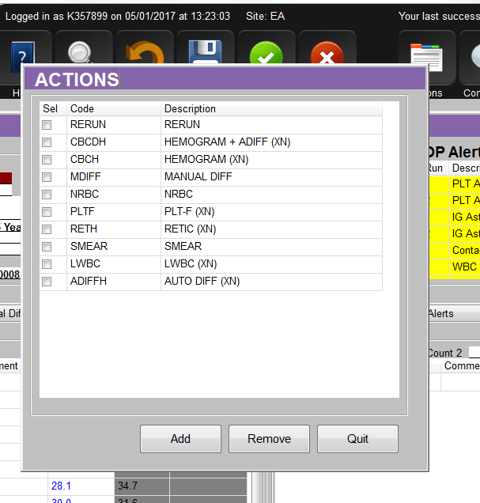
Result Validation
Workflow: Move from Left Tab to Right Tab across screen.
Result Validation: will show all of the results from the Run. If Platelet Clumping is present on Slide Scan or MDIFF, the result needs to be removed and replaced with a appropriate coded comment (pca, pci, or pcd). Result will also need to be Verifed in LIS as comment hangs up result.
ReRun Tab: will allow the user to choose which run will be validated.
If a 1:2 or 1:5 Dilution done on the re-run sample, the Dilution number (2 or 5) will go in the Dilution field directly below instrument ID. Click Calculate Button. Click the Save Icon in the banner bar to save calculations
To select a run click the Run button above result column.
If a rerun is not reflexed by WAM and the user would like to add rerun you can do so by using the Action Icon in the banner bar and selecting the test to add from the Actions window. Selecting Rerun will reorder the initial test.

Slide 13
Result Validation
Flags- Analyzer Flags are listed at this location.
Scattergrams-
Histograms-
Legend- Decodes the different color of displayed results.

Slide 14
Analyzer Results
Manual Differential
Performed on CBC based on Op Alert and and all body fluids.
The Keys for MDIFF are listed on the screen. ( Same as Cerner )
Cursor must be in Yellow Count square to count cells.
Add button is a toggle switch. Click to subtract cells. Click again to resume counting.
Counter: Allows for a second user to perform a count for comparison by changing to Count 2
Once MDIFF is complete and you move to the MORPH tab a message will display asking if you want to order a MDIFF. Click YES to order MDIFF and cancel ADIFF in LIS.
If more than one MDIFF was counted a message will display asking which count you want to choose. Choose count 1 or 2, do not select average.
XN USERS ONLY- Do not count NRBCs- Accept Auto NRBC count. Do not add WBCCORR comment. NRBC is a direct measurement.
XS and XT USERS- Count NRBCs. WAM will correct the WBC count for NRBC and calculate and place & symbol to the left of the WBC result. Add Comment: WBCCORR Comment in the comment field

Slide 15
Analyzer Results
Morphology:
Required Fields: RBC Morphology & PLT Com. These fields must be resulted to complete sample from COXX WAM Pending log.
RBC Morph- Use Normal when not reporting any morphology. Use Reviewed when reporting morphology. New required field.
Double click in result field to bring up choices for resulting. Once you know codes you can type them into the result field and arrow down to next field until completed.
RBC morphology is alphabetized at top.
WBC morphology is alphabetized at bottom.

Slide 16
After you have completed the Morph tab click the Save icon to return to the Result Validation tab.
This screen will now show the results you want to report based on the Rerun selected and MDIFF/Morph results entered.
Final chance to review results and make changes before validating sample. Instrument results appear in the instrument section and MDIFF/Morph results are in the Manual section.
If you need to make changes go back to the appropriate tab and correct results. Click the Save icon to return to the Result Validation Tab.
Click the Val All icon to validate results to the LIS.
If you have any Alert Values the Critical Call Documentation box will open. Fill in with first/last name of person results were called to and check to box stating results where read back.

Slide 17
Results Validation
Previous Results tab: allows user to see up to 10 previous results for easy access.
View Critical Results tab: Allow user to see previous alert results.
Op Alerts tab: Show user a detailed screen of the yellow Op Alerts box. User this tab to see what is needed to resolve alerts. The run # applies to what run the alert occurred on. By clicking on the description line you will be told by WAM how to handle the alert under Detail Information.

Slide 18
Comments
Comments are added to a result by double clicking in the Comment field.
This will open the Coded Comment window to select a comment from.
Click the Save button to add your comment
Click the Save icon in the banner bar to save comment before changing tabs.

Slide 19
Modify Result
To modify a result or replace a result with a comment click in the result field to change.
A pop up window will appear asking if you really want to modify the result? Respond Yes.
Change the result or double click in the result window to bring up the Coded Comment window and select the appropriate comment.
Click the Save Icon in the banner bar to save your changes.

Slide 20
Resources and References
RRL Technical Resource: 303 404 4243
Stuart Hofer (Day Shift)
Ben Dubbeld (Day Shift)
Matt Melland ( Evening Shift)
Sysmex TAC: 1 888 879 7639 #1 #3 WAM Serial #: 110122
Procedure :Sysmex WAM Hematology Middleware http://www.insidekpco.net/sites/default/files/groups/Laboratory/Stapleton/Hematology_Procedures/WAM_5.0_Middleware_Procedure_29Aug16.pdf

