Slide 1
Urine Drug Screen Interpretation Competency
L.K. Bechtel 11/13/2017

Slide 2


I have read and understand the procedures described in 1.1550 Urine Drug Screen Reflex and Interpretation and the associated job aids.

Slide 3
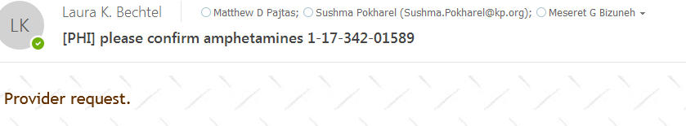
When there is a drug confirmation request from the provider. They may call Toxicology phone or email or request through Staff message.
If the call goes to Dr. B you will receive an email that looks like this below:
[PHI] in the subject header and the specimen ID
A snapshot of the ARE from Cerner is usually included along with the requested drug confirmation

Slide 4
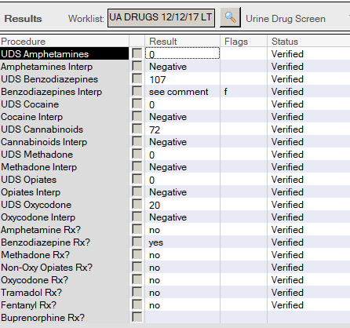
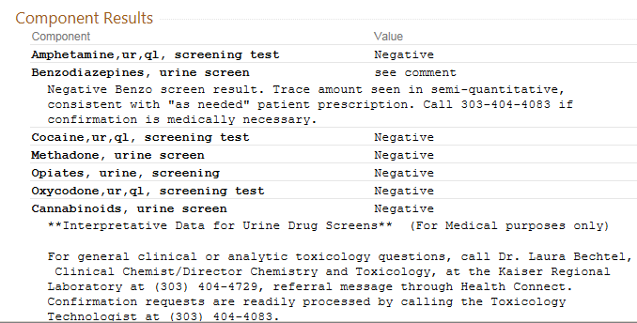
When a comment is added in Cerner. It will look like this in Health Connect .

Slide 5
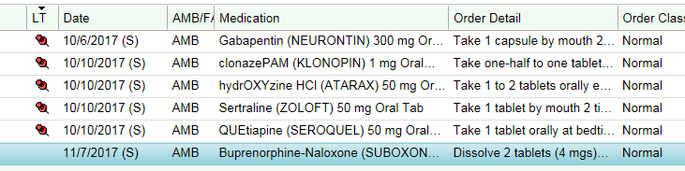
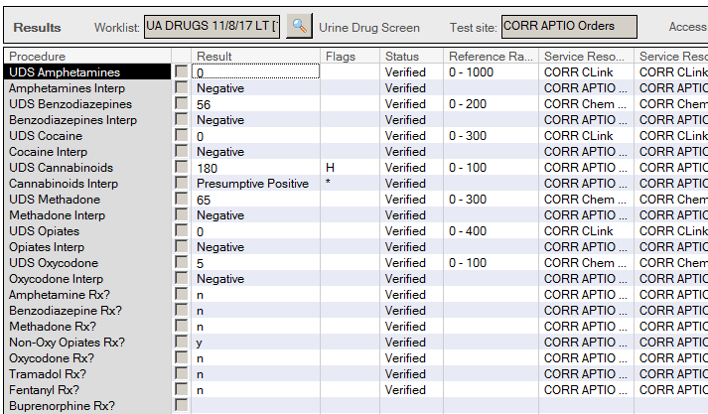
1. QUESTION
What tests should be ordered?
Opiate Confirmation
Cannabinoid Confirmation
Buprenorphine Screen
Buprenorphine Confirmation
No further testing is needed

Slide 6
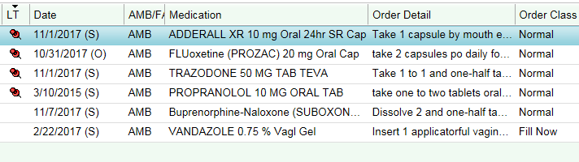
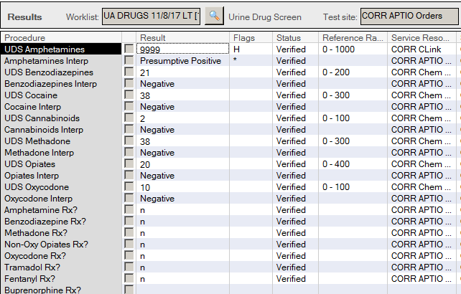
2. QUESTION
What tests should be ordered?
Opiate Confirmation
Amphetamine Confirmation
Buprenorphine Screen
Buprenorphine Confirmation
No further testing is needed

Slide 7
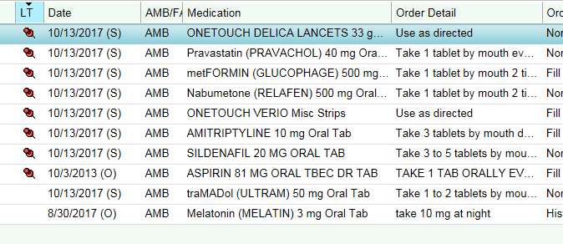
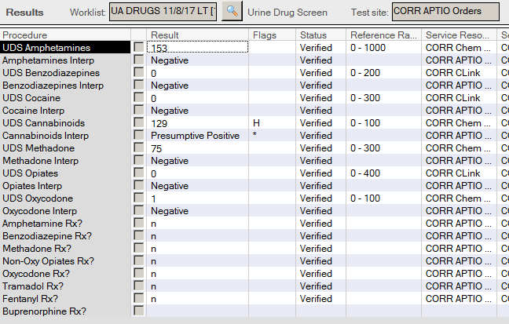
3. QUESTION
What tests should be ordered?
Opiate Confirmation
Cannabinoid Confirmation
Buprenorphine Screen
Buprenorphine Confirmation
No further testing is needed

Slide 8
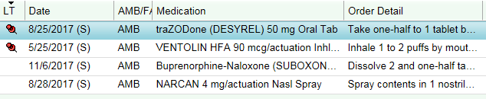

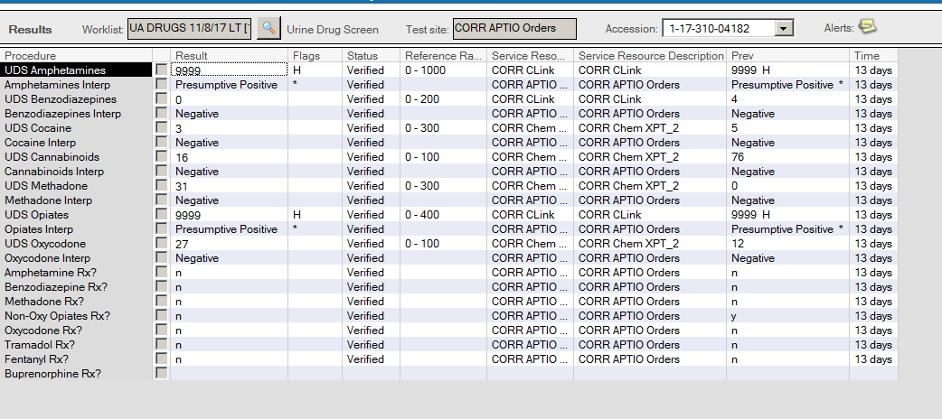
4. QUESTION
What tests should be ordered?
(multiple answers allowed)
Opiate Confirmation
Amphetamine Confirmation
Buprenorphine Screen
Buprenorphine Confirmation
Heroin Confirmation

Slide 9
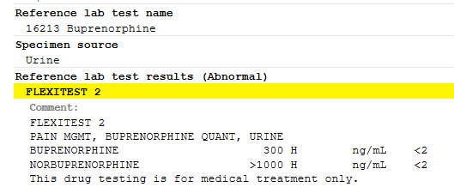
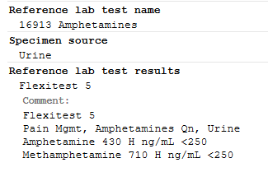
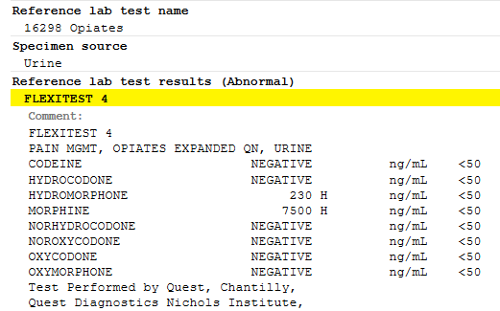
Urine Confirmation results from last month:
BUPRENORPHINE INGESTED, this is known because the metabolite is present
METHAMPHETAMINE,
INCONSISTENT
MORPHINE,
INCONSISTENT

Slide 10
The heroin metabolite profile and morphine process impurity profile are not the same.
Codeine
Norcodeine
Morphine
Hydrocodone
< 5% MORPHINE
Hydromorphone
Norhydrocodone
Last month, this patient demonstrated Morphine use.
Up to 5% of the morphine concentration in the urine could be metabolized to the minor morphine metabolite, Hydromorphone.
Since the morphine concentration is 7,500 ng/mL, then 5% would be 375 ng/mL.
The hydromorphone concentration is 230 ng/mL. Since this is less than the maximum allowable limit for this minor metabolite (230 < 375), then this person has morphine usage, not both morphine and hydromorphone.

Slide 11
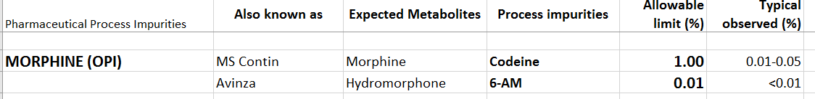
Process impurities may be present in numerous drugs that we monitor for abuse/misuse.
Process impurities are very small amounts of drug “contaminating” (or co-purifying with) a prescribed drug. These tiny amounts are present during manufacturing. The Allowable limit is the amount present the FDA allows for release of a morphine lot.

Slide 12
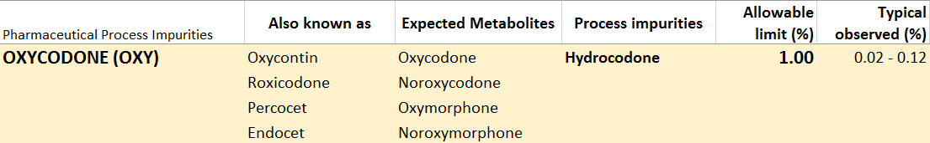
Process impurities may be present in numerous drugs that we monitor for abuse/misuse.
Process impurities are very small amounts of drug “contaminating” a prescribed drug. These tiny amounts are present during the process of manufacturing / synthesizing the drug.
The most frequent example we see of this type of “false positive” is Oxycodone and Hydrocodone.

Slide 13
A complete list of FDA approved limits for common narcotics is listed below:

Slide 14
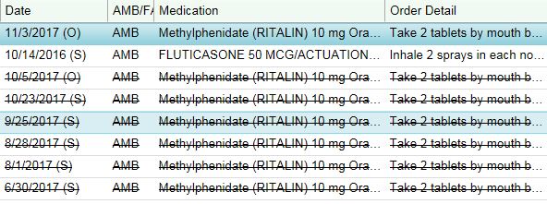
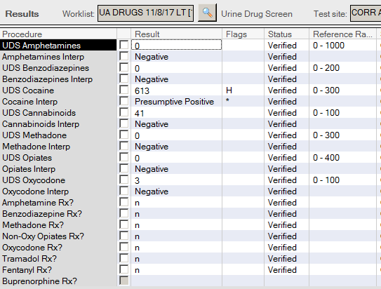
5. QUESTION
What tests should be ordered?
(multiple answers may exist)
Opiate Confirmation
Amphetamine Confirmation
Add Amphetamine Screen Canned Comment
Cocaine Confirmation
No additional testing required

Slide 15
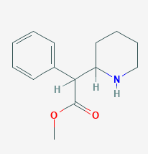
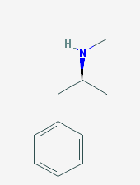
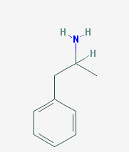
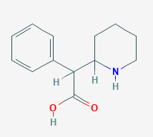
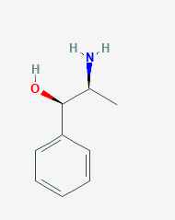
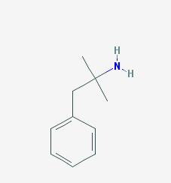
METHYLPHENIDATE
METHAMPHETAMINE
AMPHETAMINE
CYP450s: 2D6
N-deamination
Ester group
De-esterification by
carboxylesterase CES1A1
CYP450s:
2D6, 3A4
Hydroxylation
Amphetamine Screen antibody
will bind to these drugs
NOREPHEDRINE
PHENTERMINE
Carboxyllic acid group
Amphetamine Screen antibody
will NOT bind.

Slide 16
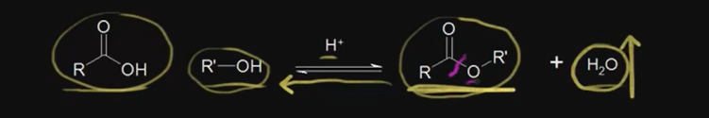
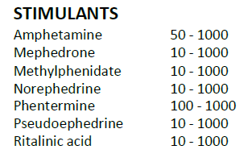
METHYLPHENIDATE
Ester group
Methylphenidate Brand Names: Concerta, Ritalin, Ritalin-SR, Daytrana, Metadate
MOA: CNS stimulant; blocks the reuptake of norepinephrine and dopamine.
The Quest confirmation only detects Ritalinic Acid. This is fine because there is not much parent compound found in the urine anyway
CU Tox Lab detects both Methylphenidate and its metabolite, Ritalinic acid.
De-esterification by
carboxylesterase CES1A1
RITALINIC ACID
Carboxyllic acid group

Slide 17
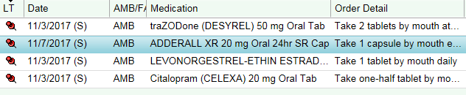
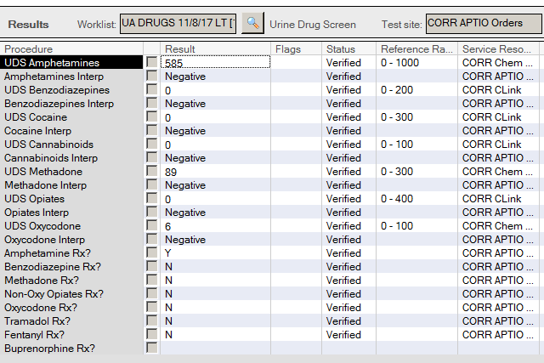
6. QUESTION
What tests should be ordered?
(multiple answers allowed)
Opiate Confirmation
Amphetamine Confirmation
Buprenorphine Screen
Buprenorphine Confirmation
Amphetamine Canned Comment

Slide 18
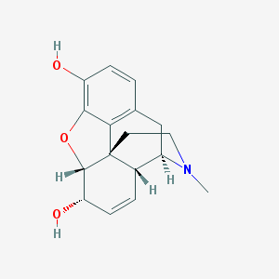
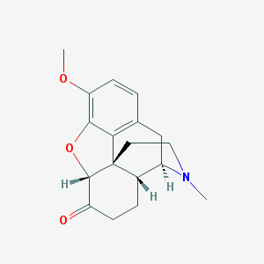
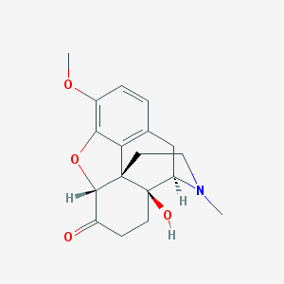
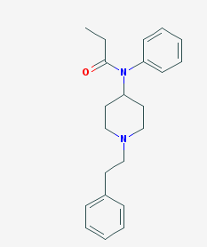
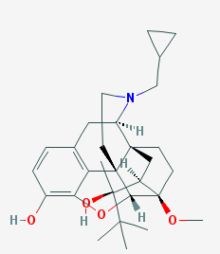
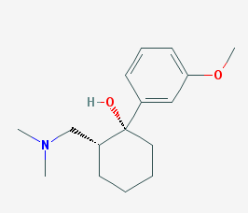
Which compounds are similar in structure?
MORPHINE
HYDROCODONE
OXYCODONE
TRAMADOL
BUPRENORPHINE
FENTANYL

Slide 19
Where do you think the opiate screen antibody is binding?
MORPHINE
HYDROCODONE
OXYCODONE

Slide 20
Where do you think the opiate screen antibody is binding?
MORPHINE
HYDROCODONE
OXYCODONE
This region is most similar between opiates that bind well in the opiate assay:
Codeine
Norcodeine
Dihydrocodone
Morphine
Hydrocodone
Hydromorphone

Slide 21
OPIOID METABOLITE CHART
Heroin
Codeine
Norcodeine
6-Acetylmorphine
Morphine
Hydrocodone
Hydromorphone
Norhydrocodone
Oxycodone
Oxymorphone
Noroxycodone
Noroxymorphone
Intricate metabolism of opiates.
Minor metabolic pathways in red.

Slide 22

NaF
Heroin
Blood
“pseudocholinesterase”
Carboxylesterases
Fast!!!
6-acetyl morphine

Slide 23
NaF
Blood / Liver
“pseudocholinesterase”
Carboxylesterases (CES1* and CES2*)
Heroin
Fast!!!
6-acetyl morphine
Slower - Hydrolyzed in liver
Morphine
Morphine-3-glucuronide
Morphine-6-glucuronide
* Known polymorphisms

Slide 24

Why is there codeine in heroin positive urine specimens? Co-purified from opium
1-15%
Clin Chem 47,(2) 2001:303

Slide 25
Codeine
Codeine is a Process impurity of morphine
  ≤ 0.5% morphine concentration (0.01 – 0.05% typical)
  Opium contains morphine to codeine in a ratio of approximately 10:1

Slide 26
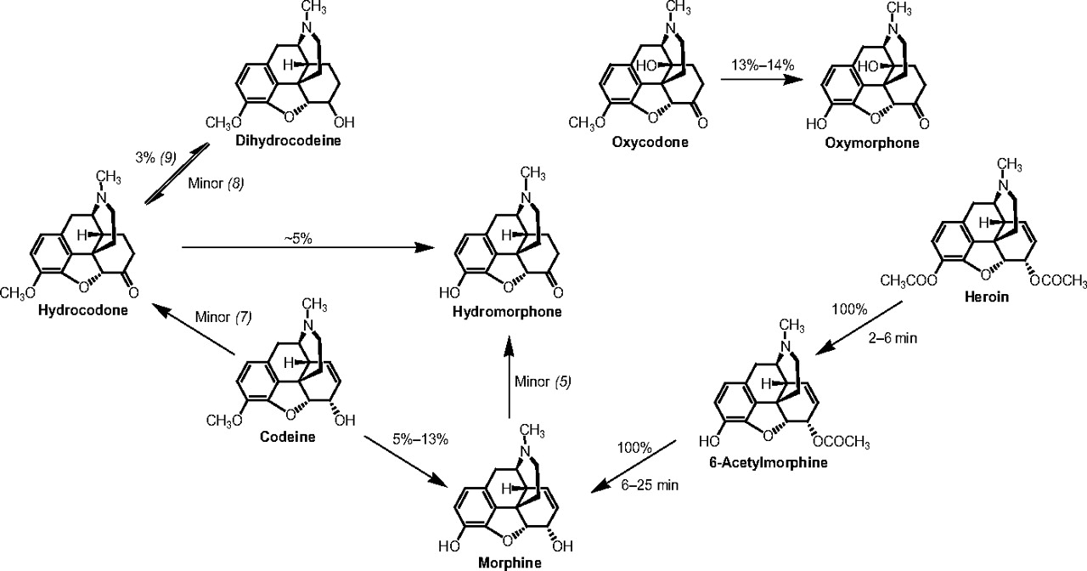
Clinical Chemistry 2009 vol. 55 no. 10 1765-1768

Slide 27
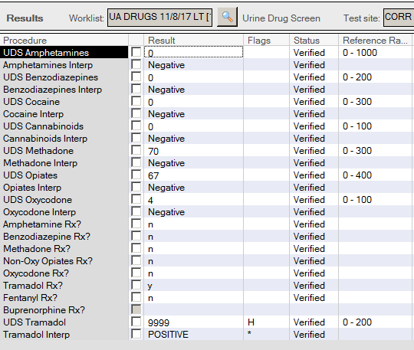
7. QUESTION
What tests should be ordered?
Opiate Confirmation
Amphetamine Confirmation
Tramadol Screen
Tramadol Canned Comment
Tramadol Confirmation

Slide 28
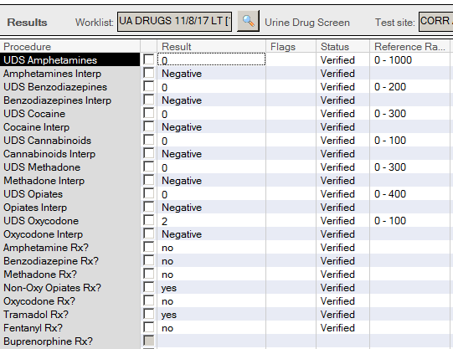
8. QUESTION
What tests should be ordered?
Oxy Confirmation
Amphetamine Confirmation
Tramadol Screen
Tramadol Canned Comment
Tramadol Confirmation

Slide 29
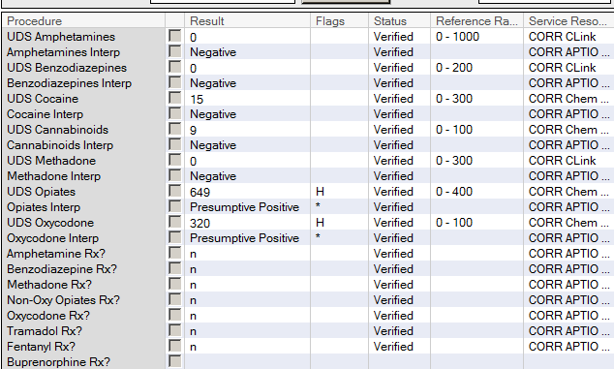
9. QUESTION
This is a CD patient only prescribed suboxone. No comments requesting specific testing. What tests should be ordered?
Oxy Confirmation
Opiate Confirmation
Tramadol Screen
Buprenorphine Screen
Buprenorphine Confirmation

Slide 30
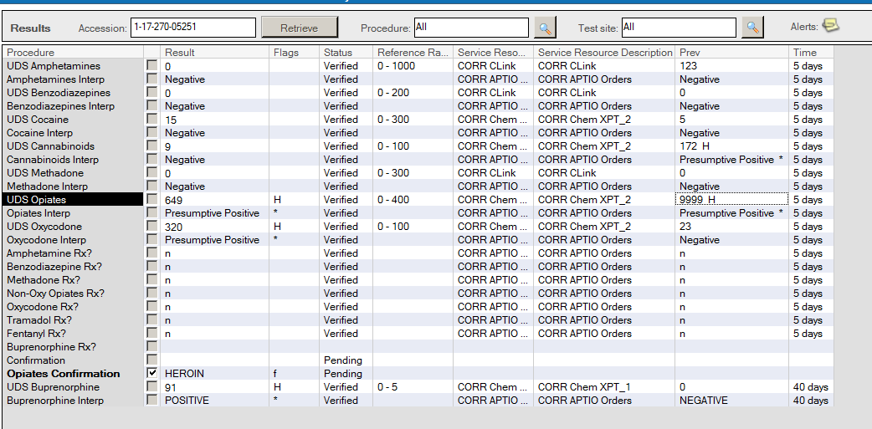
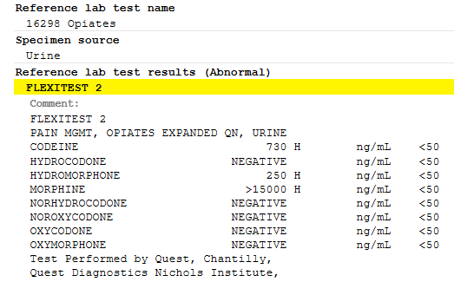
Previous Drug Screen to Confirm result 5 days prior (collected 11/1/17).
This is a typical Heroin metabolite profile.

Slide 31
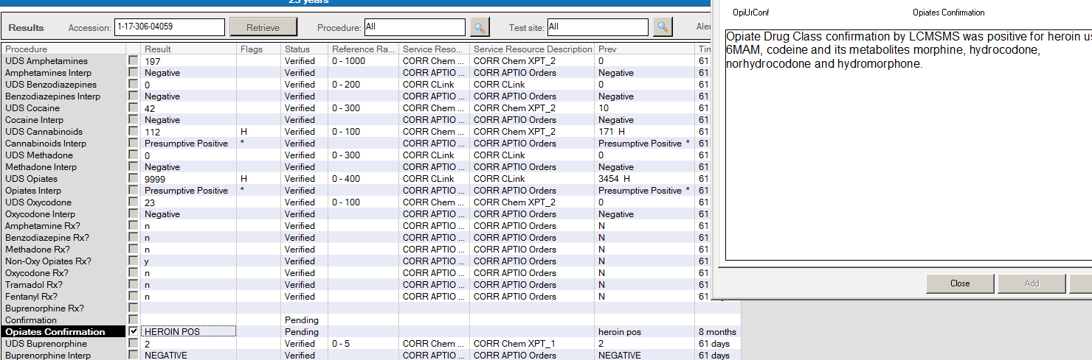
Another heroin example.

Slide 32
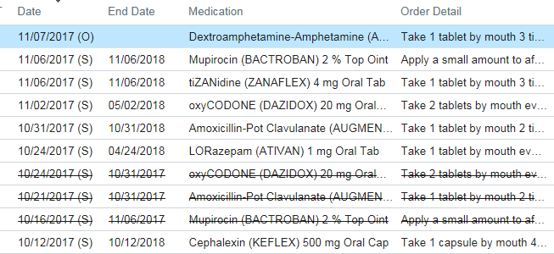
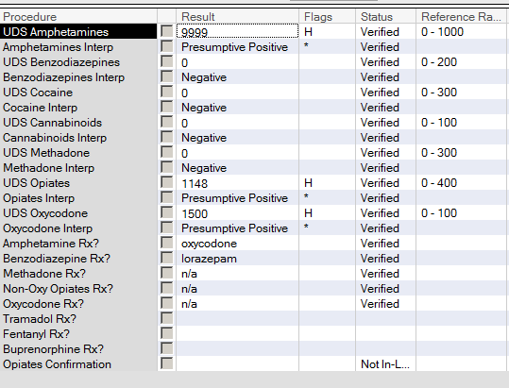
10. QUESTION
What tests should be ordered?
Opiate Confirmation
Amphetamine Confirmation
Benzodiazepine Confirmation
Oxy/Opi Canned Comment
No further testing required

Slide 33
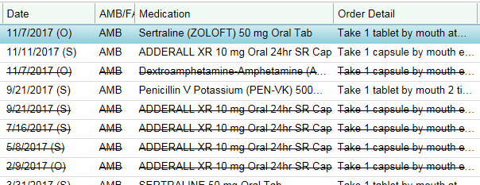
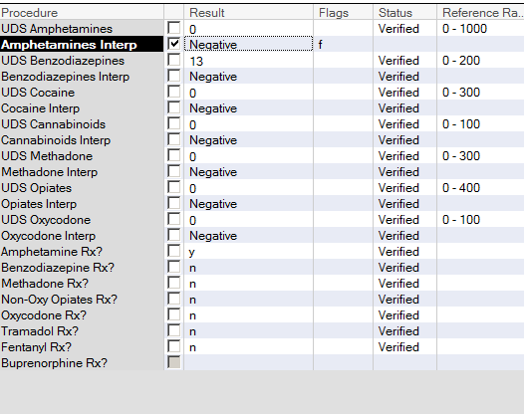
11. QUESTION
What tests should be ordered?
Amphetamine Canned Comment
Amphetamine Confirmation
Buprenorphine Screen
Buprenorphine Confirmation
No further testing is needed

Slide 34
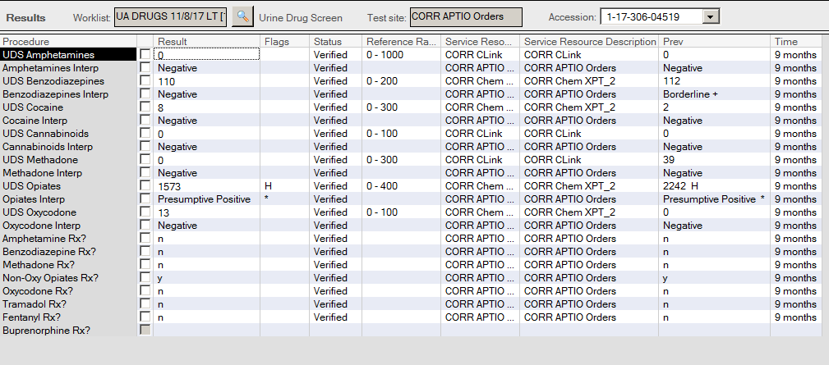
12. QUESTION
What tests should be ordered?
Amphetamine Canned Comment
Amphetamine Confirmation
Buprenorphine Screen
Buprenorphine Confirmation
No further testing is needed

Slide 35
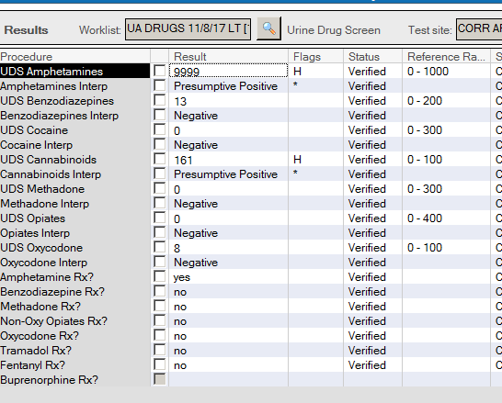
13. QUESTION
What tests should be ordered?
Amphetamine Canned Comment
Amphetamine Confirmation
Buprenorphine Screen
THC Confirmation
No further testing is needed

Slide 36
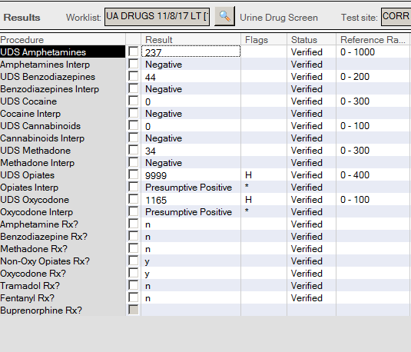
14. QUESTION
What tests should be ordered?
Amphetamine Canned Comment
Oxy/Opi Canned Comment
Opiate Confirmation
Oxy Confirmation
No further testing is needed

Slide 37
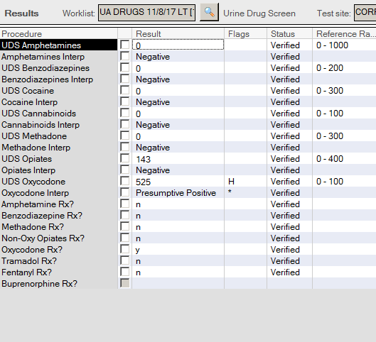
15. QUESTION
What tests should be ordered?
Amphetamine Canned Comment
Oxy/Opi Canned Comment
Opiate Confirmation
Oxy Confirmation
No further testing is needed

Slide 38
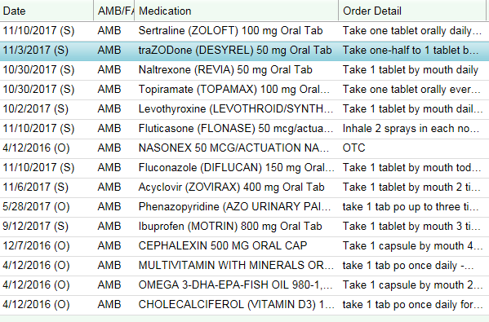

16. QUESTION
This is a non-CD patient
What tests should be ordered?
Amphetamine Canned Comment
Oxy/Opi Canned Comment
Benzodiazepine Confirmation
Oxy Confirmation
No further testing is needed

Slide 39
17. QUESTION
What if this is a CD patient?
What tests should be ordered?
Amphetamine Canned Comment
Oxy/Opi Canned Comment
Benzodiazepine Confirmation
Oxy Confirmation
No further testing is needed

Slide 40

18. QUESTION
What other comments/tests should be ordered?
Amphetamine Canned Comment
Benzodiazepine Canned Comment
Benzodiazepine Confirmation
Oxy Confirmation
No further testing is needed

Slide 41

Benzodiazepine Screen
Do you think this person is taking
Benzodiazepines?
Sertraline is an SSRI and can cross react with the Benzodiazepine screen. Low level positive would be an expected results for such an occurrence. We still send out for confirmation. I did add a comment to this Benzo Confirm result saying the Sertraline is the cause of the false positive. It is ok NOT to send for confirm and just add a comment saying “possible false positive due to Sertraline”. Especially if confirm has been done in past with a Negative benzo result and similar screen semi-quant.

Slide 42




SERTRALINE
DIAZEPAM
FLUOXETINE (PROZAC)
SEROTONIN REUPTAKE INHIBITOR
OXAZEPAM
NOT SIMILAR STRUCTURES
SIMILAR STRUCTURES

Slide 43




DIAZEPAM
TEMAZEPAM-glucuronide
TEMAZEPAM
UDP-glucuronosyltransferase
CYP3A4
UGT
CYP2C19
CYP3A4
BOLD are active metabolites, but when glucronidated excreted
OXAZEPAM-glucuronide
norDIAZEPAM
OXAZEPAM
UGT
GLUCURONIDATION
CYP3A4
UGT

Slide 44


19. QUESTION
What tests should be ordered?
Amphetamine Canned Comment
Benzodiazepine Canned Comment
Benzodiazepine Confirmation
Opi Confirmation
No further testing is needed

Slide 45



20. QUESTION
What tests should be ordered?
Amphetamine Canned Comment
Opiate Canned Comment
Benzodiazepine Confirmation
Opiate Confirmation
No further testing is needed

Slide 46

21. QUESTION
What tests should be ordered?
Amphetamine Canned Comment
Opiate Canned Comment
Benzodiazepine Confirmation
Opiate Confirmation
No further testing is needed

Slide 47

22. QUESTION
What tests should be ordered?
Amphetamine Canned Comment
Opiate Canned Comment
Benzodiazepine Confirmation
Opiate Confirmation
No further testing is needed

Slide 48




OXYMORPHONE-3-GLUCURONIDE
OXYMORPHONE
OXYCODONE
UDT
2D6
O – demethylation
3A4
N – demethylation
3A4
N – demethylation
NOROXYMORPHONE
NOROXYCODONE

Slide 49

23. QUESTION
What tests should be ordered?
Amphetamine Canned Comment
Oxy Canned Comment
Benzodiazepine Confirmation
Oxy Confirmation
No further testing is needed

Slide 50


24. QUESTION
What tests should be ordered?
Amphetamine Canned Comment
Opiate Confirmation
Benzodiazepine Confirmation
Fentanyl Screen
No further testing is needed

Slide 51


25. QUESTION
What tests should be ordered?
Amphetamine Canned Comment
Opiate Confirmation
Methadone Confirmation
Cocaine Confirmation
No further testing is needed

Slide 52


26. QUESTION
What tests should be ordered?
Amphetamine Canned Comment
Opiate Confirmation
Methadone Confirmation
Cocaine Confirmation
No further testing is needed

Slide 53

27. QUESTION
Provider comment: Please confirm suboxone and do confirmation on any positive results and report level. Patient only prescribed suboxone.
What tests should be ordered?
(multiple answers exist)
Amphetamine Confirmation
Opiate Confirmation
Methadone Confirmation
Buprenorphine Confirmation
Add Buprenorphine screen

Slide 54

28. QUESTION
Where do you find the Tox screen rules and canned comments?
What tests should be ordered?
Ask the director
I keep the old out dated one on my personal drive
Matt has it
Teresa has it
Only one current copy should be kept on the X:drive

Slide 55

There are 6 tabs in this file.
The “SCREEN INTERPRETATIONS” tab contains canned comments for pasting into UDS result comment field in Cerner.
When adding a comment be sure to type “SEE COMMENT” in the result field.

Slide 56

There are 6 tabs in this file.
The “CONF RULES” tab contains rules for when to send a specimen on for confirmation. Some are CD specific.

Slide 57

There are 6 tabs in this file.
The “CONF INTERPRETATIONS” tab contains canned comments when entering urine drug confirmation results into Cerner (primarily for KP-Georgia).

Slide 58

There are 6 tabs in this file.
The “PROCESS IMPURITIES” tab contains a list of acceptable limits for common narcotic drugs.

Slide 59

There are 6 tabs in this file.
The “CU TOX LAB” tab contains a list of CU TOX LAB TEST CODES AVAILABLE IN CERNER.

Slide 60

There are 6 tabs in this file.
The “QUEST” tab contains a list of QUEST LAB TEST CODES AVAILABLE IN CERNER.

Slide 61


29. QUESTION
If I’m not sure about what to comment or order what should I do?
What tests should be ordered?
(multiple answers exist)
Ask the director
Ask Matt
Email the director
A and C
All of the Above

Slide 62





More Heroin case examples

Slide 63

This is not suspect for heroin abuse. The opiate semi quant is too low to suspect heroin use.
Selecting Opiate from CU Tox was a good idea, because if only OPI was ordered from Quest, then we would not have detected the Tramadol

Slide 64

This IS suspect for heroin abuse. The opiate semi quant is to high to be cross reactivity to oxycodone in the urine.
Selecting Opiate (CD) from CU Tox was the Correct choice. This minimizes the cost to the patient and provides
The next slide shows his confirmation report from CU Tox lab.

Slide 65

Opiate Drug Class confirmation by LCMSMS was positive for heroin use: 6MAM (>1000 ng/mL), codeine (27 ng/mL) and its metabolite morphine (456 ng/mL). Results suggest very recent exposure.
Oxycodone was also present (270 ng/mL).
Buprenorphine was present (>1000 ng/mL), but its metabolite norbuprenorphine was not present. Results suggest urine contamination with buprenorphine pill. Bup was not ingested.

Slide 66

Same patient 10 days later.

Slide 67

Opiate Drug Class confirmation by LCMSMS was positive for heroin use: 6MAM (>1000 ng/mL), codeine (19 ng/mL)and its metabolites morphine (287 ng/mL). This profile suggests very recent use.
Opiate Drug Class confirmation by LCMSMS was positive for buprenorphine (>1000 ng/mL) and its metabolite, norbuprenorphine was not detected. Naloxone was present at >1000 ng/mL.
Pattern for buprenorphine suggests suboxone was not consumed, but "dipped" in urine.

Slide 68

This IS suspect for heroin abuse.
Selecting Opiate (CD) from CU Tox was the Correct choice. This minimizes the cost to the patient and provides
The next slide shows his confirmation report from CU Tox lab.

Slide 69

Opiate Drug Class confirmation by LCMSMS was positive for heroin use: 6MAM (>1000 ng/mL), codeine (>1000 ng/mL) and its metabolite morphine (>1000 ng/mL). Results suggest very recent exposure.
Buprenorphine was present (15 ng/mL), and the metabolite norbuprenorphine was present (170 ng/mL). Results suggest urine contamination with buprenorphine pill. Bup was not ingested.
This patient is on sublingual suboxone (8 mg bup/ 2 mg naloxone). The results show primarily metabolite is present and negligible parent drug. This profile suggests a dose was recently missed and heroin was taken after last dose.

Slide 70

This is a KPGA patient. What would you do here?
Is this Tramadol?

Slide 71

KPGA patients have been typically compliant. Currently we are not sending for 6MAM confirmation. If the metabolic patter is suspicious then we can add-on the test or send a note to the provider at the time confirmation interpretations are added.
The OPI screen result was too high to only be Tramadol.
This looks like recent Codeine use to me.
Confirmation Interpretation Released:
Opiate confirmation by LCMSMS was positive for Tramadol (>1000 ng/mL) and its metabolite O-desmethyl-tramadol (>1000 ng/mL).
Urine Opiate Drug Class confirmed by LCMSMS was also positive for codeine (>1000 ng/mL) and its metabolites norcodeine (741 ng/mL) and morphine (236 ng/mL).
This specimen was not confirmed by LCMSMS for 6AM. Heroin use is NOT suspected. Please call if 6AM confirmation is medically necessary.

Slide 72

This is a KPGA patient. What would you do here?

Slide 73

The OPI screen result is above 550 so it looks to be more than just OPI screen cross reactivity to oxycodone.
This was appropriately sent to CU Tox for OPI. CD is not necessary. The OPI screen results are too low.
The patient is taking fentanyl, but is not prescribed fentanyl. This is misuse. Calling it illicit use is also correct terminology.

Slide 74

This is a KPGA patient. What would you do here?

Slide 75

Yes, order opiates. The level is high enough for 6MAM presence, but we do not typically see heroin in their population. We wait to review the metabolic profile. It is easy to add on at CU Tox. This is not the case with Quest.
Confirmation Interpretation Released:
Urine Opiate Drug Class confirmed by LCMSMS was positive for Fentanyl (158 ng/mL) and its metabolite norfentanyl (241 ng/mL). Trace hydrocodone (85 ng/mL) and its metabolites norhydrocodone (80 ng/mL) observed. The presence of these analytes are due to pharmaceutical process impurities possible when high doses of oxycodone are used.
This specimen was not confirmed by LCMSMS for 6AM. Heroin use is NOT suspected. Please call if 6AM confirmation is medically necessary.

Slide 76

This is a KPGA patient. What would you do here?

Slide 77
Order OPI confirmation.
The confirm was negative.
If you see numerous patients with high OPI screen without prescribed meds and can not account for OXY cross reactivity, then check the QC performance for the run. Are the QCs running high? If it is only a couple specimens no need to check.

Slide 78
Why we do not necessary need to test for CD (heroin) when OPI is <800 ng/mL.
There have been numerous publication documenting “Incidental exposure” to morphine due to eating poppy seeds.
Providers need to educate patients receiving pain or chemical dependence treatment to abstain from using poppy seeds in their diet. Food products with 15 g poppy seeds can cause positive opiate drug screens and confirmation if urine is collected within 2-24 hours after consumption of the poppy seeds.
An article is available if you are interested
X:\TOXICOLOGY\ARTICLES for Reference and CME\ Incidental exposure to morphine in Poppy Seeds

Slide 79
This does not mean they did not take heroin. But, it will be very difficult to determine drug exposure.
Heroin metabolite, 6-acetylmorphine (6MAM) typically is detectable in urine for about 12 hours after exposure.
After that time you will only see morphine and possibly co-contaminates (codeine and its metabolites).
Once the levels of opiate are low, around 300 – 500 ng/mL, there will not be 6MAM present, because it has been metabolized to morphine.
Often the metabolite profile will help to determine if heroin or codeine was consumed.
Historically the ratio of morphine to codeine is 10:1. This is dependent on the heroin purification method. And as you are aware this type of processing is not done at a pharmaceutical manufacturer.
NaF
Blood / Liver
“pseudocholinesterase”
Carboxylesterases (CES1* and CES2*)
Present in serum
Heroin
Fast!!!
6-acetyl morphine
Slower - Hydrolyzed in liver
Morphine
Morphine-3-glucuronide
Morphine-6-glucuronide
* Known polymorphisms

Slide 80



Slide 81
Pharmaceutical impurities

