Slide 1
Urine Drug Screen Interpretation Competency
L.K. Bechtel 11/13/2017

Slide 2


I have read and understand the procedures described in 1.1550 Urine Drug Screen Reflex and Interpretation and the associated job aids.

Slide 3
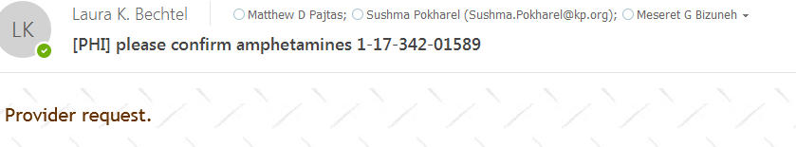
When there is a drug confirmation request from the provider. They may call Toxicology phone or email or request through Staff message.
If the call goes to Dr. B you will receive an email that looks like this below:
[PHI] in the subject header and the specimen ID
A snapshot of the ARE from Cerner is usually included along with the requested drug confirmation

Slide 4
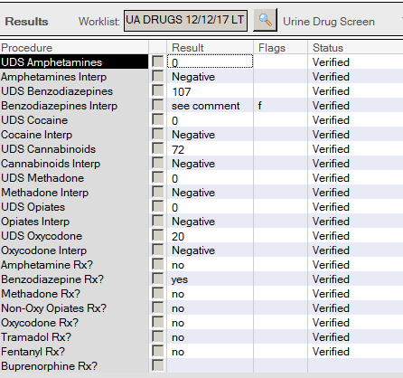
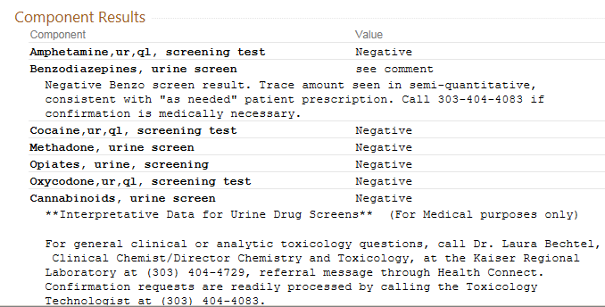
When a comment is added in Cerner. It will look like this in Health Connect .

Slide 5
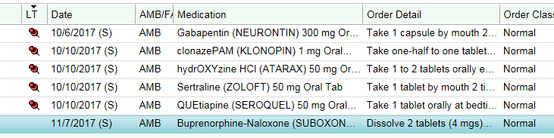
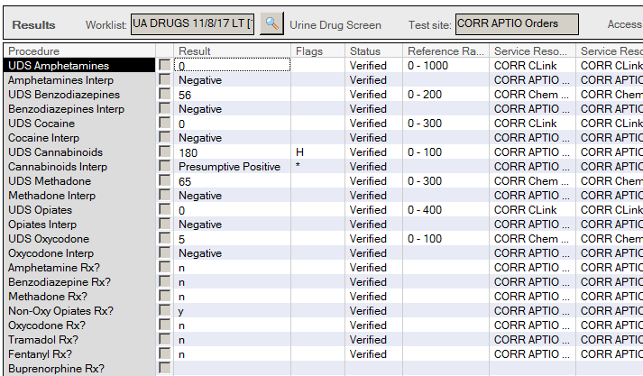
1. QUESTION
What tests should be ordered?
Opiate Confirmation
Cannabinoid Confirmation
Buprenorphine Screen
Buprenorphine Confirmation
No further testing is needed

Slide 6
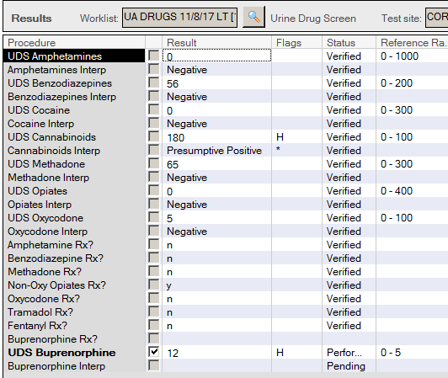
1. ANSWER
What tests should be ordered?
Opiate Confirmation
Cannabinoid Confirmation
Buprenorphine Screen
Buprenorphine Confirmation
No further testing is needed
If the Bup screen result is negative, then there is no further testing.
If the Bup screen result is positive, and if the patient is a KPCO CD patient, then send for Buprenorphine confirmation.

Slide 7
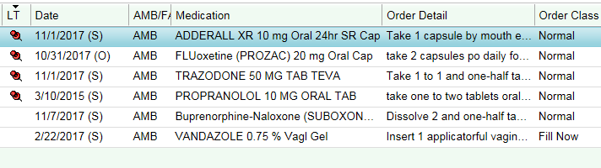
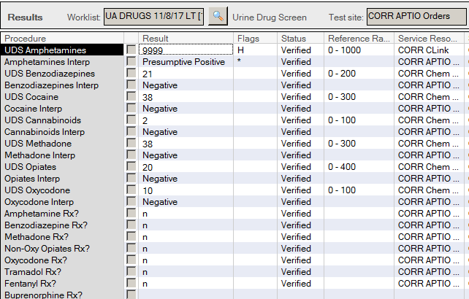
2. QUESTION
What tests should be ordered?
Opiate Confirmation
Amphetamine Confirmation
Buprenorphine Screen
Buprenorphine Confirmation
No further testing is needed

Slide 8
2. ANSWER
What tests should be ordered?
Opiate Confirmation
Amphetamine Confirmation
Buprenorphine Screen
Buprenorphine Confirmation
No further testing is needed
Since the results are Consistent: Positive AMP and the Amphetamine Rx was not checked. This should prompt you to check Health Connect to verify if there is a prescription. Since there is a valid prescription when the UDS was ordered no further testing is necessary, unless specifically requested by the physician.

Slide 9
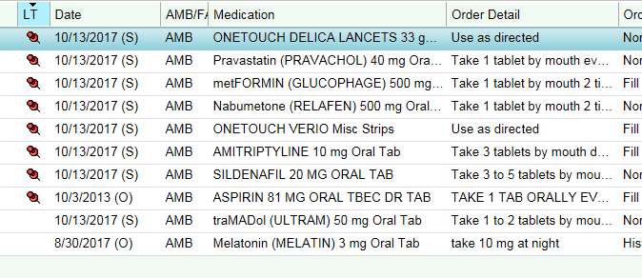
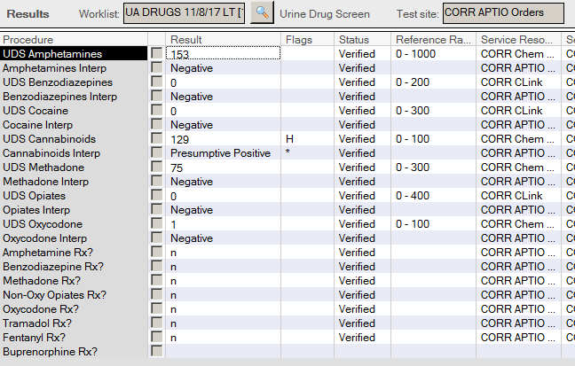
3. QUESTION
What tests should be ordered?
Opiate Confirmation
Cannabinoid Confirmation
Buprenorphine Screen
Buprenorphine Confirmation
No further testing is needed

Slide 10
3. ANSWER
What tests should be ordered?
Opiate Confirmation
Cannabinoid Confirmation
Buprenorphine Screen
Buprenorphine Confirmation
No further testing is needed
Even though Tramadol is in the Medication list, there is no indication by the provider a Tramadol screen is required. You do not need to check Health Connect Meds tab.
Cannabinoids are not sent for confirmation unless specifically requested by provider.

Slide 11
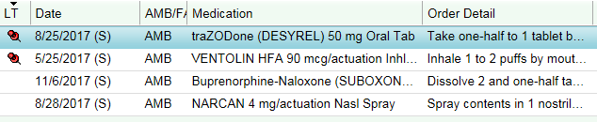

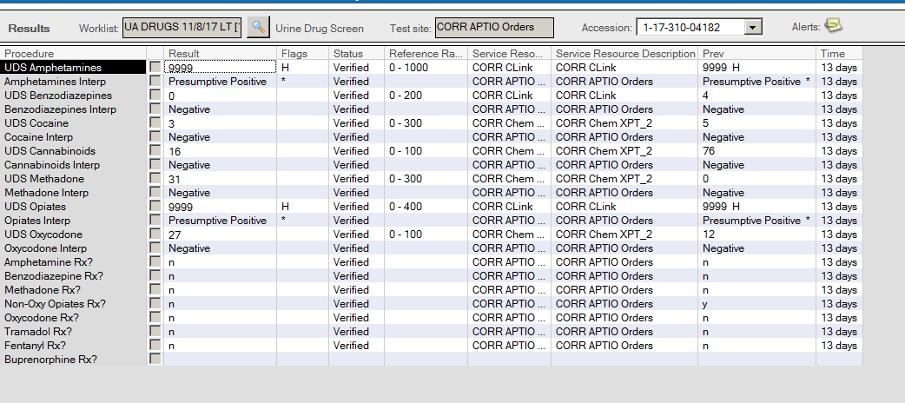
4. QUESTION
What tests should be ordered?
(multiple answers allowed)
Opiate Confirmation
Amphetamine Confirmation
Buprenorphine Screen
Buprenorphine Confirmation
Heroin Confirmation

Slide 12
4. ANSWER
What tests should be ordered?
Opiate Confirmation
Amphetamine Confirmation
Buprenorphine Screen
Buprenorphine Confirmation
Heroin Confirmation
This person is a KPCO Chemical Dependency patient. Positive Amphetamine screen is inconsistent, confirm. No additional comment is necessary
Since they are prescribed Suboxone (Buprenorphine/Naloxone) perform a Bup Screen. If negative stop testing. If positive, CD patients get Buprenorphine confirmation.
Although the drug Rx was not filled out, past UDS 13 days ago shows the same drug use pattern and the “Non-Oxy Opiates Rx?” was filled out.
First thing you should do is check the Health Connect and review his medications and past confirmation results.

Slide 13
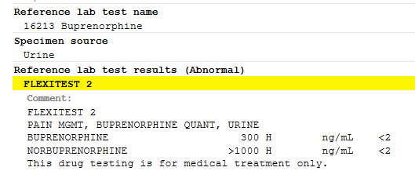
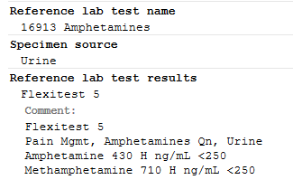
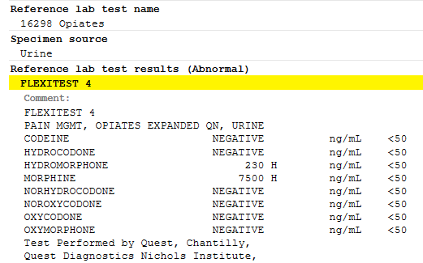
Urine Confirmation results from last month:
BUPRENORPHINE INGESTED, this is known because the metabolite is present
METHAMPHETAMINE,
INCONSISTENT
MORPHINE,
INCONSISTENT

Slide 14
The heroin metabolite profile and morphine process impurity profile are not the same.
Codeine
Norcodeine
Morphine
Hydrocodone
< 5% MORPHINE
Hydromorphone
Norhydrocodone
Last month, this patient demonstrated Morphine use.
Up to 5% of the morphine concentration in the urine could be metabolized to the minor morphine metabolite, Hydromorphone.
Since the morphine concentration is 7,500 ng/mL, then 5% would be 375 ng/mL.
The hydromorphone concentration is 230 ng/mL. Since this is less than the maximum allowable limit for this minor metabolite (230 < 375), then this person has morphine usage, not both morphine and hydromorphone.

Slide 15
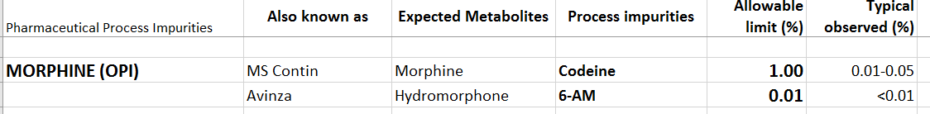
Process impurities may be present in numerous drugs that we monitor for abuse/misuse.
Process impurities are very small amounts of drug “contaminating” (or co-purifying with) a prescribed drug. These tiny amounts are present during manufacturing. The Allowable limit is the amount present the FDA allows for release of a morphine lot.

Slide 16
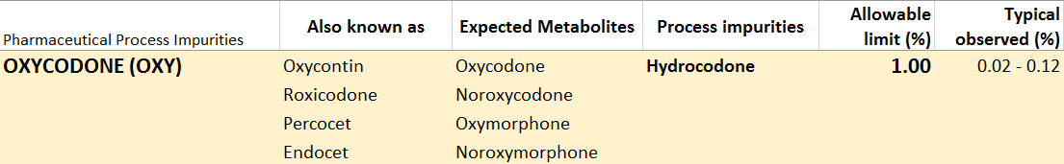
Process impurities may be present in numerous drugs that we monitor for abuse/misuse.
Process impurities are very small amounts of drug “contaminating” a prescribed drug. These tiny amounts are present during the process of manufacturing / synthesizing the drug.
The most frequent example we see of this type of “false positive” is Oxycodone and Hydrocodone.

Slide 17
A complete list of FDA approved limits for common narcotics is listed below:

Slide 18
4. ANSWER
What tests should be ordered?
Opiate Confirmation
Amphetamine Confirmation
Buprenorphine Screen
Buprenorphine Confirmation
Heroin Confirmation
This person is a KPCO Chemical Dependency patient.
OPI (CD) to CU Tox Lab is the most cost efficient choice for confirmation of Opiates, Bup, 6MAM.

Slide 19
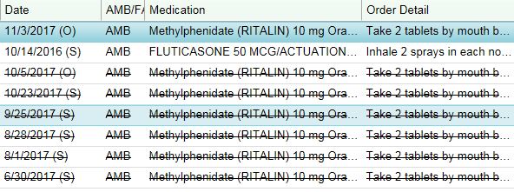
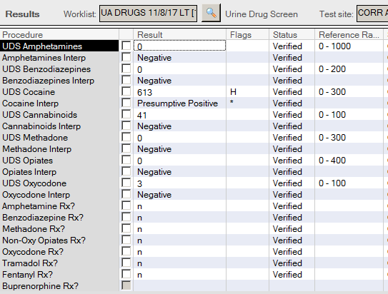
5. QUESTION
What tests should be ordered?
(multiple answers may exist)
Opiate Confirmation
Amphetamine Confirmation
Add Amphetamine Screen Canned Comment
Cocaine Confirmation
No additional testing required

Slide 20
5. QUESTION
What tests should be ordered?
(multiple answers may exist)
Opiate Confirmation
Amphetamine Confirmation
Add Amphetamine Screen Canned Comment
Cocaine Confirmation
No additional testing required
At this time we are confirming Cocaine screens.
Cocaine is positive, obviously inconsistent with Rx.
He is prescribed Ritalin (Methylphenidate). Add comment to the Amphetamine screen
Consistent with Rx; Amphetamine screen does not detect Methylphenidate (Ritalin); low dose Amphetamine (<50 mg per day) may screen negative; Notify lab (303-404-4083) if Ritalin or Amphetamine confirmation is medically necessary.

Slide 21
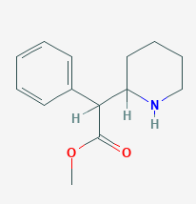
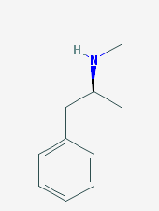
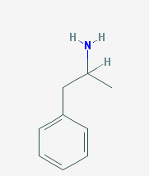
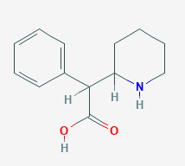
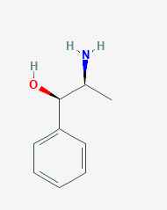
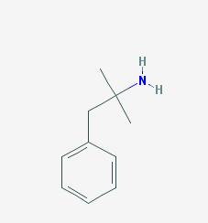
METHYLPHENIDATE
METHAMPHETAMINE
AMPHETAMINE
CYP450s: 2D6
N-deamination
Ester group
De-esterification by
carboxylesterase CES1A1
CYP450s:
2D6, 3A4
Hydroxylation
Amphetamine Screen antibody
will bind to these drugs
NOREPHEDRINE
PHENTERMINE
Carboxyllic acid group
Amphetamine Screen antibody
will NOT bind.

Slide 22
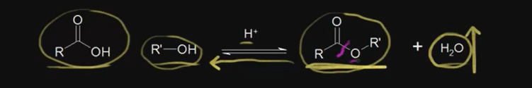
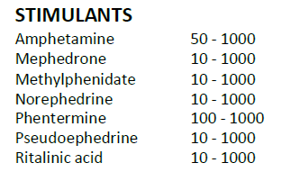
METHYLPHENIDATE
Ester group
Methylphenidate Brand Names: Concerta, Ritalin, Ritalin-SR, Daytrana, Metadate
MOA: CNS stimulant; blocks the reuptake of norepinephrine and dopamine.
The Quest confirmation only detects Ritalinic Acid. This is fine because there is not much parent compound found in the urine anyway
CU Tox Lab detects both Methylphenidate and its metabolite, Ritalinic acid.
De-esterification by
carboxylesterase CES1A1
RITALINIC ACID
Carboxyllic acid group

Slide 23
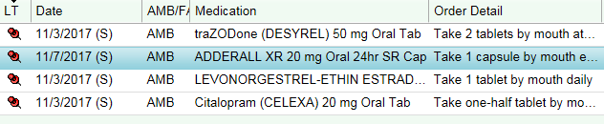
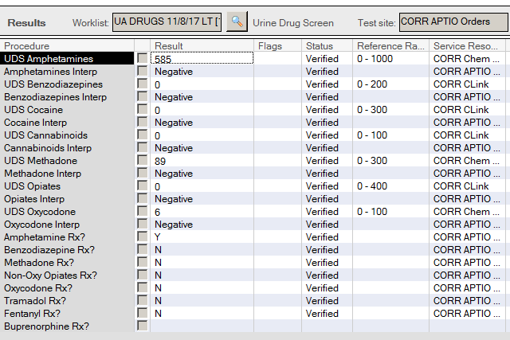
6. QUESTION
What tests should be ordered?
(multiple answers allowed)
Opiate Confirmation
Amphetamine Confirmation
Buprenorphine Screen
Buprenorphine Confirmation
Amphetamine Canned Comment

Slide 24
6. ANSWER
What tests should be ordered?
(multiple answers allowed)
Opiate Confirmation
Amphetamine Confirmation
Buprenorphine Screen
Buprenorphine Confirmation
Amphetamine Canned Comment

Slide 25
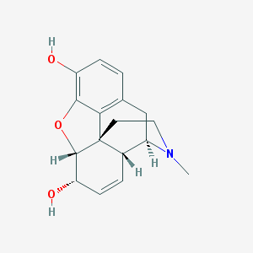
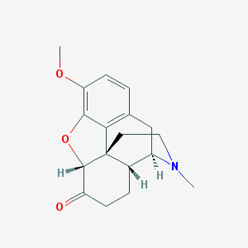
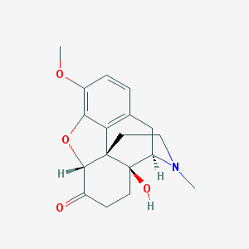
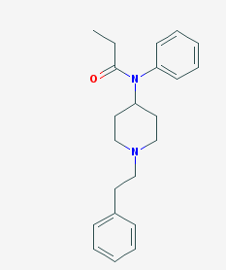
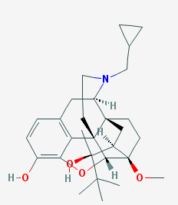
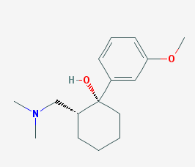
Which compounds are similar in structure?
MORPHINE
HYDROCODONE
OXYCODONE
TRAMADOL
BUPRENORPHINE
FENTANYL

Slide 26
Where do you think the opiate screen antibody is binding?
MORPHINE
HYDROCODONE
OXYCODONE

Slide 27
Where do you think the opiate screen antibody is binding?
MORPHINE
HYDROCODONE
OXYCODONE
This region is most similar between opiates that bind well in the opiate assay:
Codeine
Norcodeine
Dihydrocodone
Morphine
Hydrocodone
Hydromorphone

Slide 28
OPIOID METABOLITE CHART
Heroin
Codeine
Norcodeine
6-Acetylmorphine
Morphine
Hydrocodone
Hydromorphone
Norhydrocodone
Oxycodone
Oxymorphone
Noroxycodone
Noroxymorphone
Intricate metabolism of opiates.
Minor metabolic pathways in red.

Slide 29

NaF
Heroin
Blood
“pseudocholinesterase”
Carboxylesterases
Fast!!!
6-acetyl morphine

Slide 30
NaF
Blood / Liver
“pseudocholinesterase”
Carboxylesterases (CES1* and CES2*)
Heroin
Fast!!!
6-acetyl morphine
Slower - Hydrolyzed in liver
Morphine
Morphine-3-glucuronide
Morphine-6-glucuronide
* Known polymorphisms

Slide 31

Why is there codeine in heroin positive urine specimens? Co-purified from opium
1-15%
Clin Chem 47,(2) 2001:303

Slide 32
Codeine
Codeine is a Process impurity of morphine
  ≤ 0.5% morphine concentration (0.01 – 0.05% typical)
  Opium contains morphine to codeine in a ratio of approximately 10:1

Slide 33
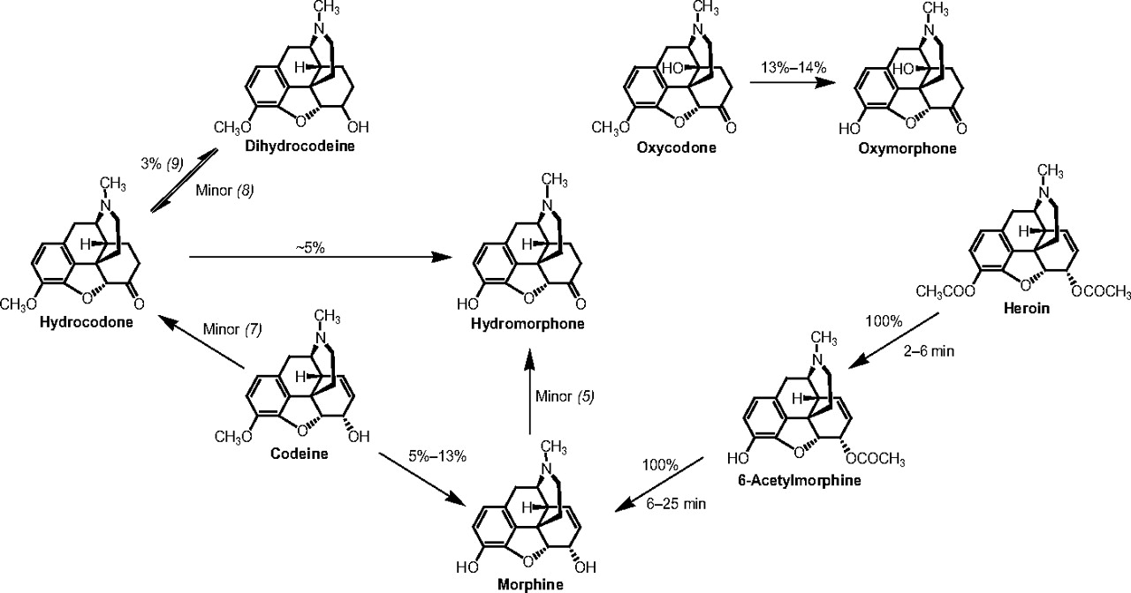
Clinical Chemistry 2009 vol. 55 no. 10 1765-1768

Slide 34
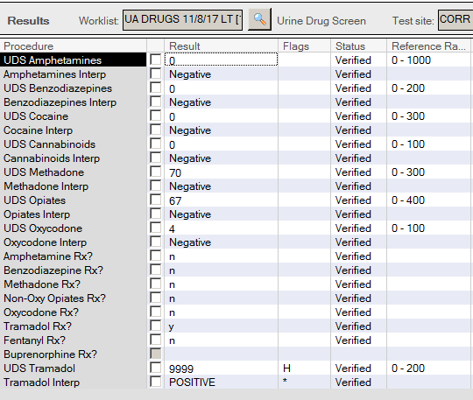
7. QUESTION
What tests should be ordered?
Opiate Confirmation
Amphetamine Confirmation
Tramadol Screen
Tramadol Canned Comment
Tramadol Confirmation

Slide 35
7. ANSWER
What tests should be ordered?
Opiate Confirmation
Amphetamine Confirmation
Tramadol Screen
Tramadol Canned Comment
Tramadol Confirmation
The provider marked Tramadol Screen in the UDS order.
We are trying to encourage providers to order Tram screen at the same time they place the UDS order.
No confirmation is required.

Slide 36
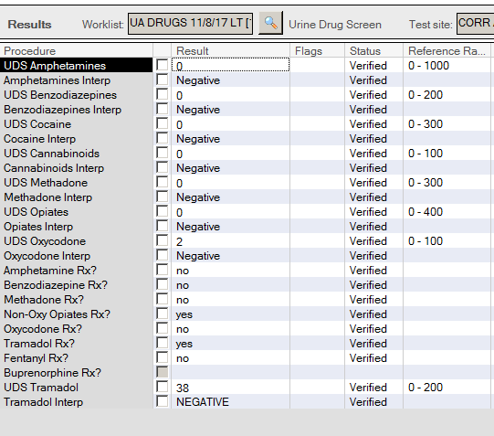
8. QUESTION
What tests should be ordered?
Oxy Confirmation
Amphetamine Confirmation
Tramadol Screen
Tramadol Canned Comment
Tramadol Confirmation

Slide 37
8. ANSWER
What tests should be ordered?
Oxy Confirmation
Amphetamine Confirmation
Tramadol Screen
Tramadol Canned Comment
Tramadol Confirmation
Check Health Connect Med list for “Non-Oxy Opiate Rx”. Most likely the provider is referring to Tramadol.

Slide 38
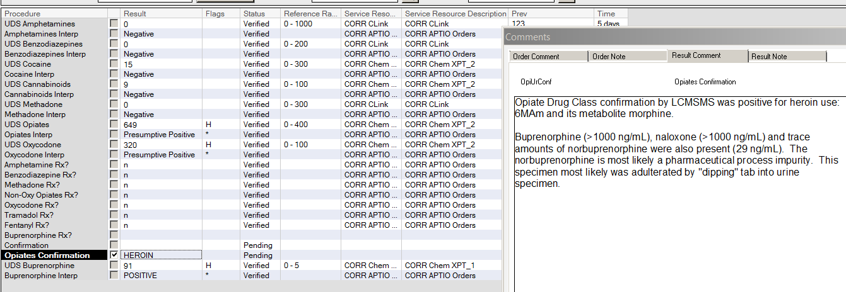
9. QUESTION
This is a CD patient only prescribed suboxone. No comments requesting specific testing. What tests should be ordered?
Oxy Confirmation
Opiate Confirmation
Tramadol Screen
Buprenorphine Screen
Buprenorphine Confirmation

Slide 39
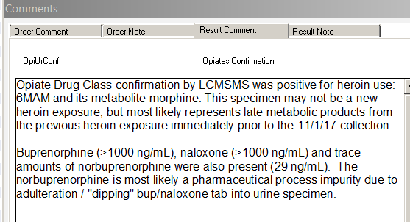
9. ANSWER
This is a CD patient only prescribed suboxone. No comments requesting specific testing. What tests should be ordered?
Oxy Confirmation
Opiate Confirmation
Tramadol Screen
Buprenorphine Screen
Buprenorphine Confirmation

Slide 40
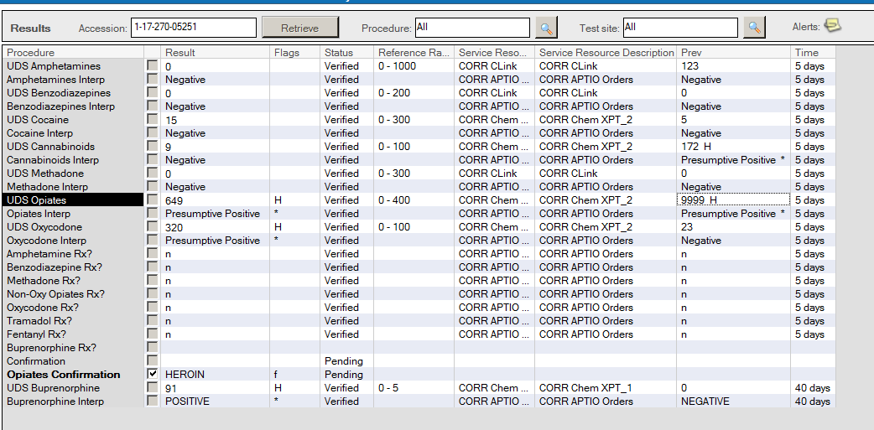
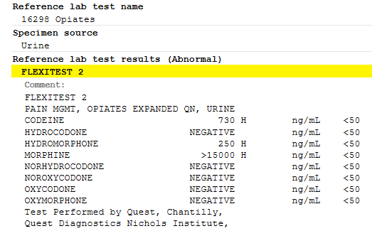
Previous Drug Screen to Confirm result 5 days prior (collected 11/1/17).
This is a typical Heroin metabolite profile.

Slide 41
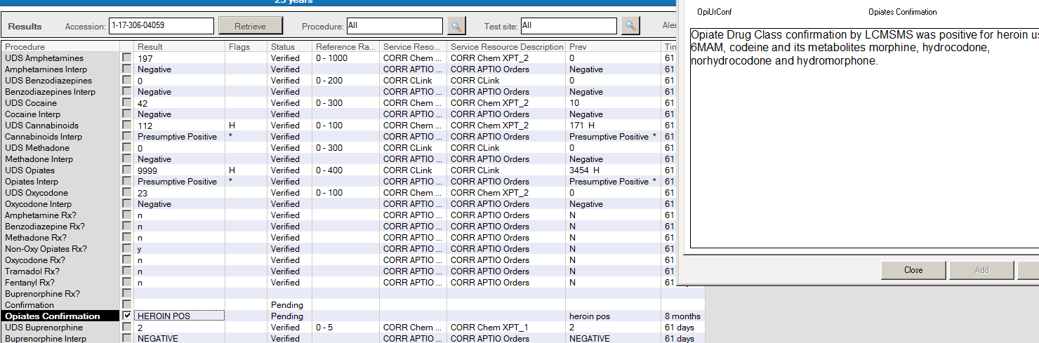
Another heroin example.

Slide 42
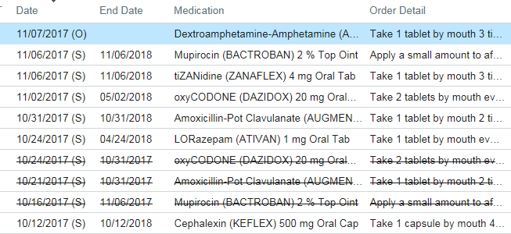
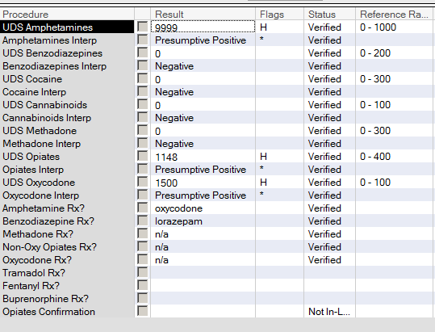
10. QUESTION
What tests should be ordered?
Opiate Confirmation
Amphetamine Confirmation
Benzodiazepine Confirmation
Oxy/Opi Canned Comment
No further testing required

Slide 43
10. ANSWER
What tests should be ordered?
Opiate Confirmation
Amphetamine Confirmation
Benzodiazepine Confirmation
Oxy/Opi Canned Comment
No further testing required

Slide 44
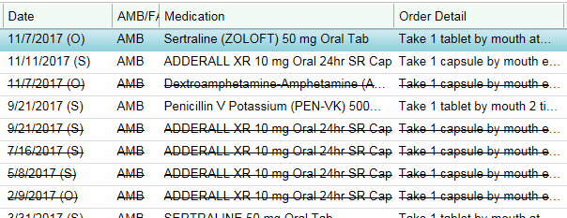
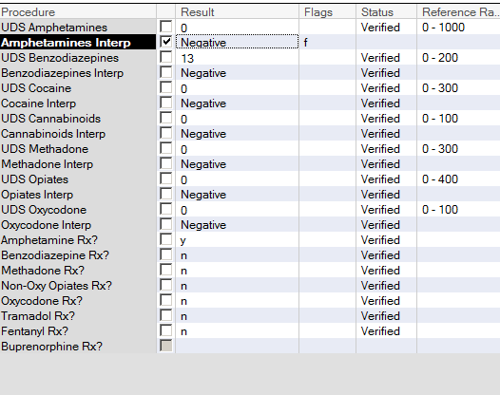
11. QUESTION
What tests should be ordered?
Amphetamine Canned Comment
Amphetamine Confirmation
Buprenorphine Screen
Buprenorphine Confirmation
No further testing is needed

Slide 45
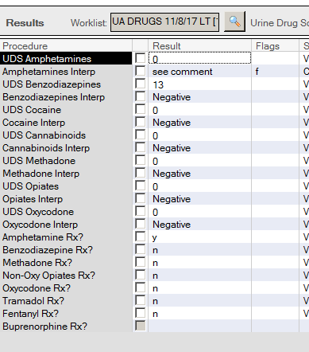
11. ANSWER
What tests should be ordered?
Amphetamine Canned Comment
Amphetamine Confirmation
Buprenorphine Screen
Buprenorphine Confirmation
No further testing is needed
Provider marked Amphetamine Rx, therefore they are prescribed a drug from the Amphetamine screen. The canned comment below covers Amph and Ritalin.
Result is negative; Amphetamine screen does not detect Methylphenidate (Ritalin); Notify lab if Amphetamine confirmation is medically necessary.

Slide 46
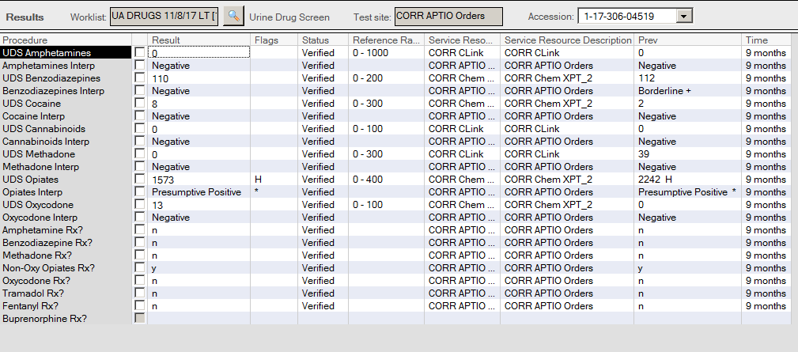
12. QUESTION
What tests should be ordered?
Amphetamine Canned Comment
Amphetamine Confirmation
Buprenorphine Screen
Buprenorphine Confirmation
No further testing is needed

Slide 47
12. ANSWER
What tests should be ordered?
Amphetamine Canned Comment
Amphetamine Confirmation
Buprenorphine Screen
Buprenorphine Confirmation
No further testing is needed
No need for checking Heath Connect or further testing. The results are
consistent with provider marked Rx.

Slide 48
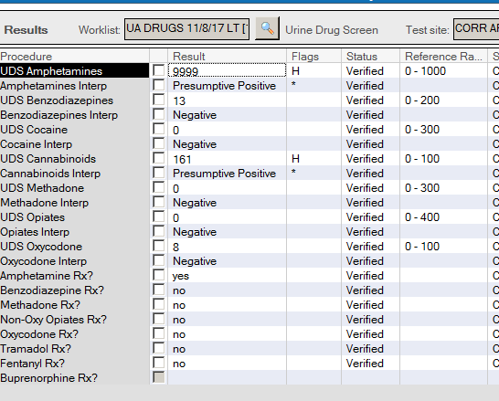
13. QUESTION
What tests should be ordered?
Amphetamine Canned Comment
Amphetamine Confirmation
Buprenorphine Screen
THC Confirmation
No further testing is needed

Slide 49
13. QUESTION
What tests should be ordered?
Amphetamine Canned Comment
Amphetamine Confirmation
Buprenorphine Screen
THC Confirmation
No further testing is needed
THC is not sent for confirmation unless specifically requested by the provider.
We do not enter a screen semi quant value, because this assay’s semi quants do not correlate to cTHC quantitative results. The Cannabinoid screen calibration curve reaches a maximum at 150 ng/mL. The cutoff used at RRL is very close to the ULOL. This is why the Cannabinoid High QC is difficult to control above the cutoff.

Slide 50

14. QUESTION
What tests should be ordered?
Amphetamine Canned Comment
Oxy/Opi Canned Comment
Opiate Confirmation
Oxy Confirmation
No further testing is needed

Slide 51
14. ANSWER
What tests should be ordered?
Amphetamine Canned Comment
Oxy/Opi Canned Comment
Opiate Confirmation
Oxy Confirmation
No further testing is needed
The provider indicates the patient is prescribed both oxycodone and a non-oxy opiate.
The results are consistent with Rx.
Neither drug screen requires confirmation.

Slide 52

15. QUESTION
What tests should be ordered?
Amphetamine Canned Comment
Oxy/Opi Canned Comment
Opiate Confirmation
Oxy Confirmation
No further testing is needed

Slide 53
15. ANSWER
What tests should be ordered?
Amphetamine Canned Comment
Oxy/Opi Canned Comment
Opiate Confirmation
Oxy Confirmation
No further testing is needed
The provider indicates the patient is prescribed oxycodone.
The results are consistent with Rx.

Slide 54


16. QUESTION
This is a non-CD patient
What tests should be ordered?
Amphetamine Canned Comment
Oxy/Opi Canned Comment
Benzodiazepine Confirmation
Oxy Confirmation
No further testing is needed

Slide 55
16. QUESTION
This is a non-CD patient
What tests should be ordered?
Amphetamine Canned Comment
Oxy/Opi Canned Comment
Benzodiazepine Confirmation
Oxy Confirmation
No further testing is needed
Borderline results has been removed from Cerner. In this example Sertraline was causing false positive benzodiazepine screen.

Slide 56
17. QUESTION
What if this is a CD patient?
What tests should be ordered?
Amphetamine Canned Comment
Oxy/Opi Canned Comment
Benzodiazepine Confirmation
Oxy Confirmation
No further testing is needed

Slide 57
17. ANSWER
This is a CD patient
What tests should be ordered?
Amphetamine Canned Comment
Oxy/Opi Canned Comment
Benzodiazepine Confirmation
Oxy Confirmation
No further testing is needed
We removed borderline results for benzodiazepines.

Slide 58

18. QUESTION
What other comments/tests should be ordered?
Amphetamine Canned Comment
Benzodiazepine Canned Comment
Benzodiazepine Confirmation
Oxy Confirmation
No further testing is needed

Slide 59
18. ANSWER
What other comments/tests should be ordered?
Amphetamine Canned Comment
Benzodiazepine Canned Comment
Benzodiazepine Confirmation
Oxy Confirmation
No further testing is needed
Screen Negative for Benzodiazepines. Lorazepam and Clonazepam do not cross react with screen unless used at high dose. Notify lab (303-404-4083) if confirmation is medically necessary.

Slide 60

Benzodiazepine Screen
Do you think this person is taking
Benzodiazepines?
Sertraline is an SSRI and can cross react with the Benzodiazepine screen. Low level positive would be an expected results for such an occurrence. We still send out for confirmation. I did add a comment to this Benzo Confirm result saying the Sertraline is the cause of the false positive. It is ok NOT to send for confirm and just add a comment saying “possible false positive due to Sertraline”. Especially if confirm has been done in past with a Negative benzo result and similar screen semi-quant.

Slide 61




SERTRALINE
DIAZEPAM
FLUOXETINE (PROZAC)
SEROTONIN REUPTAKE INHIBITOR
OXAZEPAM
NOT SIMILAR STRUCTURES
SIMILAR STRUCTURES

Slide 62




DIAZEPAM
TEMAZEPAM-glucuronide
TEMAZEPAM
UDP-glucuronosyltransferase
CYP3A4
UGT
CYP2C19
CYP3A4
BOLD are active metabolites, but when glucronidated excreted
OXAZEPAM-glucuronide
norDIAZEPAM
OXAZEPAM
UGT
GLUCURONIDATION
CYP3A4
UGT

Slide 63


19. QUESTION
What tests should be ordered?
Amphetamine Canned Comment
Benzodiazepine Canned Comment
Benzodiazepine Confirmation
Opi Confirmation
No further testing is needed

Slide 64
19. ANSWER
What tests should be ordered?
Amphetamine Canned Comment
Benzodiazepine Canned Comment
Benzodiazepine Confirmation
Opi Confirmation
No further testing is needed
Opiate result is consistent with provider marked Rx.
No confirmation required.

Slide 65



20. QUESTION
What tests should be ordered?
Amphetamine Canned Comment
Opiate Canned Comment
Benzodiazepine Confirmation
Opiate Confirmation
No further testing is needed

Slide 66
20. ANSWER
What tests should be ordered?
Amphetamine Canned Comment
Opiate Canned Comment
Benzodiazepine Confirmation
Opiate Confirmation
No further testing is needed
Low dose Hydrocodone (5-15 mg daily usage) prescribed.
Results consistent with less than 10 mg hydrocodone daily. Notify lab (303-404-4083) if confirmation is medically necessary.

Slide 67

21. QUESTION
What tests should be ordered?
Amphetamine Canned Comment
Opiate Canned Comment
Benzodiazepine Confirmation
Opiate Confirmation
No further testing is needed

Slide 68
22. ANSWER
What tests should be ordered?
Amphetamine Canned Comment
Opiate Canned Comment
Benzodiazepine Confirmation
Opiate Confirmation
No further testing is needed
Presumptive Positive for Opiate Drug Class is most likely due to cross reactivity with high concentrations of oxycodone in the urine specimen. Daily oxycodone dose ≥40 mg. Notify lab if confirmation is medically necessary.

Slide 69

23. QUESTION
What tests should be ordered?
Amphetamine Canned Comment
Opiate Canned Comment
Benzodiazepine Confirmation
Opiate Confirmation
No further testing is needed

Slide 70
23. ANSWER
What tests should be ordered?
Amphetamine Canned Comment
Opiate Canned Comment
Benzodiazepine Confirmation
Opiate Confirmation
No further testing is needed
Benzo comment was added stating, “Screen Negative for Benzodiazepines. Lorazepam and Clonazepam do not cross react with screen unless used at high dose. Notify lab (303-404-4083) if confirmation is medically necessary. “
Oxy screen is consistent

Slide 71




OXYMORPHONE-3-GLUCURONIDE
OXYMORPHONE
OXYCODONE
UDT
2D6
O – demethylation
3A4
N – demethylation
3A4
N – demethylation
NOROXYMORPHONE
NOROXYCODONE

Slide 72

24. QUESTION
What tests should be ordered?
Amphetamine Canned Comment
Oxy Canned Comment
Benzodiazepine Confirmation
Oxy Confirmation
No further testing is needed

Slide 73
24. ANSWER
What tests should be ordered?
Amphetamine Canned Comment
Oxy Canned Comment
Benzodiazepine Confirmation
Oxy Confirmation
No further testing is needed
Provider checked Oxycodone Rx, Yes.
Low semi-quant Oxy screen indicates low amount of Oxy present.
Add comment, “Results consistent with less than 10 mg oxycodone daily. Notify lab (303-404-4083) if confirmation is medically necessary.

Slide 74


25. QUESTION
What tests should be ordered?
Amphetamine Canned Comment
Opiate Confirmation
Benzodiazepine Confirmation
Fentanyl Screen
No further testing is needed

Slide 75
25. ANSWER
What tests should be ordered?
Amphetamine Canned Comment
Opiate Confirmation
Benzodiazepine Confirmation
Fentanyl Screen
No further testing is needed
The provider marked non-Oxy Opiates, therefore OPI screen results are Consistent.
Fentanyl Rx: Y, Add Fentanyl screen. If Pos or Neg stop testing there.
Do not send for confirmation unless provider specifically requests.

Slide 76


26. QUESTION
What tests should be ordered?
Amphetamine Canned Comment
Opiate Confirmation
Methadone Confirmation
Cocaine Confirmation
No further testing is needed

Slide 77
26. ANSWER
What tests should be ordered?
Amphetamine Canned Comment
Opiate Confirmation
Methadone Confirmation
Cocaine Confirmation
No further testing is needed
Although the Cocaine screen is very specific and sensitive, KPCO seem to always want it confirmed.
The provider did not list Methadone as Rx. Check HC Meds. No Methadone is listed. This does not need to be confirmed unless the provider requests it. This is a sensitive and specific test for Methadone and its metabolite, EDDP.

Slide 78


27. QUESTION
What tests should be ordered?
Amphetamine Canned Comment
Opiate Confirmation
Methadone Confirmation
Cocaine Confirmation
No further testing is needed

Slide 79
27. ANSWER
What tests should be ordered?
Amphetamine Canned Comment
Opiate Confirmation
Methadone Confirmation
Cocaine Confirmation
No further testing is needed
25 mg daily oxycodone usage should not max out the Oxy Screen.
Even though the oxy concentration is high the Opiate cross reactivity should not give a result of 677.

Slide 80

28. QUESTION
Provider comment: Please confirm suboxone and do confirmation on any positive results and report level. Patient only prescribed suboxone.
What tests should be ordered?
(multiple answers exist)
Amphetamine Confirmation
Opiate Confirmation
Methadone Confirmation
Buprenorphine Confirmation
Add Buprenorphine screen

Slide 81
28. ANSWER
Provider comment: Please confirm suboxone and do confirmation on any positive results and report level.
What tests should be ordered?
Amphetamine Confirmation
Opiate Confirmation
Methadone Confirmation
Buprenorphine Confirmation
Add Buprenorphine screen
Provider requests in UDS order comment section over-ride our general rules.

Slide 82

29. QUESTION
Where do you find the Tox screen rules and canned comments?
What tests should be ordered?
Ask the director
I keep the old out dated one on my personal drive
Matt has it
Teresa has it
Only one current copy should be kept on the X:drive

Slide 83

29. ANSWER
Where do you find the Tox screen rules and canned comments?
What tests should be ordered?
Ask the director
I keep the old out dated one on my personal drive
Matt has it
Teresa has it
Only one current copy should be kept on the X:drive

Slide 84

There are 6 tabs in this file.
The “SCREEN INTERPRETATIONS” tab contains canned comments for pasting into UDS result comment field in Cerner.
When adding a comment be sure to type “SEE COMMENT” in the result field.

Slide 85

There are 6 tabs in this file.
The “CONF RULES” tab contains rules for when to send a specimen on for confirmation. Some are CD specific.

Slide 86

There are 6 tabs in this file.
The “CONF INTERPRETATIONS” tab contains canned comments when entering urine drug confirmation results into Cerner (primarily for KP-Georgia).

Slide 87

There are 6 tabs in this file.
The “PROCESS IMPURITIES” tab contains a list of acceptable limits for common narcotic drugs.

Slide 88

There are 6 tabs in this file.
The “CU TOX LAB” tab contains a list of CU TOX LAB TEST CODES AVAILABLE IN CERNER.

Slide 89

There are 6 tabs in this file.
The “QUEST” tab contains a list of QUEST LAB TEST CODES AVAILABLE IN CERNER.

Slide 90


30. QUESTION
If I’m not sure about what to comment or order what should I do?
What tests should be ordered?
(multiple answers exist)
Ask the director
Ask Matt
Email the director
Complain to Teresa
Walk and refuse to do this stuff

Slide 91
30. QUESTION
If I’m not sure about what to comment or order what should I do?
What tests should be ordered?
(multiple answers exist)
Ask the director
Ask Matt
Email the director
Complain to Teresa
Walk and refuse to do this stuff
Laura Bechtel’s office number is 303-404-4729 and her cell is 303-345-7019.
Remember, the reason we are not just screening and sending all positives for confirmation is because it saves LOTS of money.
Missing something is not going to be the end of the world.
We try to be consistent so the providers have confidence when they will or will not be getting a confirm result,
or
So providers know when to contact the lab to add a test.

Slide 92





More Heroin case examples

Slide 93

This is not suspect for heroin abuse. The opiate semi quant is too low to suspect heroin use.
Selecting Opiate from CU Tox was a good idea, because if only OPI was ordered from Quest, then we would not have detected the Tramadol

Slide 94

This IS suspect for heroin abuse. The opiate semi quant is to high to be cross reactivity to oxycodone in the urine.
Selecting Opiate (CD) from CU Tox was the Correct choice. This minimizes the cost to the patient and provides
The next slide shows his confirmation report from CU Tox lab.

Slide 95

Opiate Drug Class confirmation by LCMSMS was positive for heroin use: 6MAM (>1000 ng/mL), codeine (27 ng/mL) and its metabolite morphine (456 ng/mL). Results suggest very recent exposure.
Oxycodone was also present (270 ng/mL).
Buprenorphine was present (>1000 ng/mL), but its metabolite norbuprenorphine was not present. Results suggest urine contamination with buprenorphine pill. Bup was not ingested.

Slide 96

Same patient 10 days later.

Slide 97

Opiate Drug Class confirmation by LCMSMS was positive for heroin use: 6MAM (>1000 ng/mL), codeine (19 ng/mL)and its metabolites morphine (287 ng/mL). This profile suggests very recent use.
Opiate Drug Class confirmation by LCMSMS was positive for buprenorphine (>1000 ng/mL) and its metabolite, norbuprenorphine was not detected. Naloxone was present at >1000 ng/mL.
Pattern for buprenorphine suggests suboxone was not consumed, but "dipped" in urine.

Slide 98

This IS suspect for heroin abuse.
Selecting Opiate (CD) from CU Tox was the Correct choice. This minimizes the cost to the patient and provides
The next slide shows his confirmation report from CU Tox lab.

Slide 99

Opiate Drug Class confirmation by LCMSMS was positive for heroin use: 6MAM (>1000 ng/mL), codeine (>1000 ng/mL) and its metabolite morphine (>1000 ng/mL). Results suggest very recent exposure.
Buprenorphine was present (15 ng/mL), and the metabolite norbuprenorphine was present (170 ng/mL). Results suggest urine contamination with buprenorphine pill. Bup was not ingested.
This patient is on sublingual suboxone (8 mg bup/ 2 mg naloxone). The results show primarily metabolite is present and negligible parent drug. This profile suggests a dose was recently missed and heroin was taken after last dose.

Slide 100

This is a KPGA patient. What would you do here?
Is this Tramadol?

Slide 101

KPGA patients have been typically compliant. Currently we are not sending for 6MAM confirmation. If the metabolic patter is suspicious then we can add-on the test or send a note to the provider at the time confirmation interpretations are added.
The OPI screen result was too high to only be Tramadol.
This looks like recent Codeine use to me.
Confirmation Interpretation Released:
Opiate confirmation by LCMSMS was positive for Tramadol (>1000 ng/mL) and its metabolite O-desmethyl-tramadol (>1000 ng/mL).
Urine Opiate Drug Class confirmed by LCMSMS was also positive for codeine (>1000 ng/mL) and its metabolites norcodeine (741 ng/mL) and morphine (236 ng/mL).
This specimen was not confirmed by LCMSMS for 6AM. Heroin use is NOT suspected. Please call if 6AM confirmation is medically necessary.

Slide 102

This is a KPGA patient. What would you do here?

Slide 103

The OPI screen result is above 550 so it looks to be more than just OPI screen cross reactivity to oxycodone.
This was appropriately sent to CU Tox for OPI. CD is not necessary. The OPI screen results are too low.
The patient is taking fentanyl, but is not prescribed fentanyl. This is misuse. Calling it illicit use is also correct terminology.

Slide 104

This is a KPGA patient. What would you do here?

Slide 105

Yes, order opiates. The level is high enough for 6MAM presence, but we do not typically see heroin in their population. We wait to review the metabolic profile. It is easy to add on at CU Tox. This is not the case with Quest.
Confirmation Interpretation Released:
Urine Opiate Drug Class confirmed by LCMSMS was positive for Fentanyl (158 ng/mL) and its metabolite norfentanyl (241 ng/mL). Trace hydrocodone (85 ng/mL) and its metabolites norhydrocodone (80 ng/mL) observed. The presence of these analytes are due to pharmaceutical process impurities possible when high doses of oxycodone are used.
This specimen was not confirmed by LCMSMS for 6AM. Heroin use is NOT suspected. Please call if 6AM confirmation is medically necessary.

Slide 106

This is a KPGA patient. What would you do here?

Slide 107
Order OPI confirmation.
The confirm was negative.
If you see numerous patients with high OPI screen without prescribed meds and can not account for OXY cross reactivity, then check the QC performance for the run. Are the QCs running high? If it is only a couple specimens no need to check.

Slide 108
Why we do not necessary need to test for CD (heroin) when OPI is <800 ng/mL.
There have been numerous publication documenting “Incidental exposure” to morphine due to eating poppy seeds.
Providers need to educate patients receiving pain or chemical dependence treatment to abstain from using poppy seeds in their diet. Food products with 15 g poppy seeds can cause positive opiate drug screens and confirmation if urine is collected within 2-24 hours after consumption of the poppy seeds.
An article is available if you are interested
X:\TOXICOLOGY\ARTICLES for Reference and CME\ Incidental exposure to morphine in Poppy Seeds

Slide 109
This does not mean they did not take heroin. But, it will be very difficult to determine drug exposure.
Heroin metabolite, 6-acetylmorphine (6MAM) typically is detectable in urine for about 12 hours after exposure.
After that time you will only see morphine and possibly co-contaminates (codeine and its metabolites).
Once the levels of opiate are low, around 300 – 500 ng/mL, there will not be 6MAM present, because it has been metabolized to morphine.
Often the metabolite profile will help to determine if heroin or codeine was consumed.
Historically the ratio of morphine to codeine is 10:1. This is dependent on the heroin purification method. And as you are aware this type of processing is not done at a pharmaceutical manufacturer.
NaF
Blood / Liver
“pseudocholinesterase”
Carboxylesterases (CES1* and CES2*)
Present in serum
Heroin
Fast!!!
6-acetyl morphine
Slower - Hydrolyzed in liver
Morphine
Morphine-3-glucuronide
Morphine-6-glucuronide
* Known polymorphisms

Slide 110



Slide 111
Pharmaceutical impurities

