Slide 1
PREVI ISOLA: Has been in use since October 17, 2011

Slide 2
Inoculation of plates

Slide 3
Inoculation of Plates
0.01mL of urine is pipetted onto each plate, so each colony = 100/mL
A comb consisting of 17 “loops” streaks the urine around in a circle
Low and high probability contamination urines will be set up on Previ unless QNS

Slide 4
Reading plates
Ignore the center 5 “rings” of growth
Look for growth in each quadrant
Special “readers” will be used

Slide 5
Reading plates

Slide 6
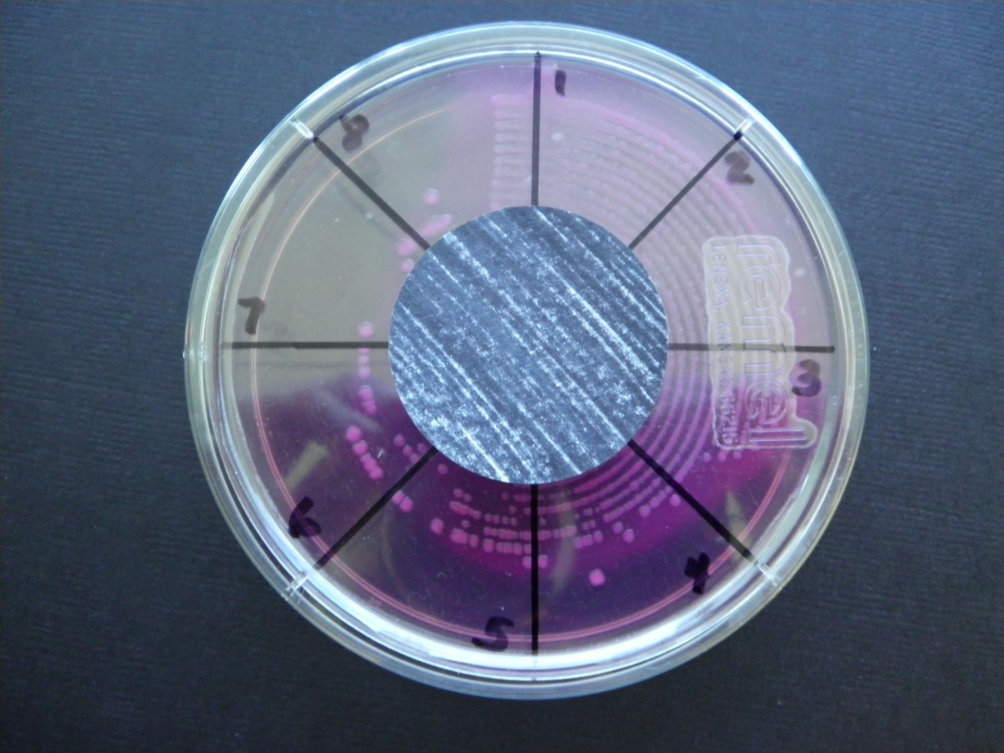
Reading plates

Slide 7
Reading plates
Do not read plates marked with an “X”
Something went wrong during set up – no inoculum, no pipet tip, etc.
Can be misread as No Growth

Slide 8
Reading plates

Slide 9
Reading plates
Whenever you report a heavy colony count (60,000-100,000 CFU/mL or >100,000 CFU/mL), there must be heavy growth in the center rings that are ignored
When in doubt, count the number of colonies and multiply by 100 – then select the colony count range to report.

Slide 10
Reading plates
If you are able to count the colonies, it should not be reported as 60,000-100,000 CFU/mL or >100,000 CFU/mL
If you see one or two colonies in a quadrant, that is not enough growth to report – so default to the next lower quadrant
If you see one or more skipped quadrants with growth in later quadrants – default to the lowest quadrant with growth

Slide 11
Reporting: high probability contamination specimens
High probability contamination urines will be reported using ranges of colony counts
Report colony count as one of four ranges

Slide 12
Reporting: high probability contamination specimens
Quadrant | Colony Count | LIS Code
1 & 2 | <10,000 CFU/mL | L10K
3 | 10,000-50,000 CFU/mL | TTF
4 | 60,000-100,000 CFU/mL | SXTH
5, 6, 7, & 8 | >100,000 CFU/mL | G100K

Slide 13
Reporting: low probability contamination specimens
Low probability contamination urines will be reported by counting each colony and multiplying by 100
For colony counts <1,000, report an actual colony count rounded to the nearest 100 – do not report a range

Slide 14
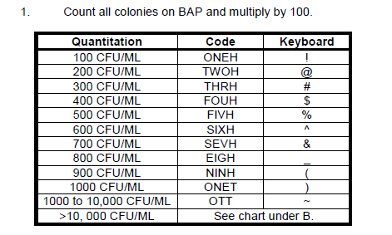
Reporting: low probability contamination specimens

Slide 15
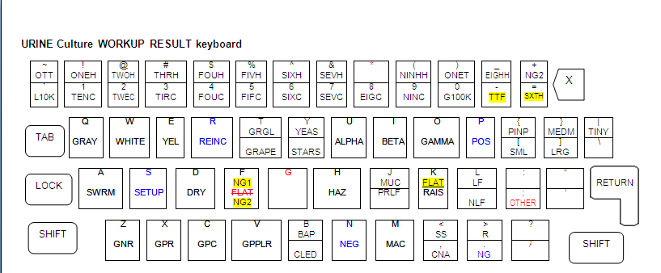
Reporting

Slide 16
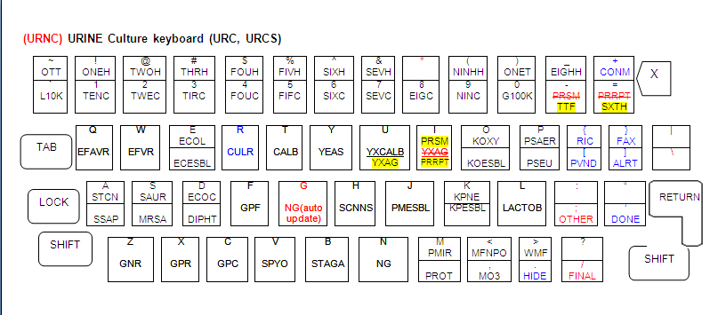
Reporting

