Slide 1
Advanced Instruments Operation Training

Slide 2
What’s new

Slide 3
Instrument Operation

Slide 6
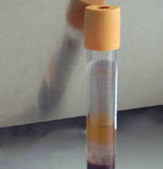
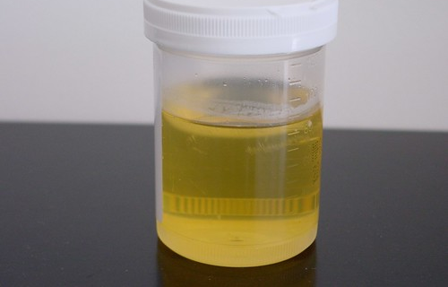
Specimen: (validated by ACL Labs)
SAMPLE STORAGE STABILITY
Serum Ambient 24 Hours
Refrigerated 7 days
Frozen 14 days
Lithium Heparin Plasma Ambient 24 Hours
Refrigerated 3 Days
Frozen 14 Days
Urine Refrigerated 7 Days

Slide 7
Controls

Slide 8
Controls
ChemTRAK unassayed Chemistry Control Level 1
Store at -15 to -25 C Thaw completely prior to use. Open vial stability is 14 days when stored at 2-8 degrees C.
UrichemTRAK Urine Chemistry controls Level 1 and Level 2. Store at 2-8 degrees before and after opening. Refer to expiration date on Vial.
OSTD 290 Reference solution. Contains NaCl and H2O. Store at Room Temperature. No preparation required. Refer to expiration date on box.

Slide 9
Controls Continued
The result of control reference solution 290 must be 290 + 3. Failed 290 controls may indicate that a calibration needs to be done.
QC material is not required to be tested in duplicate.
QC must be performed at least every 24 hours when patient testing is performed, and after major maintenance or calibration.

Slide 10
Testing

Slide 16
Patient Testing
Patient testing is performed in duplicate
The first result in any given series of tests may differ slightly sue to temperature conditioning or residual contamination of the chamber.
Duplicate results MUST agree with in 3mOsm/kg for results between 0 and 400.
Duplicate results must agree with in 1% for results between 400 and 2000.
If duplicates do not agree, repeat patient testing.
If the results agree, do not average, report the last result run.

Slide 19
Common Tech errors
Failing to clean the chamber with a chamber cleaner.
Failing to leave a chamber cleaner in the port when not in use.
Not seating the plastic sample tip fully on the pipette.
Over wicking the sample tip.

Slide 20
References
Power point was modified from Installation and Training Guide Osmo1 Osmometer Power Point from Advanced Instruments.
This power point does not replace the Procedure in PolicyTech.
Please review the OSMOLALITY-ADVANCED OSMOMETER OSMO1 procedure Reference #60678 prior to performing testing.

