Slide 1
ACL IL- Direct Immunofluorescence
(DIF)
Prepared by: WI & IL Histology

Slide 2
WHY?
95% of specimens received are fixed in formalin and receive an H&E protocol… BUT
5% of specimens require a SPECIFIC transport medium of fresh tissue in order to perform necessary tests.
If the specimen is not put in the correct solution, the specimen is NOT VIABLE and results in a patient safety event or recollection issue.
When you see SKIN, MUSCLE, LUNG, KIDNEY (renal), ORAL biopsy, STOP AND THINK.

Slide 3
DIF OR IF?
Immunofluorescence testing can be direct or indirect depending on the method of testing.
DIF/IF refer to the same type of testing
DIF/IF specimens require specific transport mediums and are cut frozen on a cryostat
DIF/IF specimens CANNOT be performed on formalin fixed tissue.

Slide 4
Introduction to
Immunofluorescence
Fluorescence labeled antibodies are used to detect specific antigens in cells or tissues. These specimens REQUIRE a special solution.
Examples:
  Skin, muscle (myo), lung, kidney (renal), oral biopsies

Slide 5
Specialty Fixatives
Glutaraldehyde- used for fresh kidney specimens for Electron Microscopy
Saline- fresh specimen
Michel- transport medium for fresh tissue that will get snap frozen in histology
Zues- transport medium for fresh tissue that will get snap frozen in histology

Slide 6
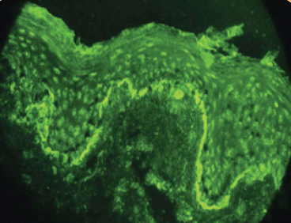
Introduction - Immunofluorescence
Direct Immunofluorescene (DIF)-helps a dermatopathologist diagnose immune-related disorders of the skin such as:
  Pemphigus vulgaris
  Pemphigus foliaceus
  Paraneoplastic pemphigus
  Immunoglobulin (Ig) A pemphigus
  Bullous pemphigoid
  Pemphigoid gestationis
  Mucous membrane pemphigoid (cicatricial pemphigoid)
  Epidermolysis bullosa acquisita
  Bullous systemic lupus erythematosus (SLE)
  Linear IgA bullous disease
  Dermatitis herpetiformis

Slide 7
Transport Medium
If specimen arrives in these fixatives, pay close attention to the protocol chosen.
Zeus Fixative
Michel’s Transport Medium
Both solutions are specifically for the transport of unfixed tissue being sent for immunofluorescence testing

Slide 8
ACCESSIONING
Skin specimens for DIF will typically be sent in pairs
  A)Formalin for routine formalin fixed tissue
  B)Zeus or Michel’s for IF testing
ALL skin specimens with a DERM DOCTOR or CLIENT CODE receive a DOS prefix at the time of accessioning at the fixative can be indicated as an engineering control.
ATTENTION TO DETAIL IS KEY!
If something doesn’t look right always have a questioning attitude
  Note: A single skin specimen may be received for DIF testing, where a second specimen for H&E is not received.

Slide 9
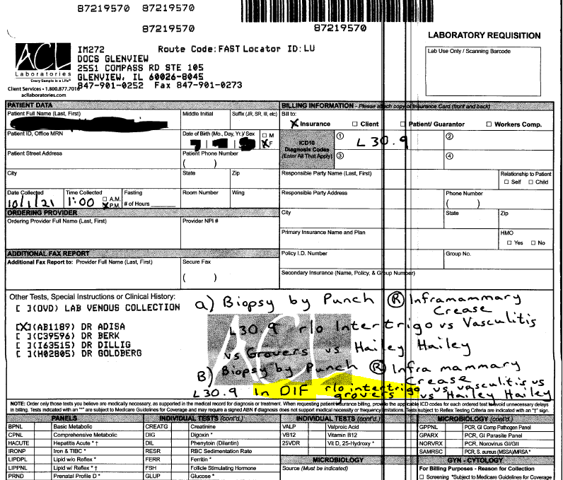
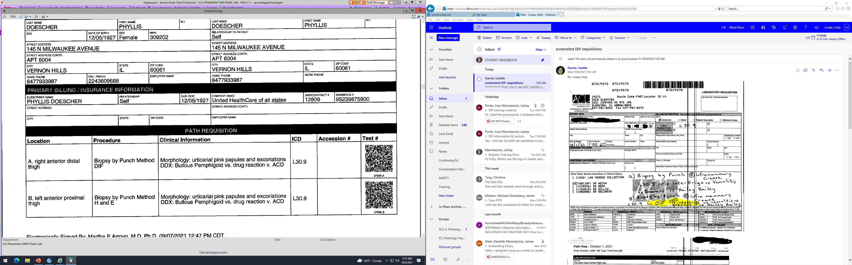
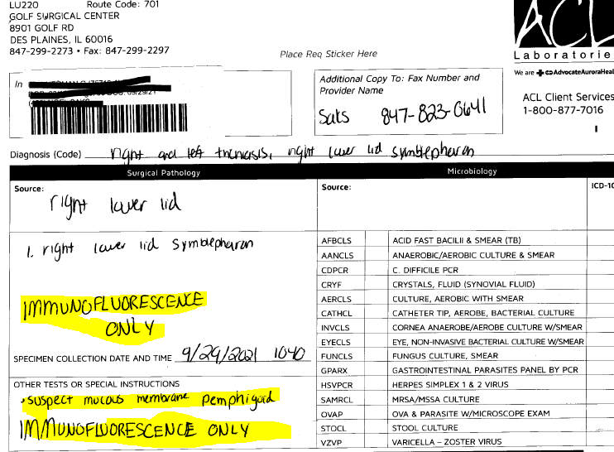
REQUISITIONS
Look for DIF or IF on the requisition
ATTENTION TO DETAIL IS KEY

Slide 10
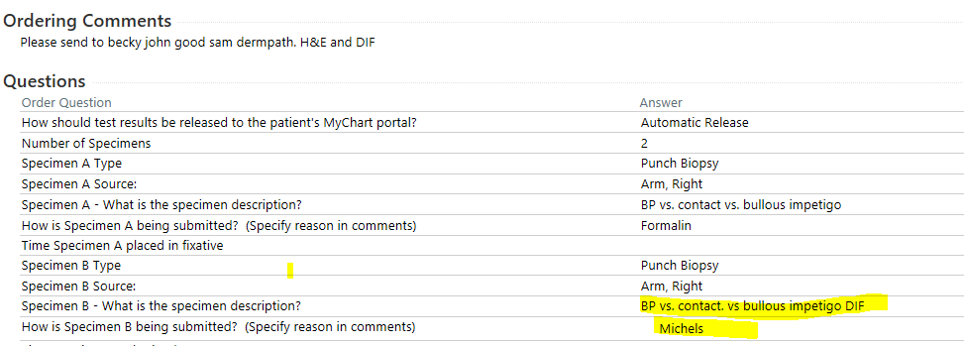
EPIC ORDER REQUISITION
ATTENTION TO DETAIL!

Slide 11
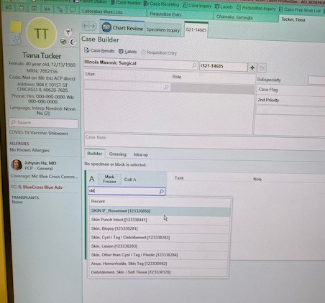
ACCESSIONING- PROTOCOL
**EPIC ticket entered to change the protocol name
to make it more obvious for DIF.
It will say IL SKIN Direct Immunofluorescence DIF/IF
SKIN IF_ Rosemont OR
IL SKIN Direct Immunofluorescence DIF IF is the protocol to choose

Slide 12
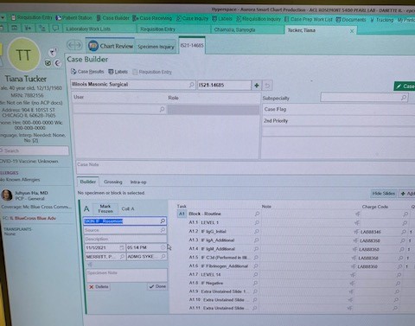
ACCESSIONING- PROTOCOL
SKIN IF_ Rosemont OR
IL SKIN Direct Immunofluorescence DIF IF is the protocol to choose

Slide 13
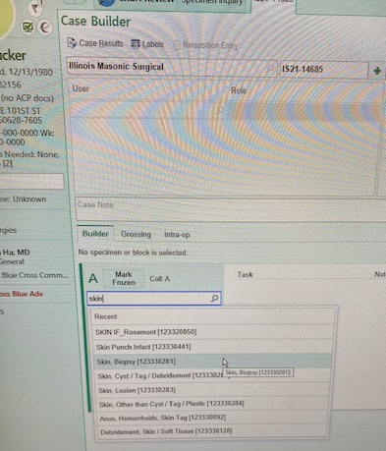
NOT THIS!
If SKIN, Biopsy is chosen the specimen will be treated as a normal formalin specimen and will NOT be viable for DIF

Slide 14
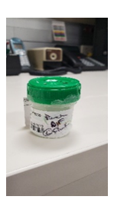
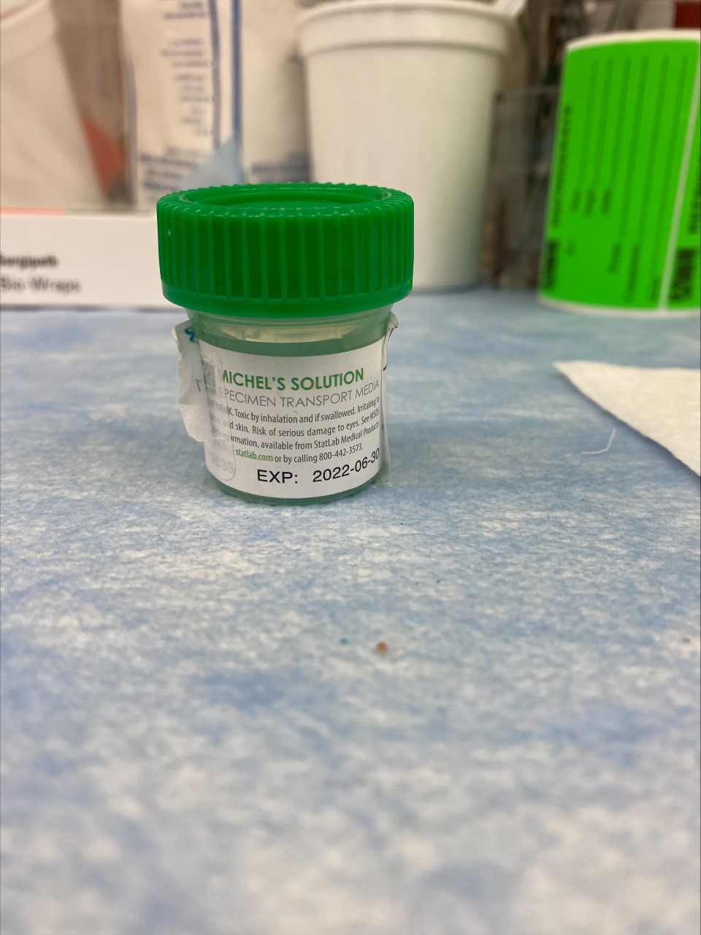
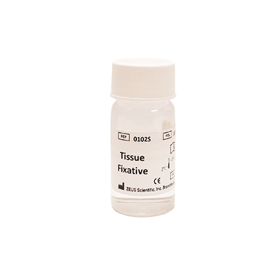
Containers
Zeus and Michel’s Fixative containers are very small
Manufacturer label is usually covered by EPIC patient label
DO NOT assume green top OR GLASS specimen container is formalin
Attention to detail & check the container
Michel’s Solution bottle
DIF clearly labeled on patient specimen
ZEUS Tissue Fixative bottle

Slide 15
Communication
As always, the more communication the better.
If something doesn’t look right PLEASE ask questions!!

Slide 16
QUESTIONS?

