Slide 1
Reducing Hemolysis in Specimen Collection and Processing
This presentation was prepared by the ACL Specimen Collection, Processing, and Exception Handling Technical Advisory Team
Last reviewed 8/12/2022 SJP/SDV

Slide 2
Objectives:
This presentation applies to new and experienced phlebotomists, laboratory assistants, and all team members involved in collection or processing of blood specimens.
Improve patient safety by reducing specimen rejection due to hemolysis to ensure accurate results
Define hemolysis and its causes
Tips for prevention and reduction of hemolysis
Tips for specimen processing
Best practices when using butterfly/wing-set collection devices

Slide 3
What is Hemolysis?
Hemolysis is the rupture of red blood cells and the release of intracellular contents
Hemolysis is mainly caused by:
Improper specimen collection
Improper specimen handling
Minor causes of hemolysis:
Hemolytic anemia and certain disease states in patient
If serum/plasma is a pink/red color it is typically an indication of hemolysis

Slide 4
Possible Outcomes if Best Practices Are Not Followed
Patient safety is compromised
Testing delay
Delay in treatment / diagnosis / discharge
Redraws / additional patient sticks
Rework
Patient Dissatisfaction
Physician Dissatisfaction

Slide 5
Venipuncture Best Practices
Recommended needle size is 21 gauge. Smaller gauges may be used in difficult or pediatric venipuncture situations, but have higher chance of hemolysis.
Cleanse site with alcohol and allow site to air dry
Never leave tourniquet on for more than 60 seconds
Patient should be asked to close their hand without clenching or pumping
Instruct patient to open hand once blood starts flowing into vacutainer tube(s)
Avoid slow draws/poor blood flow from improperly positioned needles
In the event a syringe needs to be used for the collection, the plunger must be pulled back slowly and gently to prevent hemolysis

Slide 6
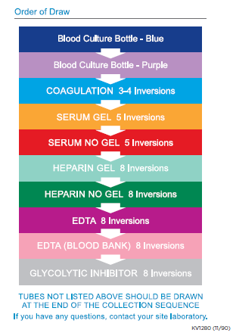
Venipuncture Best Practices (continued)
Tubes must be collected via venipuncture in the correct order of draw to avoid contamination from preceding tube:
Blood Cultures
Blue top tubes (sodium citrate)
Gold top tubes (serum tube with or without gel)
Red top tubes (serum tube without gel)
Green tubes (heparin gel)
Green tubes (heparin no gel)
Lavender top tubes (EDTA)
Pink top tubes (EDTA)
Gray top tubes (glycolytic inhibitor)
Royal blue top tubes(with or without additive)

Slide 7
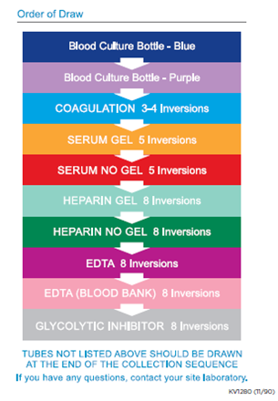
Venipuncture Best Practices (continued)
Any additional tubes, for example (ACD Yellow, Quantiferon Kit, etc..)
Note: If a winged butterfly set is used and a coagulation tube needs to be drawn and a blood culture sample is not required, use a no-additive or sodium citrate discard tube first.
Note: If a capillary collection is completed, the order of draw is: EDTA > Lithium Heparin (no gel) > Lithium Heparin (with gel) > Sodium Fluoride > Clot Activator and gel for serum separation > No Additive.

Slide 8
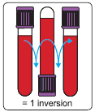
Venipuncture Best Practices (continued)
Immediately after each tube is filled, invert tubes gently the appropriate # of times to ensure thorough mixing:
Blue 3-4 times each
Gold/Red 5 times each
All other tube types 8 times each
*DO NOT SHAKE TUBES!*
Red cells can be damaged and release potassium and other cell contents that can impact results
Quantiferon Collection Kit is an exception
Note: If not properly mixed, fine clots may form in tubes containing anticoagulants that may seriously interfere with all testing.

Slide 9
Processing Best Practices
Allow gel top tubes to clot in an upright position for 30 minutes at room temperature; no longer than 2 hours before centrifuging
Allow red top tubes to clot in an upright position for 60 minutes at room temperature; no longer than 2 hours before centrifuging
Specimens must be centrifuged for the appropriate time at the appropriate speed
Do not re-spin blood in a gel tube after it has been centrifuged to recover additional serum
Do not refrigerate specimens prior to centrifugation
Refrigeration will elevate potassium levels quickly, significantly, and irreversibly
Do not freeze blood in a gel tube or freeze a serum aliquot if red cells are present.
Freezing will release potassium from red cells

Slide 10
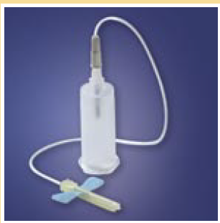
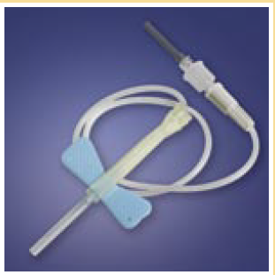
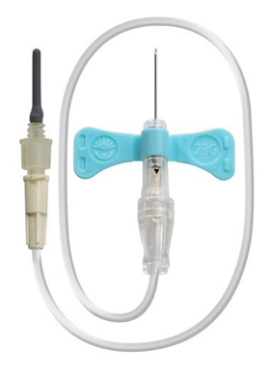
Butterflies (also known as: winged infusion sets)
Butterfly usage should be kept to a minimum and used with discretion as they are inherently higher risk for hemolysis
When collecting blood cultures
When it is a difficult venipuncture
Small/difficult veins
Hand veins
When a patient is insistent
Pediatric patient
21 Gauge butterfly is the preferred size to prevent hemolysis
Reasons not to use butterflies:
Butterflies with a gauge of 22 or higher are not indicated for certain types of draws (i.e. potassium) because the smaller diameter of the needle may damage red cells
Increased risk of needle stick incident
Higher cost/expense

Slide 11
Butterflies (continued)
Misconceptions:
Drawing multiple tubes is easier with a butterfly.
Truth: with proper technique, drawing multiple tubes with a standard, straight needle is the same
Using a butterfly causes less discomfort.
Truth: discomfort is caused by poor technique and certainly not by the length of the needle
Butterflies are easier to use and control
Truth: more accidental needle sticks occur while performing venipunctures with a butterfly (source: Medical Data International)

Slide 12
Positive Patient Outcomes
Increased Patient Safety by:
Providing timely test results and treatment
Providing successful venipunctures
Following best practices
Increased Patient Satisfaction
Increased Physician Satisfaction

Slide 13
Reducing Hemolysis in Specimen Collection and Processing
This presentation was prepared by the ACL Specimen Collection, Processing, and Exception Handling Technical Advisory Team
Last reviewed 8/12/2022 SJP/SDV

