Slide 1
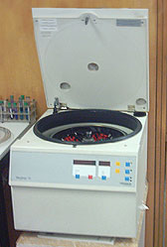
Centrifugation & Aliquots
GOAL = Platelet Poor Plasma (PPP)
Platelet Count <10,000/mcL
However, an even lower platelet count is better for frozen specimens.
Any specimen to be frozen for coagulation
testing must be double spun to assure
that the specimen is platelet poor

Slide 2
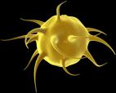
Why Platelet Poor Plasma ???
What is the BIG DEAL …????
Platelets are source of phospholipid
Reagents for coag tests are phospholipids
Therefore, platelets in the specimen can
  shorten results
Platelets release PF4 in cold and when frozen
PF4 can neutralize heparin…shorten aPTT
Spun tube…platelets can resuspend
StatSpin…beware platelets diffuse back into plasma
For these reasons, processing of samples for coagulation
testing is CRITICAL

Slide 3
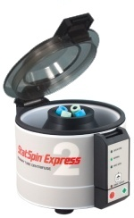
Don’t use the STAT-SPIN
It’s a fast spin - good for
  immediate testing
However, platelets resuspend
to an unacceptable level
very quickly
 | Platelet Counts (x10³/uL)
 | Trial 1 |  | Trial 2
Sampling | Top | Bottom | Top | Bottom
Immediate | 4 | 3 | 3 | 4
10 Minutes | 3 | 14 | 12 | 33
30 Minutes | 17 | 30 | 26 | 57
Residual Platelet Counts of Plasma Prepared for Coagulation Studies Using the StatSpin Express®
Ellinor I. B. Peerschke, Department of Pathology, Cornell University Medical College, New York, New York

Slide 4
Preparation of Frozen Aliquots
*** DO NOT USE STAT-SPIN ***
pipette
pipette
-20ºC
Freezer
Primary
Tube
Plastic
Tube#1
Plastic
Tube#1
Plastic
Tube#2
Process
As soon as possible after collection, spin primary tube for 15 minutes at 2500-3500 x g (Refer to your centrifuge for appropriate RPM setting)
Transfer plasma to a plastic pour off tube with a plastic transfer pipette. Be sure not to disturb the cell layer - leave a layer of plasma on the cells.
3. Centrifuge pour off tube at 2500-3000 x g for 15 minutes.
With a plastic pipette, transfer plasma to properly labeled aliquot tubes. (Residual cells may not be visible in the tube, but they are there. Do not remove all the plasma. This will assure complete platelet removal.)
A minimum of 1 mL and a maximum of 2 mL of plasma should be placed in each tube.
5. Freeze immediately in an upright position.

Slide 5
pipette
Proper Transfer of
Plasma
Primary
Tube
Plastic
Tube#1
Do not disturb buffy coat
avoid buffy coat & platelet button
Use Plastic Transfer Pipets
Do not pour plasma from one tube to another
More plasma is not better

Slide 6
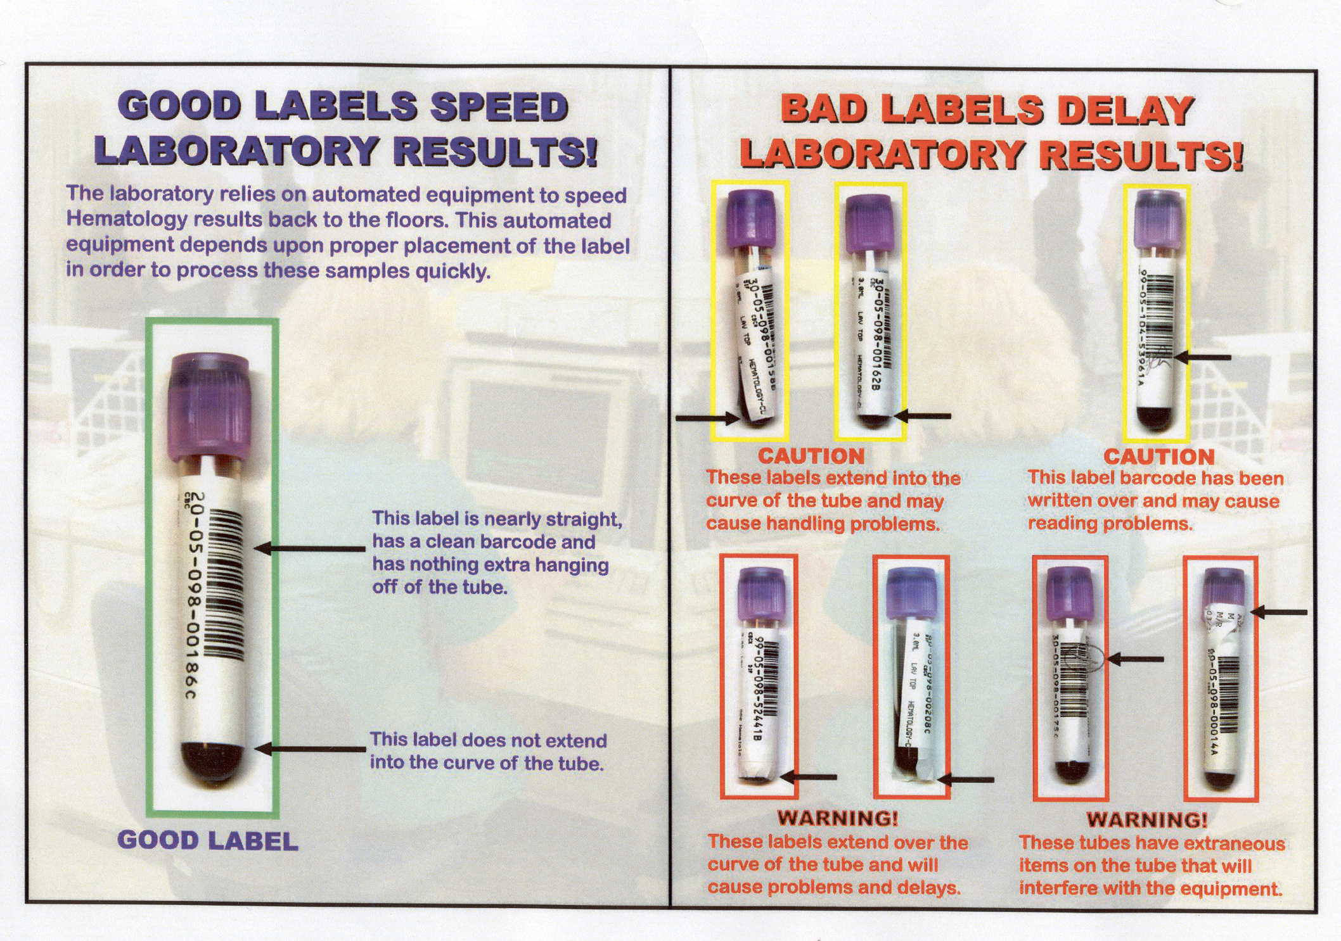
PROPER LABELING IS IMPORTANT
Even though this picture deals with hematology specimens, it is true of label placement on all tubes, including pour off tubes, that may be placed on an analyzer to be read.

Slide 7
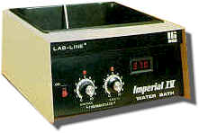
Samples must remain frozen until tested.
This is just as important as all other handling.
Samples are in 1-2mL aliquots and thaw quickly.
The manner in which coagulation specimens are thawed is very important and should only be done by the coagulation technologist.
Be sure that samples do not thaw during specimen transport or receipt
Correct Thawing of Frozen Aliquots
Rapidly in 37ºC water bath
No longer than 10 minutes, remove when liquid
Mix
Assay or store @ 4ºC for 2 hours

