Slide 1
Reducing Hemolysis in Specimen Collection and Processing
Last Reviewed: 8/4/2023
SJP and SDV

Slide 2
Presentation Objectives:
This presentation applies to new and experienced phlebotomists, laboratory assistants, and all staff involved in drawing or processing blood samples
Improve patient safety by reducing specimen rejection due to hemolysis and, therefore, providing accurate results
Define hemolysis and its causes
Tips for prevention and reduction of hemolysis
Tips for specimen processing
Best practices when using butterflies

Slide 3
What is Hemolysis?
Hemolysis is the rupture of red blood cells and the release of intracellular contents
Hemolysis is mainly caused by:
Incorrect specimen collection
Incorrect specimen handling
Minor causes of hemolysis:
Hemolytic anemia and certain disease states

Slide 4
Possible Outcomes if Best Practices Are Not Followed
Hemolysis
Patient Safety Is Compromised
Test Delay
Treatment Delay
Redraws
Rework
Patient Dissatisfaction
Physician Dissatisfaction

Slide 5
Venipuncture Best Practices
Recommended needle size is 21 gauge. Smaller gauges may be used in difficult venipuncture situations
Cleanse site with alcohol and allow site to air dry
Never leave tourniquet on for more than 60 seconds
Patient should be asked to close their hand without clenching or pumping
Instruct patient to open hand once blood starts flowing into tube

Slide 6
Venipuncture Best Practices (continued)
Tubes must be collected in the correct order of draw to avoid contamination from preceding tube:
• Blood cultures
• Blue top tubes (sodium citrate)
• Red or gold top tubes (serum tube with or without gel)
• Green top tubes (with or without gel)
• Lavender top tubes (EDTA)
• Pink top tubes (EDTA)
• Gray top tubes (glycolytic inhibitor)
• Royal blue top tubes(with or without additive)
• Any additional tubes, for example (ACD Yellow, Quantiferon Kit etc..)
Note: If a winged butterfly set is used and a coagulation tube needs to be drawn and a blood culture sample is not required, use a no-additive or sodium citrate discard tube first.

Slide 7
Venipuncture Best Practices (continued)
When using a syringe, be sure to expel all air in the syringe barrel prior to venipuncture
Pull back slowly and steadily on the syringe once the vein has been accessed
When transferring blood from a syringe, do not force blood into the collection tube; use a transfer device when transferring blood or red cells may be damaged
Do not combine or pour blood drawn from one tube into another
Test results will be inaccurate

Slide 8
Venipuncture Best Practices (continued)
Immediately after each tube is filled, invert tubes gently
Blue 3-4 times each
Gold/Red 5 times each
All other tube types 8 times each
DO NOT SHAKE TUBES!*
Red cells can be damaged and release potassium
Clot activation is needed in gel tubes
* Quantiferon Collection Kit is an exception

Slide 9
Best Practices Continued

Slide 10
Processing Best Practices
*Quantiferon TB
Exception to standard tube inversion

Slide 11
Processing Best Practices
Allow gel top tubes to clot in an upright position for 30 minutes at room temperature; no longer than 2 hours before centrifuging
Allow red top tubes to clot in an upright position for 60 minutes at room temperature; no longer than 2 hours before centrifuging
Specimens must be centrifuged for the appropriate time
Do not re-spin blood in a gel tube after it has been centrifuged to recover additional serum

Slide 12
Processing Best Practices (continued)
Do not refrigerate specimens prior to centrifugation
Refrigeration will elevate potassium levels quickly,
significantly, and irreversibly
Do not freeze blood in a gel tube or freeze a serum aliquot if red cells are present.
Freezing will release potassium from red cells

Slide 13
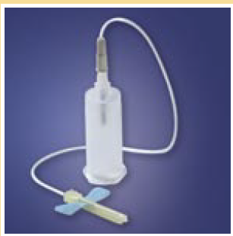
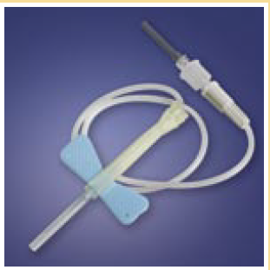
Butterflies
Sometimes called winged infusion sets

Slide 14
Butterflies (summary)
Butterfly usage should be kept to a minimum and used with discretion
When collecting blood cultures
When it is a difficult venipuncture
Small/difficult veins
Hand veins
When a patient is insistent
Pediatric patient
21 Gauge butterfly is the preferred size to prevent hemolysis

Slide 15
Butterflies (continued)
Reasons not to use butterflies:
Butterflies with a gauge of 22 or higher are not indicated for certain types of draws (i.e. potassium) because the smaller diameter of the needle may damage red cells
Increased risk of needle stick incident
Expense

Slide 16
Butterflies (continued)
Misconceptions:
Drawing multiple tubes is easier with a butterfly.
Truth: with proper technique, drawing multiple tubes with a standard needle is the same
Using a butterfly causes less discomfort.
Truth: discomfort is caused by poor technique, not needle gauge or length

Slide 17
Butterflies (continued)
Misconceptions (continued):
Butterflies are easier to use and control
Truth: more accidental needle sticks occur while performing venipunctures with a butterfly
(source: Medical Data International)

Slide 18
Positive Patient Outcomes
Increased Patient Safety by
Providing timely test results and treatment
Providing successful venipunctures
Following best practices
Increased Patient Satisfaction
Increased Physician Satisfaction

Slide 19
Reducing Hemolysis in Specimen Collection and Processing
Questions

Slide 20
Reducing Hemolysis in Specimen Collection and Processing
This presentation was prepared by the
Chemistry Technical Advisory Team (TATm) and
Specimen Collection TATm – October 2012
Revised in 2015 by the Specimen Collection and Processing Exception Handling TATm – March 2015

