Slide 1
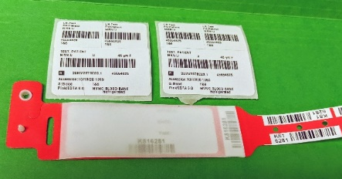
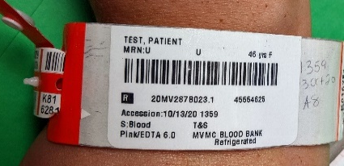
Red Blood Bands |  | CONTACT:​ Jessica Ryffel ryffelj@slhs.org
LOCATION:​ System | Audience (Roles): MLS, Phlebotomy | Lab Areas: Transfusion Services
EFFECTIVE DATE:​ 12/19/24 | REVIEW DUE DATE: ​ 12/19/2026 | ASSOCIATED PROCEDURE:​ TS0101
RATIONALE: ​ Red blood bands are to be used for potential transfusions when a white printed patient identification band is not available. |  | PRINTED DATE:​
Step 1
Verify with the patient when and where their procedure will take place. For a Type and Screen to be valid for a procedure, it must be collected within 72 hours prior to the procedure.
Complete the Patient Identification & Verification process per policy SLHS PA013.
Print an extra specimen label – total of 2.
Exception: For patients having surgery or possible transfusion at a different location than where the specimen is collected, prior to printing labels, change “performing lab” in the collection screen.
Refer to mSL Tip Sheet “Change Destination Lab for Pre-procedural Transfusion Specimens”.
Step 2
Collect specimen.
Step 3
On the red band, press firmly while writing the collection information (initials, date, and time) on the right within the red box.
At the left within the red box, place 1 specimen label. Do not obstruct the written collection information.
Peel the completed label from the red band and place on the collected specimen.
Step 4
Add the other specimen label to the red band.
Remove backing from the clear protective shield and place over the patient label.
Separate the extra numbered labels or ‘tail’ from the band and place one of the small barcoded labels on the pink top tube.
Step 5
Place band on the patient by securing snap closure.
Instruct patient to keep the band on and that hospital personnel will remove the band when it is no longer needed.
Transport tubes and all remaining unused labels (the tail) to the Blood Bank.

