Slide 1

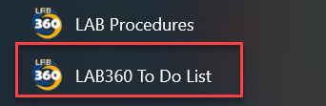
Lab360 Collaboration Tips
Effective strategies for successful teamwork and communication
Notes:
"Welcome, everyone, to our Lab360 Collaboration Tips session! Today, we’re not just talking about working together—we’re talking about making teamwork work for us. Imagine a lab where every voice is heard, every idea counts, and every project runs smoother than a freshly calibrated centrifuge.
Take a look at this scene: colleagues gathered around, sharing ideas, reviewing documents, and maybe even debating the best coffee in the break room. That’s the energy we want in our collaboration—dynamic, supportive, and always moving forward.
And don’t forget: with Lab360, you’re never flying solo. Whether you’re reviewing procedures, brainstorming improvements, or just checking off your to-do list, you’re part of a team that’s committed to quality, compliance, and a little bit of fun along the way.
So, let’s dive in and discover how we can make our teamwork not just effective, but exceptional. Ready to collaborate like a pro? Let’s get started!

Slide 2

Your Roadmap to Success!
The Basics
How the review process works
How to do a quick review
More In Depth File Edit Review
Tips and Tricks
How to finalize and submit
Notes:
"Alright, buckle up! Here’s your roadmap to collaboration greatness. We’ll cover the basics, the review process, quick reviews, deep dives, and a few tips and tricks.
Don’t worry—this isn’t a marathon. Most folks finish in under 20 minutes, unless you get distracted by cat videos or the snack drawer.
Remember, every step you take helps us keep our standards high and our procedures sharp. Ready to hit the road? Let’s roll!"
[Lab360_Col...ation_Tips | PowerPoint]

Slide 3
Lab360 Collaboration
Why is it important?
Collaboration prevents delays by catching issues early. For example, coordinated editing sessions and clear communication loops ensure smooth progression from draft to approval, avoiding bottlenecks in implementation.
Collaborative review helps align procedures with regulatory standards (CAP, CLIA, CLSI) and organizational policies. End-user feedback often identifies gaps that could lead to non-compliance or preanalytical errors.
Insight into real-world workflows, ensuring procedures are not just theoretically correct, but practically executable.
Procedures developed with end-user input serve as better training tools because they reflect actual practice. This supports onboarding and continuous education, reducing variability in performance.
Involved end users have a sense of ownership, which improves adherence to protocols. When staff feel their voice matters, they are more likely to follow procedures consistently and advocate for quality improvements.
Notes:
"Why is collaboration important? Well, imagine trying to assemble IKEA furniture without instructions or a teammate who actually reads them.
Collaboration gives us real-world insight, helps us meet regulatory standards, and lets everyone feel like their voice matters—no more shouting into the lab void!
Plus, catching issues early means fewer delays and less drama. And when procedures reflect actual practice, onboarding new staff is less like a scavenger hunt and more like a guided tour.
So, let’s keep those communication loops open and the teamwork flowing!"

Slide 4
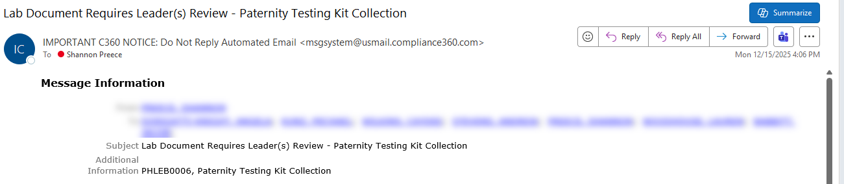

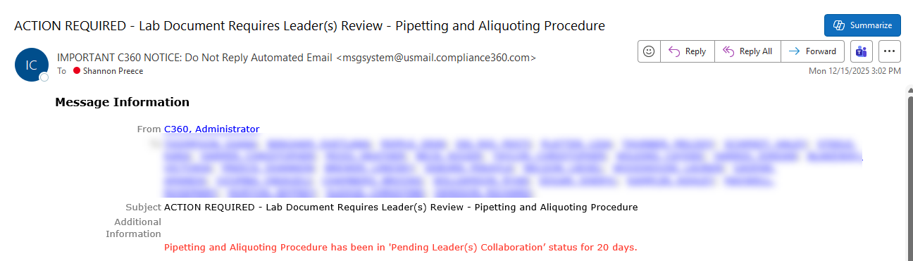
Collaboration Basics
  How will I know that I have been assigned to collaborate?
  You will receive an email from C360 informing you about a procedure that requires your collaboration.
  From first notification, you have 30 calendar days to complete your collaboration.
  If the procedure isn't marked Leader(s) Review Complete within 20 days, you'll get a second email reminder and have 10 days left to review.
  What if I am not the best person from my campus to collaborate?
  Reach out to the person who sent you the collaboration request and let them know who from your campus would be a better option.
    Do not just ignore the request.
  Active collaboration from every campus is required by our Medical Directors.
Notes:
Let’s talk about collaboration—Lab360 style! You don’t need a secret decoder ring or a bat signal. You’ll get an email from C360. It’s basically the lab world’s version of a Hogwarts letter, except instead of an owl, it’s Outlook. And instead of magic, you get 30 calendar days to work your review wizardry.
If you’re still perfecting your procrastination skills and haven’t finished after 20 days, you’ll get a friendly nudge—another email reminder. C360 is like your digital accountability buddy, minus the guilt trips.
If you’re not the best person for the job, don’t just hit snooze or vanish into the ether. Reach out and suggest someone better. Ignoring collaboration requests is like ignoring the lab fridge—eventually, things get messy, and nobody wants that.
Track Changes is always on. Every edit is recorded, so if you accidentally change ‘centrifuge’ to ‘centipede,’ we’ll know who did it. Every suggestion is a chance to make our procedures better, and nothing gets lost in translation (or autocorrect).
Let’s keep it transparent, accurate, and above all, collaborative. Teamwork isn’t just a buzzword—it’s how we keep the lab running smoother than a pipette in a rainstorm!"

Slide 5
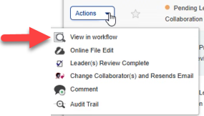
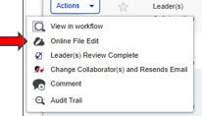
Collaboration
Basics
There are TWO different ways to perform procedure collaboration that will be highlighted.
View in Workflow
  Preferred starting point for procedure review.
  Does not lock collaboration, more than one person can be in view workflow at a time.
Online File Edit
  Use this detailed process when adding comments or questions.
  Does lock the procedure from other collaborators.
  Can only be functionally reviewed for 4 hours per a session.
Notes:
"There are TWO ways to collaborate—like choosing between coffee and tea, but both keep you productive!
First, View in Workflow: the preferred starting point. It’s like window shopping for procedures—no commitment, just browsing.
Second, Online File Edit: for when you want to get hands-on. This locks the procedure for others, so don’t hog the spotlight—share the editing love!"

Slide 6

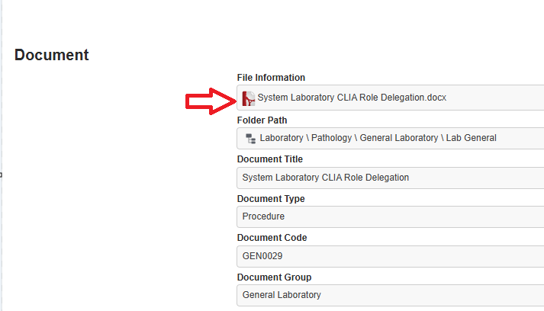
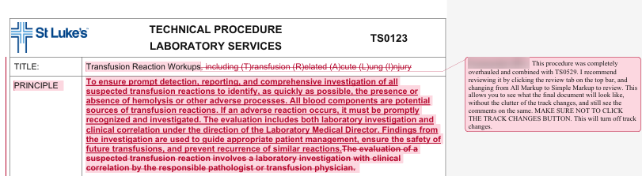
View in Workflow
This method allows you to review the PDF of a procedure with proposed changes and comments that have been added via Online File Edit.
STEP 1: Click on View in workflow
Step 2: Click on the PDF icon next to the title.
STEP 3: Review changes and comments visible in the PDF file.
Notes:
---
"View in Workflow is your quick review mode. Click, browse, and admire the PDF—no edits, just pure observation.
It’s perfect for those moments when you want to look but not touch, like admiring a cake you’re not allowed to eat.
Just remember to close the tab when you’re done, or you might end up editing the wrong version and causing a minor lab legend!"

Slide 7
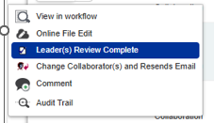
View in Workflow- Continued
Step 4: At this point there are two options.
  Option 1: You have no questions or collaborative comments to make and are ready to complete the process.
  Close PDF File, taking you to the Document Page.
  Press blue Close in upper right corner.
  Open Actions again and select “Leader Review Complete”
  You have now completed and documented your collaboration.
  The procedure will no longer be visible on your Collaboration Dashboard.
  If you determine you need to access the file again before it is fully returned to the Program Manager, you need request access from Carie Scott at scottc@slhs.org
  Option 2: You have questions or comments you would like to add to the working WORD document.
  Close PDF File, taking you to the Document Page.
  Press blue Close in upper right corner.
  You will now begin the Online File Edit process. (See next Slides)
Notes:
"At this point, you have two options:
Option 1: No questions? You’re done! Mark it complete and bask in the glory of a finished task.
Option 2: Got questions or comments? Time to switch gears and start Online File Edit.
And if you need access again, just ask Carie Scott—she’s the gatekeeper of all things collaborative!"

Slide 8
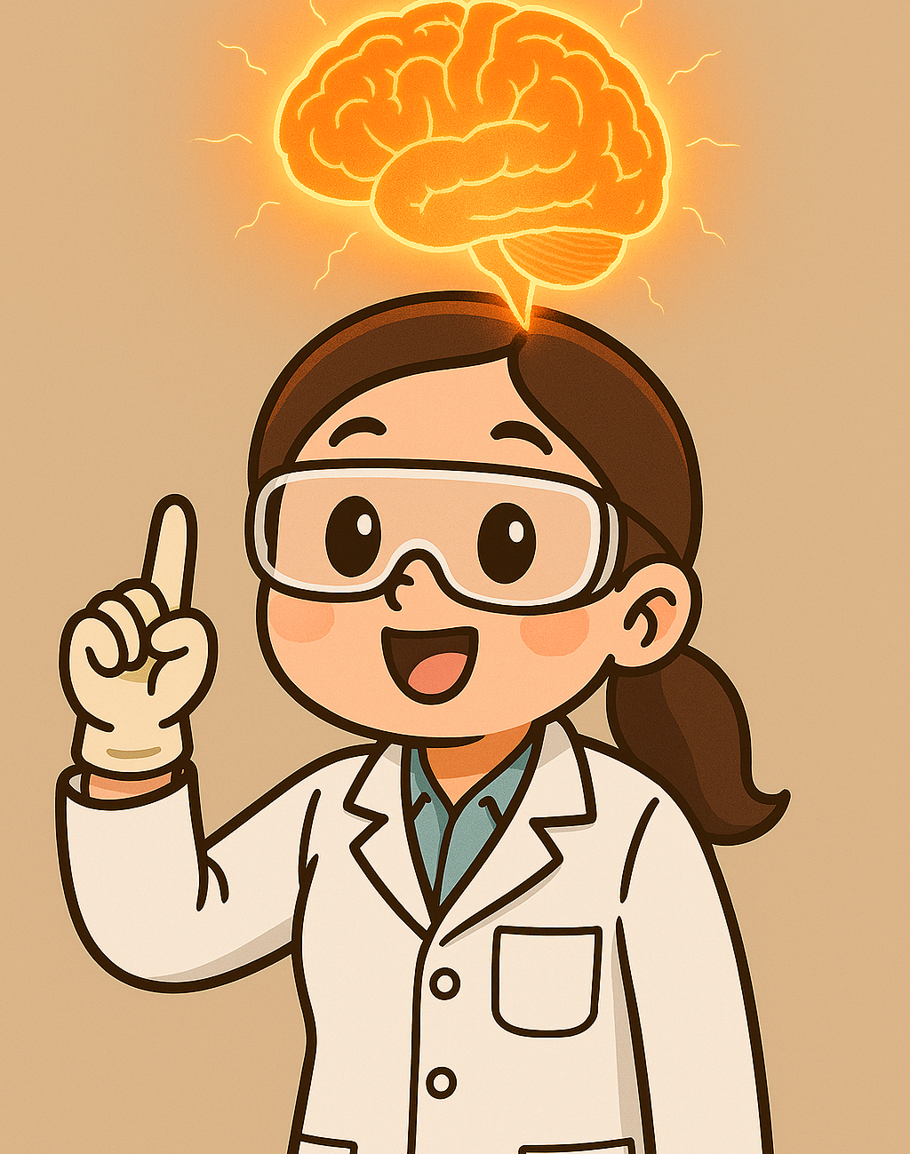
A few tips to remember before starting Online File Edit
Notes:
"Before you dive into Online File Edit, here’s a tip: channel your inner lab genius!
Remember, every edit counts, and every comment is a chance to shine.
And if you get stuck, just imagine your favorite scientist cheering you on from the sidelines!"

Slide 9
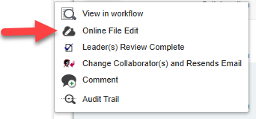
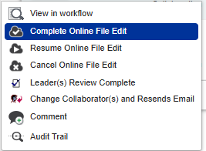
Online File Edits
This method allows you to review, add changes, comments or questions directly into the working WORD document.
STEP 1: Click on Online File Edit from your Actions Tab to open the working WORD document.
Step 2: Ensure your track changes view is set to your preference per previous instructions.
STEP 3: Add minor wording changes directly in text or add questions or comments in comments boxes as described.
  Remember to manually save your document (File-Save) regularly and before closing.
STEP 4: Once you finish collaborating or need to pause, save and close the file by clicking X in top right corner. You will be returned to your To-Do List. (If Lab360 is logged out, restart Lab360 Admin.)
IMPORTANT STEP 5: Select Complete Online File Edit from the Actions menu, even if you plan to come back later to make additional changes.
  Note: Changes must be finalized with Complete Online File Edit within 4-hours of checkout, or they will not be included in the final document.
Notes:
"Online File Edit is where the magic happens. Open the Word doc, set your Track Changes view, and start editing.
Minor tweaks? Go for it. Big questions? Drop a comment.
And don’t forget to save—because unsaved edits are like unlabelled samples: lost forever!
When you’re done, mark it complete—even if you plan to come back later. Otherwise, your edits might vanish like socks in the laundry."

Slide 10
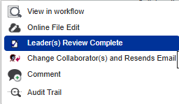
Online File Edits Continued
  After Completing Online File Edits, you have two choices
  Option 1: You have completed all your Online File Edits and are ready to submit it back to the Program Manager.
    From the Actions Button select Leader(s) Review Complete. This removes the procedure from your To-Do list and documents your collaboration.
  Option 2: You have not completed your Edits, have outstanding questions and would like to return later.
    Do not mark the procedure as complete. Close out of your To-Do list. When you are ready to collaborate again, start the Online File Edit process over.
Most Important Take Away
Make sure you have Completed Online File Edits
Within 4-hours of checking the procedure out.
Before pressing Leader(s) Review Complete.
Before leaving your To-Do list (ensure all file status are at Checked In)
Notes:
"After editing, you have two choices:
Option 1: All done? Submit to the Program Manager and celebrate!
Option 2: Not finished? No worries—just close out and come back when you’re ready.
Just remember, edits must be completed within 4 hours of checkout, or they’ll disappear faster than free donuts in the break room."

Slide 11
Responsibilities
Procedure owner Responsibilities
Collaborator Responsibilities
Procedure Collaboration Timeline
  Ensure all sites have a 30-day window for thorough review and collaboration on procedures.
Feedback Evaluation
  Carefully assess all feedback to balance practicality, compliance, and clarity in procedural updates.
Regulatory Compliance Reference
  Review guidelines from CAP, CLSI, CLIA, and other relevant regulatory agencies to confirm that procedures comply with both industry and regulatory standards.
Final Draft Approval
  Prepare final procedure draft and obtain sign-off from all medical directors before implementation.
Documentation of Changes
  Create and maintain documentation of all significant changes made during the collaboration process for transparency and audit purposes.
Timely and Thoughtful Review
  Collaborators must review procedures carefully within set timeframes to ensure compliance and prevent delays.
Use Approved Collaboration Methods
  Using approved methods like View in Workflow or Online File Edit prevents document locking and ensures access for all reviewers.
Maintain Standardized Formatting
  Collaborators must keep the established format to ensure clarity and consistency across all labs and departments.
Escalation for Reformatting Requests
  Requests for reformatting require submitting an SBAR, which is reviewed by system leadership for approval.
Notes:
let’s talk about what it really means to be a responsible collaborator in Lab360!
First, time is of the essence! You’ve got a 30-day window to review and collaborate on procedures. That’s plenty of time, unless you spend 29 days searching for the perfect pen.
Next, feedback isn’t just a suggestion box—it’s your chance to help balance practicality, compliance, and clarity. Every comment you make helps us avoid confusion and keeps our procedures sharp.
Regulatory compliance is our north star. So, when in doubt, check those CAP, CLSI, and CLIA guidelines. If you’re not sure, ask! It’s better than guessing and accidentally inventing a new lab rule.
When you’re done, make sure all your changes are documented. Transparency isn’t just for lab glassware—it’s for our process, too. Auditors love a good paper trail, and so do we.
Stick to the approved collaboration methods—View in Workflow or Online File Edit. This keeps things running smoothly and prevents document lockouts (and frustrated colleagues).
Keep the formatting standardized. If you want to reformat, submit an SBAR and let system leadership review it. No rogue fonts or rainbow tables, please.
And finally, review thoughtfully and on time. The lab runs on teamwork, not telepathy—so let’s keep everyone in the loop and the procedures in tip-top shape!
Remember: responsible collaboration means better labs, happier teams, and fewer audit surprises. Let’s do this!"

Slide 12
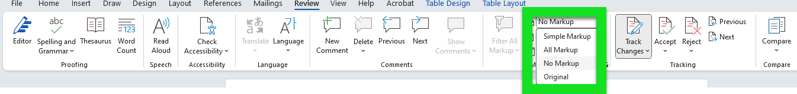
Online File Edit Tips- Track Changes
Track changes are always on when collaborating in the Word Document
  Do Not Turn Off Track Changes or Accept or Reject any proposed changes.
  You can adjust Track Changes to your preferred view for collaboration.
  Track Change View can be changed in the Review Tab
    All Markup shows all previous text, new text, formatting changes and comments and can be very busy and difficult to read.
    Simple Markup shows clean new text with old text hidden. You can tell that changes have been made by the red line to the left of the text and comments are visible. This is usually the preferred method for viewing.
    No Markup is not suggested as it only shows new proposed text without indication as to what has been changed.
Change Markup View
Do Not Make any changes here.
Notes:
---First rule: Track Changes is always on. Think of it as the lab’s motion sensor lights—always watching, always recording. Don’t turn it off, and don’t accept or reject changes. Every edit you make is part of our transparent process, so own your suggestions and let others see your brilliance (or your typos)!
You can adjust your Track Changes view for comfort. Simple Markup is usually best—clean, clear, and easy to follow. But remember, No Markup is like wearing sunglasses indoors: you might look cool, but you’ll miss the details.
Your responsibility is to keep edits visible, feedback constructive, and the process collaborative. Every change helps us improve, every comment keeps us compliant, and every review makes our procedures stronger.
So, keep those changes tracked, those comments coming, and let’s make our documentation audit-proof and teamwork-friendly!"
"Track Changes is always on—like the lab’s motion sensor lights.
Don’t turn it off, and don’t accept or reject changes.
Adjust your view to Simple Markup for a cleaner look, but remember: No Markup is like wearing sunglasses indoors—cool, but you’ll miss the details!"

Slide 13

Online File Edit Tips Continued- Time Limit
Only one person can have a procedure checked out in Online File Edit at a time.
  You will see Editing online and a person's name in the File Status column, and you will not have the Online File Edit option in your actions. You will have to come back later to complete your edits.
Online File Edit has a 4-hour limit. File must be marked as Complete Online File Edit within that 4-hour window.
  If a file is not marked as complete within the four-hour timeframe, any modifications (regardless of whether they have been saved) will not be retained in the final document.
  Closing the Word File does not complete online file edits, you must select Complete Online File Edit from your actions tab.
Marking a file as Complete Online File Edit does not remove the procedure from your To-Do list, you will be able to go back in and add more edits until the 30-day collaboration period ends or you mark as Leader Review Complete.
Remember to be courteous to other collaborators. If you have a procedure checked out and you cannot finish, save your changes, Complete Online File Edit , and check it out later when you have time to complete your work.
  By doing this you are eliminating the risk of losing your edits and locking the procedure for other collaborators.
Notes:
"Only one person can edit at a time, and you’ve got a 4-hour window—so don’t dawdle!
If you don’t mark it complete, your edits will vanish, and you’ll have to start over.
Be courteous: if you can’t finish, save, mark complete, and let someone else take a turn.
It’s teamwork, not a solo act—let’s keep the collaboration train moving!"

Slide 14


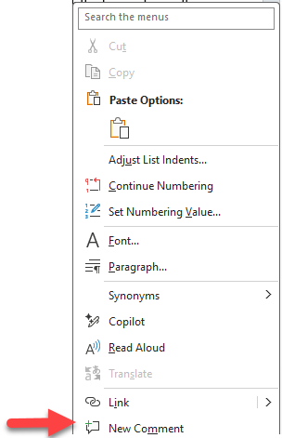
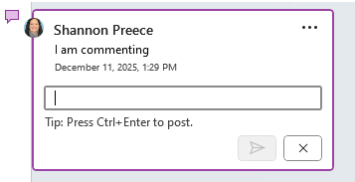
Online File Edit Tips Continued- Adding Changes and Comments
Making edits/changes within the body of the document.
  If you need to make minor wording or grammatical changes, they can be made directly in the body of the text. Track changes will record who made the change.
  If you have major changes or questions, these should be added as a comment.
    This allows the Program Manager or others to reply to your question or comment.
    Once discussion is final, the Program Manager will make the appropriate changes to the body of the text.
Adding a Comment
Verify in the top right corner of the document that you are in Reviewing mode
If there are any previous comments, you will see them to the right of the text.
To add a new comment.
  Find the spot in the text you want to address and right click the mouse.
  Select New Comment from the bottom of the list.
  A comment box will appear on the right. Put in your comment or question and push the arrow to post.
  Any collaborator can add additional comments or answer comment questions by replying to the original comment.
Notes:
---"Let’s talk about making edits and adding comments like a true Lab360 collaborator! If you’re making minor changes, just type them right into the document—Track Changes will keep a record of your brilliance. For bigger questions or suggestions, use the comment feature so everyone can join the conversation.
But here’s the golden rule: before you exit, always hit that save icon in Word! Even though Word Online saves in real time, clicking save is your safety net—like double-checking your lab results before you sign off. It’s the best way to make sure none of your hard work disappears into the digital ether.
So, remember: edit, comment, and always save before you leave. That way, your feedback helps the whole team, and your changes are there when you come back!"
"Making edits? Minor changes go in the text, major ones or questions go in comments.
Verify you’re in Reviewing mode, and don’t be shy—add your thoughts!
Comments are like sticky notes for the digital age, and every reply helps us get closer to the perfect procedure.
And remember, editing in Word Online means your changes are saved in real time—no more version confusion or frantic email chains!"

Slide 15

Let’s Wrap Up!
Teamwork is the Dreamwork!
Be Thoughtful
Don’t Use ONLINE FILE EDIT until you’ve reviewed the document and know that you have enough time.
Provide Constructive Feedback
Have a Plan
Make sure you save, and Complete File Edit before you step away from your Online File Edit.
Save your work frequently
Follow the Process
Don’t put in major changes directly into the document.
Ask questions if you’re ever confused!
Notes:
"As we wrap up, let’s hit the highlights of what makes Lab360 collaboration effective and, yes, even enjoyable:
Teamwork is Essential: Every voice matters. When we collaborate, we turn good procedures into great ones.
Stay on Track: You have 30 days to review and contribute—don’t let those reminders pile up!
Use the Tools: View in Workflow for quick reviews, Online File Edit for hands-on changes. Remember, Track Changes is always on for transparency.
Give Constructive Feedback: Your comments help us balance compliance, clarity, and real-world practicality.
Save Your Work: Always hit the save icon before you exit—think of it as your lab safety net!
Follow the Process: Stick to approved methods, keep formatting consistent, and document all changes for a smooth audit trail.
Ask Questions: When in doubt, reach out. Collaboration means no one is left guessing.
Thanks for being part of a team that values quality, compliance, and a little bit of fun. Let’s keep our lab running smoother than a pipette in a rainstorm!"

