Slide 1

Fall Prevention Guidelines and Strategies for Laboratory staff

Slide 2
Learning Objectives
Review fall prevention screening standards and practices as outlined in the St. Luke’s Fall Prevention Program policy PE026.
Identify who is at risk for falls during laboratory procedures.
Describe safety equipment and signage to promote patient safety.
Explain methods to ensure a safe environment and reduce fall risks.
Document fall or near-miss events.

Slide 3
Learning Objective
Review fall prevention screening standards and practices as found in C360.
Both the St. Luke’s Fall Prevention Program policy PE026 with related policy appendices / safety guides and PE016 Ambulatory Clinic Guidebook appendix xw have Fall Risk materials outlined in them.

Slide 4
OVERVIEW
Fall screening helps identify patients at risk of falling to guide prevention efforts in healthcare and home settings.
Falls in healthcare can cause injuries from minor to severe, but about one-third are preventable through risk assessment and environment management.
SLHS prioritizes fall risk identification as part of a National Patient Safety Goal.

Slide 5
Fall Prevention Policy
Everyone working for the Laboratory is responsible for ensuring a safe environment for SLHS patients.
Updates have been made to the Fall Prevention Procedure in C360. All staff are accountable to this information.
Review PE026 - Fall Prevention Program Policy.
Review PE026xg and PE026xi - Ambulatory Clinical Fall Prevention Program Appendices.
PE026 SLHS – Fall Prevention Program
PE026 SLHS Appendices xg and xi – Ambulatory Clinical Fall Prevention Program.
Tips &Tricks for Assisting a Patient with Mobility issues ( non-clinician )

Slide 6
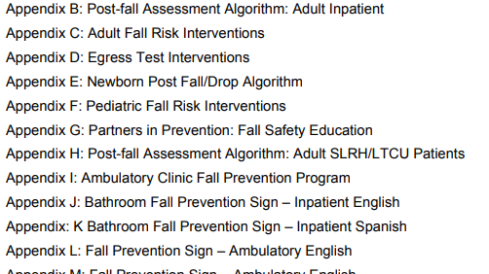
Fall Prevention strategies PE026
There are numerous appendices for PE026. You are also responsible for this information as well. Please review carefully.

Slide 7
Fall Screening
Phlebotomy can raise fall risk, so take care with:
patients 65+,
those under 65 with fall risks,
pediatric patients.

Slide 8
Awareness of the patient’s risk for falling is the first step toward preventing falls
Intrinsic – factors caused by specific situational or environmental related issues part of or inside the patient’s body
Extrinsic – factors caused by situations in the environmental surroundings outside the patient

Slide 9
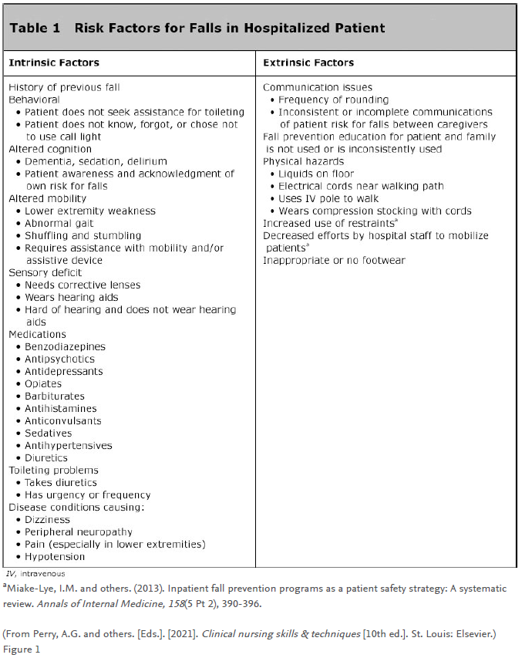
Risk factors for Falls
What a Phlebotomist would recognize as a patient’s
risk for falling
Age 65 years old or older
Possible dizziness
Altered mobility
Decreased energy or fatigue
Loss of muscle strength
Decreased reflexes
Decreased vision
Gait disturbances
( needs a walker or cane )
Altered cognition
Impaired memory and cognition
Confusion

Slide 10
What a Phlebotomist would recognize as a patient’s risk for falling
Risk factors for Falls
Environmental factors:
ill-fitting shoes
physical restraints
inappropriate clothes
clutter in the walking path
spills
dim lighting
height of the bed
wheelchair use

Slide 11
Interventions
“Leave it like you find it” –
Return the tray table to original location if you have moved it
Re-establish Privacy
Return assistive devices (e.g., walking aids, bedside commodes) on the exit side of the bed if moved for blood draw access
Replace the patient’s bedside table, water, and personal care items (e.g., eyeglasses, dentures, telephone) within easy reach.
Ensure that the ambulatory patient’s pathway to the bathroom, waiting area or exit is clear.
Ensure that the floor surfaces are clean and dry. Clean up all spills promptly.

Slide 12
Recognition of Risk of a Fall
Observation of the patient
Loss of color, turning pale
Clammy skin or sweaty palms
Heavy or slowed breathing
Nonresponsive but eyes open
Who should stay in the room
At least one person should stay with patient until they are stable
Driving – Observe for 30 minutes
Observe for 15 otherwise

Slide 13
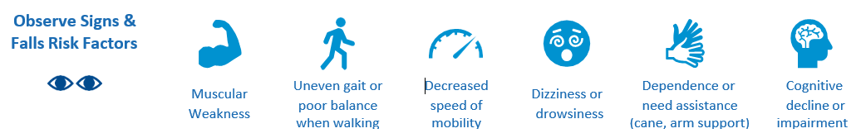
Tips & Tricks for Assisting a Patient with Mobility concerns
If a patient is exhibiting ANY signs below -- seek clinical assistance, use a wheelchair and/or use a mechanical lift.
Check the Scene for Trip Hazards
Uneven ground
Changes in flooring (carpet to tile, tile to carpet), floor mats
Wet or slick surfaces
Cords, Chairs, Garbage bins
Stairs

Slide 14

Tips & Tricks for Assisting a Patient with Mobility concerns
Feel free to suggest a wheelchair when necessary.
If you are worried about a patient’s fall risk, don’t wait for the patient to decide on using the wheelchair.
Always lock the brakes before getting in or out of the chair.
Utilize the patient transfer chair whenever possible.
Keep the armrests down so the patient can hold onto them for support.
Move the leg rests aside when possible for transferring.
Whenever feasible, keep the patient in the wheelchair during the exam to minimize extra transfers.
Use a Wheelchair

Slide 15

Tips & Tricks for Assisting a Patient with Mobility concerns
Use the armrests to help lower yourself into or rise from the seat.
Since it's a long walk, let's use a wheelchair.
If you can't safely support mobility, ask if they'd prefer to have their blood taken while seated in the wheelchair.
Inform me if you feel weak, dizzy, or at risk of falling.
Have a plan to safely lower the patient if they fall.
Coach the Patient

Slide 16

Tips & Tricks for Assisting a Patient with Mobility concerns
Minimize
Minimize "hands-on" help when possible, prioritizing clinical support and patient safety.
Avoid
Avoid pulling or pushing the patient to move them.
Stand
If manual support is needed, stand beside the patient—not in front—and support under the armpits rather than using their arms or hands.
Manual Support
( NOT recommended )

Slide 17


Tips & Tricks for Assisting a Patient with Mobility concerns
Sit
Prevent patients from standing too long in the outpatient waiting area.
Encourage patients to sit while waiting, if feasible.
Suggest
Suggest a nearby restroom
Offer
Offer help walking to or from the restroomSuggest using a wheelchair
Seek
Seek clinical support if assistance is needed in the restroom
Explain
Briefly explain how to use the restroom alarm
Bathroom for urine collection

Slide 18
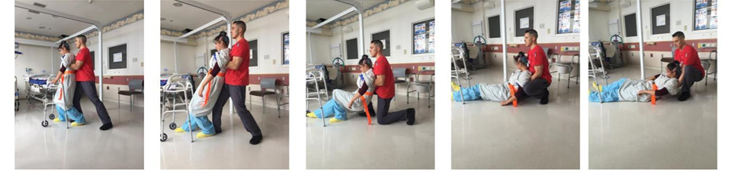
Lowering a Falling Patient to the Ground Safely
Brace
Hug
Slide
Lower
Support
Take a wide stance. Keep your back straight and tighten your core.
Bring the patient close to your body.
Slowly slide the patient down your leg.
Lower the patient to the ground while keeping your back straight.
Support the patient’s head.

Slide 19
Call lights and Alarms – toilet or bed
Call lights are used to notify nursing
Use this button to call when you need any assistance with the patient.
If patient requests assistance to leave bed during phlebotomy, activate call light so that nursing can assist.
Bed and toileting alarms
Nursing responds to bed and/or toileting alarms

Slide 20
Hospitalized patients determined to be at risk for falls are often identified with:
yellow wrist bands,
yellow non-skid socks, and
a visual cue on the patient’s door.

Slide 21
Pediatric Interventions Patient instruction, education, & engagement
Remind parent / caregiver to supervise the child at all times
Discuss of elements of risk inherent to the clinic environment:
standing on chairs or exam tables,
sitting on rolling stools, and/or
playing with equipment intended for staff
Encourage moving the child to the exam table only when provider indicates a necessity
Remind parent / caregiver to help their child on and off the exam table
Remind parent / caregiver to keep a hand on the child while on the exam table and not to turn or walk away

Slide 22
If a Patient loses Consciousness, there is a potential for fall risk - What steps must be taken immediately once a patient loses consciousness and there is a risk that he/she may fall to the floor?
In an outpatient setting, whether the patient is standing or sitting in the draw station chair –
You must always look out for the safety of the patient.
The patient should never be left alone once they have lost consciousness.
Activate the call button
In Clinic, this will bring nursing staff to come to the room. RN/LPN, Provider will take charge of the situation when they arrive on scene.
At a Laboratory draw station, this will bring co-workers to come assist. Emergency Room nursing or the Rapid Response Team may need to be activated.
If in an area without a call button, call 9-1-1 if medical intervention is needed.
If the patient has stopped breathing while in syncope, activate the code blue call if an RN is not in room or call 9-1-1if call button is not available.

Slide 23
If a Patient loses Consciousness, there is a potential for fall risk – Once an outpatient loses consciousness, who can release the patient and/or the phlebotomist from care?
In Clinic, an office nurse or triage nurse must be the one to dismiss the patient if the patient losses consciousness.
The phlebotomist should stay by patient side to assist and give info to office/triage nurse until no longer needed by nurse.
The office/triage nurse will take over the situation once they arrive on scene.
At a Laboratory draw station, if Emergency Room nursing, the Rapid Response Team or EMS have been engaged, they will take over the situation once they arrive at the scene.
A SpeakUP MUST be placed each time a patient loses consciousness.

Slide 24
If a Patient loses Consciousness, there is a potential for fall risk - What steps must be taken immediately once an Inpatient loses consciousness?
In an inpatient setting, even if the patient is safely lying in bed or sitting in a chair –
You must always look out for the safety of the patient.
Activate the call button to get nursing staff to come to the room.
The patient should never be left alone once they have lost consciousness.
RN will take charge of the situation when they arrive on scene.
If the patient has stopped breathing while in syncope, activate the code blue call if RN is not in room.
A SpeakUP MUST be placed each time a patient loses consciousness.

Slide 25
If a Patient has Fallen
Ask if the patient is OK
• Activate the call button to request help
• Do not attempt to carry or lift the patient
• Report incident to supervisor

Slide 26
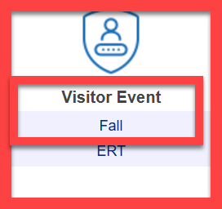
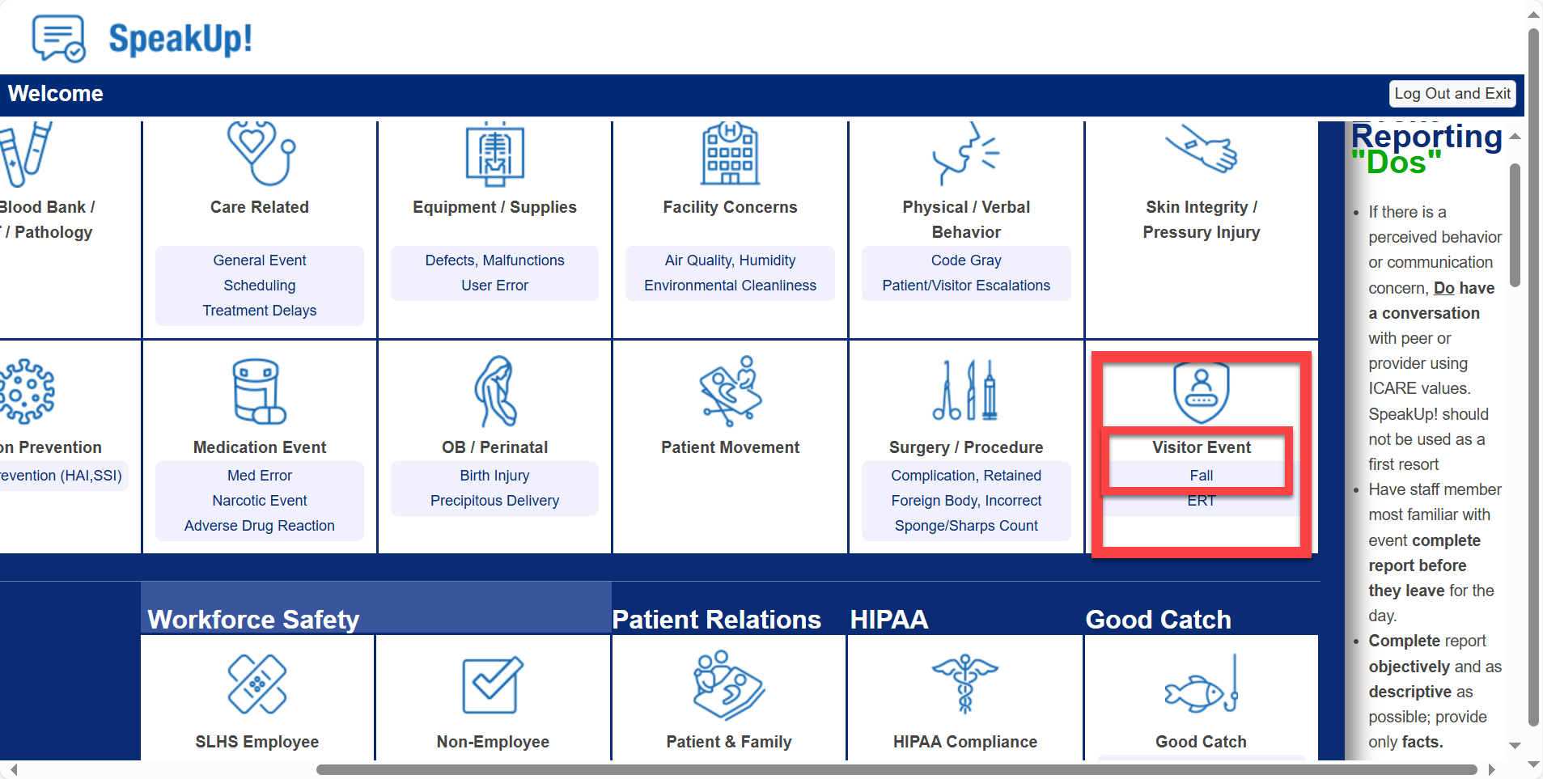
How to Document Falls in SpeakUP
To log a fall in any laboratory setting, document under a VISITOR EVENT-FALL
The Fall Icon includes out of scope questions that lab personnel may be unable to answer.
If you witness a fall in a public area, communicate with responders on who will fill out the SpeakUP

Slide 27
Positive feedback
Use safety huddles to review and reinforce when a “good catch” or “near miss event” occurs and patient safety is maintained.

