Slide 1
RDS® InCup® Tutorial
This Training Program is intended to provide a means for a drug test administrator to develop an understanding of the InCup product and to receive our online manufacturer's certification.
What follows is a self-paced presentation.
To move to the next page simply click on the right arrow at the bottom of the page. To return to the previous page simply click on the left arrow.
Once you finish this training program you may test your knowledge with our Certification Test. If you pass the test you may print out a personalized Certificate of Training.

Slide 2
RDS InCup is a multi-drug, urine based point of collection test that incorporates collection and testing of up to 12 drugs in less than 5 minutes. ttHH
Drug |  | Cutoff Concentration*
AMP | Amphetamines | 1,000 ng/ml
BUP | Buprenorphine | 12.5 ng/ml
BZO | Benzodiazepine | 300 ng/ml
COC | Cocaine | 150 ng/ml or 300 ng/ml
MTD | Methadone | 300 ng/ml
METH | Methamphetamine | 1,000 ng/ml
OPI | Opiates | 300 ng/ml or 2,000 ng/ml
OXY | Oxycodone | 100 ng/ml
THC | Cannabinoids | 50 ng/ml

Slide 3
Features
Up to 12 tests per device
25 Cups per case
Each cup individually packaged
Moisture and temperature sensitive
Must be used 8 hours after foil pouch is opened
Store product at room temperature (59° to 86°F)
Each case and cup is labeled
Product Number (Panel)
LOT Number
Expiration Date
Customized panels available
Temperature strip: validates specimen
Clear cup: visual integrity check
Closed specimen cup - NO EXPOSURE
No dipping, tipping, aligning lids, EASY!
Simple: Collect, verify temp, read results
No timing: read when control lines form
Read results up to 60 minutes

Slide 4
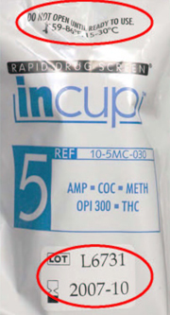
InCup device should be stored at room temperature (59° to 86°F or 15° to 30°C)
Verify Expiration Date Is Valid Do not use beyond expiration date

Slide 5
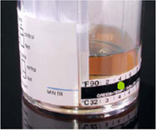
Verify identity of donor
Ensure restroom is secure
Instruct donor to fill cup above minimum fill line
Green dot = temperature Read within 4 minutes
Acceptable Specimen: 90-100F / 32-38C A visual check for specimen integrity may also be performed

Slide 6
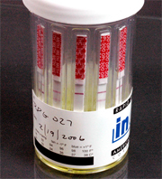
The results may be interpreted once the control lines have formed and the background is clear.
Results are stable for 60 minutes.
Control line (top line) = test valid
No control line = test invalid (repeat)
Test line= test negative
No test line = test positive
Line intensities may vary

Slide 7
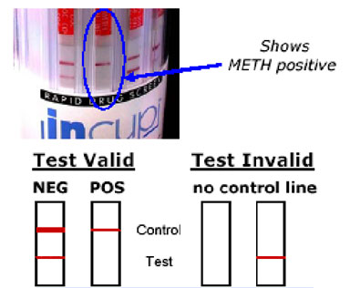

Slide 8
Drug Detection Periods
Drug |  | Approximate Detection Times
AMP | Amphetamines | 2-4 days
BUP | Buprenorphine | 1-3 days
BZO | Benzodiazepine | Up to 2 weeks
COC | Cocaine | 1-3 days
METH | Methamphetamine | 1-2 days
MTD | Methadone | 1-3 days
OPI | Opiates | 1-3 days
OXY | Oxycodone | 1-3 days
THC | Cannabinoids | Infrequent Use: 2-5 days Moderate Use: 10-15 days Chronic/Heavy Use: 1 month

Slide 9
You have now completed the tutorial. You may go back over any or all of the material by simply clicking the desired slides on the left. There is no limit to how long or how often you go through this training.
American Bio Medica offers a personalized certificate of completion which you can download and print out once you have passed our Certification Test. Click the link listed below or enter into your web browser.
http://abmc.com/training/index.html
Click the Register Here button, fill out the pertinent information. Proceed to login and complete exam for RDS InCup. Email a copy of your certificate to:
Lisa.Lee10@va.gov
The Certification Test consists of 13 questions. Once you take the test your score will automatically be calculated. If you receive a score of 100% you will be able to access and print out your personalized 'Certificate of Training'.
You may now proceed to the Certification Test.

Slide 10
RDS InCup Certification Test
Please read each question and select the best answer. Select your answer by clicking the button next to it. After you have answered all of the questions click 'Certify Me' and your test will automatically be scored.

Slide 11
1) The InCup has a maximum fill volume of:
a) the min fill line b) the temperature strip c) no maximum fill d) all of the above

Slide 12
2) The temperature of the specimen should be read within:
a) doesn't matter b) no more than 1 minute after collection c) 15 minutes after collection d) within 4 minutes after collection

Slide 13
3) What is the acceptable temperature range for the urine specimen?
a) 90 - 100 F (32 - 38 C) b) Below 90 F (32 C) c) Above 100 F (38 C) d) d) Both a) and c)

Slide 14
4) The InCup can test for up to how many drugs at one time?
a) 12 b) 20 c) 3 d) 5

Slide 15
5) The test kit may be used after the expiration date:
a) if the kit has not been opened b) never c) within one month after the expiration date d) only if the kit has been frozen

Slide 16
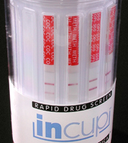
6) Interpret the results of this InCup:
a) METH test is invalid b) THC test is invalid c) METH test is positive d) b) and c) only
Notes:
From left to right: COC, METH, OPI 300

Slide 17
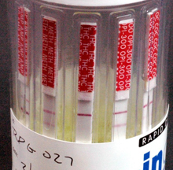
7) Interpret the results in this InCup:
a) All drugs are negative b) Positive for THC, negative for the other drugs c) Invalid test d) Positive for Cocaine, negative for the other drugs
Notes:
From left to right: AMP, METH, THC, OPI 300, COC

Slide 18
8) InCup results can be interpreted:
a) immediately after the sample is collected b) once a reddish-purple control line with a clear background forms in all channels of the test (typically 3-5 minutes) c) up to 1 hour after the test is complete d) b) and c)

Slide 19
9) The InCup test results are stable for:
a) up to one hour b) 30 seconds c) two weeks d) a and c

Slide 20
10) InCup provides:
a) a preliminary drug screen result b) a qualitative result c) a quantitative result d) a and b

Slide 21
11) A test line that is a very light intensity compared to other test lines:
a) should be considered invalid b) should be interpreted as a marginal positive c) should be interpreted as a negative d) should be re-run since the results are questionables

Slide 22
12) To perform a drug test using the InCup :
a) Collect a urine sample, verify the temperature, read the results b) Pipette reagents into the InCup after collection c) Tip the cup upside down d) Shake the cup vigorously for 5 seconds

Slide 23
13) The InCup can be used in:
a) The office b) The field c) On a job site d) All of the above

