Slide 1
RDS® InCup® Tutorial
This Training Program is intended to provide a means for a drug test administrator to develop an understanding of the InCup product and to receive our online manufacturer's certification.
What follows is a self-paced presentation.
To move to the next page simply click on the right arrow at the bottom of the page. To return to the previous page simply click on the left arrow.
Once you finish this training program you may test your knowledge with our Certification Test. If you pass the test you may print out a personalized Certificate of Training.

Slide 2
RDS InCup is a multi-drug, urine based point of collection test that incorporates collection and testing of up to 12 drugs in less than 5 minutes. ttHH
Drug |  | Cutoff Concentration*
AMP | Amphetamines | 1,000 ng/ml
BUP | Buprenorphine | 12.5 ng/ml
BZO | Benzodiazepine | 300 ng/ml
COC | Cocaine | 150 ng/ml or 300 ng/ml
MTD | Methadone | 300 ng/ml
METH | Methamphetamine | 1,000 ng/ml
OPI | Opiates | 300 ng/ml or 2,000 ng/ml
OXY | Oxycodone | 100 ng/ml
THC | Cannabinoids | 50 ng/ml

Slide 3
Features
Up to 12 tests per device
25 Cups per case
Each cup individually packaged
  Moisture and temperature sensitive
  Must be used 8 hours after foil pouch is opened
  Store product at room temperature (59° to 86°F)
Each case and cup is labeled
  Product Number (Panel)
  LOT Number
  Expiration Date
Customized panels available
Temperature strip: validates specimen
Clear cup: visual integrity check
Closed specimen cup - NO EXPOSURE
No dipping, tipping, aligning lids, EASY!
Simple: Collect, verify temp, read results
No timing: read when control lines form
Read results up to 60 minutes

Slide 4
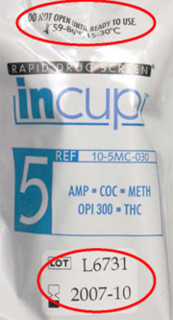
InCup device should be stored at
room temperature
(59° to 86°F or 15° to 30°C)
Verify Expiration Date Is Valid
Do not use beyond expiration date

Slide 5
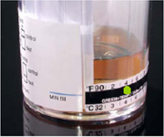
Verify identity of donor
Ensure restroom is secure
Instruct donor to fill cup above minimum fill line
Green dot = temperature
Read within 4 minutes
Acceptable Specimen: 90-100F / 32-38C
A visual check for specimen integrity may also be performed

Slide 6
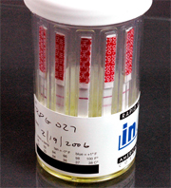
The results may be interpreted once the control lines have formed and the background is clear.
Results are stable for 60 minutes.
Control line (top line) = test valid
No control line = test invalid (repeat)
Test line= test negative
No test line = test positive
Line intensities may vary

Slide 7
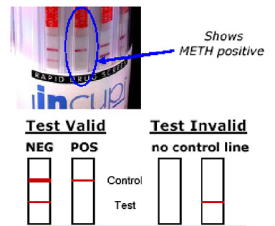

Slide 8
Drug Detection Periods
Drug |  | Approximate Detection Times
AMP | Amphetamines | 2-4 days
BUP | Buprenorphine | 1-3 days
BZO | Benzodiazepine | Up to 2 weeks
COC | Cocaine | 1-3 days
METH | Methamphetamine | 1-2 days
MTD | Methadone | 1-3 days
OPI | Opiates | 1-3 days
OXY | Oxycodone | 1-3 days
THC | Cannabinoids | Infrequent Use: 2-5 days Moderate Use: 10-15 days Chronic/Heavy Use: 1 month

