Slide 1
CVVAMC iSTAT User Training for Chem8+ (BUN & Creatinine)
By Lisa Lee, Ancillary Testing Coordinator ext. 2124 Lisa.Lee10@va.gov
Ext. 2124 Abbott Diagnostics Help Line 1-877-529-7185

Slide 2
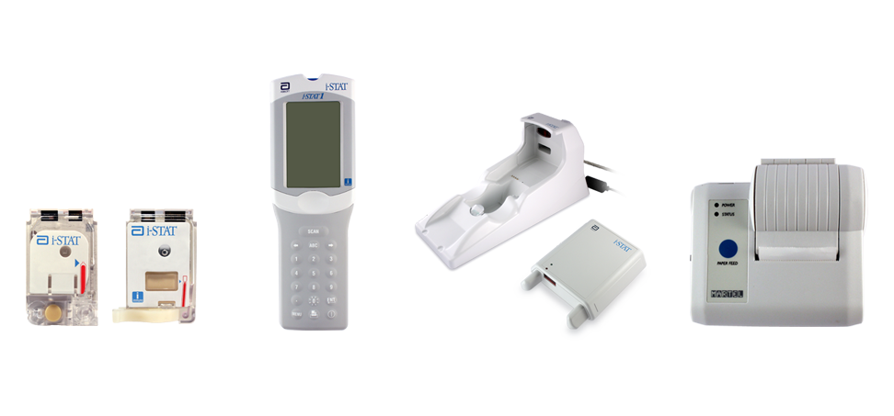
Components of the i-STAT System
Primary System Components
Cartridge
Handheld
Downloader
Printer

Slide 3
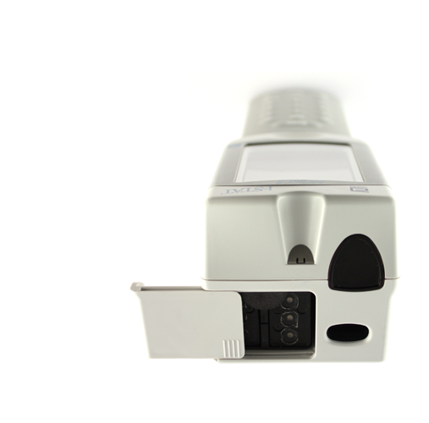
Handheld External Components
Handheld: Top
Battery compartment
Infrared eye
Barcode scanner
Battery
compartment
Infrared eye
Barcode scanner

Slide 4
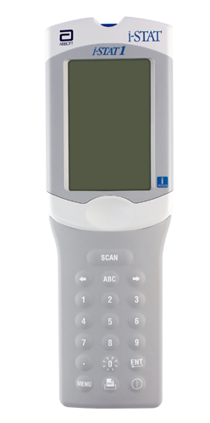
Handheld External Components (cont.)
Handheld: Front
Display screen
Keypad
  SCAN key
  Arrow keys
  ABC key
  Number keys
  Decimal Point key
  ENT key
  MENU key
  Power key
Display screen
SCAN key
Arrow keys
ABC key
Number keys
Keypad
Decimal Point key
MENU key
ENT key
Power key

Slide 5
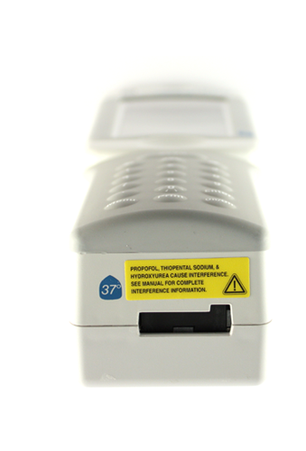
Handheld External Components (cont.)
Handheld: Bottom
Cartridge port
Cartridge Port

Slide 6
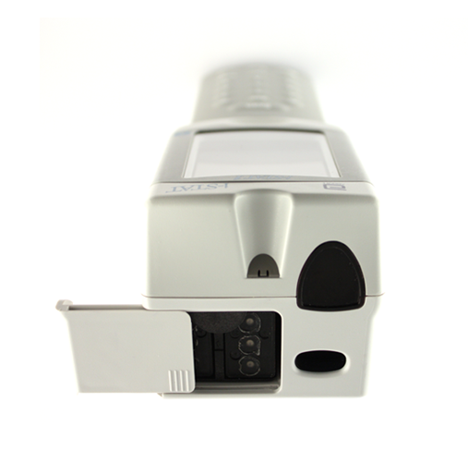
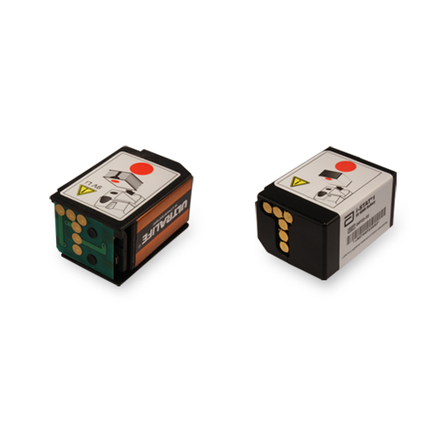
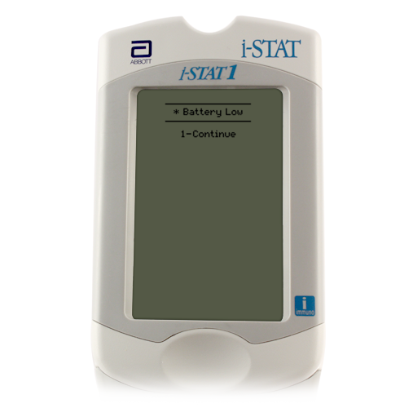
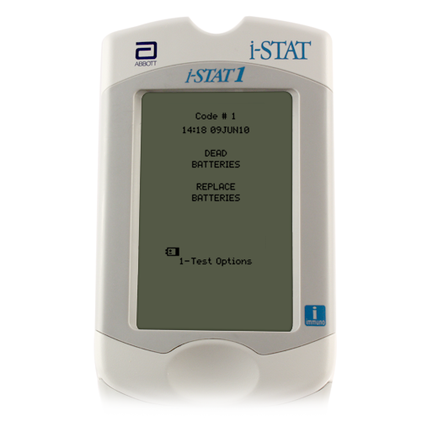
Batteries: 9 Volt
Battery compartment
Abbott rechargeable battery pack
Change the batteries when:
“Battery Low ” message is displayed
Abbott rechargeable battery pack
Battery
compartment

Slide 7
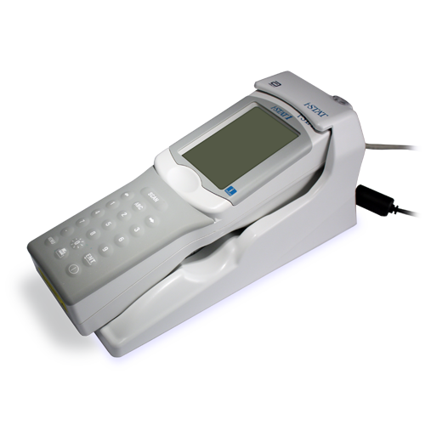
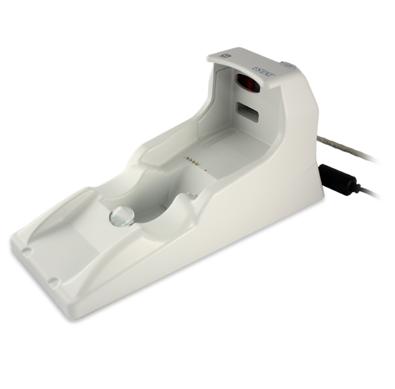


The Rechargeable Battery Pack
Recharging the batteries
In the handheld
In the Downloader/Recharger battery compartment
New batteries must charge a minimum of 40 hours prior to use
Recharging in the handheld
Handheld must be properly placed in Downloader/Recharger
Red or green status light illuminates when charging
Battery compartment
Status Light

Slide 8
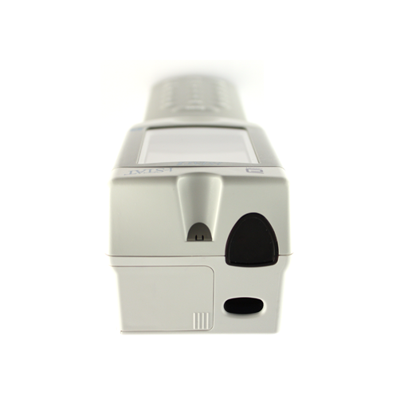
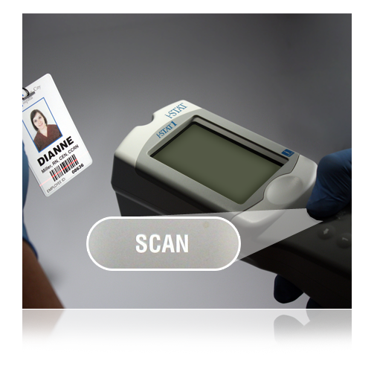
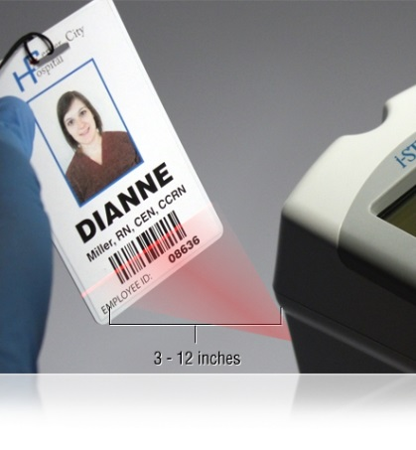
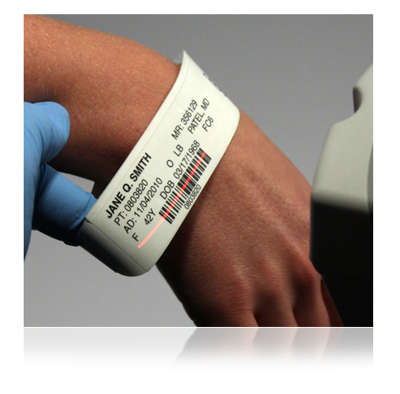
The Barcode Scanner
Used to scan
Operator IDs
Patient IDs
Cartridge lot number barcode
To scan
Hold the handheld 3 to 12 inches away from the barcode
Press and hold down the SCAN key
Laser beam must cover the entire length of the barcode
Wait for the beep or for laser beam to disappear
Release the SCAN key
Repeat if prompted
Barcode scanner
The barcode scanner is a class II laser device. Momentary exposure is not known to be harmful—however you should never point the scanner at anyone or look into the laser beam.

Slide 9
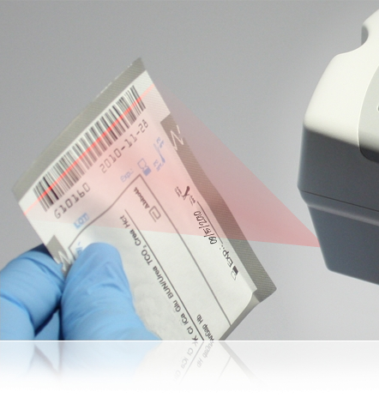
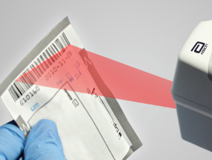
The Barcode Scanner (cont.)
If the scan is unsuccessful, try again.
Make sure the barcode is completely covered by the red beam
Press and HOLD the SCAN key
Tilt the barcode away from strong light
The barcode scanner is a class II laser device. Momentary exposure is not known to be harmful—however you should never point the scanner at anyone or look into the laser beam.

Slide 10
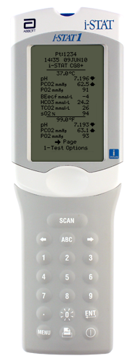
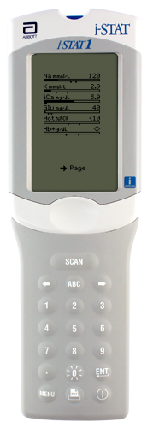
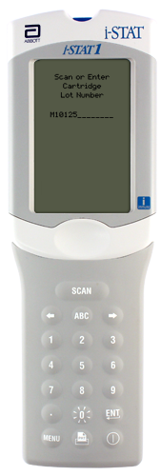

Handheld Keys: Arrow Keys
Arrow keys
Right Arrow key is for navigating pages within a test result
Left Arrow key is a backspace to clear keypad entries

Slide 11
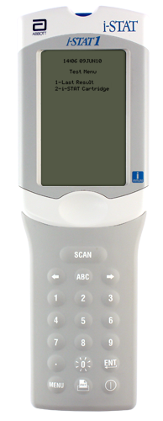
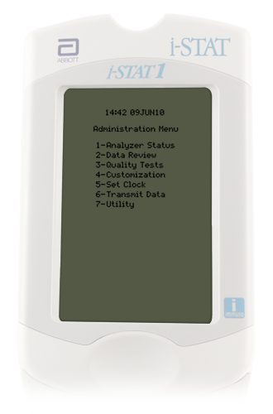
Handheld Keys: MENU Key
Menu key
Toggles between the Administration and Test menus
Escape key

Slide 12
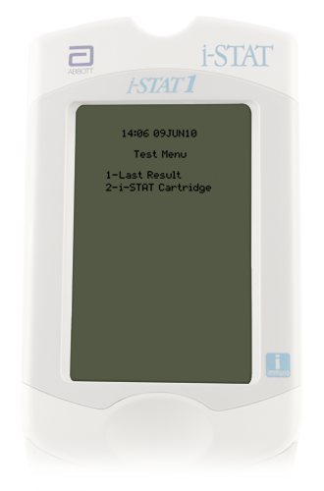
Handheld Test Menu
Test Menu
First menu to appear
Important Note:
This menu is used for patient tests only!
Cartridge Test Menu options
1 = Last Result
2 = i-STAT Cartridge (for a patient test)

Slide 13
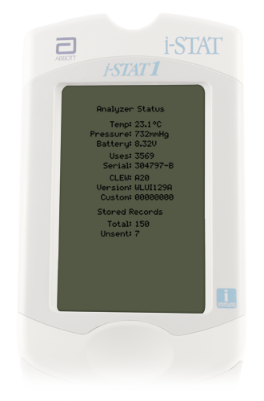
Administration Menu: Analyzer Status
Administration Menu
Analyzer Status
Analyzer Status screen
Press MENU to get to the Administration Menu
Press 1 for Analyzer Status
Information includes:
Total records
Unsent records

Slide 14
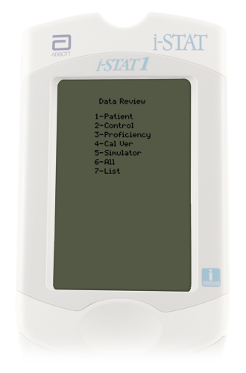
Administration Menu: Data Review
Data Review
Press MENU to get to the Administration Menu
Press 2 for Data Review
7 options for grouping or filtering stored data
View or print any stored record

Slide 15
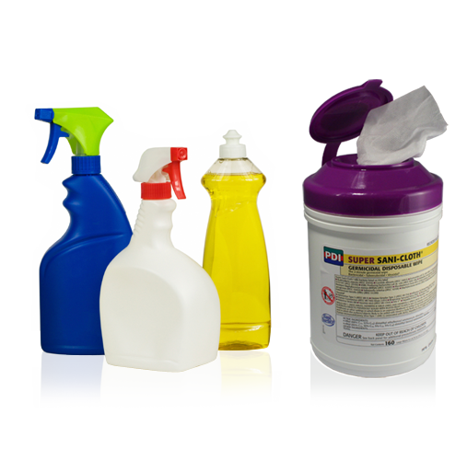
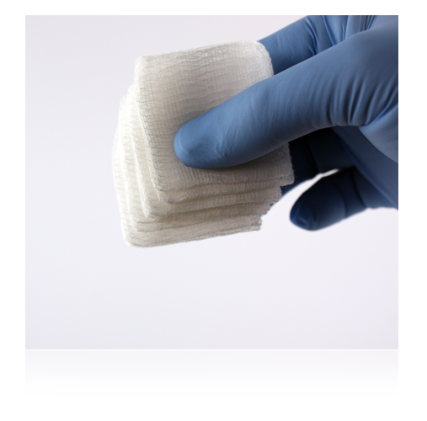
Cleaning the Handheld
Cleaning the handheld
Clean the display screen with
  Mild, nonabrasive cleaner
  Detergent
  Soap and water
  Alcohol
  10% bleach solution
  PDI® Super Sani-Cloth®
Rinse using gauze pad moistened with water
Allow to dry

Slide 16
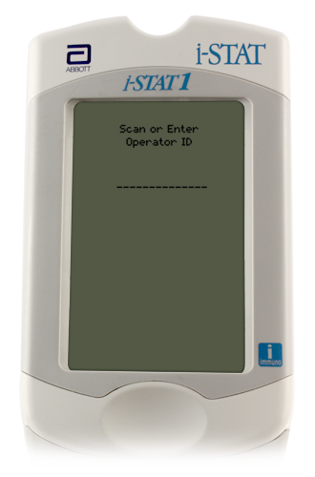
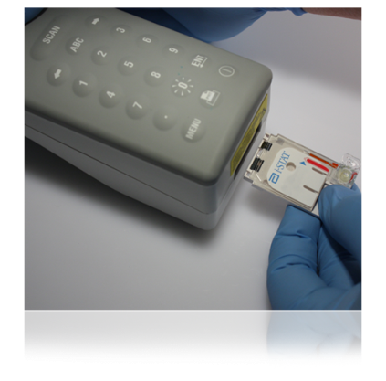
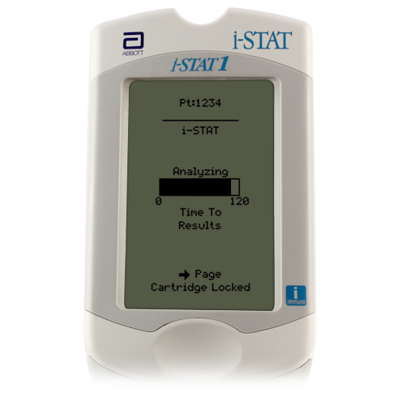
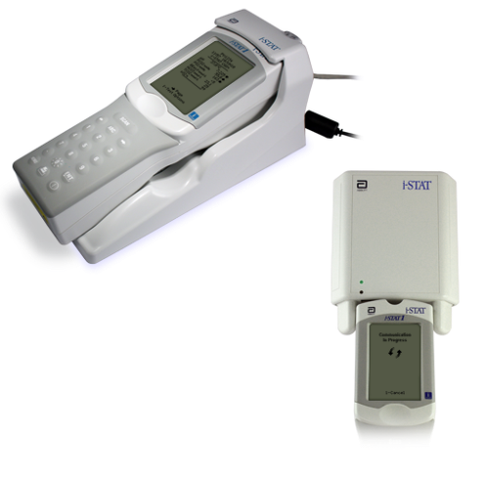
The i-STAT System Testing Process
Collect blood sample in a lithium heparin (light green top) tube. Sample stable for 30 minutes post collection.
Enter information into handheld
Fill cartridge
Insert cartridge; results will appear: within 10 minutes for Troponin; within 2 minutes for Chem 8+ and G3+ cartridges.
Download results

Slide 17
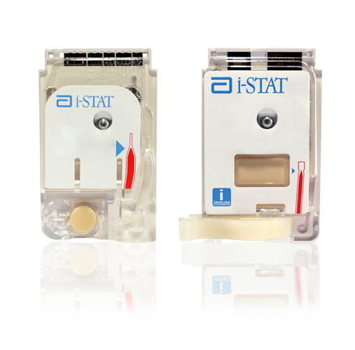
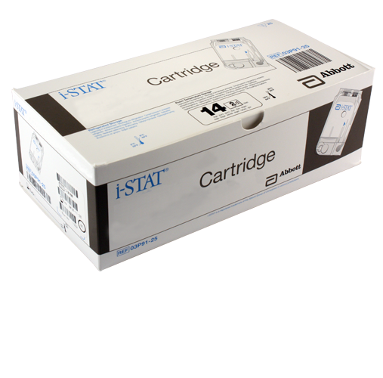
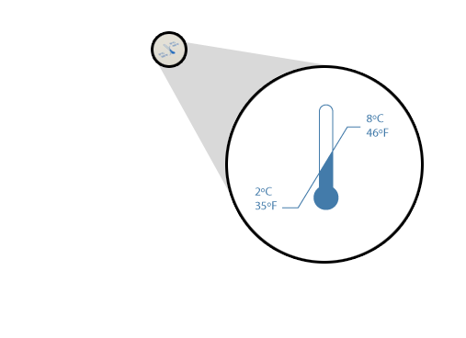
i-STAT Cartridge Overview
i-STAT Cartridges
Self-contained lab analyzers
Analysis, sample manipulation, and waste are confined within the cartridge
Refrigerated storage
May be used until the expiration date
Refrigerated storage range is 2°C - 8°C

Slide 18
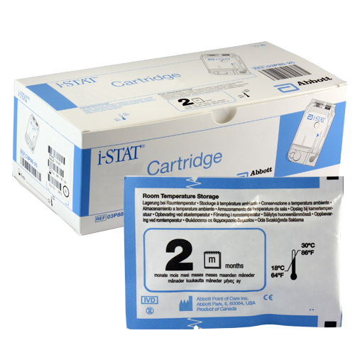
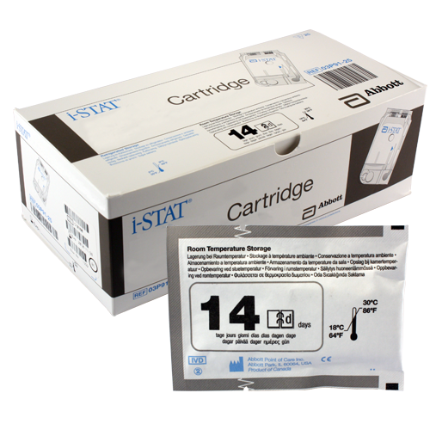
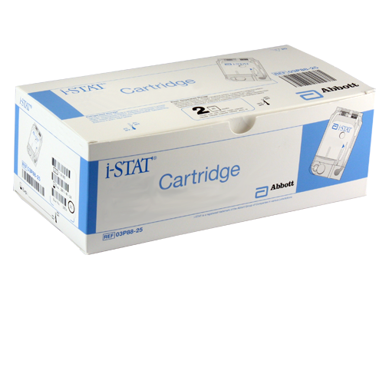
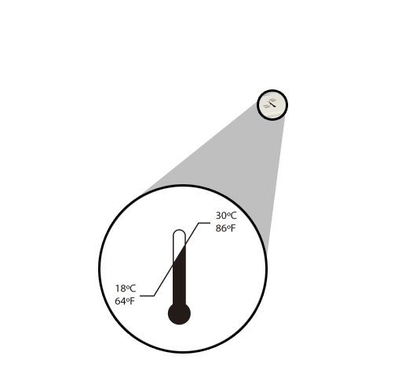
i-STAT Cartridge Overview (cont.)
Room temperature storage
14d = 14 days (Chem8+ for BUN and CRE and Troponin-I)
2m = 2 months (G3+ Blood Gas)
Check the cartridge box for the stability date range on your particular cartridges
Room temperature storage range is 18°C - 30°C

Slide 19

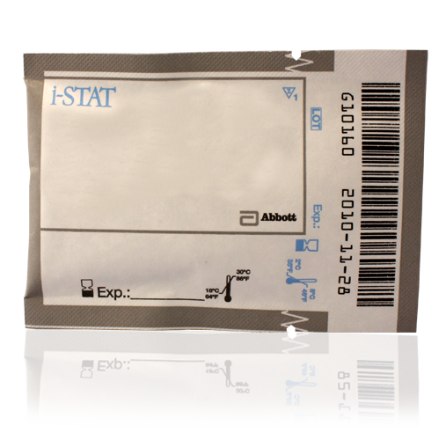
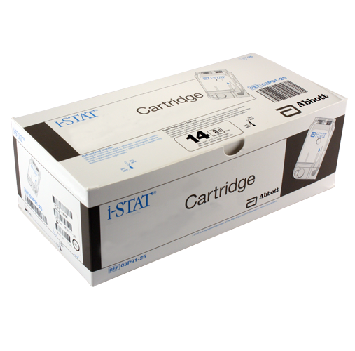

i-STAT Cartridge Overview (cont.)
Cartridges MUST be brought to room temperature before use
5 minutes for a single cartridge
1 hour for a box of cartridges
Do NOT manipulate the cartridge in any way to bring it to room temperature more quickly.

Slide 20
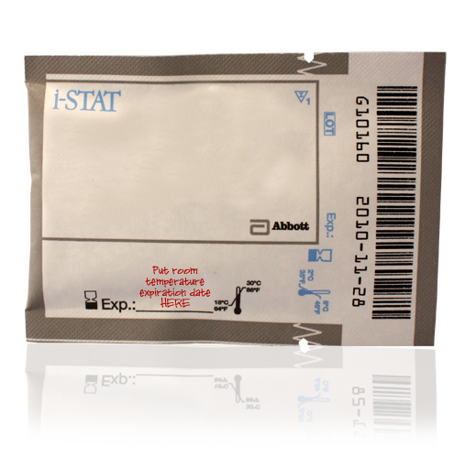
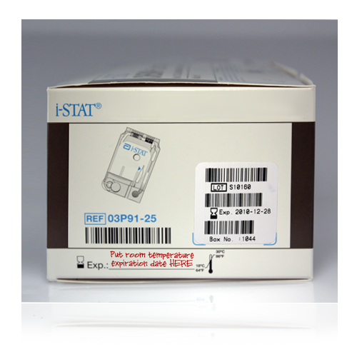
i-STAT Cartridge Overview (cont.)
After removing cartridge(s) from refrigeration
They CANNOT be put back into the refrigerator
The room temperature expiration date must be written on the box or individual cartridge pouch
If the box is marked, cartridges must remain in the box until used
Cartridge disposal
Follow your hospital’s disposal guidelines for products used with blood
Put room temperature expiration date here

Slide 21
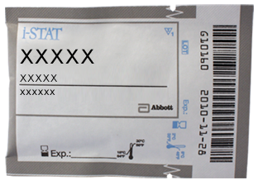
i-STAT Cartridge Overview (cont.)
Pouch labeling
Panel name
Analyte(s)
Lot number
Cartridge barcode
Refrigerated expiration date
Room temperature storage expiration date
Lot number
Cartridge barcode
Panel name
Analytes
Room temperature storage expiration date
Refrigerated expiration date

Slide 22
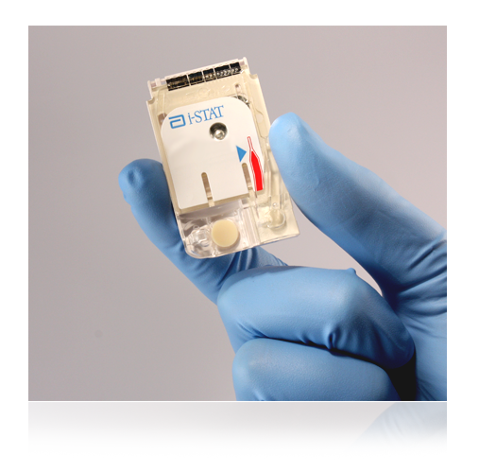
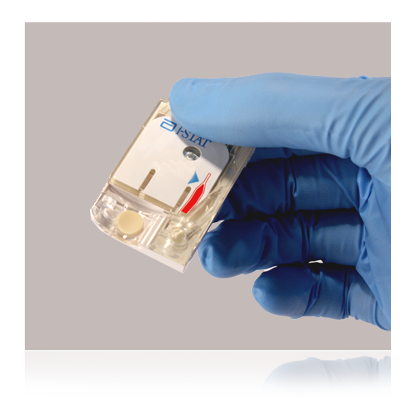


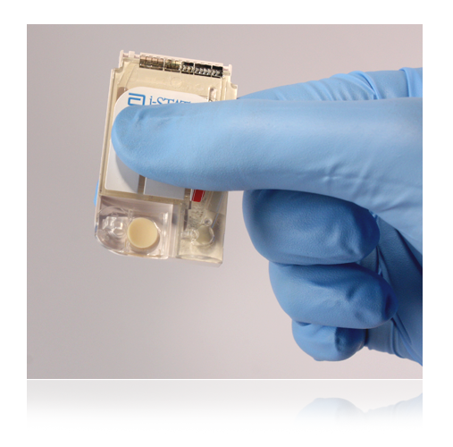
i-STAT Cartridge Overview (cont.)
Handling cartridges
Carefully tear open the cartridge pouch where indicated
Hold the cartridge by the sides or the bottom
Do not touch the sensors or apply pressure to the center of the cartridge
Prior to testing
The handheld will perform quality checks
Failure of a quality check will result in a Quality Check Code

Slide 23
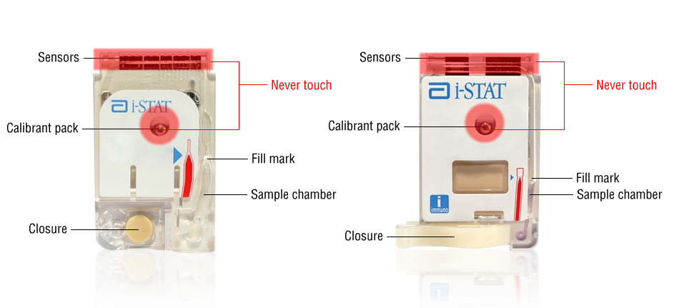
i-STAT Cartridge Components

Slide 24
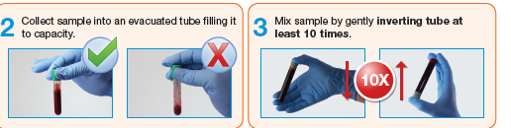
Sample Collection Techniques
i-STAT System may be used with:
Venous samples ONLY
Use Lithium Heparin (mint green top tube ONLY
Tube must be AT LEAST half full
Mix tube well; NO CLOTS
Test immediately; sample stability 30 minutes.
Important notes:
  Make sure to follow your hospital’s procedures for proper sample collection.
  Always correlate results with the status of the patient!

Slide 25
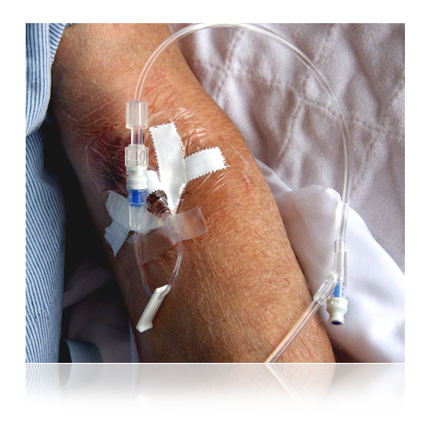
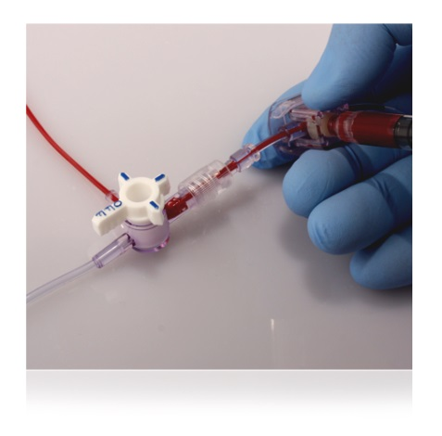
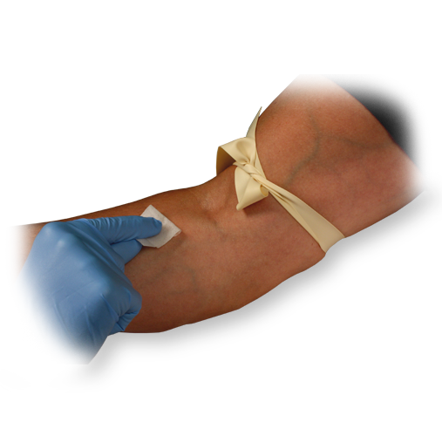

General Sample Collection Techniques
Ensure a quality sample is obtained
IV line
  Avoid drawing from an arm with an IV line
  IV solutions dilute sample
Indwelling line
  Draw sufficient waste
Tourniquet
  If applied for more than 1 minute, release and reapply after 2 to 3 minutes to avoid hemolysis

Slide 26


General Sample Collection Techniques (cont.)
Avoid extra muscular activity:
  Clenching and unclenching fist
Avoid Hemolysis:
  Allow residual alcohol to dry
  Discard sample from traumatic draw
Allow to dry

Slide 27

Factors That May Affect Results
Avoid factors that may affect the sample prior to analysis.
Always correlate results with the status of the patient.
References:
Cartridge and Test Information Sheets (CTI Sheets)
  i‑STAT 1 System Manual
  www.abbottpointofcare.com

Slide 28


Factors That May Affect Creatinine Results
Avoid affecting creatinine results:
Use another testing method if the patient has been administered hydroxyurea (Droxia®, Hydrea®)

Slide 29




Preparing the Handheld: Turning the Handheld On and Selecting Patient Test
Turn on the handheld
Press the Power key
Test Menu will be displayed
Patient Test option
Option 2- i-STAT Cartridge
Press 2 on the keypad

Slide 30


Preparing the Handheld:
Entering Operator ID via Barcode Scan
Scan Operator ID
Hold the handheld 3 to 12 inches away from the barcode
Press and hold down the SCAN key
Laser beam must cover the entire length of the barcode
Wait for the beep or for laser beam to disappear
Release the SCAN key
Repeat if prompted
Note: Your user ID for the iSTAT is your SS#

Slide 31

Preparing the Handheld:
Entering Operator ID Manually
Manually entering the Operator ID
Use Number keys on the keypad
Press ENT key
Repeat if prompted

Slide 32



Preparing the Handheld:
Entering Patient ID via Barcode Scan
Scan Patient ID
Hold the handheld 3 to 12 inches away from the barcode
Press and hold down the SCAN key
Laser beam must cover the entire length of the barcode
Wait for the beep or for laser beam to disappear
Release the SCAN key
Repeat if prompted
3 – 12 inches

Slide 33

Preparing the Handheld: Entering Patient ID Manually
Manually entering the Patient ID
Use Numeric keys on the keypad
Press ENT key
Repeat if prompted

Slide 34



Preparing the Handheld: Scanning Cartridge Lot Number
Scan cartridge lot number
Hold the handheld 3 to 12 inches away from the barcode
Press and hold down the SCAN key
Laser beam must cover the entire length of the barcode
Wait for the beep or for laser beam to disappear
Release the SCAN key
Repeat if prompted
3 – 12 inches
Very Important Reminder:
The correct barcode to scan is the barcode on the cartridge pouch, not the one on the cartridge box!

Slide 35



Running a Patient Test: The Insert Cartridge Screen
From the Insert Cartridge prompt, you have 15 minutes to:
Obtain venous sample
Scan and open cartridge pouch
Fill cartridge. NOTE: Once cartridge is filled, DO NOT delay insertion into meter. DO NOT prefill cartridge prior patient data entry.
Close cartridge
Insert cartridge into handheld
  Sensors first
  Label facing up
Note: After 15 minutes the handheld will turn off and require re-entry of information to perform a test.
Important note:
Always mix properly and test promptly!

Slide 36


Running a Patient Test: Cartridge Filling Overview
Avoid Quality Check Codes!
Mix the sample thoroughly and gently by inverting tube 8 to 10 times
Use Saf Evac Adapter or Transfer Pipette to dispense sample
Fill to the fill mark
Close the closure to seal
Fill mark
closure is closed

Slide 37

Running a Patient Test: Cartridge Filling Overview
If the cartridge is not sealed, the handheld will return an Unable to Position Sample Quality Check Code.

Slide 38



Chem8+ Cartridges
Chem8+ Cartridges
Whole blood sample
Use a green-top tube
Time to test:
Within 30 minutes when collected in a mint green-top tube (Lithium Heparin)

Slide 39

Running a Patient Test:
Immediately after Inserting the Cartridge
Running a patient test:
Place handheld on a level, non-vibrating surface or in the Downloader
The message “Cartridge Locked” will display
Do not attempt to remove the cartridge when the “Cartridge Locked” message is displayed
When the test is complete:
Results are displayed
“Cartridge Locked” message disappears
It is safe to remove the cartridge

Slide 40


Interpreting Test Results: The Results Screen
Results screen
Patient ID
Time and date of test
Type of cartridge
Test results
High results outside reference range display
Low results outside reference range display
  May display on 2 pages
  Use right Arrow key to navigate

Slide 41

Interpreting Test Results: Out of Reportable Range Flags
Out of Reportable Range flag
Indicated with a < or > flag
Follow your facility’s policy for handling results that are out of the Reportable Range
Suppressed Result Flag
Indicated with a “<>” flag
Result was dependent on the result that was flagged as < or >

Slide 42

Interpreting Test Results: Star Outs (***)
Star outs
*** appears in place of the test result
Indicates that a sensor on the cartridge is unable to report a result
Follow your facility’s policy for handling *** result

Slide 43

Transmitting Results: Downloader
To transmit results:
Turn handheld off
Place handheld in the Downloader
Look for display screen to show arrows and the message “Communication in Progress”
When transmission is complete:
Screen goes blank
Handheld turns off

Slide 44


Recalling Previous Results: Last Result
To view the last result:
Go to the Test Menu
Press the “1” key

Slide 45
Troubleshooting Errors

Slide 46

Dead Batteries/Replace Batteries
Indicates insufficient battery power to complete test cycle
To resolve, replace or recharge batteries

Slide 47

Cartridge Preburst/Use Another Cartridge
Indicates
Handheld detected fluid on sensors too early
Calibration pack burst prior to inserting cartridge
Caused by excessive pressure on center of cartridge
To resolve, repeat test with new cartridge.

Slide 48


Unable to Position Sample/Use Another Cartridge
Indicates
Handheld did not detect movement of the sample across sensors.
May be the result of:
  Clot in sample
  Snap closure not closed
  Aberrant cartridge
To resolve,
Use another cartridge
If you suspect clotted sample, draw new sample
Snap closure not closed

Slide 49



Sample Positioned Short of Fill Mark/Use Another Cartridge
Indicates the sample did not reach fill mark
To resolve,
Use new cartridge
Make sure sample reaches fill mark
Fill mark
Fill mark

Slide 50


Sample Positioned Beyond Fill Mark/Use Another Cartridge
Indicates the sample extended past fill mark
To resolve,
Use another cartridge
Ensure sample does not extend beyond fill mark
Fill mark
Fill mark

Slide 51


Cartridge Type Not Recognized / Use Another Cartridge
Indicates
Incorrect information was entered in response to the “Scan or Enter Cartridge Lot Number” prompt
Barcode on cartridge pouch may not have been scanned correctly
To resolve,
Use new cartridge
Scan barcode on cartridge pouch when prompted

Slide 52



Cartridge Error/Use Another Cartridge
What it indicates
Handheld could not complete test
Various causes:
  Clots
  Air bubbles
  Failure to seal the cartridge using the snap closure
Most often caused by issues in sample handling
To troubleshoot,
Refer to i-STAT 1 System Manual
Follow your facility’s policy for troubleshooting information

