Slide 1
TORNADOS CVVAMC COMPRESHENSIVE EMERGENCY MANAGEMENT PLAN (CEMP) 138-21
CEMP 138-21
Tornado Warning:
Tornado Warning means a tornado has actually been sighted or indicated by radar and may strike in the vicinity of the facility.
Take shelter immediately and complete all possible precautions immediately to safeguard life and property.
CEMP 138-21
Tornado Watch
This is an alert that conditions are favorable for a tornado and are expected in or near the WATCH area. Preliminary precautions to safeguard life and property should be taken.
In this phase if you are outside continue to monitor the weather as you make your way indoors. Secure any loose objects that may become airborne in the event of a tornado or strong winds.

Slide 2
Emergency Shelter Location CVVAMC COMPRESHENSIVE EMERGENCY MANAGEMENT PLAN (CEMP) 138-21
The engineering department has identified alternate structurally sound areas that could be used as pre-designated “Emergency Shelter Locations” in the event of a tornado warning. These areas are identified by the sign “Emergency Shelter Location” pictured on the left hand side of the power point.
These signs are posted throughout the facility. Be mindful of your surroundings and know the shelter location for the areas you frequent.
Below the “Emergency Shelter Location” Sign is a map that outlines where the emergency shelter starts and ends. As seen on the left side of the power point.
These shelter locations are only applicable for tornado sheltering and warnings only.
When you take shelter in these areas be aware of what is around you. Look for large objects that could crush you or objects that could become flying missiles and move away from them. Glass objects should be avoided and protect your head as much as possible.

Slide 3
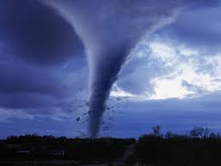
Emergency Shelter Location Continued CVVAMC COMPRESHENSIVE EMERGENCY MANAGEMENT PLAN (CEMP) 138-21
What is a Tornado Warning (REPEATED):
Tornado Warning: This means a tornado has actually been sighted or indicated by radar may strike in the vicinity of the facility. Take shelter immediately and complete all possible precautions immediately to safeguard life and property.
What to do if a Tornado Warning is issued:
Employees and Patients:
All employees whose work site is located on or near patient units (such as ward clerks, secretaries, clerks, doctors, therapists, social workers, housekeeping aides, etc.) must report to the charge nurse of the unit nearest them for instructions regarding ensuring patient safety.
Patients that are located in rooms without windows should be left in their room and their beds should be pushed against the interior wall. Close their door.
Patients with windows should be moved to the interior corridor marked “Emergency Shelter Locations” if possible.

Slide 4
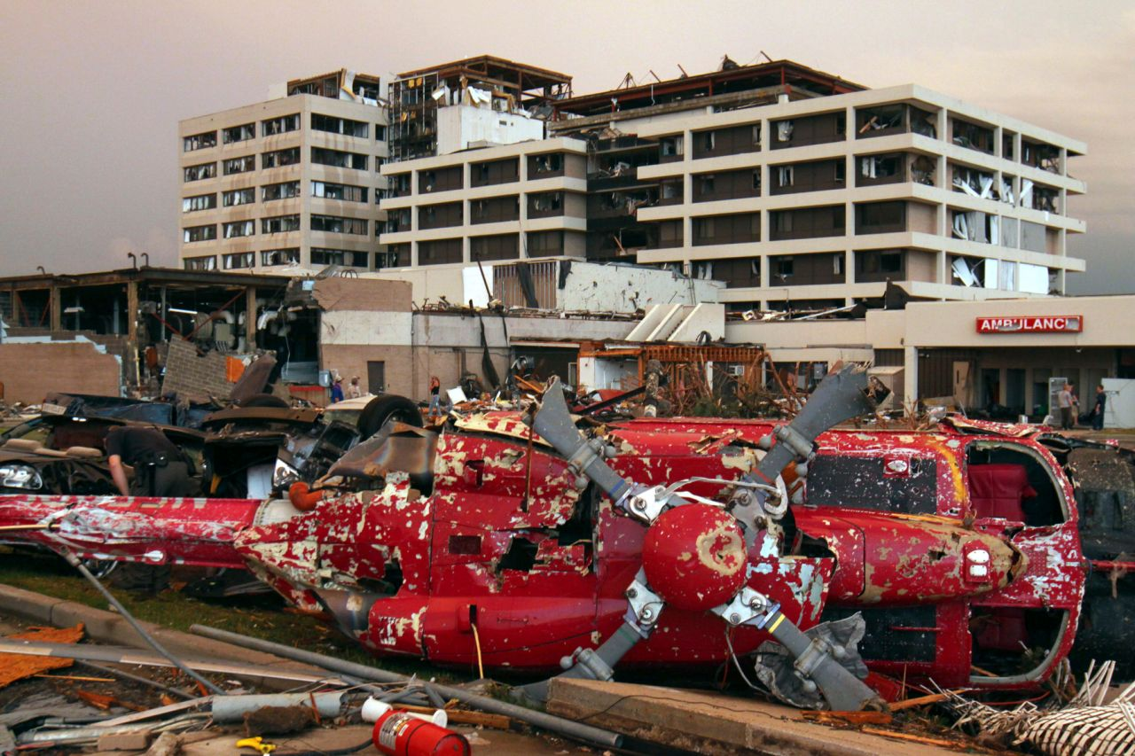
Emergency Shelter Location Continued CVVAMC COMPRESHENSIVE EMERGENCY MANAGEMENT PLAN (CEMP) 138-21
If movement is not possible due to patient's equipment and needs, the bed will be moved as far from the window as safely possible. Employees should assist in padding the beds of the patients who have to remain in their rooms with extra linens and pillows, under the direction of the nurse. Close all window blinds and shut the door to the empty or occupied room. A nurse or other appropriate designated direct patient care giver must be present with all patients who have to remain in their closed rooms.
Visitors in the Hospital:
Direct them toward the “Emergency Shelter Locations”
St John’s Regional Medical Center Joplin, Mo

Slide 5
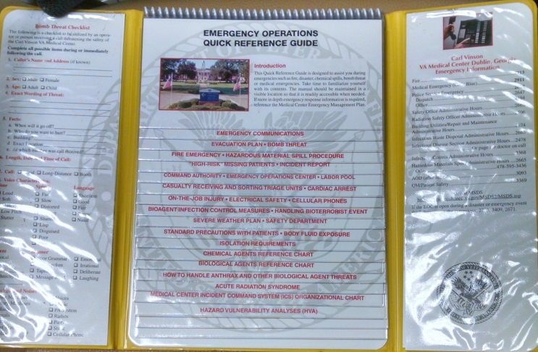
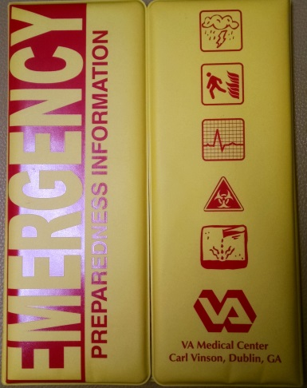
Review and know contents of Emergency Preparedness Information Binder (Yellow or Red) CVVAMC COMPRESHENSIVE EMERGENCY MANAGEMENT PLAN (CEMP) 138-21
Each Service Line should have an Emergency Preparedness Binder. If not, contact Sherry Thomas x3599.

Slide 6
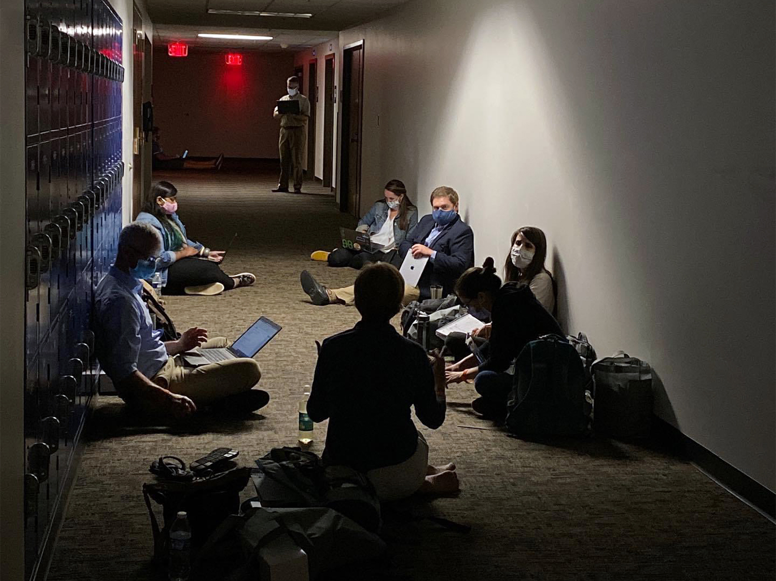
Tornado Sheltering during COVID
Social distancing may not be possible during a tornado warning.
Attempts should be made to maintain 6 feet apart.
Immediate life safety for yourself, veterans, visitors and fellow staff members is always the top priority.
When you hear the Code Yellow announcement, if you do not already have your mask on, grab your mask and proceed to your designated shelter location.

